Slide 1
2.7 - Populations

Slide 2
Life takes place in populations
A Population is a group of individuals of same species in same area at same time
Populations increase
when individuals reproduce more than needed to replace individuals who have left or died.
rely on same resources
interact
interbreed
Population Ecology: What factors affect a population?

Slide 3
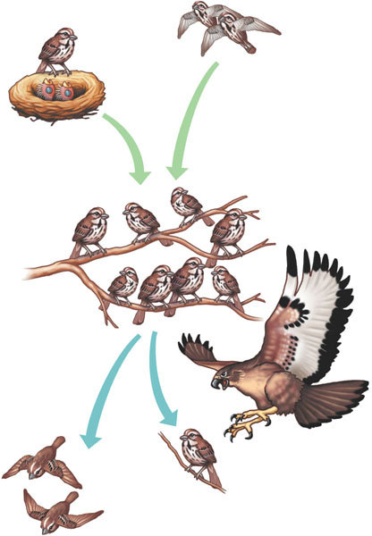
Population Size
Births and immigration add individuals to a population.
Changes to population size
adding & removing individuals from a population
birth
death
immigration
emigration
Births
Immigration
PopuIation size
Emigration
Deaths
Deaths and emigration remove individuals from a population.

Slide 4
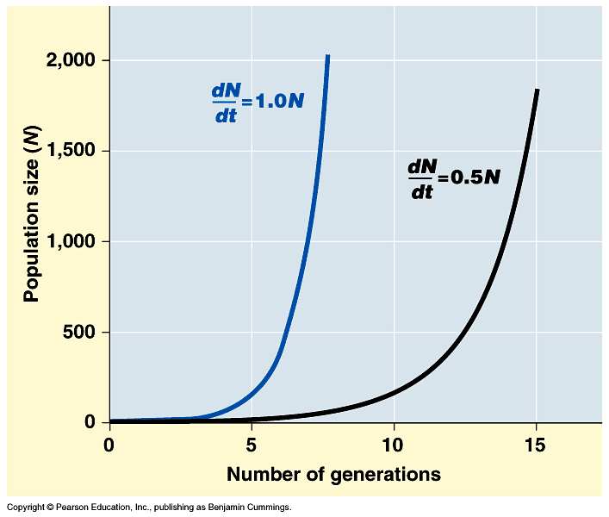
Exponential Growth
When a population increases in number. This usually occurs because resources are available or a predator has left.
growth increasing at constant rate
every pair has 4 offspring
every pair has 3 offspring

Slide 5
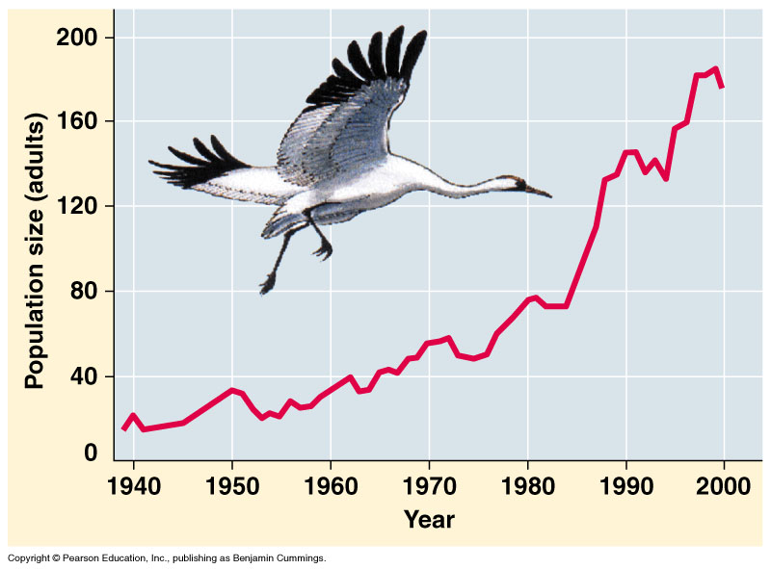
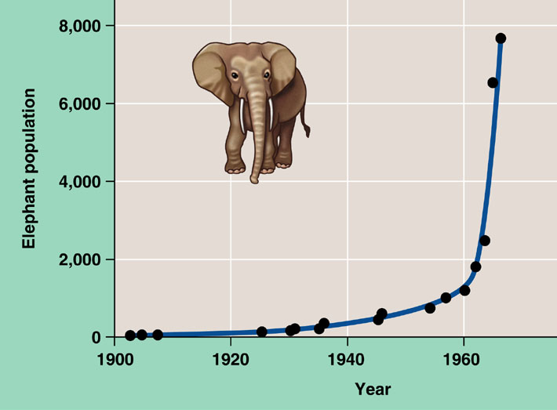
Exponential growth rate
Characteristic of populations without limiting factors
introduced to a new environment or rebounding from a catastrophe
Whooping crane
coming back from near extinction
African elephant
protected from hunting
Notes:
The J–shaped curve of exponential growth is characteristic of some populations that are introduced into a new or unfilled environment or whose numbers have been drastically reduced by a catastrophic event and are rebounding. The graph illustrates the exponential population growth that occurred in the population of elephants in Kruger National Park, South Africa, after they were protected from hunting. After approximately 60 years of exponential growth, the large number of elephants had caused enough damage to the park vegetation that a collapse in the elephant food supply was likely, leading to an end to population growth through starvation. To protect other species and the park ecosystem before that happened, park managers began limiting the elephant population by using birth control and exporting elephants to other countries.

Slide 6
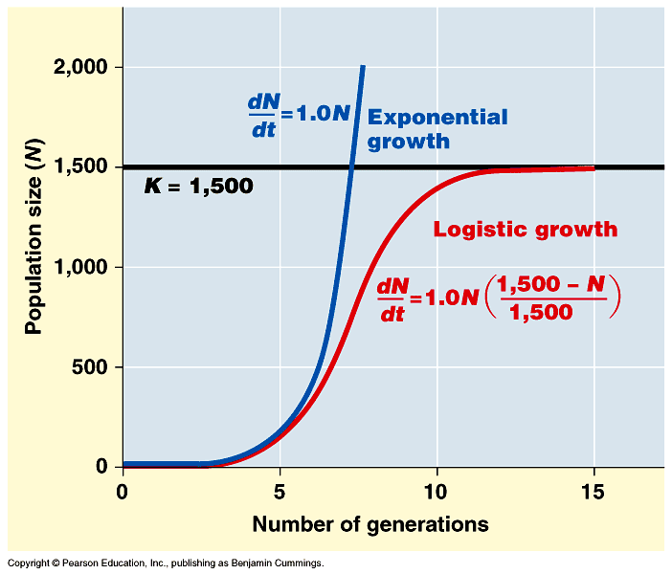
Logistic rate of growth
Can populations continue to grow exponentially?
Of course not!
no natural controls
K = carrying capacity
What happens as N approaches K?
effect of natural controls
Notes:
Decrease rate of growth as N reaches K

Slide 7
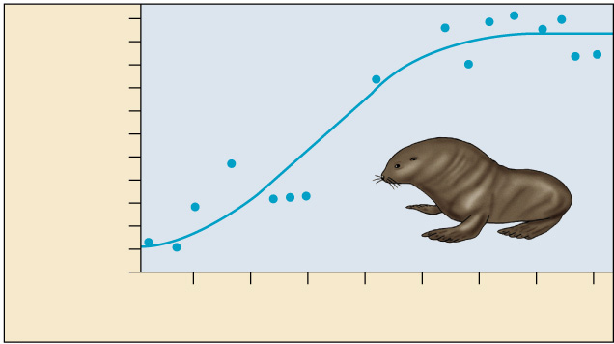
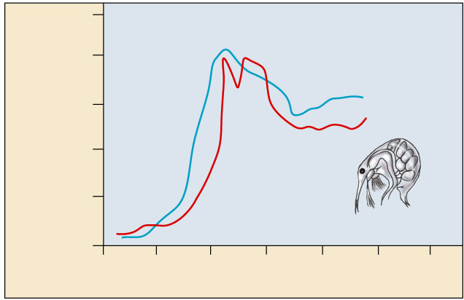
Carrying capacity
Growth cannot be sustained for an unlimited period of time.
The Maximum population size which can be supported indefinitely by the resources in an ecosystem.
10
8
Number of breeding male
fur seals (thousands)
6
4
2
0
1915
1925
1935
1945
Time (years)
500
400
Number of cladocerans
(per 200 ml)
300
200
100
0
0
10
20
30
40
50
60
Time (days)

Slide 8
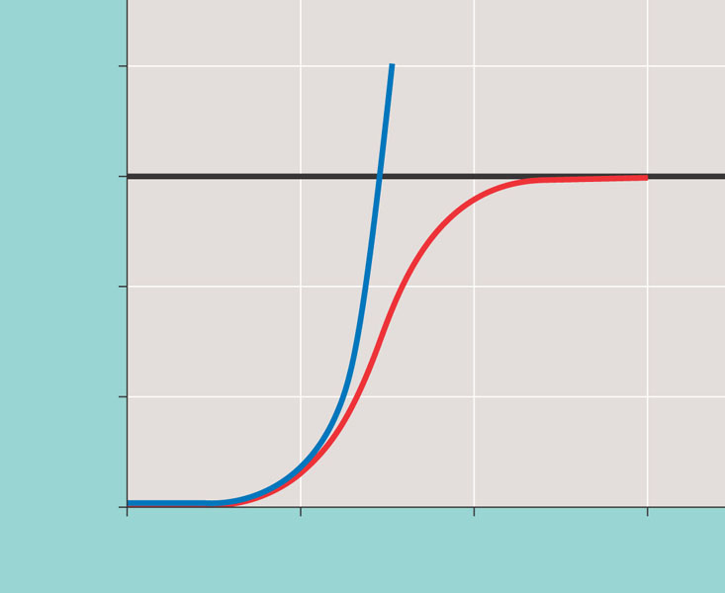
Population growth predicted by the logistic model
2,000
dN
=
1.0N
Exponential growth
dt
1,500
K = 1,500
Logistic growth
Population size (N)
1,000
dN
1,500 − N
=
1.0N
dt
1,500
500
0
0
5
10
15
Number of generations

Slide 9
Regulation of population size
Limiting factors
density dependent
competition: food, mates, nesting sites
predators, parasites, pathogens
density independent
abiotic factors
sunlight (energy)
temperature
rainfall
swarming locusts

Slide 10
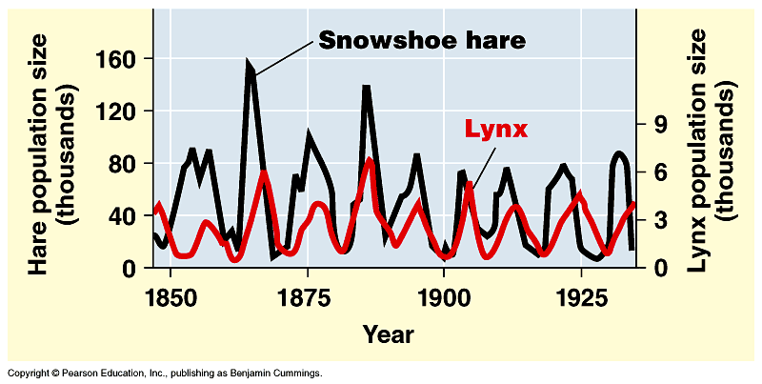
Changes in Carrying Capacity
Population cycles
predator – prey interactions
At what population level is the carrying capacity?
K
K

Slide 11
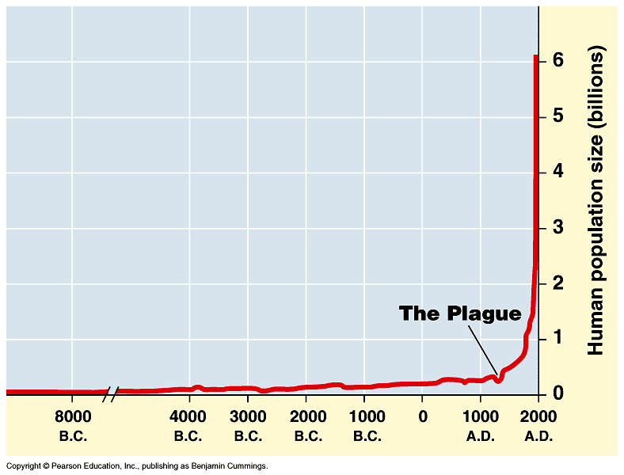
Human population growth
Population of… China: 1.3 billion
India: 1.1 billion
Doubling times
1b → 2b = 80y (1850–1930)
2b → 4b = 75y (1930–1975)
adding 82 million/year
~ 200,000 per day!
2005→6 billion
Significant advances
in medicine through
science and technology
What factors have contributed to this exponential growth pattern?
Industrial Revolution
Bubonic plague "Black Death"
1650→500 million
Notes:
The population doubled to 1 billion within the next two centuries, doubled again to 2 billion between 1850 and 1930, and doubled still again by 1975 to more than 4 billion. The global population now numbers over 6 billion people and is increasing by about 73 million each year. The population grows by approximately 201,000 people each day, the equivalent of adding a city the size of Amarillo, Texas, or Madison, Wisconsin. Every week the population increases by the size of San Antonio, Milwaukee, or Indianapolis. It takes only four years for world population growth to add the equivalent of another United States. Population ecologists predict a population of 7.3–8.4 billion people on Earth by the year 2025.

