Slide 1
Introduction to the Periodic Table

Slide 2
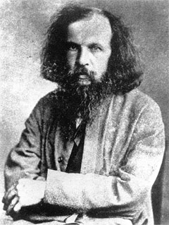
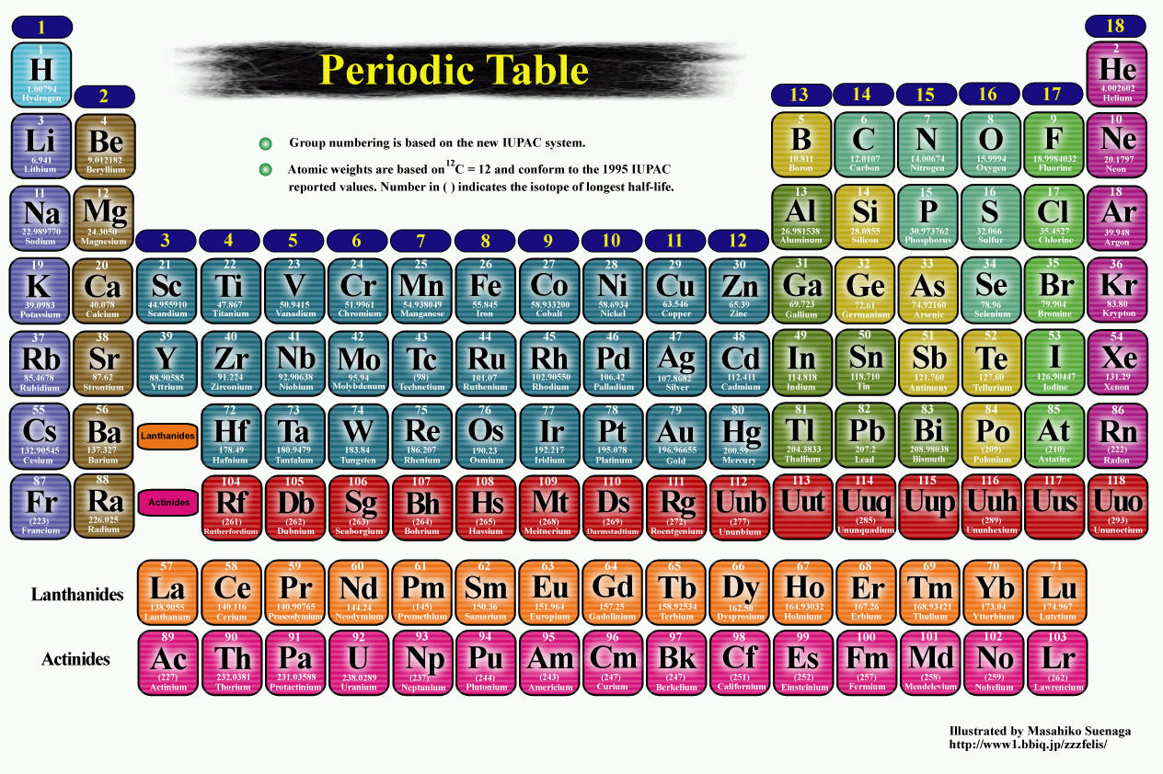
I am Dmitri Mendeleev!
I made the PERIODIC TABLE !

Slide 3
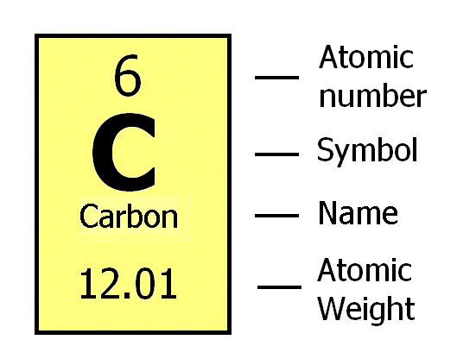
How do you read the PERIODIC TABLE?

Slide 4
The Periodic Table
Elements are organized according to increasing atomic mass!
Periodic law – If elements are arranged according to their atomic mass, a pattern of similar properties can be seen
Horizontal rows are called periods
Vertical columns are called groups
Elements in the same group are called a chemical family
Elements in the same group share similar properties!

Slide 5
3 Classes of Elements
Using this as a guide, color code your periodic table to show the three classes. Start by highlighting the “zig-zag.”
Class | Color
Metal
Non-Metal
Metalloid

Slide 6
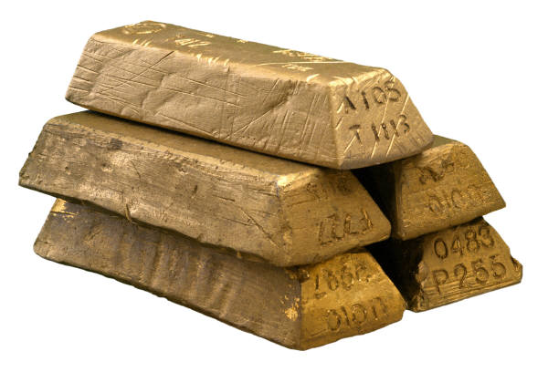
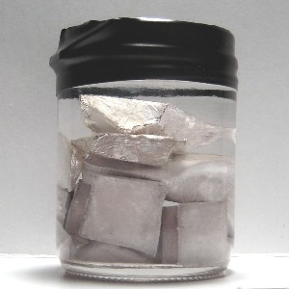
Metals
Location
Found on the left of the zigzag line/staircase on the periodic table (exception → Hydrogen)
Chemical Properties
Have few electrons in their outer energy level, thus lose electrons easily → + charge
Physical Properties
ductile, good conductors, malleable, shiny, most are solid @ room temperature
79 Au 196.967
11 Na 22.990
Image taken from:
http://chemistry.about.com/od/periodictableelements/ig/Element-Photo-Gallery.--98/Sodium.htm
What metal is not a solid
@ room temperature?

Slide 7
Atoms with Few Electrons in their Outer Energy Level
Notice: only 1 electron in outer level
11 Na 22.990
-
+
-
+
+
-
-
+
-
-
-
-
+
+
+
+
+
-
+
+
+
-
+
-
4 Be 9.012
+
+
Notice: only 2 electrons in outer level
-
-
-
-

Slide 8
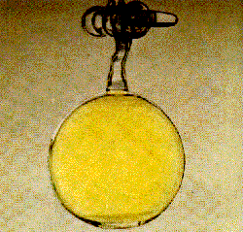
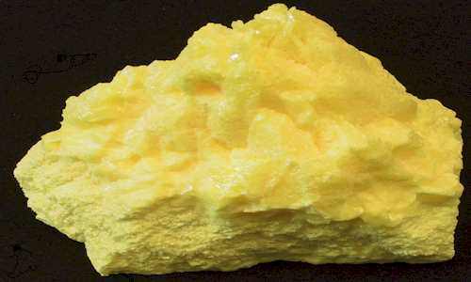
Non-Metals
Location
Most found to the right of the zigzag line/staircase on the periodic table
Chemical Properties
Most have almost full outer energy levels, thus they tend to gain electrons; some have completely full outer level –> - charge!
Except group 18, Noble gases → have a full outer shell
Physical Properties
not ductile or malleable (are brittle), not shiny, poor conductors, Can be solid, liquid or gas at room temperature
17 Cl 35.453
Image taken from:
http://nobel.scas.bcit.ca/resource/ptable/cl.htm
16 S 32.066
Image taken from:
https://www.dmr.nd.gov/ndgs/rockandmineral/sulfur.asp

Slide 9
Atoms with Full or Almost Full Outer Energy Level
8 O 15.999
-
-
Notice: 2 electrons in outer level – FULL
-
-
+
+
+
-
+
+
+
+
+
-
-
+
+
-
-
2 He 4.003
-
-
-
-
Notice: 6 electrons in outer level – almost full
-
+
+
+
+
+
+
+
-
Notice: 7 electrons in outer level – almost full
+
+
-
9 F 18.998
-
-
-

Slide 10
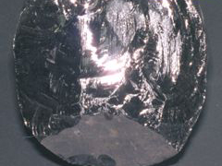
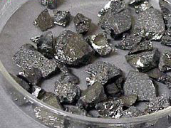
Metalloids
Location
Border the zigzag line/staircase on the periodic table
Chemical Properties
Most atoms have ½ (≈) complete set of electrons in outer level
Physical Properties
have properties of both metals and non-metals
14 Si 28.086
Image taken from:
http://library.thinkquest.org/C0113863/bios.shtml
5 B 10.811
Image taken from:
http://library.thinkquest.org/C0113863/bios.shtml

Slide 11
Atoms with ½ (≈) Complete Outer Energy Level
-
Notice: only 4 electrons in outer level
5 B 10.811
-
+
+
-
+
+
-
+
-
-
-
-
-
-
+
+
+
+
+
+
+
Notice: only 3 electrons in outer level
+
+
+
-
-
-
-
+
+
+
+
-
14 Si 28.086
-
-
-
-

Slide 12
Important Features of the Periodic Table:
Period (Row)
each horizontal row of elements on the periodic table
How many
periods (rows)
are on the
Periodic Table
Of Elements?
FROM LEFT TO RIGHT OR RIGHT TO LEFT

Slide 13
Period (Row) Properties
Seven periods on a periodic table (numbered from the top down)
Atomic numbers and atomic masses increase as you move from the left to the right in a period
All atoms of the elements in the same period have the same number of orbitals/shells
  Example
    Period 1 = 1 orbital
    Period 2 = 2 orbitals
    Period 3 = 3 orbitals
    Etc…

Slide 14
Examples of Period (Row) elements having the same number of orbitals/levels in their atoms
-
-
-
In what period (row) do
you think these atoms
reside?
-
+
+
+
+
+
+
-
+
+
+
-
-
+
-
+
+
-
-
-
-
-
-
-
-
-
-
-
-
-
-
In what period (row) do
you think these atoms
reside?
+
+
+
+
+
+
+
+
+
+
+
+
+
+
+
+
+
+
-
+
-
-
-
+
-
-
+
+
+
+
+
-
-
-
-
-
-
-
-
-

Slide 15
Important Features of the Periodic Table: Group (Family)
each column of elements on the periodic table
How many groups (families)
are on the
Periodic Table
Of Elements?
FROM TOP TO BOTTOM OR BOTTOM TO THE TOP

Slide 16
Group (Family) Properties
Eighteen groups on the periodic table (numbered from left to right)
Atomic numbers and atomic masses increase as you move from the top down in a group (family)
Atoms of elements in the same group have the same number of electrons in the outer orbitals/levels of their atoms (known as valence electrons)
  Exceptions:
    Transition elements (3-12)
    Hydrogen (could be 1 or 17)
    Helium (actually has 2 valence electrons)
Elements in groups usually have similar physical and chemical properties
Reactivity increases as you go down a group
    Li < Na < K < Rb < Cs < Fr

Slide 17
Examples of Group Elements with the same # of valence electrons (electrons in the outer shell)
How many electrons do each of these atoms have in their outer orbital/level?
1
H
1.008
3
Li
6.941
11
Na
22.990
-
-
-
19
K
39.098
-
-
+
37
Rb
85.468
+
+
+
+
+
+
+
-
+
-
+
+
55
Cs
132.905
-
87
Fr
(223)
-
-
What group (family) do these elements reside in?
-

Slide 18
Group (Family) Names
Alkali Metals
Alkaline Earth Metals
Noble Gases
Halogens
Transition Metals

