Slide 1
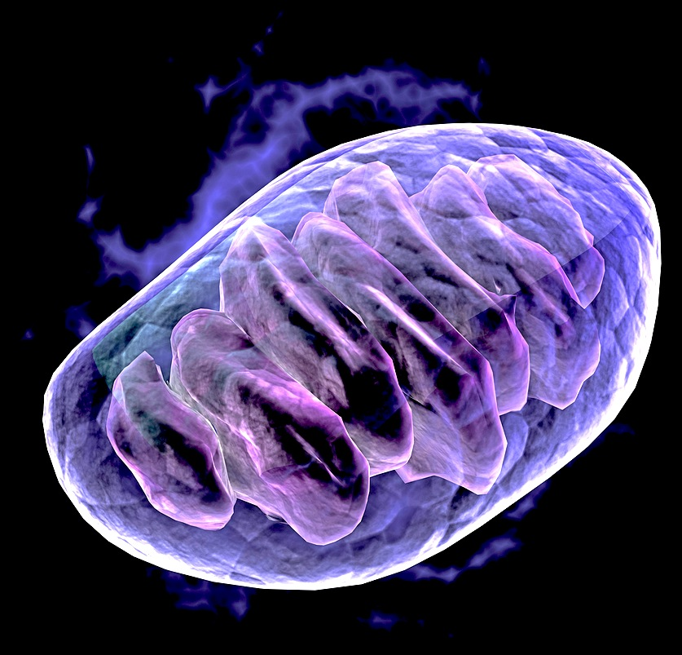
Cellular Respiration
How do cells extract energy from glucose?

Slide 2
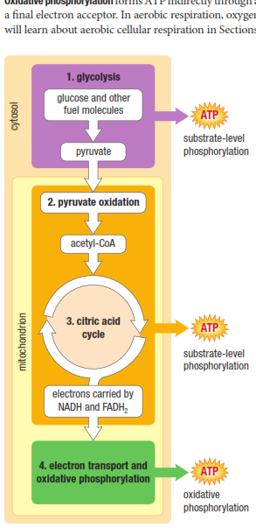
Four Main Stages
Glycolysis
  Anaerobic / In cytosol
  breaks glucose (6C) into two pyruvate (3C)
  Generates 2 ATP and 2 NADH
Pyruvate Oxidation
  Pyruvate converted to acetyl CoA
  Oxidative decarboxylation
  Generates NADH (inside mitochondria)
Krebs Cycle
  Within mitochondrial matrix
  Two more oxidative decarboxylation reactions
  Generates ATP, NADH and FADH₂
Electron Transport Chain
  Along the inner mitochondrial membrane
  Uses high energy electrons from NADH and FADH₂ to create an electrochemical proton (H⁺) gradient which powers ATP synthesis

Slide 3
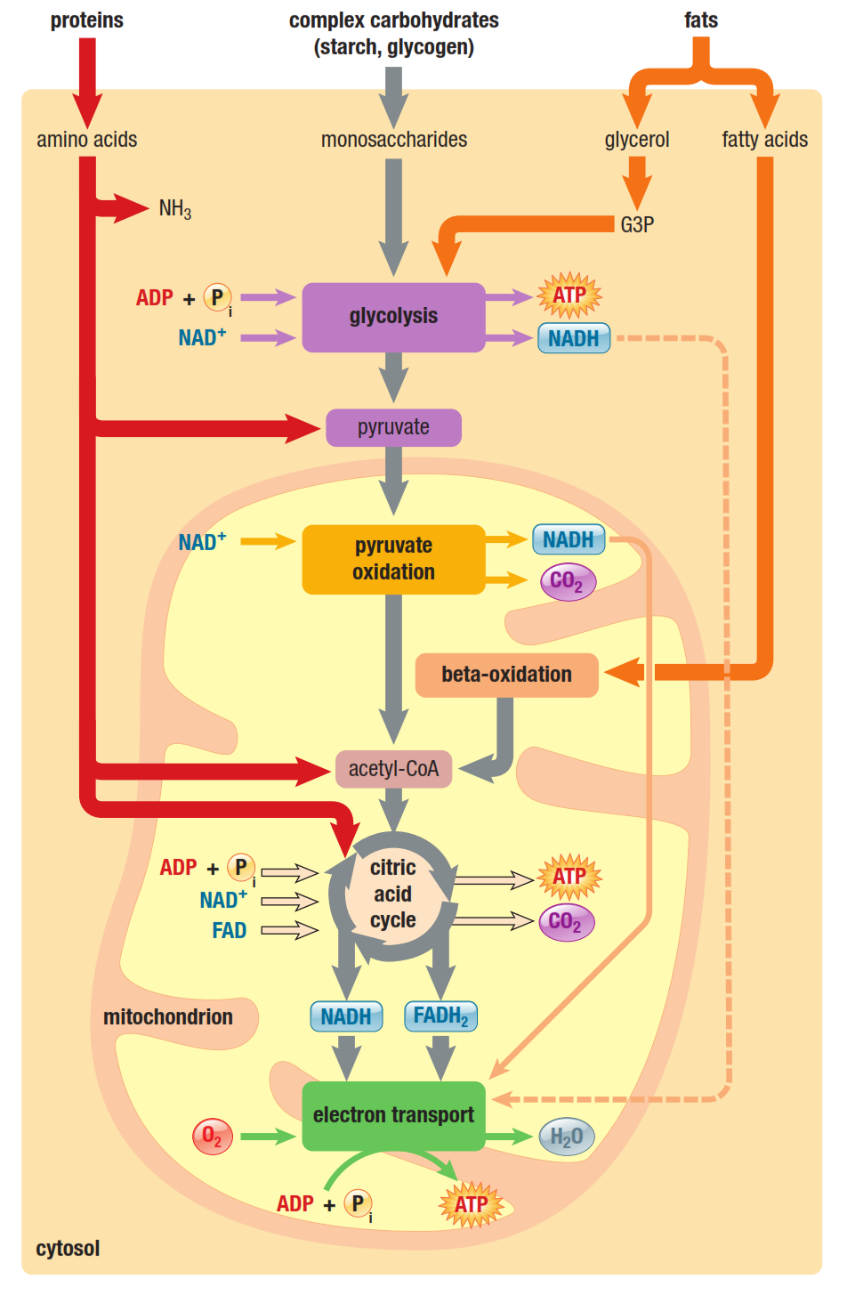
Alternate Metabolic Pathways

Slide 4
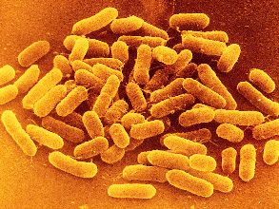
Fermentation
When oxygen is NOT available, cells can metabolize pyruvate (derived from glucose) by the process of fermentation.
Two Types
(i) alcohol fermentation:
pyruvate is reduced to ethyl alcohol (ethanol) and CO₂; occurs in yeast cells
(ii) lactic acid fermentation:
pyruvate reduced to lactic acid (lactate) in muscle cells

Slide 5
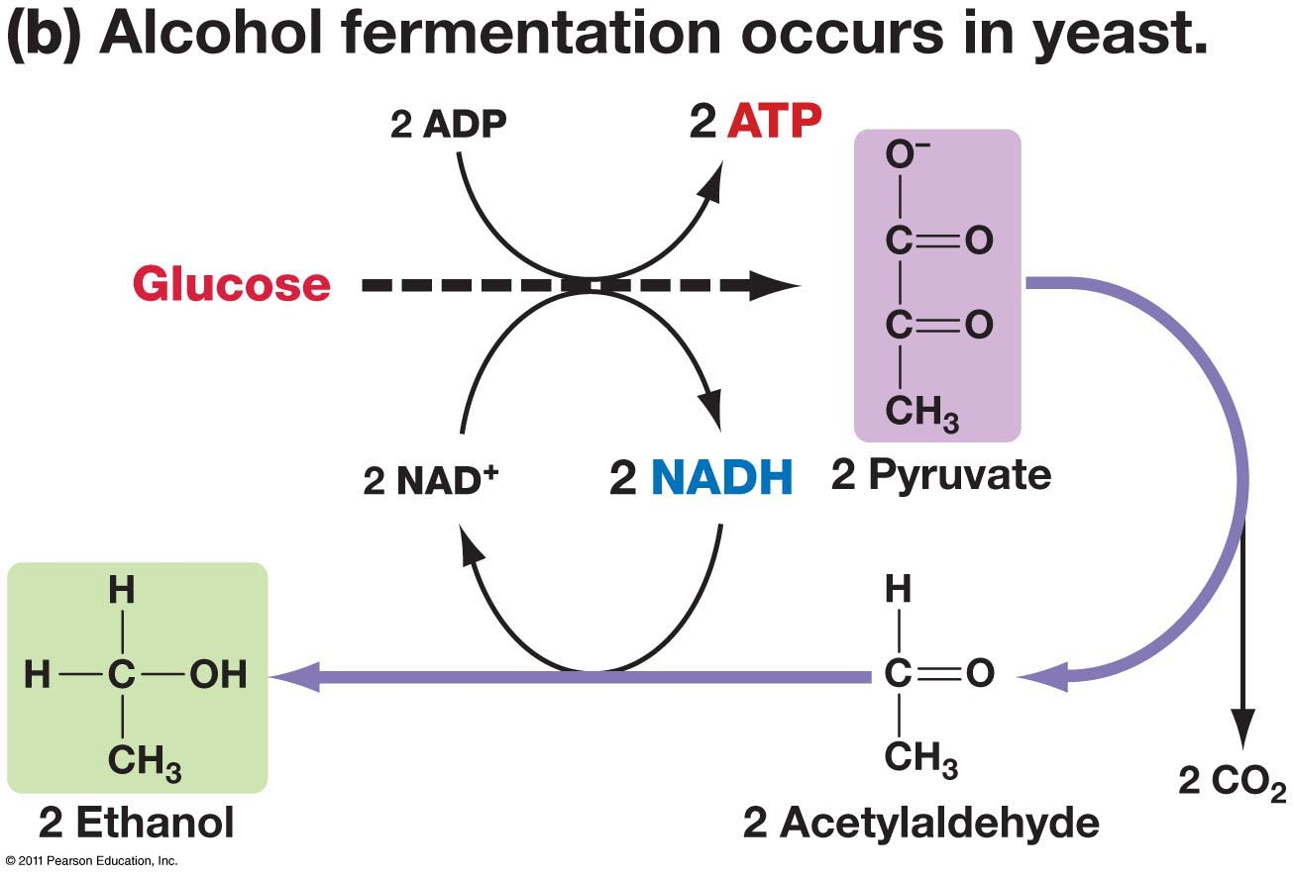

Slide 6
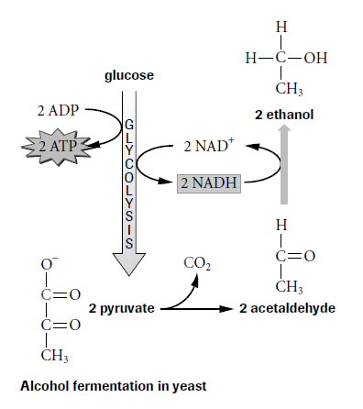
Alcoholic Fermentation
Occurs in organisms that do not carry out cellular respiration or lactic acid fermentation
Produces ATP, but also ethanol and CO2 as byproducts.
Yeast cells do this—we use them to make beer, wine, and bread.

Slide 7
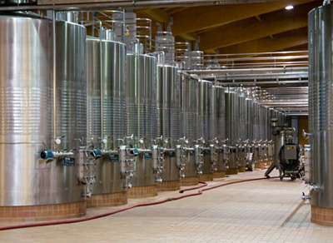

Micro-organisms in industry
Respiring micro-organisms are used in the commercial production of many different products, including:
bread
alcohol
biofuels.
These micro-organisms break substances down using aerobic or anaerobic respiration. The effect of anaerobic respiration is often called fermentation.
Notes:
7
Photo credit: © (David H. Seymour), Shutterstock 2009
Boardworks GCSE Additional Science: Biology
Anaerobic Respiration

Slide 8
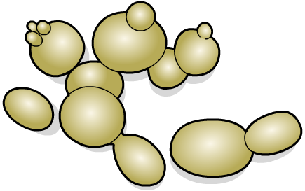
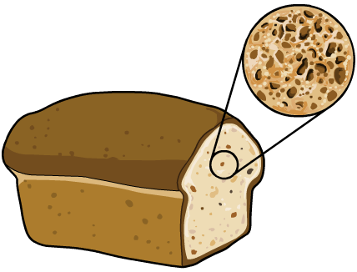
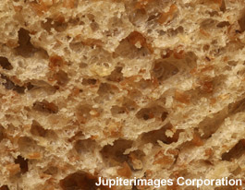
Yeast in bread production
Yeast is a type of fungus used in bread production. Yeast digests the carbohydrates in flour, producing carbon dioxide.
This carbon dioxide causes bread to rise. It also creates gas pockets in the dough, giving baked bread a spongy texture.
At first the yeast respires aerobically, but once it uses up the available oxygen it begins to respire anaerobically.
Notes:
8
Teacher notes
Ethanol is also made during the fermentation process, but this evaporates when the bread is baked.
Photo credit: © 2006 Jupiterimages Corporation
Boardworks GCSE Additional Science: Biology
Anaerobic Respiration

Slide 9


Yeast in the production of alcohol
Yeast is used to make alcoholic beverages such as beer, wine, rum, whiskey and vodka.
During fermentation, anaerobic respiration in yeast cells converts glucose into ethanol.
The amount of ethanol produced is limited as alcohol becomes toxic to microbes at certain concentrations.
Glucose comes from different sources in the production of different alcohols. For example, in winemaking, natural sugars in the grapes form the energy source for yeast.
Notes:
9
Boardworks GCSE Additional Science: Biology
Anaerobic Respiration

Slide 10
Lactic Acid Fermentation
Takes place when there’s not enough oxygen for cellular respiration
Produces ATP, but also Lactic Acid
Also regenerates the NAD⁺ required to continue with glycolysis.
Muscles do this when they run low on oxygen
Lactic Acid causes the burning sensation

Slide 11

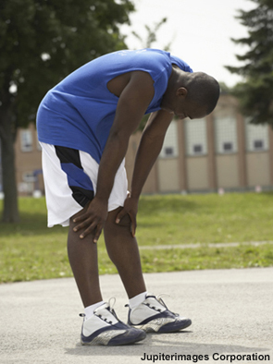
Lactic acid
The incomplete breakdown of glucose during anaerobic respiration produces lactic acid.
Lactic acid builds up in muscle cells and prevents the muscles from contracting efficiently. The build-up of lactic acid can cause fatigue, pain and cramping.
After vigorous exercise, the body needs to remove lactic acid before it damages cells. Some lactic acid is broken down in the muscles. Some passes into the bloodstream and is taken to the liver to be broken down there.
Notes:
11
Teacher notes
Students could investigate lactic acid build-up by holding objects at arm’s length and timing how long it takes before their muscles begin to feel fatigued.
The information on this slide is higher tier for OCR Gateway GCSE Additional Science.
Photo credit: © Jupiterimages Corporation
Boardworks GCSE Additional Science: Biology
Anaerobic Respiration

Slide 12
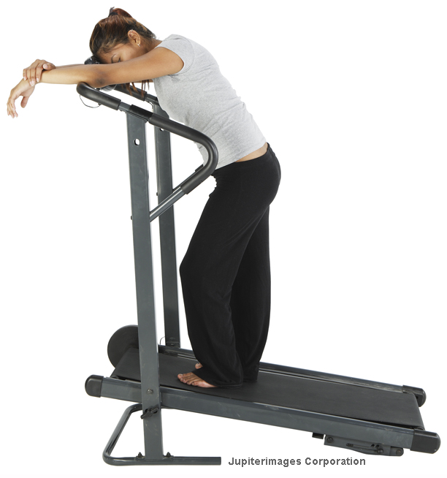
Oxygen debt
Oxygen is needed to break lactic acid into water and carbon dioxide.
Following strenuous exercise, an individual breathes heavily and maintains an elevated heart rate. This moves lactic acid to the liver and supplies liver and muscle cells with the necessary oxygen to break down lactic acid.
The amount of oxygen needed to break down lactic acid remaining after exercise is called excess post-exercise oxygen consumption (EPOC), or an oxygen debt.
Notes:
12
The information on this slide regarding the oxygen debt is higher tier for AQA GCSE Additional Science and OCR Gateway GCSE Additional Science.
Photo credit: © Jupiterimages Corporation
Boardworks GCSE Additional Science: Biology
Anaerobic Respiration

Slide 13
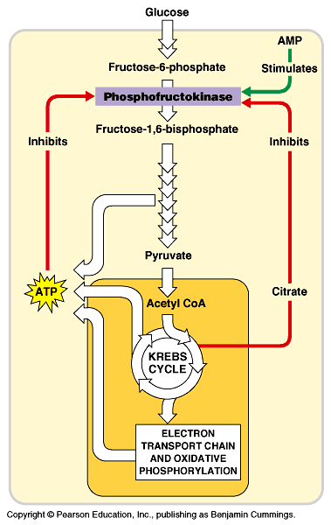
Control of Cellular Respiration
Cellular respiration is carefully regulated:
- when ATP is abundant, respiration slows down (ATP & citrate ihibit the enzyme phosphofructokinase)
- when ATP is needed, respiration speeds up
Notes:
Figure: 6.7a
Caption:
(a) The oxidation of pyruvate and formation of acetyl CoA is under both negative and positive control.

Slide 14
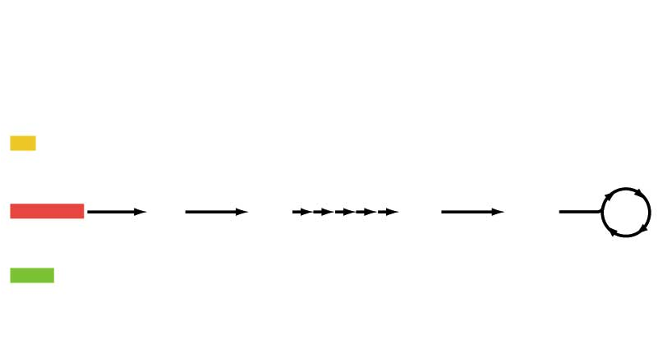
The metabolism of all macromolecules is tied to cellular respiration
Carbohydrates, fats, and proteins can be broken
down and used in glycolysis and the Kreb’s cycle.
Fatty acids
Fats
Glycerol
Krebs cycle
Carbs
Sugars
Glucose
Pyruvate
Acetyl CoA
Proteins
Amino acids
NH₃

Slide 15
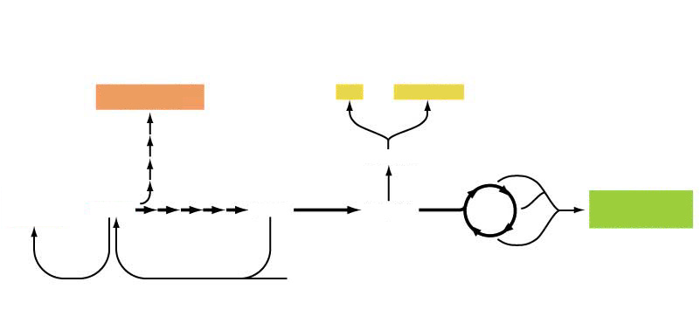
The metabolism of all macromolecules is tied to cellular respiration
Excess intermediates of glycolysis and the Kreb’s cycle can be converted to stored carbohydrates, fats and proteins.
Pathway for
synthesis of
RNA, DNA
Fats
Phospholipids
Glycogen
or starch
Fatty acids
Several
intermediaries used as
substrates in amino acid synthesis
Glucose
Pruvate
Acetyl CoA
Krebs
cycle
Lactate
(from fermentation)

Slide 16
Carbohydrates
broken into monosaccharide, then broken down for energy
avg. yield of 16 kJ/g of energy
Proteins
broken down into amino acids to be used to produce cell’s proteins
amino groups removed in deamination and converted into ammonia (wastes)
rest of a.a. continue through glycolysis or Kreb’s cycle (depending on composition)

Slide 17
Lipids
triglycerides broken into glycerol and fatty acids
glycerol can be converted to glucose or G3P and enter glycolysis
fatty acids go to the matrix of mitochandria and undergo β-oxidation – 2 carbons at a time are chopped off into acetyl groups which combine with co-enzyme A to produce acteyl-coA
much more ATP formed from fats. ex lauric acid (12 C fatty acid) – produces 92 ATP
average yield is 38kJ/g of energy (vs 16 kJ/g for carbs)

Slide 18
Review Questions
Pg. 133#11, 14
Pg. 137 # 4, 7, 9
Quest Review
Try the self-assessment Pg. 153
Ch. 3 Review
- Pg 147 # 1-14 (mc), 15

