Slide 1
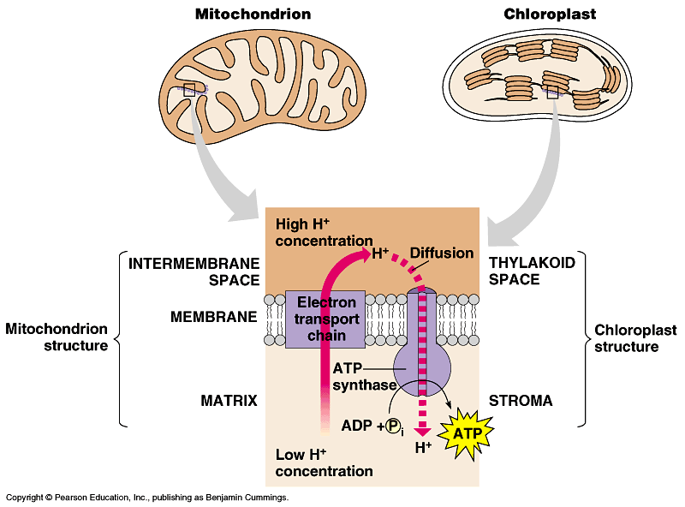
Chloroplasts vs. Mitochondria

Slide 2
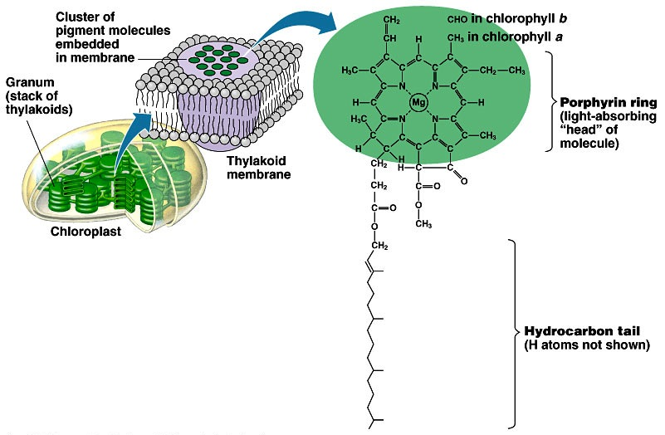
Pigments of photosynthesis
How does this
molecular structure
fit its function?
Chlorophylls & other pigments
  embedded in thylakoid membrane
  arranged in a “photosystem”
    collection of molecules
  structure-function relationship

Slide 3
Excited Chlorophyll
When photons of light are absorbed by the pigments, the energy cannot disappear.
Instead, the electrons in the pigments are excited and move to a higher orbital.
This excitement cannot last for long, and this energy needs to be stored in energy storing molecules.

Slide 4
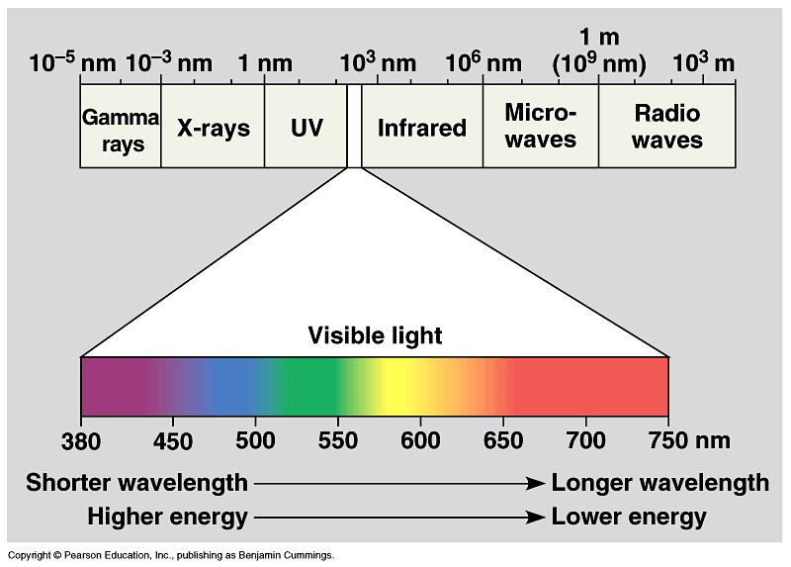
A Look at Light
The spectrum of color
V
I
B
G
Y
O
R

Slide 5
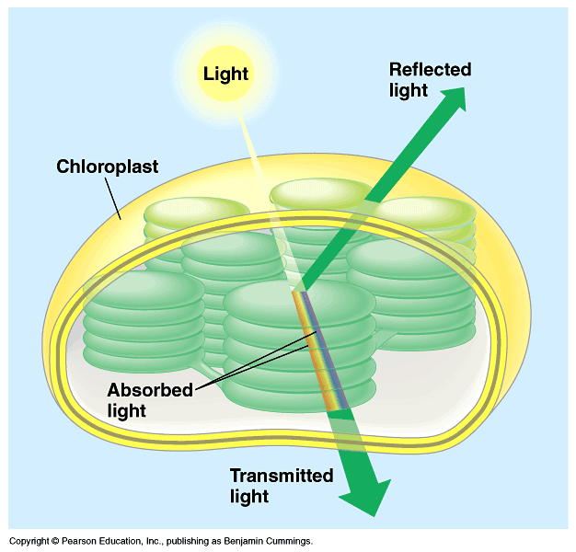
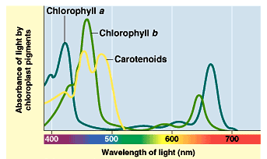
Light: absorption spectra
Photosynthesis gets energy by absorbing wavelengths of light
  chlorophyll a
    absorbs best in red & blue wavelengths & least in green
  accessory pigments with different structures absorb light of different wavelengths
    chlorophyll b, carotenoids, xanthophylls
Why are
plants green?

Slide 6
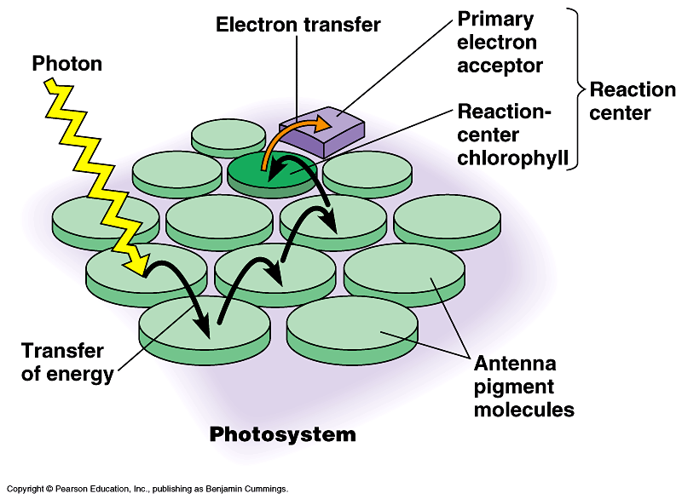
Photosystems of photosynthesis
2 photosystems in thylakoid membrane
  collections of chlorophyll molecules
  act as light-gathering molecules
  Photosystem II
    chlorophyll a
    P₆₈₀ = absorbs 680nm
    wavelength red light
  Photosystem I
    chlorophyll b
    P₇₀₀ = absorbs 700nm
    wavelength red light
reaction
center
antenna
pigments
Notes:
Photons are absorbed by clusters of pigment molecules (antenna molecules) in the thylakoid membrane.
When any antenna molecule absorbs a photon, it is transmitted from molecule to molecule until it reaches a particular chlorophyll a molecule = the reaction center.
At the reaction center is a primary electron acceptor which removes an excited electron from the reaction center chlorophyll a.
This starts the light reactions.
Don’t compete with each other, work synergistically using different wavelengths.

Slide 7
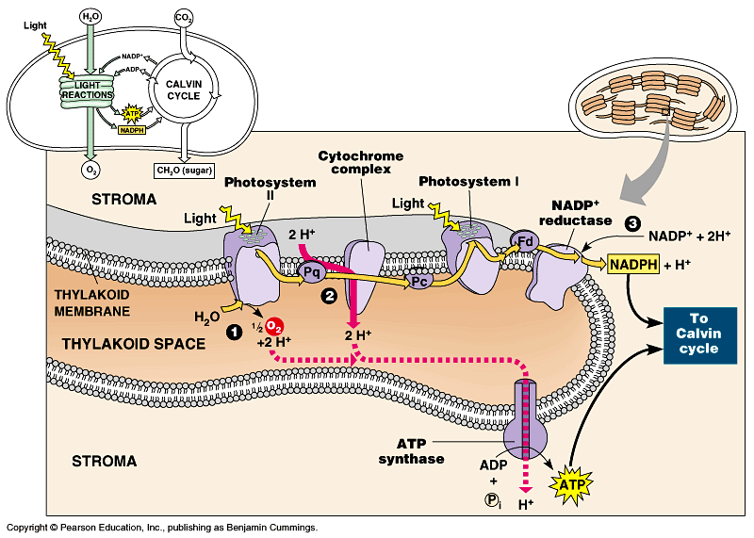
ETC of Photosynthesis
chlorophyll a
Photosystem II
chlorophyll b
Photosystem I
Notes:
Two places where light comes in.
Remember photosynthesis is endergonic -- the electron transport chain is driven by light energy.
Need to look at that in more detail on next slide

Slide 8
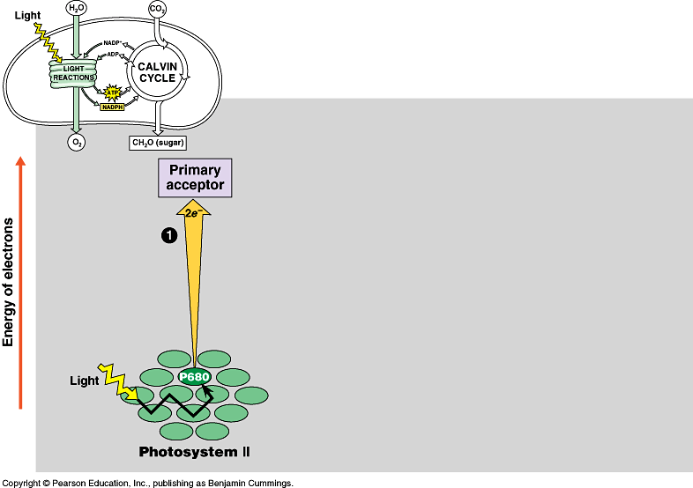
ETC of Photosynthesis
sun
1
e
e
Photosystem II
P680
chlorophyll a
Notes:
PS II absorbs light
Excited electron passes from chlorophyll to the primary electron acceptor
Need to replace electron in chlorophyll
An enzyme extracts electrons from H₂O & supplies them to the chlorophyll
This reaction splits H₂O into 2 H⁺ & O⁻ which combines with another O⁻ to form O₂
O₂ released to atmosphere
Chlorophyll absorbs light energy (photon) and this moves an electron to a higher energy state
Electron is handed off down chain from electron acceptor to electron acceptor
In process has collected H⁺ ions from H₂O & also pumped by Plastoquinone within thylakoid sac.
Flow back through ATP synthase to generate ATP.

Slide 9
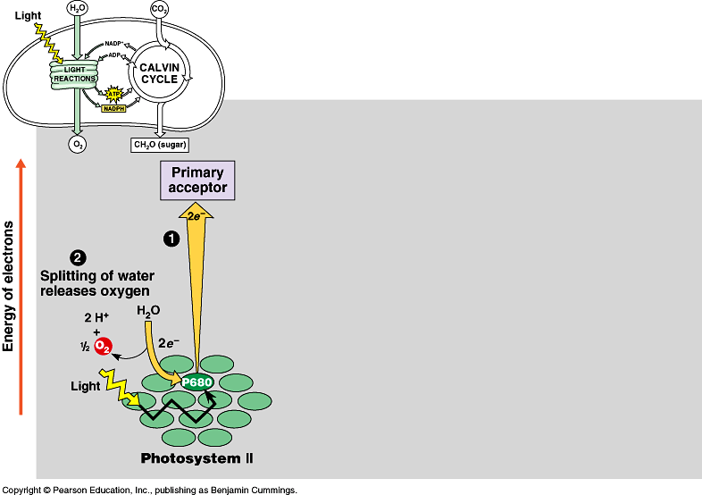
Inhale, baby!
ETC of Photosynthesis
chloroplast
thylakoid
H⁺
H⁺
H⁺
H⁺
H⁺
H⁺
H⁺
H⁺
H⁺
H⁺
H⁺
H⁺
H⁺
H⁺
H⁺
H⁺
ATP
H⁺
H⁺
H⁺
H⁺
H⁺
H⁺
Plants SPLIT water!
1
H
H
2
O
e
e
O
H
H
O
e⁻
H⁺
+H
e⁻
e
e
fill the ^{–e} vacancy
Photosystem II
P680
chlorophyll a

Slide 10
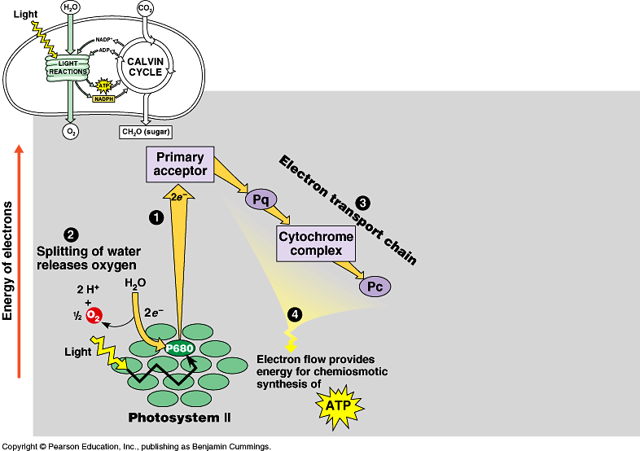
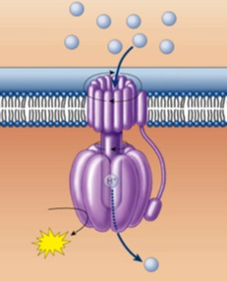
ETC of Photosynthesis
chloroplast
thylakoid
H⁺
H⁺
H⁺
H⁺
H⁺
H⁺
H⁺
H⁺
H⁺
H⁺
H⁺
H⁺
H⁺
H⁺
H⁺
H⁺
ATP
H⁺
H⁺
H⁺
H⁺
H⁺
H⁺
e
e
3
1
2
H⁺
e
e
ATP
4
H⁺
to Calvin Cycle
H⁺
H⁺
H⁺
H⁺
H⁺
H⁺
H⁺
H⁺
energy to build
carbohydrates
Photosystem II
P680
chlorophyll a
ATP
ADP + P_{i}
H⁺

Slide 11
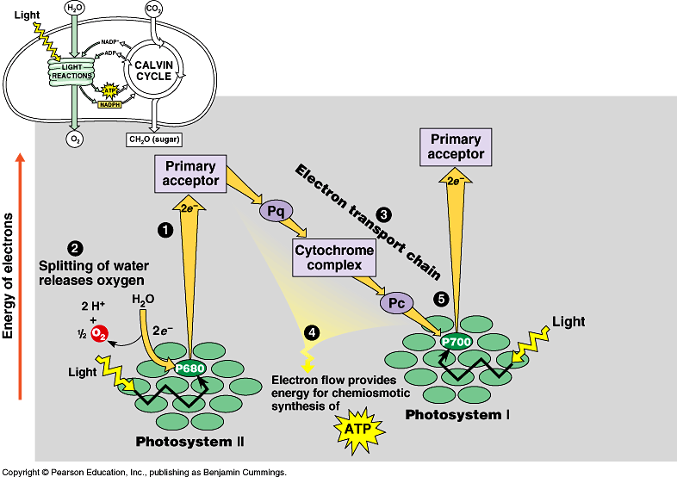
ETC of Photosynthesis
e
e
e
sun
e
fill the e– vacancy
e
5
e
e
e
Photosystem I
P700
chlorophyll b
Photosystem II
P680
chlorophyll a
Notes:
Need a 2nd photon -- shot of light energy to excite electron back up to high energy state.
2nd ETC drives reduction of NADP to NADPH.
Light comes in at 2 points.
Produce ATP & NADPH

Slide 12
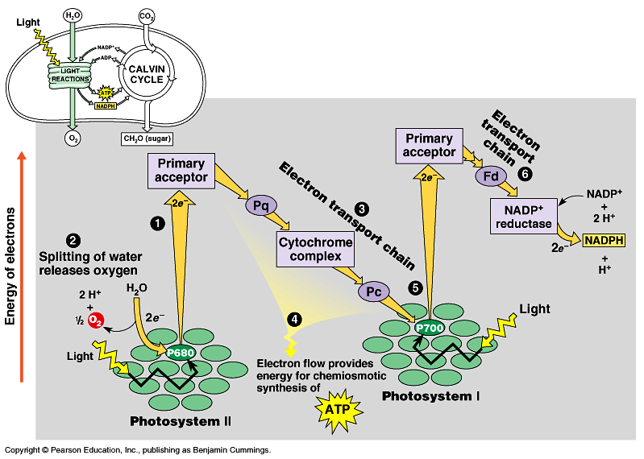

ETC of Photosynthesis
electron carrier
e
e
6
e
e
5
sun
NADPH to
Calvin Cycle
Photosystem I
P700
chlorophyll b
Photosystem II
P680
chlorophyll a
$$ in the bank…
reducing power!
Notes:
Need a 2nd photon -- shot of light energy to excite electron back up to high energy state.
2nd ETC drives reduction of NADP to NADPH.
Light comes in at 2 points.
Produce ATP & NADPH

Slide 13

ETC of Photosynthesis
sun
sun
e
e
e
e
H⁺
H⁺
H⁺
O
H⁺
H⁺
H⁺
H⁺
H⁺
to Calvin Cycle
H⁺
H⁺
H⁺
split H₂O
ATP
Notes:
Two places where light comes in.
Remember photosynthesis is endergonic -- the electron transport chain is driven by light energy.
Need to look at that in more detail on next slide

