Slide 1
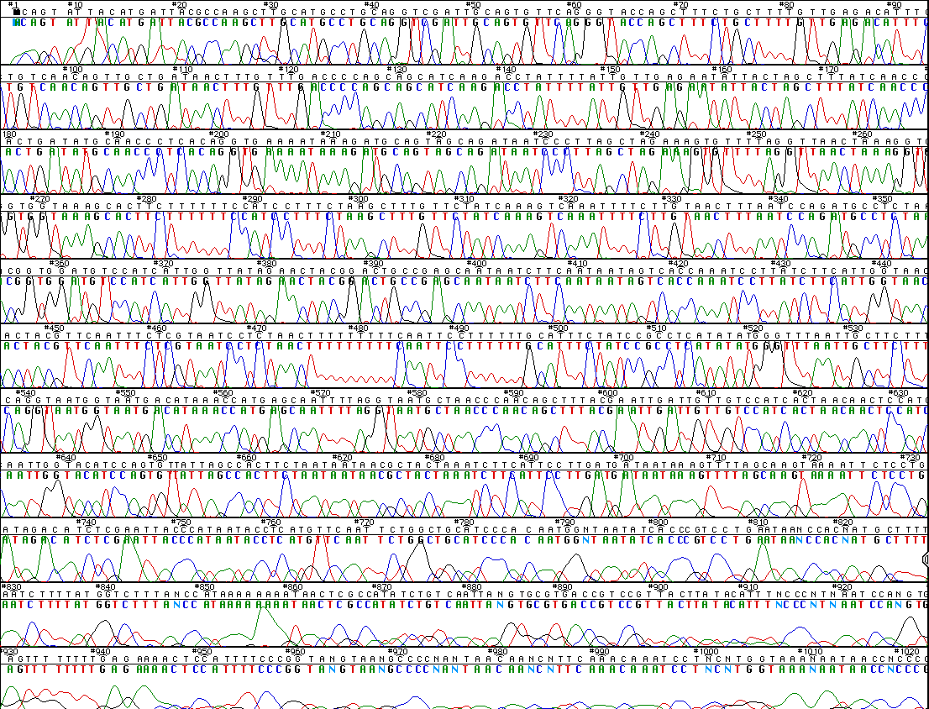
A Lot More Advanced Biotechnology Tools
DNA Sequencing

Slide 2
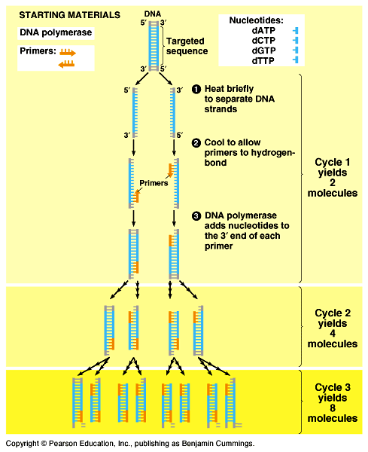
Copy DNA without plasmids? PCR!
Polymerase Chain Reaction
  method for making many, many copies of a specific segment of DNA
  only need 1 cell of DNA to start
No more bacteria,
No more plasmids,
No more E. coli
smelly looks!

Slide 3
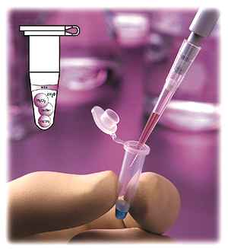
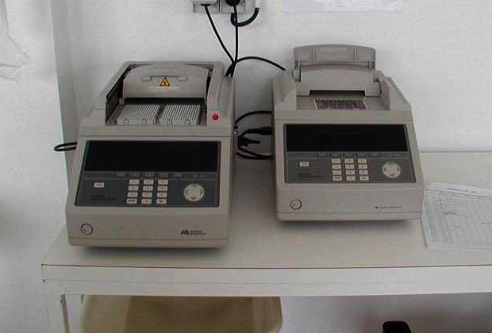
PCR process
It’s copying DNA in a test tube!
What do you need?
  template strand
  DNA polymerase enzyme
  nucleotides
    ATP, GTP, CTP, TTP
  primer
Thermocycler

Slide 4
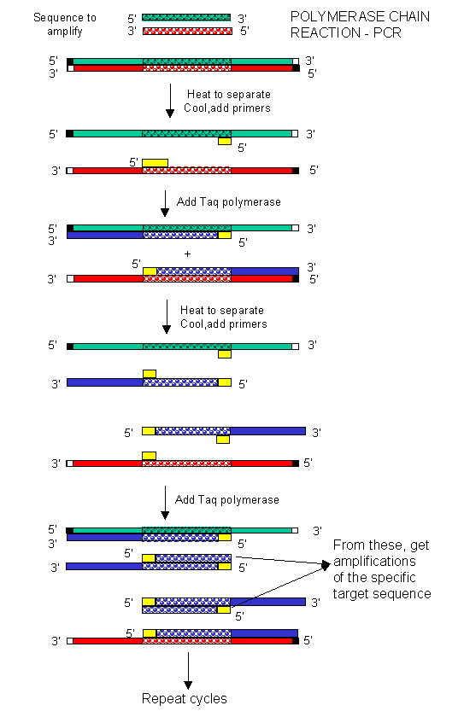

PCR primers
The primers are critical!
  need to know a bit of sequence to make proper primers
  primers can bracket target sequence
    start with long piece of DNA & copy a specified shorter segment
    primers define section of DNA to be cloned
20-30 cycles
3 steps/cycle
30 sec/step
Notes:
PCR is an incredibly versatile technique:
An important use of PCR now is to “pull out” a piece of DNA sequence, like a gene, from a larger collection of DNA, like the whole cellular genome. You don’t have to go through the process of restriction digest anymore to cut the gene out of the cellular DNA. You can just define the gene with “flanking” primers and get a lot of copies in 40 minutes through PCR.
Note: You can also add in a restriction site to the copies of the gene (if one doesn’t exist) by adding them at the end of the original primers.

Slide 5
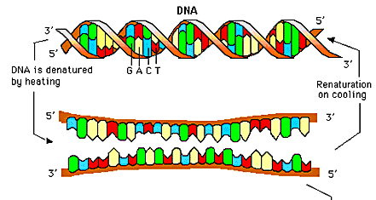
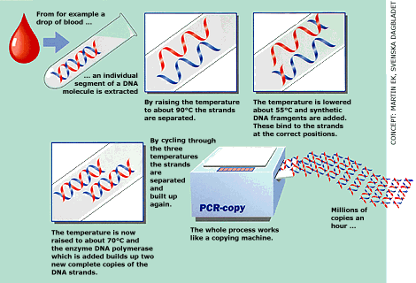
PCR process
What do you need to do?
  in tube: DNA, DNA polymerase enzyme, primer, nucleotides
  denature DNA: heat (90°C) DNA to separate strands
  anneal DNA: cool to hybridize with primers & build DNA (extension)
What does 90°C
do to our
DNA polymerase?
play DNAi movie

Slide 6
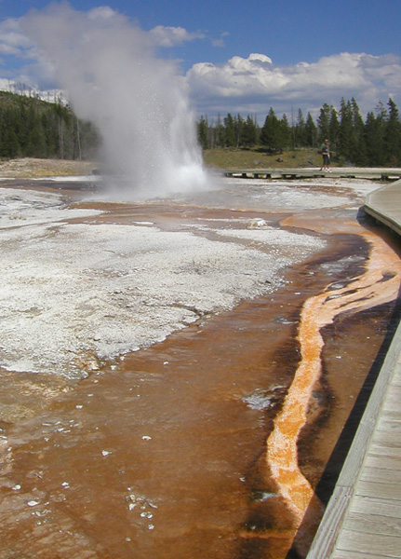
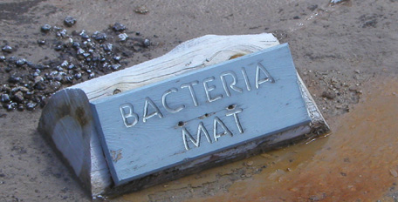
The polymerase problem
PCR
20-30 cycles
3 steps/cycle
30 sec/step
Heat DNA to denature (unwind) it
  90°C destroys DNA polymerase
  have to add new enzyme every cycle
    almost impractical!
Need enzyme that can
withstand 90°C…
  Taq polymerase
    from hot springs bacteria
      Thermus aquaticus
Notes:
Taq = Thermus aquaticus (an Archaebactera)
Highly thermostable – withstands temperatures up to 95°C for more than 40min.
BTW, Taq is patented by Roche and is very expensive. Its usually the largest consumable expense in a genomics lab. I’ve heard stories of blackmarket Taq clones, so scientists could grow up their own bacteria to produce Taq in the lab. It’s like pirated software -- pirated genes!

Slide 7
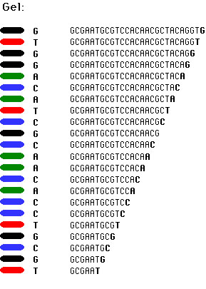
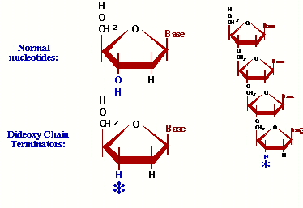
DNA Sequencing
  dideoxynucleotides
    ddATP, ddGTP, ddTTP, ddCTP
    missing O for bonding of next
    nucleotide
    terminates the growing chain

Slide 8
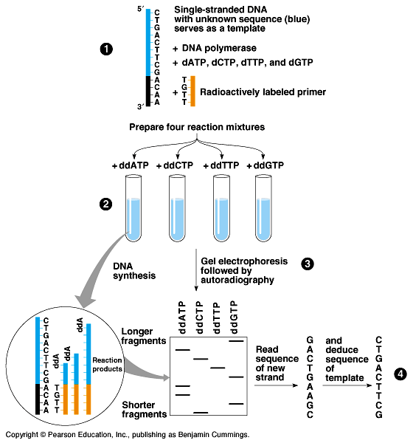
DNA Sequencing
1
Sanger method
  synthesize complementary DNA
  strand in vitro
  in each tube:
    “normal” N-bases
    dideoxy N-bases
      ddA, ddC, ddG, ddT
    DNA polymerase
    primer
    buffers & salt
2
3
4
2

Slide 9
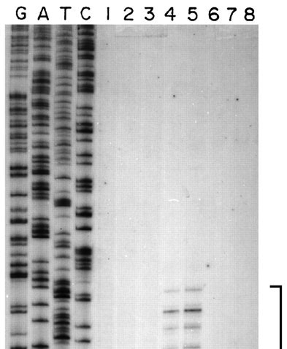
Reading the sequence
Load gel with sequences from ddA, ddT, ddC, ddG in separate lanes
  read lanes manually & carefully
  polyacrylamide gel

Slide 10

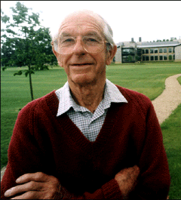
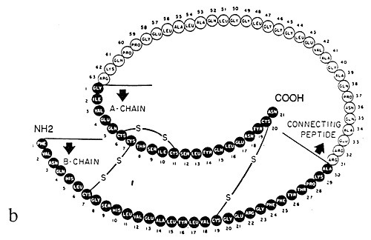
Fred Sanger
1978 | 1980
This was his 2nd Nobel Prize!!
  1st was in 1958 for the structure of insulin

