Slide 1
IB STUDENTS
7
It's Down To
Command Terms in IB Biology
Stephen Taylor
Bandung International School

Slide 2
All IB Biology questions and assessment statements are built around these command terms, which let you know exactly what is expected of you.
All definitions of command terms are taken
from the IB Biology Subject Guide:
http://xmltwo.ibo.org/publications/migrated/production-app2.ibo.org/publication/7/part/1/chapter/7.html

Slide 3
All IB Biology questions and assessment statements are built around these command terms, which let you know exactly what is expected of you.
Design
Annotate
Analyse
State
Comment
Define
Explain
Discuss
Apply
Distinguish
Measure
Label
Determine
Derive
Compare
Construct
Outline
Describe
Deduce
Solve
List
Evaluate
Draw
Estimate
Sketch
Suggest
Show
Identify
Calculate
Predict
All definitions of command terms are taken
from the IB Biology Subject Guide:
http://xmltwo.ibo.org/publications/migrated/production-app2.ibo.org/publication/7/part/1/chapter/7.html

Slide 4
All IB Biology questions and assessment statements are built around these command terms, which let you know exactly what is expected of you.
They are grouped according to the objectives of IB Biology:
Objective 1: Demonstrate an understanding of:
- scientific facts and concepts
- scientific methods and techniques
- scientific terminology
- methods of presenting scientific information
Define
Measure
Draw
Label
List
State
All definitions of command terms are taken
from the IB Biology Subject Guide:
http://xmltwo.ibo.org/publications/migrated/production-app2.ibo.org/publication/7/part/1/chapter/7.html

Slide 5
All IB Biology questions and assessment statements are built around these command terms, which let you know exactly what is expected of you.
They are grouped according to the objectives of IB Biology:
Objective 1: Demonstrate an understanding of:
- scientific facts and concepts
- scientific methods and techniques
- scientific terminology
- methods of presenting scientific information
Define
Measure
Draw
Label
List
State
Objective 2: Apply and Use:
- scientific facts and concepts
- scientific methods and techniques
- scientific terminology to communicate effectively
- appropriate methods of presenting scientific information
Describe
Identify
Distinguish
Calculate
Outline
Estimate
Apply
Annotate
All definitions of command terms are taken
from the IB Biology Subject Guide:
http://xmltwo.ibo.org/publications/migrated/production-app2.ibo.org/publication/7/part/1/chapter/7.html

Slide 6
All IB Biology questions and assessment statements are built around these command terms, which let you know exactly what is expected of you.
They are grouped according to the objectives of IB Biology:
Objective 1: Demonstrate an understanding of:
- scientific facts and concepts
- scientific methods and techniques
- scientific terminology
- methods of presenting scientific information
Define
Measure
Draw
Label
List
State
Objective 2: Apply and Use:
- scientific facts and concepts
- scientific methods and techniques
- scientific terminology to communicate effectively
- appropriate methods of presenting scientific information
Describe
Identify
Distinguish
Calculate
Outline
Estimate
Apply
Annotate
Objective 3: Construct, Analyse and Evaluate:
- hypotheses, research questions and predictions
- scientific methods and techniques
- scientific explanations
Suggest
Predict
Analyse
Discuss
Sketch
Deduce
Show
Construct
Comment
Explain
Solve
Design
Determine
Compare
Evaluate
Derive
All definitions of command terms are taken
from the IB Biology Subject Guide:
http://xmltwo.ibo.org/publications/migrated/production-app2.ibo.org/publication/7/part/1/chapter/7.html

Slide 7
General Revision and Learning Tips
Read the questions and assessment statements carefully
Learn and review all of the command terms
Highlight the command terms - in the syllabus/ handbook
Underline the command terms - in the Exam
Understand what the question wants:
outline, explain and describe are not the same!
label and annotate are not the same!
discuss, evaluate and explain are not the same!
distinguish and compare are not the same!
analyse, evaluate and suggest are not the same!
Present your answers neatly and clearly

Slide 8
Using this presentation
You can use this presentation as a tool for:
Learning the command terms
Picking up some examination tips
Testing your understanding of exam question types
Suggestions:
Use the sample questions as a revision test:
- try to answer each question on scrap paper before showing the answer key
Make up a collection of questions for each command term:
- use past papers, the syllabus and the QuestionBank CD Rom.

Slide 9
Define
Objective 1
"Give the precise meaning of a word, phrase or physical quantity."
Example:
“Define diffusion and osmosis.”
Tips:
Definitions are in the subject guide
Break the definition into its component parts – this will help with explanations
Make up a vocab list or use an online glossary to help with define questions

Slide 10
Define
Objective 1
"Give the precise meaning of a word, phrase or physical quantity."
Example:
“Define diffusion and osmosis.”
Diffusion is the passive movement of particles from regions of high concentration to lower concentration.
Osmosis is the passive movement of water molecules, across a partially (selectively) permeable membrane, from a region of lower solute concentration to a region of higher solute concentration.
Tips:
Definitions are in the subject guide
Break the definition into its component parts – this will help with explanations
Make up a vocab list or use an online glossary to help with define questions

Slide 11
Draw
Objective 1
"Represent by means of pencil lines."
Example:
“Draw a labeled graph showing a typical sigmoidal population growth curve .”
Tips:
Draw using clear, dark pencil lines (no colours)
Pay attention to whether it needs to be labeled or annotated
Make up drawings, graphs and diagrams revision book, and test each other

Slide 12
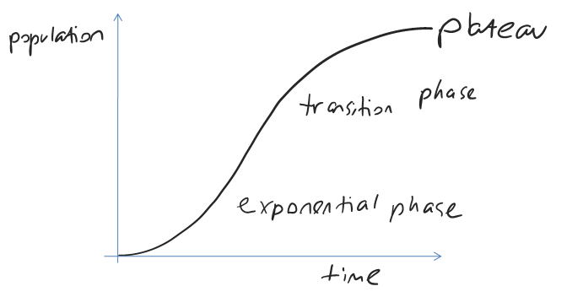
Draw
Objective 1
"Represent by means of pencil lines."
Example:
“Draw a labeled graph showing a typical sigmoidal population growth curve .”
Tips:
Draw using clear, dark pencil lines (no colours)
Pay attention to whether it needs to be labeled or annotated
Make up drawings, graphs and diagrams revision book, and test each other

Slide 13
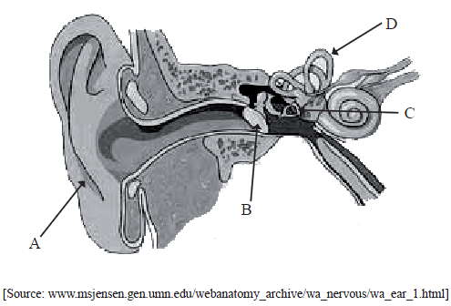
Label
Objective 1
"Add labels to a diagram."
Example:
“Label the structures of the human ear.”
Tips:
Generally, two correct labels are worth one mark
Make up drawings, graphs and diagrams revision book, and test each other
Revise and make links with regard to structures and their functions

Slide 14
Label
Objective 1
"Add labels to a diagram."
Example:
“Label the structures of the human ear.”
A = pinna
B = eardrum
C = stapes/ bones of middle ear
D = semicircular canals
Tips:
Generally, two correct labels are worth one mark
Make up drawings, graphs and diagrams revision book, and test each other
Revise and make links with regard to structures and their functions

Slide 15
List
Objective 1
"Give a sequence of names or other brief answers with no explanation."
Example:
“List seven levels in the hierarchy of taxa”
“List two examples of fibrous proteins”
Tips:
Lists can be used to present examples of any of the assessment statements
Use mnemonics for memory where the order of the list is important
Try to use examples that can link topics together, across the course

Slide 16
List
Objective 1
"Give a sequence of names or other brief answers with no explanation."
Example:
“List seven levels in the hierarchy of taxa”
Kingdom, phylum, class, order, family, genus, species
“List two examples of fibrous proteins”
Tips:
Lists can be used to present examples of any of the assessment statements
Use mnemonics for memory where the order of the list is important
Try to use examples that can link topics together, across the course

Slide 17
List
Objective 1
"Give a sequence of names or other brief answers with no explanation."
Example:
“List seven levels in the hierarchy of taxa”
Kingdom, phylum, class, order, family, genus, species
“List two examples of fibrous proteins”
Keratin, collagen
Tips:
Lists can be used to present examples of any of the assessment statements
Use mnemonics for memory where the order of the list is important
Try to use examples that can link topics together, across the course

Slide 18
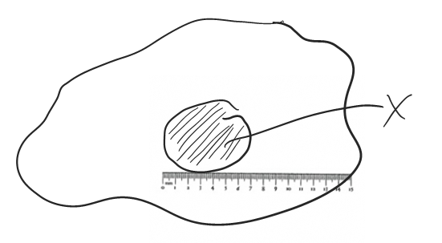
Measure
Objective 1
"Find a value for a quantity."
Example:
“Measure the length of organelle x.”
Tips:
Bring a ruler to the exam !
Generally, you’ll need to calculate from a measurement, rather than measure directly
Present all answers in metric, SI units

Slide 19
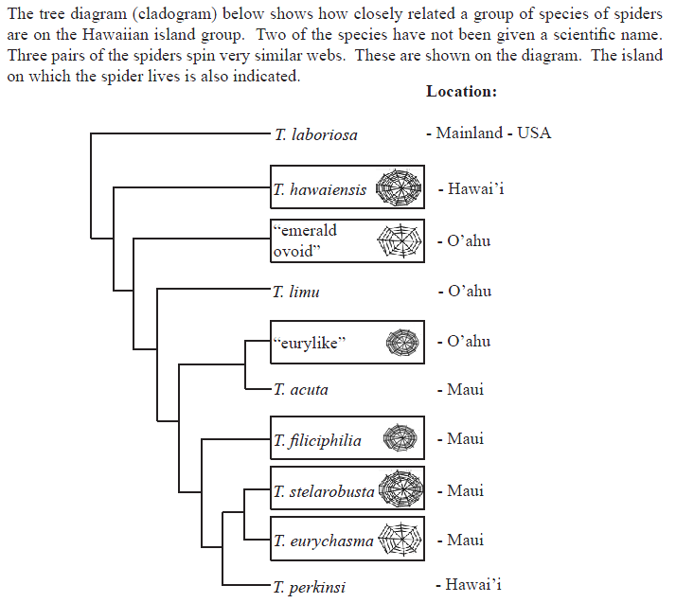
State
Objective 1
"Give a specific name, value or other brief answer without an explanation or calculation."
Example:
“State which species is most distantly related to T. perkinsi on the basis of the
tree diagram.”
Tips:
Definitions are in the subject guide
Break the definition into its component parts – this will help with explanations
Make up a vocab list or use an online glossary to help with define questions

Slide 20
State
Objective 1
"Give a specific name, value or other brief answer without an explanation or calculation."
Example:
“State which species is most distantly related to T. perkinsi on the basis of the
tree diagram.”
T. laboriosa
Tips:
Definitions are in the subject guide
Break the definition into its component parts – this will help with explanations
Make up a vocab list or use an online glossary to help with define questions

Slide 21
Annotate
Objective 2
"Add brief notes to a diagram or graph."
Example:
“Annotate a graph showing hormone levels in the menstrual cycle.”
Tips:
Annotate is more than just ‘label’ – some causes or explanation must be given
Make up a gallery of annotated graphs, diagrams, flow-charts etc, and use them as visual organisers in your revision of complex concepts

Slide 22
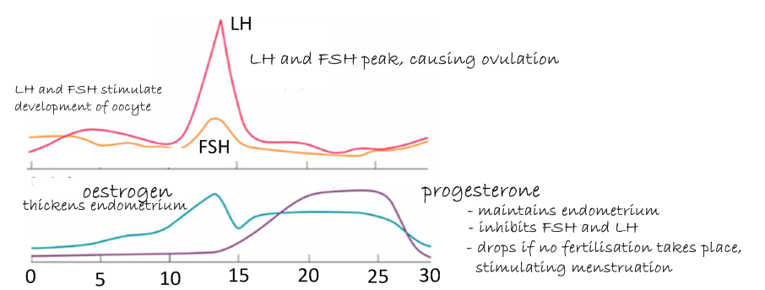
Annotate
Objective 2
"Add brief notes to a diagram or graph."
Example:
“Annotate a graph showing hormone levels in the menstrual cycle.”
Tips:
Annotate is more than just ‘label’ – some causes or explanation must be given
Make up a gallery of annotated graphs, diagrams, flow-charts etc, and use them as visual organisers in your revision of complex concepts

Slide 23
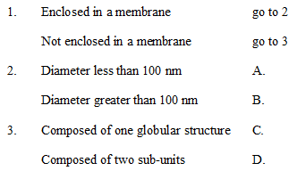
Apply
Objective 2
"Use an idea, principle, theory, law or equation in a new situation."
Example:
“Apply the dichotomous key to identify ribosomes.”
Tips:
Put an idea or technique into action
Make up some of your own dichotomous keys, for any topic or process
Learn the equations needed, as they too might need to be ‘applied’

Slide 24
Apply
Objective 2
"Use an idea, principle, theory, law or equation in a new situation."
Example:
“Apply the dichotomous key to identify ribosomes.”
Tips:
Put an idea or technique into action
Make up some of your own dichotomous keys, for any topic or process
Learn the equations needed, as they too might need to be ‘applied’

Slide 25
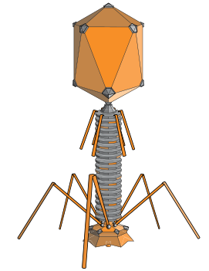
Calculate
Objective 2
"Find a numerical answer, showing the relevant stages of working."
Example:
“Calculate the magnification of the image of the bacteriophage.”
50nm
Tips:
Show your working unless otherwise told to
Make sure you use the correct SI unit in your answer
Make up a booklet of all the possible types of calculations you have learned to use

Slide 26
Calculate
Objective 2
"Find a numerical answer, showing the relevant stages of working."
Example:
“Calculate the magnification of the image of the bacteriophage.”
Measure the scale bar image length (in mm)
= 40mm
Convert to the same unit as the scale bar label
= 40 x 1000 x 1000 = 40,000,000nm
Divide out to get the multiplication factor
= 40,000,000 / 50 = 800,000 x magnification
50nm
Tips:
Show your working unless otherwise told to
Make sure you use the correct SI unit in your answer
Make up a booklet of all the possible types of calculations you have learned to use

Slide 27
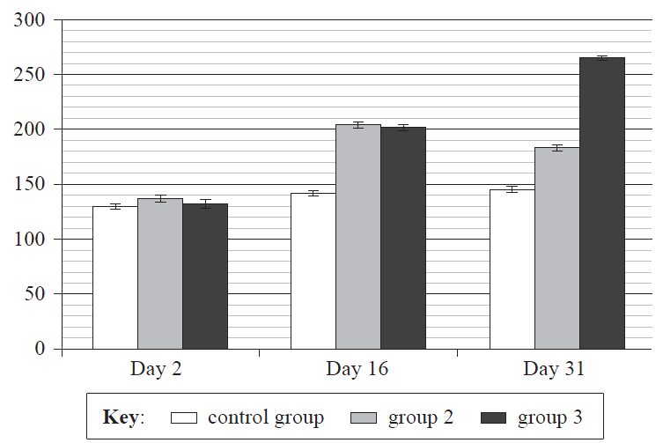
Calculate
Objective 2
"Find a numerical answer, showing the relevant stages of working."
Example:
“Calculate the percentage difference in .”response time of the control group from day 2 to day 31
Response time (secs)
May2009TZ1SLP3
Tips:
Learn all the different ‘calculate percentage…’ methods.
Make sure you use the correct SI unit in your answer
Make up a booklet of all the possible types of calculations you have learned to use

Slide 28
Calculate
Objective 2
"Find a numerical answer, showing the relevant stages of working."
Example:
“Calculate the percentage difference in .”response time of the control group from day 2 to day 31
Response time (secs)
increases from 130s to 145s
145-130 = 15s
Percentage difference = of the original measurement?
So: % diff = (15/130) x 100
= 11.5%
May2009TZ1SLP3
Tips:
Learn all the different ‘calculate percentage…’ methods.
Make sure you use the correct SI unit in your answer
Make up a booklet of all the possible types of calculations you have learned to use

Slide 29
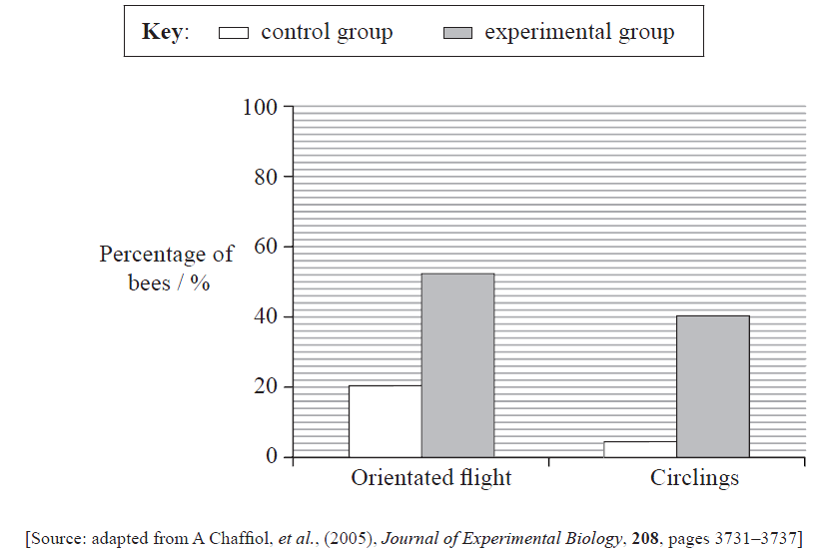
Describe
Objective 2
"Give a detailed account."
Example:
“Describe the effect of previous exposure to the odor on the flight of bees.” (2)
“Describe how biomass may be measured.” (2)
May2009TZ1SLP3
Tips:
Descriptions are not explanations
Pay attention to the number of marks available
Descriptions can be of processes or of parts of a data response graph

Slide 30
Describe
Objective 2
"Give a detailed account."
Example:
“Describe the effect of previous exposure to the odor on the flight of bees.” (2)
Experimental group fly more around odor source;
Greater circling in experimental group;
Experimental group fly more directly to odor source;
More oriented flight in experimental group.
“Describe how biomass may be measured.” (2)
May2009TZ1SLP3
Tips:
Descriptions are not explanations
Pay attention to the number of marks available
Descriptions can be of processes or of parts of a data response graph

Slide 31
Describe
Objective 2
"Give a detailed account."
Example:
“Describe the effect of previous exposure to the odor on the flight of bees.” (2)
Experimental group fly more around odor source;
Greater circling in experimental group;
Experimental group fly more directly to odor source;
More oriented flight in experimental group.
“Describe how biomass may be measured.” (2)
May2009TZ1SLP3
Organism is cleaned of dirt or soil;
Mass is recorded;
Organism is dried in an oven until constant mass reached;
Biomass is total dry mass.
Tips:
Descriptions are not explanations
Pay attention to the number of marks available
Descriptions can be of processes or of parts of a data response graph

Slide 32
Distinguish
Objective 2
"Give the differences between two or more different items."
Example:
“Distinguish between autotroph and heterotroph.”
Tips:
Looking for as many differences as there are marks awarded
No need to present similarities
Build a chart, with all possible compare/ distinguish questions you can think of

Slide 33
Distinguish
Objective 2
"Give the differences between two or more different items."
Example:
“Distinguish between autotroph and heterotroph.”
Autotroph: organism that synthesises its organic molecules from simple inorganic substances.
Heterotroph: organism that obtains organic molecules from other organisms.
Tips:
Looking for as many differences as there are marks awarded
No need to present similarities
Build a chart, with all possible compare/ distinguish questions you can think of

Slide 34
Estimate
Objective 2
"Find an approximate value for an unknown quantity."
Example:
“Describe one technique used to estimate population size of an animal species, based on capture-mark-recapture methods.”
Tips:
Estimations may come from graphical questions
Estimation techniques are used in ecology , rather than direct measurement
Make a note of all instances of ‘estimate’ in the subject guide

Slide 35
Estimate
Objective 2
"Find an approximate value for an unknown quantity."
Example:
“Describe one technique used to estimate population size of an animal species, based on capture-mark-recapture methods.”
Capture (humanely) a sample of the population;
Control for time and area;
Example of capture method;
Count and apply mark (non-harmful) to organism;
Release back to habitat;
Second capture takes place;
Count all individuals with and without marks;
Apply Lincoln Index to estimate population size;
n₁ = first capture, n₂ = total in second capture, n₃ = recapture with marks.
Tips:
Estimations may come from graphical questions
Estimation techniques are used in ecology , rather than direct measurement
Make a note of all instances of ‘estimate’ in the subject guide

Slide 36
Identify
Objective 2
"Find an answer from a given number of possibilities."
Example:
“Identify the response time of group 2 on day 31 of the study.”
Response time (secs)
“Identify the group with the largest difference in response time from day 2 to day 31.”
May2009TZ1SLP3
Tips:
Identify – pick one single answer
Practice making your own ‘identify’ questions using different types of graphs
Identify can also be used for parts of diagrams, such as curves, organelles etc.

Slide 37
Identify
Objective 2
"Find an answer from a given number of possibilities."
Example:
“Identify the response time of group 2 on day 31 of the study.”
Response time (secs)
183 seconds (unit needed)
“Identify the group with the largest difference in response time from day 2 to day 31.”
May2009TZ1SLP3
Tips:
Identify – pick one single answer
Practice making your own ‘identify’ questions using different types of graphs
Identify can also be used for parts of diagrams, such as curves, organelles etc.

Slide 38
Identify
Objective 2
"Find an answer from a given number of possibilities."
Example:
“Identify the response time of group 2 on day 31 of the study.”
Response time (secs)
183 seconds (unit needed)
“Identify the group with the largest difference in response time from day 2 to day 31.”
Group 3
May2009TZ1SLP3
Tips:
Identify – pick one single answer
Practice making your own ‘identify’ questions using different types of graphs
Identify can also be used for parts of diagrams, such as curves, organelles etc.

Slide 39
Outline
Objective 2
“Give a brief account or summary."
Example:
“Outline the light dependent reactions of photosynthesis (HL, 6 marks).”
Tips:
Pay close attention to the number of marks available
Present answers clearly to get the complete number of marks
Outline is a summary or account, without reasons or explanation (step-by-step)

Slide 40
Outline
Objective 2
“Give a brief account or summary."
Example:
“Outline the light dependent reactions of photosynthesis (HL, 6 marks).”
Light energy is absorbed by photosystem II;
Electrons excited/ photoactivated by absorption of light energy;
Electron passed along a series of carriers;
NADP⁺ reduced to NADPH + H+;
Photolysis of water produces oxygen and hydrogen;
Called non-cyclic photophosphorylation;
H+ pumped across thylakoid membrane, through ATP synthase
(by chemiosmosis), generating ATP.
Tips:
Pay close attention to the number of marks available
Present answers clearly to get the complete number of marks
Outline is a summary or account, without reasons or explanation (step-by-step)

Slide 41
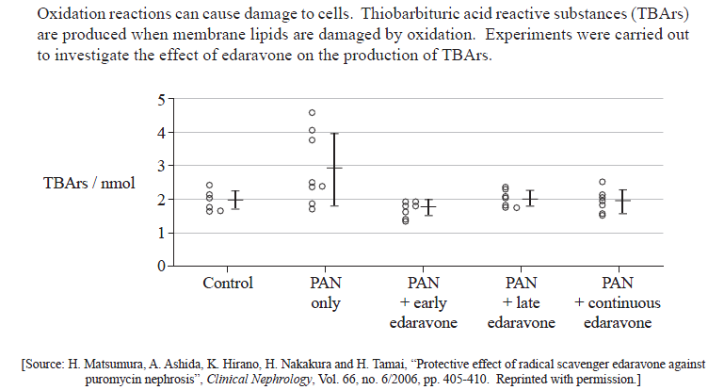
Analyse
Objective 3
"Interpret data to reach conclusions."
Example:
“Analyse the results of this experiment.”
QuestionBank CD Rom
Tips:
Use the data to reach a conclusion – it must agree with the data
Pay attentiont to the number of marks available
Practice by analysing all the graphs from data-based questions that you can find

Slide 42
Analyse
Objective 3
"Interpret data to reach conclusions."
Example:
“Analyse the results of this experiment.”
PAN increases TBArs levels/ levels highest in
PAN-only group;
PAN causes oxidation of / damage to
Membranes/ lipids;
Edaravone prevents increase in TBArs levels;
Edaravone prevents oxidation of / damage to
Membranes/ lipids;
Early edaravone is more effective than late/ continuous;
Overlap of error bars suggests results may not be significant.
QuestionBank CD Rom
Tips:
Use the data to reach a conclusion – it must agree with the data
Pay attentiont to the number of marks available
Practice by analysing all the graphs from data-based questions that you can find

Slide 43
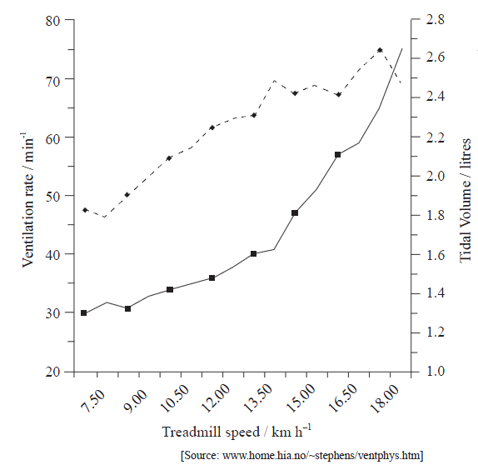
Compare
Objective 3
"Give an account of similarities and differences between two (or more) items, referring to both (all) of them throughout."
Example:
“Compare the trend in ventilation rate with the trend in tidal volume at high treadmill speeds.”
“Compare rod and cone cells.”
QuestionBank CD Rom
Tips:
Marks are available for similarities and differences – often found in data questions
Create comparison charts for as many topics as possible
Present answers in tables for clarity

Slide 44
Compare
Objective 3
"Give an account of similarities and differences between two (or more) items, referring to both (all) of them throughout."
Example:
“Compare the trend in ventilation rate with the trend in tidal volume at high treadmill speeds.”
Ventilation rate continues to increase, where tidal volume approaches a plateau.
“Compare rod and cone cells.”
QuestionBank CD Rom
Tips:
Marks are available for similarities and differences – often found in data questions
Create comparison charts for as many topics as possible
Present answers in tables for clarity

Slide 45
Compare
Objective 3
"Give an account of similarities and differences between two (or more) items, referring to both (all) of them throughout."
Example:
“Compare the trend in ventilation rate with the trend in tidal volume at high treadmill speeds.”
Ventilation rate continues to increase, where tidal volume approaches a plateau.
“Compare rod and cone cells.”
Rod cells | Cone cells
Dim light conditions | Bright light conditions;
One type, sensitive to all wavelengths of light | Three types, sensitive to specific wavelengths;
Multiple cones feed into one sensory neuron | One cone feeds into one sensory neuron;
QuestionBank CD Rom
Tips:
Marks are available for similarities and differences – often found in data questions
Create comparison charts for as many topics as possible
Present answers in tables for clarity

Slide 46
Construct
Objective 3
"Represent or develop in graphical form."
Example:
“Construct a pyramid of energy for this grassland:
The total solar energy received by a grassland is 5 × l0⁵ kJ m^{–2} y^{–1}. The net production of the grassland is 5 × 10² kJ m^{–2} y^{–1} and its gross
production is 6 × l0² kJ m^{–2} y^{–1}. The total energy passed on to primary consumers is 60 kJ m^{–2} y^{–1}. Only 10 % of this energy is passed on to the secondary consumers.”
Tips:
Read the information passages very carefully and underline important points
Use scrap paper before committing your answer to the exam paper
Practice by making construct questions for your friends

Slide 47
Construct
Objective 3
"Represent or develop in graphical form."
Example:
“Construct a pyramid of energy for this grassland:
The total solar energy received by a grassland is 5 × l0⁵ kJ m^{–2} y^{–1}. The net production of the grassland is 5 × 10² kJ m^{–2} y^{–1} and its gross
production is 6 × l0² kJ m^{–2} y^{–1}. The total energy passed on to primary consumers is 60 kJ m^{–2} y^{–1}. Only 10 % of this energy is passed on to the secondary consumers.”
Secondary consumers: 6kJ m^{–2} y^{–1}
Primary consumers: 60 kJ m^{–2} y^{–1}
Producers: 600 kJ m^{–2} y^{–1}
Tips:
Read the information passages very carefully and underline important points
Use scrap paper before committing your answer to the exam paper
Practice by making construct questions for your friends

Slide 48
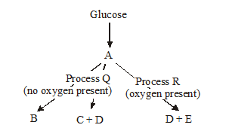
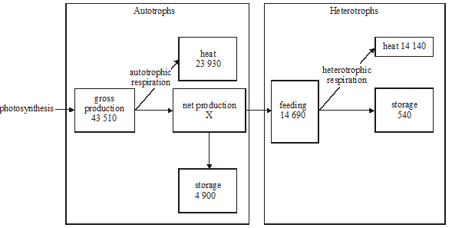
Deduce
Objective 3
"Reach a conclusion from the information given."
Example:
“Deduce the names of substances B and D.”
“Deduce the effects of sustained pollution which kills decomposers on autotrophic productivity.”
Tips:
Deduce means ‘work it out’!
When revising, make deduce questions for your friends, asking them to explain how they arrived at their answer

Slide 49
Deduce
Objective 3
"Reach a conclusion from the information given."
Example:
“Deduce the names of substances B and D.”
B = lactic acid D = carbon dioxide
“Deduce the effects of sustained pollution which kills decomposers on autotrophic productivity.”
Tips:
Deduce means ‘work it out’!
When revising, make deduce questions for your friends, asking them to explain how they arrived at their answer

Slide 50
Deduce
Objective 3
"Reach a conclusion from the information given."
Example:
“Deduce the names of substances B and D.”
B = lactic acid D = carbon dioxide
“Deduce the effects of sustained pollution which kills decomposers on autotrophic productivity.”
Autotrophs need nutrients;
Decomposers recylce nutrients into soil;
Fewer decomposer, reduced recycling of nutrients;
Therefore reduced productivity.
Tips:
Deduce means ‘work it out’!
When revising, make deduce questions for your friends, asking them to explain how they arrived at their answer

Slide 51
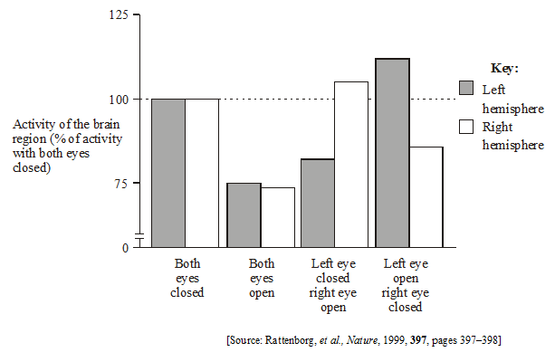
Determine
Objective 3
"Find the only possible answer."
Example:
“Determine which hemisphere is
Most awake when the right eye is open.”
QuestionBank CD Rom
Tips:
‘Determine’ often means you need to go a step further than just ‘identify’
Try to design your own ‘determine’ questions, based on graphical data or tables

Slide 52
Determine
Objective 3
"Find the only possible answer."
Example:
“Determine which hemisphere is
Most awake when the right eye is open.”
Left hemisphere
(shows biggest change from activity when both eyes are closed)
QuestionBank CD Rom
Tips:
‘Determine’ often means you need to go a step further than just ‘identify’
Try to design your own ‘determine’ questions, based on graphical data or tables

Slide 53
Discuss
Objective 3
"Give an account including, where possible, a range of arguments for an against
the relative importance of various factors, or comparisons of alternate hypotheses."
Example:
“Discuss the benefits and perceived risks of vaccination against bacterial and viral pathogens.” (HL, 8 marks)
Tips:
Pay close attention to the number of marks available and present answer clearly
Look out for qualifiers in the question, such as ‘named example’, etc.
Include two or more perspectives in the answer
Practice will all ‘discuss’ assessment statements in the subject guide

Slide 54
Discuss
Objective 3
"Give an account including, where possible, a range of arguments for an against
the relative importance of various factors, or comparisons of alternate hypotheses."
Example:
“Discuss the benefits and perceived risks of vaccination against bacterial and viral pathogens.” (HL, 8 marks)
Benefits:
Prevent disease;
Prevent epidemics;
Healthier population;
More cost-effective than treating disease;
Economical benefit, less absenteeism;
Eradicate diseases, e.g. smallpox;
Quicker immune response to disease;
Prevent disease-related disability
Perceived risks:
Some minor side effects
Some might be allergic
Might show symptoms of illness
Risks might be perceived, though lack evidence base, such as MMR scare
Tips:
Pay close attention to the number of marks available and present answer clearly
Look out for qualifiers in the question, such as ‘named example’, etc.
Include two or more perspectives in the answer
Practice will all ‘discuss’ assessment statements in the subject guide

Slide 55
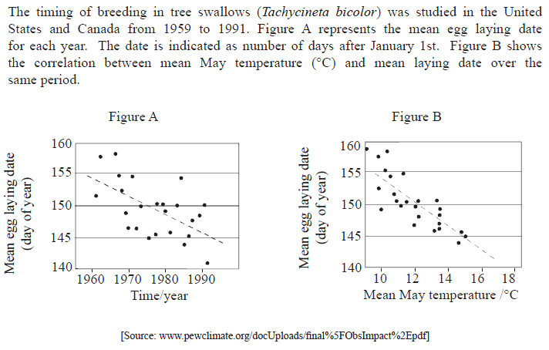
Evaluate
Objective 3
"Assess the implications and limitations."
Example:
“Evaluate the evidence for global warming, using figures A and B (2).”
Biology Specimen Paper, 2009
Tips:
Do not just describe the graphs or methods, use evaluative language
Read the introductory passage very carefully – to what extent do the data address the aims of the investigation?
Pay attention to the number of marks available

Slide 56
Evaluate
Objective 3
"Assess the implications and limitations."
Example:
“Evaluate the evidence for global warming, using figures A and B (2).”
Trend for egg laying moving earlier over the study period;
Correlation with increasing mean may temperatures;
Higher temperature leads to earlier egg laying;
Data are highly variable, especially in figure A/ correlation not strong.
Biology Specimen Paper, 2009
Tips:
Do not just describe the graphs or methods, use evaluative language
Read the introductory passage very carefully – to what extent do the data address the aims of the investigation?
Pay attention to the number of marks available

Slide 57
Explain
Objective 3
"Give a detailed account of causes, reasons or mechanisms."
Example:
“Explain two examples of evolution due to environmental change.”
Tips:
Pay attention to the number of marks available
Read the question carefully – are there any other qualifiers (e.g. ‘named example’) that must be addressed in order to get the marks?

Slide 58
Explain
Objective 3
"Give a detailed account of causes, reasons or mechanisms."
Example:
“Explain two examples of evolution due to environmental change.”
Populations tend to produce more offspring than the environment can support;
Variation exists within populations;
.
e.g. Antibiotic resistance in antibiotics
Environmental change is application of antibiotics;
some bacteria are killed;
some survive;
reproduce and pass on alleles that allowed resistance to antibiotics;
characteristics of population change over time (evolution);
.
e.g. Peppered moths
Environmental change is black pollution of the air and trees;
white moths more visible to predators;
black variants better camouflaged;
survive to reproduce and pass on alleles for black colour;
characteristics of population change over time (evolution), becoming blacker;
.
Tips:
Pay attention to the number of marks available
Read the question carefully – are there any other qualifiers (e.g. ‘named example’) that must be addressed in order to get the marks?

Slide 59
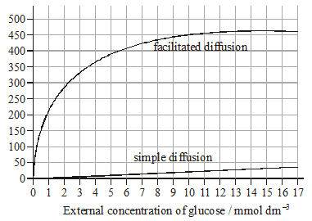
Predict
Objective 3
"Give an expected result."
Example:
“Predict, with a reason, the effect on glucose uptake by facilitated diffusion of increasing the external glucose concentration to 30mmol dm⁻³.”
QuestionBank CD Rom
Tips:
Pay attention to number of marks and qualifiers, e.g. ‘with a reason’.
Look for trends in the data and continue them onward
When practicing, test yourself by looking at datasets and making predictions

Slide 60
Predict
Objective 3
"Give an expected result."
Example:
“Predict, with a reason, the effect on glucose uptake by facilitated diffusion of increasing the external glucose concentration to 30mmol dm⁻³.”
Glucose uptake will remain constant.
Most or all protein channels are in use.
QuestionBank CD Rom
Tips:
Pay attention to number of marks and qualifiers, e.g. ‘with a reason’.
Look for trends in the data and continue them onward
When practicing, test yourself by looking at datasets and making predictions

Slide 61
Show
Objective 3
"Give the steps in a calculation or derivation."
Example:
“A male and female with normal colour vision each have a father who is colour blind. They are planning to have children. Predict, showing your working, the possible phenotypes and genotypes of male and female children.”
QuestionBank CD Rom
Tips:
Look out for this in ‘calculate’ or ‘determine’ questions
Pay attention to number of marks available for amount of detail to be shown
Present all working clearly and step-wise to ensure examiner understands it

Slide 62
Show
Objective 3
"Give the steps in a calculation or derivation."
Example:
“A male and female with normal colour vision each have a father who is colour blind. They are planning to have children. Predict, showing your working, the possible phenotypes and genotypes of male and female children.”
QuestionBank CD Rom
Colour blindness is X-linked, recessive;
Key to alleles: X^{N} = normal, X^{n} = colour blind;
Male must be X^{N} Y, to be unaffected, Female must be X^{N} X^{n};
Daughters will be 100% normal phenotype;
Sons will be 50% normal, 50% colour blind.
 | female
male | X^{N} | X^{n}
X^{N} | X^{N} X^{N} | X^{N}X^{n}
Y | X^{N} Y | X^{n}Y
Tips:
Look out for this in ‘calculate’ or ‘determine’ questions
Pay attention to number of marks available for amount of detail to be shown
Present all working clearly and step-wise to ensure examiner understands it

Slide 63
Sketch
Objective 3
"Represent by means of a graph showing a line and labeled but unscaled axes - with important features (for example intercept) clearly indicated."
Example:
“Sketch a graph to predict the effect of manipulating pH on the activity of an enzyme which has an optimal pH of 7.”
Tips:
Definitions are in the subject guide
Break the definition into its component parts – this will help with explanations
Make up a vocab list or use an online glossary to help with define questions

Slide 64
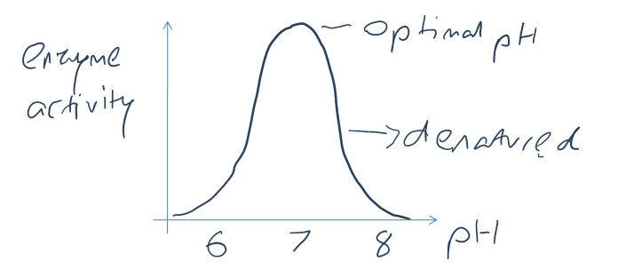
Sketch
Objective 3
"Represent by means of a graph showing a line and labeled but unscaled axes - with important features (for example intercept) clearly indicated."
Example:
“Sketch a graph to predict the effect of manipulating pH on the activity of an enzyme which has an optimal pH of 7.”
Tips:
Definitions are in the subject guide
Break the definition into its component parts – this will help with explanations
Make up a vocab list or use an online glossary to help with define questions

Slide 65
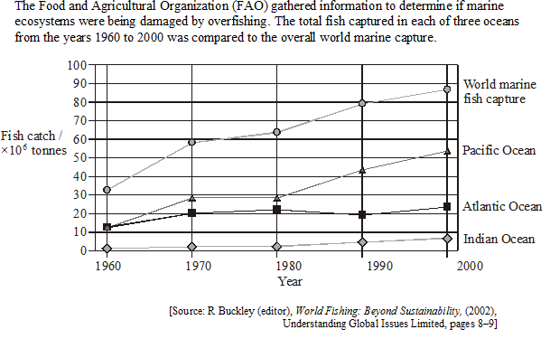
Suggest
Objective 3
"Propose a hypothesis or other possible answer."
Example:
“Suggest one reason in each case for the change in quantity of fish captured in the Atlantic and Indian Oceans from 1980 to 1990.”
QuestionBank CD Rom
Tips:
Apply your reasoning to a possibly unknown situation
Pay attention to the number of marks available
Practice these questions with friends – can you explain your suggestions to each other?

Slide 66
Suggest
Objective 3
"Propose a hypothesis or other possible answer."
Example:
“Suggest one reason in each case for the change in quantity of fish captured in the Atlantic and Indian Oceans from 1980 to 1990.”
Atlantic:
Quotas decreased/ stocks depleted/ change in market tastes/ yield decreased/ smaller fleets;
Indian Ocean:
Quotas increased/ better technology/ bigger fleets/ yield increased/ market change in tastes
QuestionBank CD Rom
Tips:
Apply your reasoning to a possibly unknown situation
Pay attention to the number of marks available
Practice these questions with friends – can you explain your suggestions to each other?

Slide 67
More exam tips & resources
“You may never know what results come of your action, but if you do nothing there will be no result.” ~ Mahatma Gandhi
Make up books or portfolios for equations, diagrams, explanations and data analysis practice.
Pair up with people who will help you succeed – not necessarily your dense mates. Test your understanding by explaining to others.
Open up loads of past paper examples. Get them from class or on the IBO store: http://store.ibo.org/
Cough up from some revision guides or the QuestionBank CD Rom for loads of practice: http://store.ibo.org/product_info.php?products_id=1224
Look up some of the free review internet sources:
Click4Biology:
http://click4biology.info
Open Door Website:
http://www.saburchill.com/chapters/bio.html
MrT’s Site:
http://sciencevideos.wordpress.com
Wake up each day, after a good night’s sleep. Don’t do all-nighters, they’re bad for your brain. Definitely don’t sleep through the exam.

Slide 68
For more IB Biology resources:
http://sciencevideos.wordpress.com
If you like these resources,
please donate to
charity through Biology4Good
Creative Commons:
Feel free to use this work, educationally and not for profit, with citations linking to the site above.
http://wp.me/P7lr1-mm
Cartoon from: http://assessment.uconn.edu/why1.htm

