Slide 1
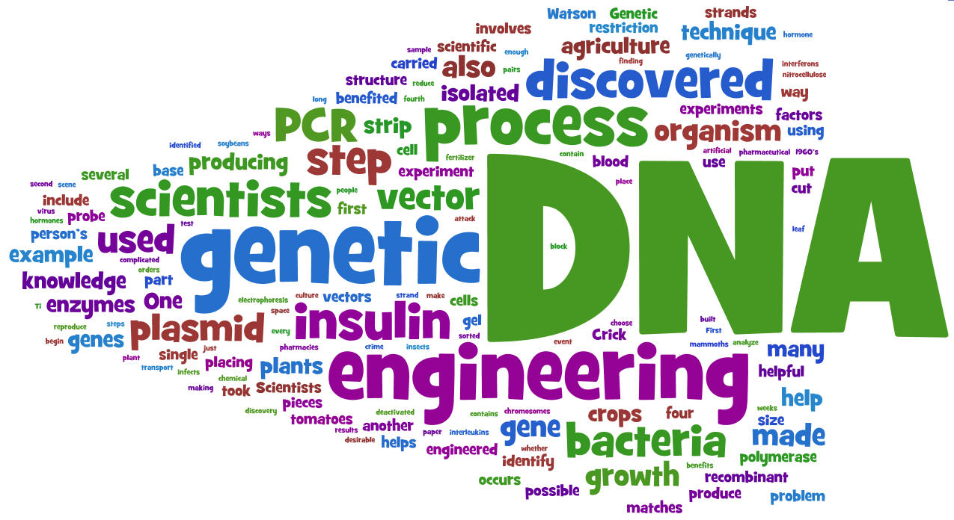

Biotechnology

Slide 2
Biotechnology today
Genetic Engineering
  manipulation of DNA
  if you are going to engineer DNA & genes & organisms, then you need a set of tools to work with

Slide 3
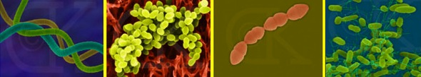
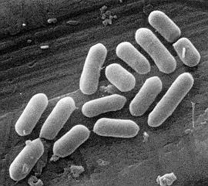
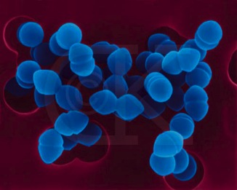
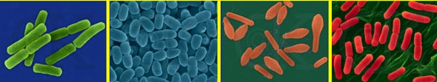
Bacteria
Bacteria review
  Unicellular prokaryotes
  reproduce by binary fission
  rapid growth
    generation every ~20 minutes
    10⁸ (100 million) colony overnight!
  dominant form of life on Earth
  incredibly diverse

Slide 4
Bacterial genome
Single circular chromosome
  haploid
  naked DNA
    no histone proteins
  ~4 million base pairs
    ~4300 genes
    1/1000 DNA in eukaryote

Slide 5
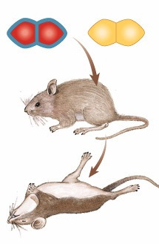
Transformation
Incorporation of foreign DNA
  import bits of chromosomes from other bacteria
  incorporate the DNA bits into their own chromosome
    express new genes
    transformation
    form of recombination
mix heat-killed
pathogenic &
non-pathogenic
bacteria
mice die

Slide 6
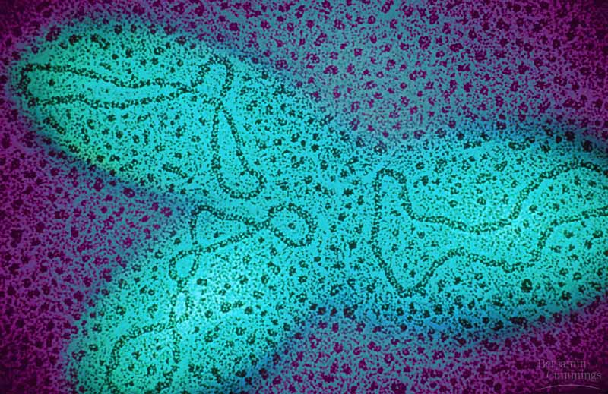
Plasmids
Small supplemental circles of DNA
    5000 - 20,000 base pairs
    self-replicating
  carry extra genes
    2-30 genes
    Ex// genes for antibiotic resistance
  can be exchanged between bacteria
  can be imported from
  environment
Notes:
Mini-chromosomes

Slide 7
How can plasmids help us?
A way to get genes into bacteria easily
  insert new gene into plasmid
  Plasmid is a vector for gene delivery
  bacteria now expresses new gene
    bacteria make new protein
transformed
bacteria
gene from
other organism
recombinant
plasmid
cut DNA
+
vector
glue DNA
plasmid

Slide 8
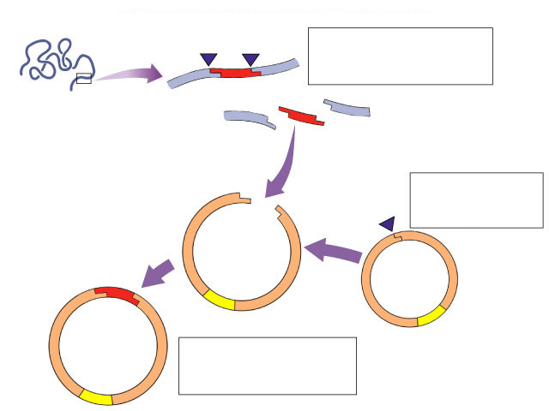
Biotechnology
Plasmids used to insert new genes into bacteria
cut DNA
gene we want
like what?
…insulin
…HGH
…lactase
cut plasmid DNA
Cut DNA?
DNA scissors?
ligase
insert “gene we want” into plasmid...
“glue” together
recombinant plasmid

Slide 9
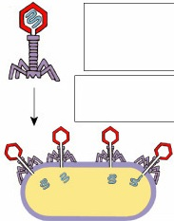
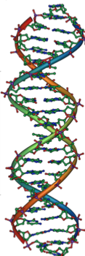
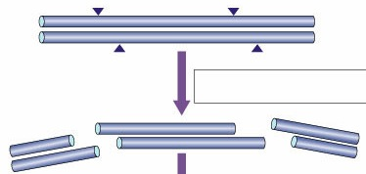
How do we cut DNA?
Restriction enzymes
  restriction endonucleases
  discovered in 1960s
  evolved in bacteria to cut up foreign DNA
    “restricted” in the sequences they cut
    protection against viruses
    & other bacteria


Slide 10
Restriction enzymes
Madam I’m Adam
Action of enzyme
  cut DNA at specific sequences
    restriction site
  symmetrical “palindrome”
  produces protruding ends
    sticky ends
    will bind to any complementary DNA
Many different enzymes
    EcoRI, HindIII, BamHI, SmaI

CTGAATTCCG
GACTTAAGGC

CTG|AATTCCG
GACTTAA|GGC

Slide 11
Restriction enzymes
Cut DNA at specific sites
  leave “sticky ends”
restriction enzyme cut site
GTAACGAATTCACGCTT
CATTGCTTAAGTGCGAA
restriction enzyme cut site
GTAACG AATTCACGCTT
CATTGCTTAA GTGCGAA

Slide 12
Sticky ends
Cut other DNA with same enzymes
  leave “sticky ends” on both
  can glue DNA together at “sticky ends”
GTAACG AATTCACGCTT
CATTGCTTAA GTGCGAA
gene
you want
GGACCTG AATTCCGGATA
CCTGGACTTAA GGCCTAT
chromosome
want to add
gene to
GGACCTG AATTCACGCTT
CCTGGACTTAA GTGCGAA
combined
DNA

Slide 13
Sticky ends help glue genes together
cut sites
gene you want
cut sites
TTGTAACGAATTCTACGAATGGTTACATCGCCGAATTCACGCTT
AACATTGCTTAAGATGCTTACCAATGTAGCGGCTTAAGTGCGAA
AATTCTACGAATGGTTACATCGCCG
GATGCTTACCAATGTAGCGGCTTAA
isolated gene
sticky ends
cut sites
chromosome want to add gene to
AATGGTTACTTGTAACG AATTCTACGATCGCCGATTCAACGCTT
TTACCAATGAACATTGCTTAA GATGCTAGCGGCTAAGTTGCGAA
DNA ligase joins the strands
Recombinant DNA molecule
sticky ends stick together
chromosome with new gene added
TAACGAATTCTACGAATGGTTACATCGCCGAATTCTACGATC CATTGCTTAAGATGCTTACCAATGTAGCGGCTTAAGATGCTAGC

Slide 14
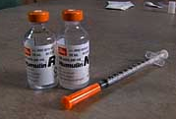
Why mix genes together?
How can
bacteria read
human DNA?
Gene produces protein in different organism or different individual
human insulin gene in bacteria
TAACGAATTCTACGAATGGTTACATCGCCGAATTCTACGATC CATTGCTTAAGATGCTTACCAATGTAGCGGCTTAAGATGCTAGC
“new” protein from organism
ex: human insulin from bacteria
aa
aa
aa
aa
aa
aa
aa
aa
aa
aa
bacteria
human insulin

Slide 15
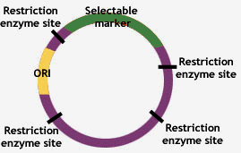
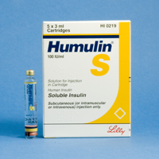
Copy (& Read) DNA
Transformation
  insert recombinant plasmid
  into bacteria
  grow recombinant bacteria in agar cultures
    bacteria make lots of copies of plasmid
    “cloning” the plasmid
  production of many copies of inserted gene
  production of “new” protein
    transformed phenotype
DNA → RNA → protein → trait

Slide 16


Grow bacteria…make more
transformed
bacteria
gene from
other organism
recombinant
plasmid
+
vector
plasmid
grow
bacteria
harvest (purify)
protein

Slide 17

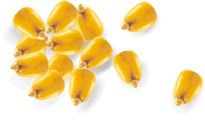
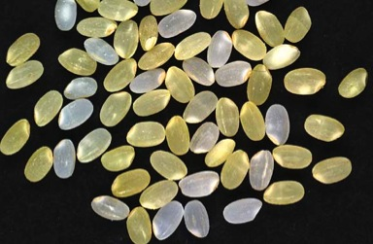
Uses of genetic engineering
Genetically modified organisms (GMO)
  enabling plants to produce new proteins
    Protect crops from insects: BT corn
      corn produces a bacterial toxin that kills corn borer (caterpillar pest of corn)
    Extend growing season: fishberries
      strawberries with an anti-freezing gene from flounder
    Improve quality of food: golden rice
      rice producing vitamin A
      improves nutritional value

Slide 18
Engineered plasmids
Building custom plasmids
  restriction enzyme sites
  antibiotic resistance genes as a selectable marker
EcoRI
BamHI
HindIII
restriction sites
Selectable marker
antibiotic resistance gene on plasmid
  ampicillin resistance
selecting for successful transformation
  successful uptake of recombinant plasmid
plasmid
ori
amp
resistance

Slide 19
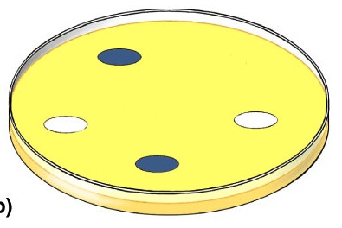
Selection for plasmid uptake
Antibiotic becomes a selecting agent
  only bacteria with the plasmid will grow on antibiotic (ampicillin) plate
only transformed
bacteria grow
all bacteria grow
a
a
a
a
a
a
a
a
a
a
a
a
a
a
a
a
a
LB plate
LB/amp plate
cloning

Slide 20
Need to screen plasmids
Need to make sure bacteria have recombinant plasmid
restriction sites
inserted
gene
of interest
EcoRI
all in LacZ gene
BamHI
HindIII
LacZ gene
broken
LacZ gene
lactose → blue color
X
lactose → white color
plasmid
recombinant
plasmid
amp
resistance
amp
resistance
origin of
replication

Slide 21
Screening for recombinant plasmid
Bacteria take up plasmid
Functional LacZ gene
Bacteria make blue color
Bacteria take up recombinant plasmid
Non-functional LacZ gene
Bacteria stay white color
Which colonies
do we want?

Slide 22
Many uses of restriction enzymes…
Now that we can cut DNA with restriction enzymes…
  we can cut up DNA from different people… or different organisms…
  and compare it
  why?
    forensics
    medical diagnostics
    paternity
    evolutionary relationships
    and more…

Slide 23
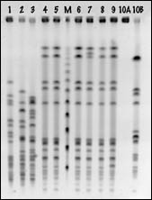
Comparing cut up DNA
How do we compare DNA fragments?
  separate fragments by size
How do we separate DNA fragments?
  run it through a gel
    agarose
    made from algae
  gel electrophoresis

Slide 24
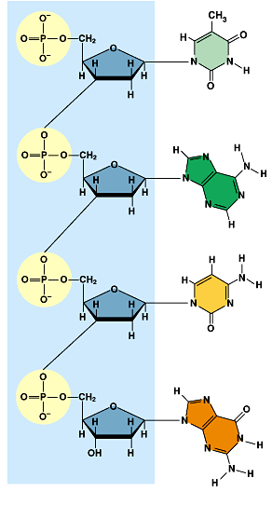
Gel electrophoresis
A method of separating DNA in a gelatin-like material using an electrical field
  DNA is negatively charged
  when it’s in an electrical field it moves toward the positive side
DNA → → → → → → → →
–
+
“swimming through Jello”

Slide 25
Gel electrophoresis
DNA moves in an electrical field…
    size of DNA fragment affects how far it travels
      small pieces travel farther
      large pieces travel slower & lag behind
DNA → → → → → → →
–
+
“swimming through Jello”

Slide 26
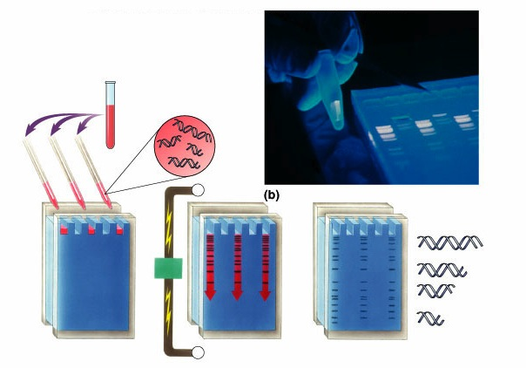
Gel Electrophoresis
DNA &
restriction enzyme
-
wells
longer fragments
power
source
gel
shorter fragments
+
completed gel

Slide 27
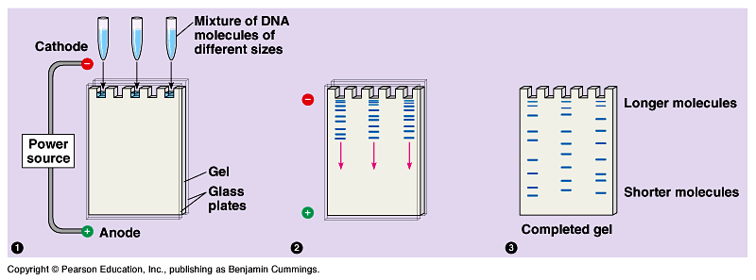
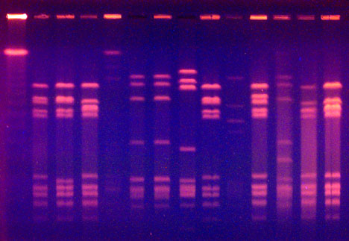
Running a gel
fragments of DNA
separate out based
on size
cut DNA with restriction enzymes
1
2
3
Stain DNA
  ethidium bromide binds to DNA
  fluoresces under UV light

Slide 28
Uses: Evolutionary relationships
Comparing DNA samples from different organisms to measure evolutionary relationships
turtle
snake
rat
squirrel
fruitfly
–
1
2
3
4
5
1
2
3
4
5
DNA
↓
+

Slide 29
Uses: Medical diagnostic
Comparing normal allele to disease allele
chromosome
with normal
allele 1
chromosome with
disease-causing
allele 2
allele 1
allele 2
–
DNA
↓
Example: test for Huntington’s disease
+

Slide 30
Uses: Forensics
Comparing DNA sample from crime scene with suspects & victim
suspects
crime
scene
sample
S1
S2
S3
V
–
DNA
↓
+

Slide 31
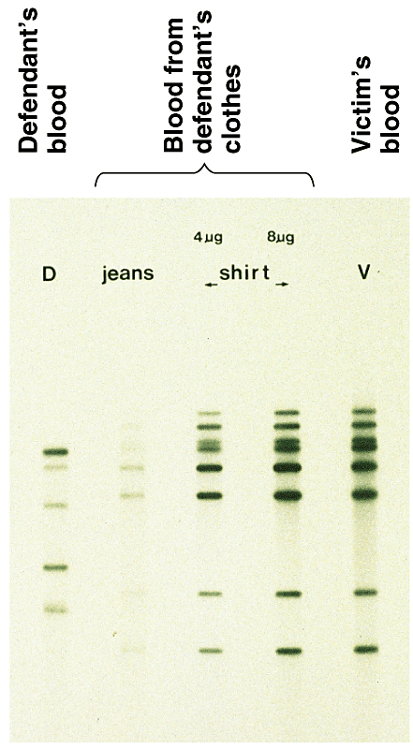
DNA fingerprints
Comparing blood samples on defendant’s clothing to determine if it belongs to victim
  DNA fingerprinting
  comparing DNA banding pattern between different individuals
  unique patterns

Slide 32
Uses: Paternity
Who’s the father?
–
Mom
F1
F2
child
DNA
↓
+

