Slide 1
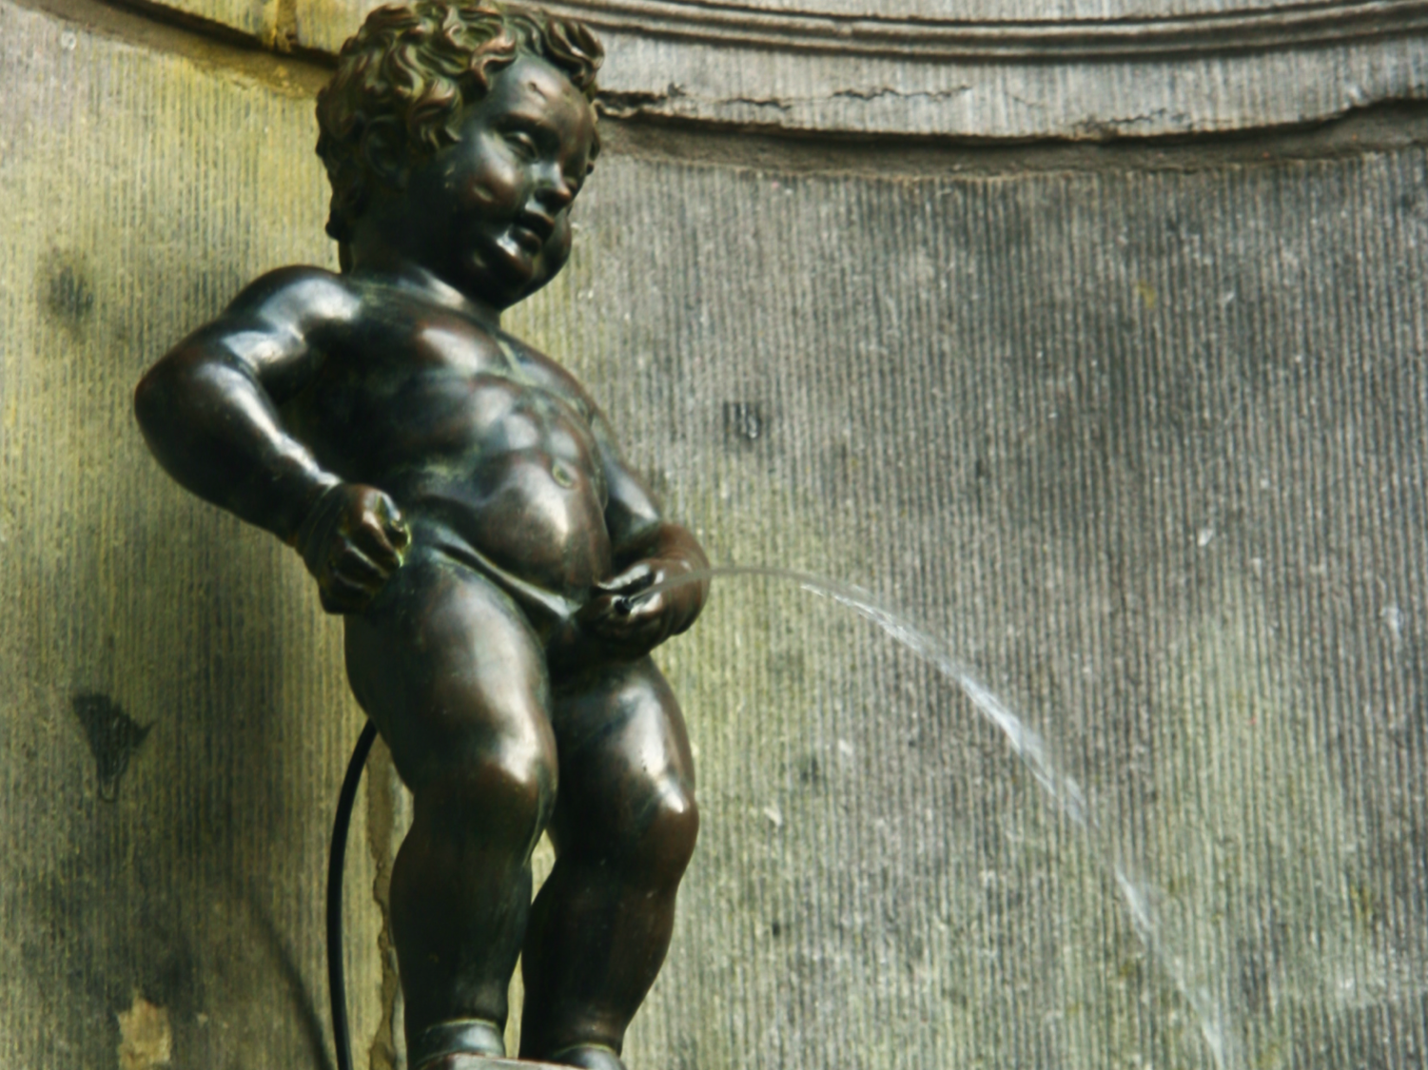
The Excretory System, Homeostasis and Osmoregulation

Slide 2
Homeostasis
Keeping the balance
  animal body needs to coordinate
  many systems all at once
    temperature
    blood sugar levels
    energy production
    water balance & intracellular waste disposal
    nutrients
    ion balance
    cell growth
  maintaining a “steady state” condition

Slide 3
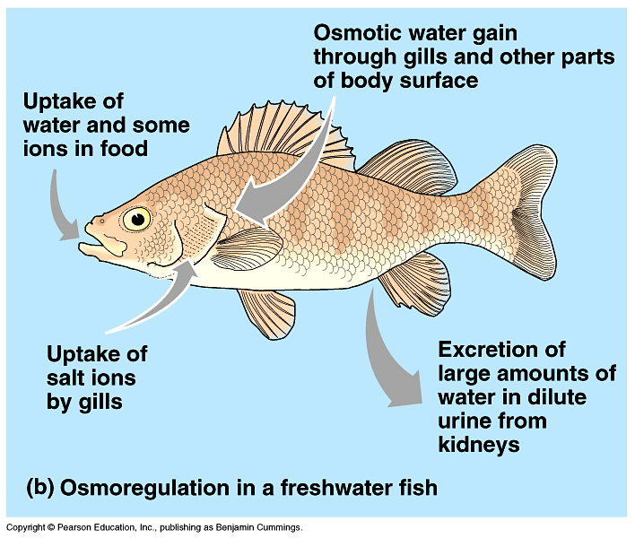
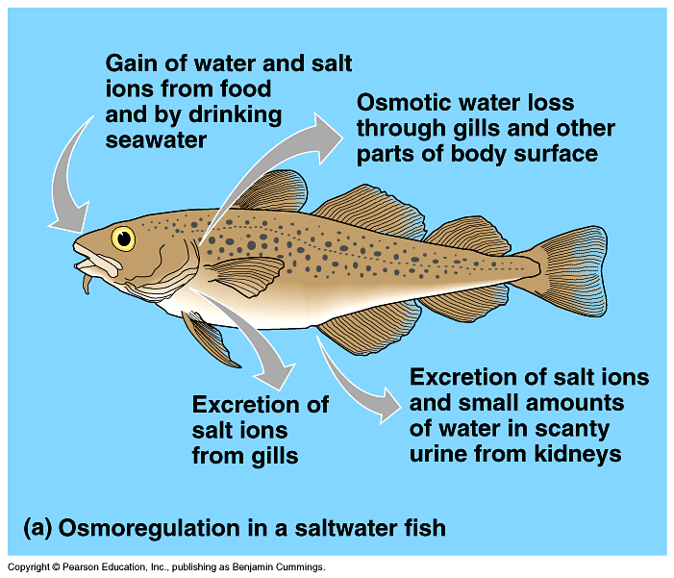
Osmoregulation
hypotonic
Water balance
  freshwater
    hypotonic
    water flow into cells & salt loss
  saltwater
    hypertonic
    water loss from cells
  land
    dry environment
    need to conserve water
    may also need to conserve salt
hypertonic
Why do all land animals have to conserve water?
always lose water (breathing & waste)
may lose life while searching for water
Notes:
The threat of desiccation (drying out) is perhaps the largest regulatory problem confronting terrestrial plants and animals.
Humans die if they lose about 12% of their body water.
Adaptations that reduce water loss are key to survival on land. Most terrestrial animals have body coverings that help prevent dehydration. These include waxy layers in insect exoskeletons, the shells of land snails, and the multiple layers of dead, keratinized skin cells.
Being nocturnal also reduces evaporative water loss.
Despite these adaptations, most terrestrial animals lose considerable water from moist surfaces in their gas exchange organs, in urine and feces, and across the skin.
Land animals balance their water budgets by drinking and eating moist foods and by using metabolic water from aerobic respiration.
And don’t forget plants, they have to deal with this too!

Slide 4
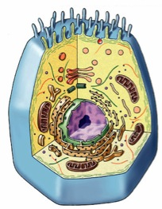
Intracellular Waste
What waste products?
  what do we digest our food into…
    carbohydrates = CHO
    lipids = CHO
    proteins = CHON
    nucleic acids = CHOPN
→ CO₂ + H₂O
lots!
→ CO₂ + H₂O
very
little
→ CO₂ + H₂O + N
→ CO₂ + H₂O + P + N
cellular digestion…
cellular waste
H
O
H
|
|
|
CO₂ ₊ H₂O
N
–C–
C–OH
NH₂ =
ammonia
H
|
R
Notes:
Can you store sugars? YES
Can you store lipids? YES
Can you store proteins? NO
Animals do not have a protein storage system

Slide 5
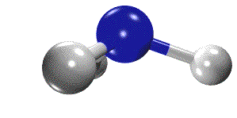

Nitrogenous waste disposal
Ammonia (NH₃)
  very toxic
    carcinogenic
  very soluble
    easily crosses membranes
  must dilute it & get rid of it… fast!
How you get rid of nitrogenous wastes depends on
  who you are (evolutionary relationship)
  where you live (habitat)
aquatic
terrestrial
terrestrial egg layer

Slide 6
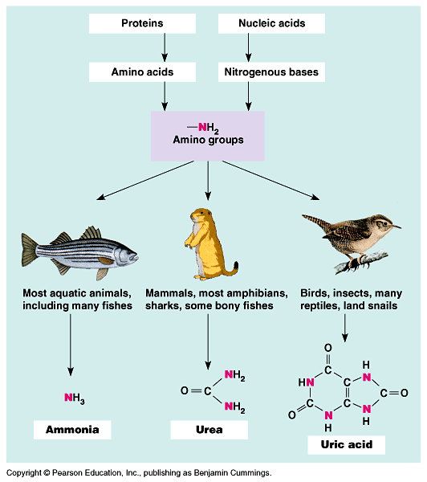
Nitrogen waste
Aquatic organisms
  can afford to lose water
  Ammonia: most toxic
Terrestrial
  need to conserve
  water
  Urea: less toxic
Terrestrial egg
layers
  need to conserve water
  need to protect
  embryo in egg
  uric acid: least toxic
Notes:
Mode of reproduction appears to have been important in choosing between these alternatives.
Soluble wastes can diffuse out of a shell-less amphibian egg (ammonia) or be carried away by the mother’s blood in a mammalian embryo (urea).
However, the shelled eggs of birds and reptiles are not permeable to liquids, which means that soluble nitrogenous wastes trapped within the egg could accumulate to dangerous levels (even urea is toxic at very high concentrations).
In these animals, uric acid precipitates out of solution and can be stored within the egg as a harmless solid left behind when the animal hatches.

Slide 7
Kidney Structure & Function
Excretion: the process of removing metabolic waste from the cells, tissue fluid, and blood of living organisms
  The main organ of excretion in mammals is the kidney
Osmoregulation: the control of water balance of the blood, tissue or cytoplasm of a living organism

Slide 8
Kidney Structure & Function
Functions:
  Produces urine
  Maintain water balance
  Maintain blood pH
  Maintain blood pressure
The functional unit of the kidney is the nephron
There are more than 1 million nephrons in a human kidney
On average 120mL/min of fluid passes through the kidney

Slide 9
Kidney Structure & Function
Roles of the nephron:
  Ultrafiltration
  Reabsorption
  Secretion
For the kidney you should be able to label:
  Cortex
  Medulla
  Pelvis
  Ureter
  Renal blood vessels

Slide 10
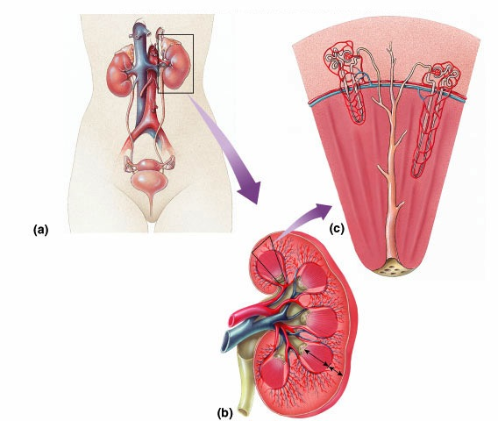
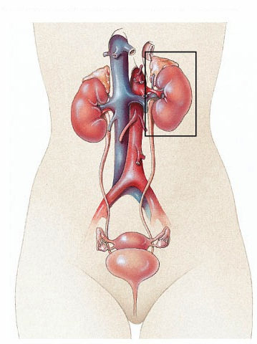
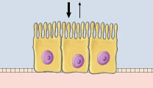
Mammalian Kidney
inferior
vena cava
aorta
adrenal gland
kidney
nephron
ureter
renal vein
& artery
epithelial
cells
bladder
urethra
Notes:
From Bowman’s capsule, the filtrate passes through three regions of the nephron: the proximal tubule; the loop of Henle, a hairpin turn with a descending limb and an ascending limb; and the distal tubule.
The distal tubule empties into a collecting duct, which receives processed filtrate from many nephrons.
The many collecting ducts empty into the renal pelvis, which is drained by the ureter.

Slide 11
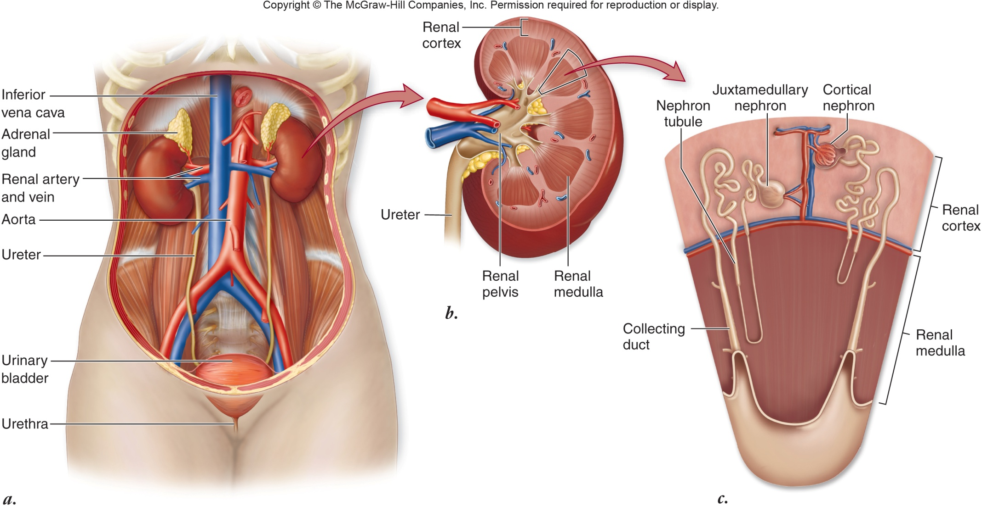

Slide 12
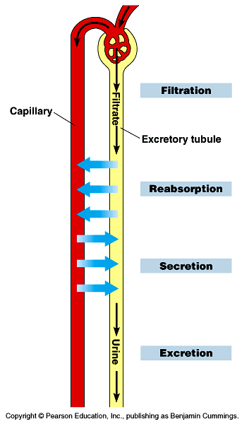
Mammalian System
Filter solutes out of blood & reabsorb H₂O + desirable solutes
Key functions
  Filtration: fluids (water & solutes) filtered out of blood
  Reabsorption: selectively reabsorb (diffusion) needed water + solutes back to blood
  Secretion: pump out any other unwanted solutes to urine
  Excretion: expel concentrated urine (N waste + solutes + toxins) from body
blood
filtrate
concentrated
urine
Notes:
What’s in blood?
Cells
Plasma
H₂O = want to keep
proteins = want to keep
glucose = want to keep
salts / ions = want to keep
urea = want to excrete

Slide 13
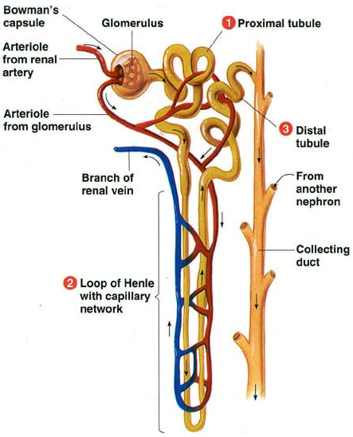
Afferent
Efferent

Slide 14
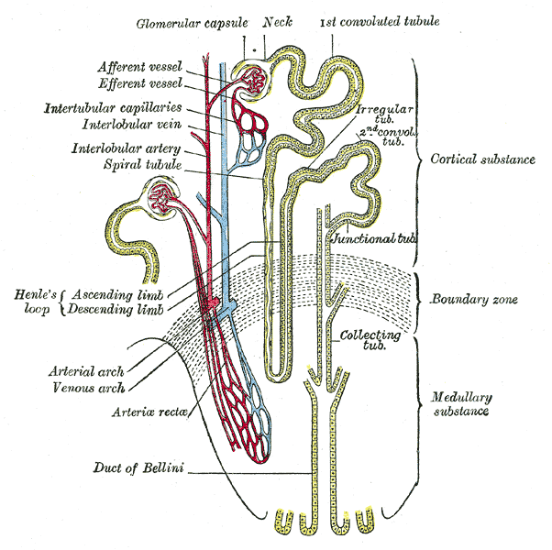
Nephron
Functional units of kidney
  1 million nephrons
  per kidney
Function
  filter out urea & other
  solutes (salt, sugar…)
  blood plasma filtered
  into nephron
    high pressure flow
  selective reabsorption of
  valuable solutes & H₂O
  back into bloodstream
    greater flexibility & control
Notes:
Each nephron consists of a single long tubule and a ball of capillaries, called the glomerulus.
The blind end of the tubule forms a cup-shaped swelling, called Bowman’s capsule, that surrounds the glomerulus.
Each human kidney packs about a million nephrons.

Slide 15
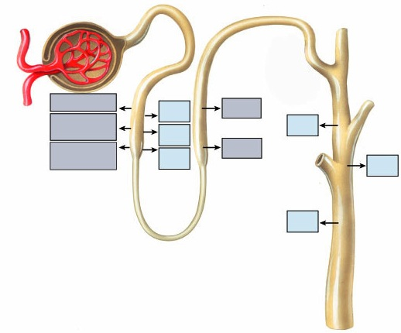
Mammalian kidney
Interaction of circulatory & excretory systems
Circulatory system
  glomerulus =
  ball of capillaries
Excretory system
  nephron
  Bowman’s capsule
  loop of Henle
    proximal tubule
    descending limb
    ascending limb
    distal tubule
  collecting duct
Bowman’s capsule
Proximal
tubule
Distal tubule
Glomerulus
Glucose
H₂O
Na⁺ Cl⁻
Amino
acids
H₂O
H₂O
Mg⁺⁺ Ca⁺⁺
H₂O
Na⁺ Cl⁻
H₂O
H₂O
Collecting
duct
Loop of Henle

Slide 16
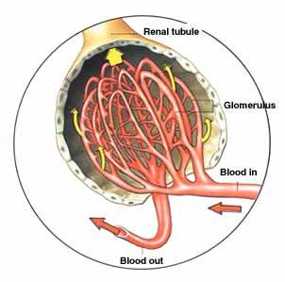
Nephron: Filtration
Glomerulus: a ball of capillaries that are fenestrated (have pores) and are surrounded by a basement membrane that filters what passes through into the filtrate
  filtered out of blood
    H₂O
    glucose
    salts / ions
    urea
  not filtered out
    cells
    proteins
high blood pressure in kidneys
force to push (filter) H₂O & solutes out of blood vessel
BIG problems when you start out with high blood pressure in system
hypertension = kidney damage
Notes:
Filtrate from Bowman’s capsule flows through the nephron and collecting ducts as it becomes urine.
Filtration occurs as blood pressure forces fluid from the blood in the glomerulus into the lumen of Bowman’s capsule.
The porous capillaries, along with specialized capsule cells called podocytes, are permeable to water and small solutes but not to blood cells or large molecules such as plasma proteins.
The filtrate in Bowman’s capsule contains salt, glucose, vitamins, nitrogenous wastes, and other small molecules.

Slide 17
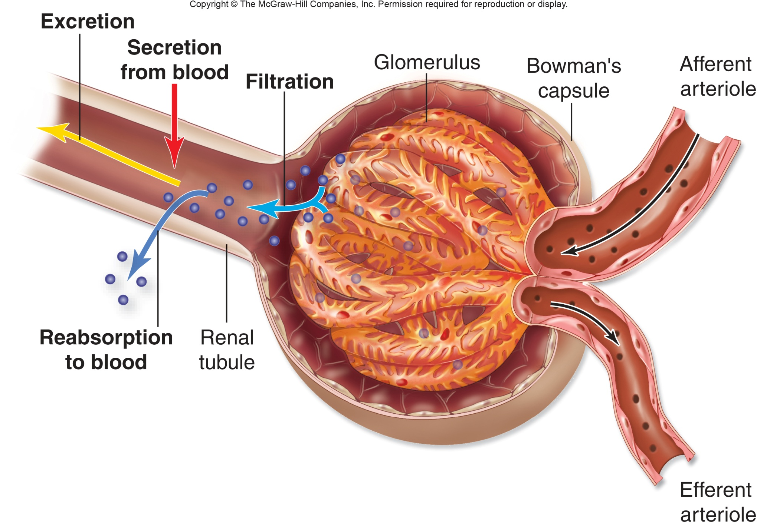
Afferent arteriole: brings blood into the glomerulus from the renal artery
Efferent arteriole: takes blood out of the glomerulus into the surrounding capillary network and then into the renal vein

Slide 18
Nephron: Re-absorption
Proximal tubule
  reabsorbed back into blood
    NaCl
      active transport
      of Na⁺
      Cl– follows
      by diffusion
    H₂O
    glucose
    HCO₃⁻
      bicarbonate
      buffer for
      blood pH
Notes:
One of the most important functions of the proximal tubule is reabsorption of most of the NaCl and water from the initial filtrate volume.
The epithelial cells actively transport Na⁺ into the interstitial fluid.
This transfer of positive charge is balanced by the passive transport of Cl⁻ out of the tubule. As salt moves from the filtrate to the interstitial fluid, water follows by osmosis.
For example, the cells of the transport epithelium help maintain a constant pH in body fluids by controlled secretions of hydrogen ions or ammonia.
The proximal tubules reabsorb about 90% of the important buffer bicarbonate (HCO₃⁻).

Slide 19
Nephron: Re-absorption
Loop of Henle
  descending limb
    high permeability to H₂O
      many aquaporins in cell membranes
    low permeability to salt
      few Na⁺ or Cl– channels
  reabsorbed
    H₂O
Notes:
Proximal tubule.
Secretion and reabsorption in the proximal tubule substantially alter the volume and composition of filtrate.
For example, the cells of the transport epithelium help maintain a constant pH in body fluids by controlled secretions of hydrogen ions or ammonia.
The proximal tubules reabsorb about 90% of the important buffer bicarbonate (HCO₃⁻).
Descending limb of the loop of Henle. Reabsorption of water continues as the filtrate moves into the descending limb of the loop of Henle.
This transport epithelium is freely permeable to water but not very permeable to salt and other small solutes.

Slide 20
Nephron: Re-absorption
Loop of Henle
  ascending limb
    low permeability
    to H₂O
    Na⁺ pump
    Cl⁻ follows by diffusion
      different membrane proteins
    Thin – NaCl passively absorbed;
    Thick – NaCl actively
  reabsorbed
    salts
      maintains osmotic gradient
Notes:
Ascending limb of the loop of Henle.
In contrast to the descending limb, the transport epithelium of the ascending limb is permeable to salt, not water.
As filtrate ascends the thin segment of the ascending limb, NaCl diffuses out of the permeable tubule into the interstitial fluid, increasing the osmolarity of the medulla.
The active transport of salt from the filtrate into the interstitial fluid continues in the thick segment of the ascending limb.
By losing salt without giving up water, the filtrate becomes progressively more dilute as it moves up to the cortex in the ascending limb of the loop.

Slide 21
Nephron: Re-absorption
Distal tubule
  reabsorbed
    salts
    H₂O
    HCO₃⁻
      Bicarbonate (pH balance)
  Secreted
    K⁺ secreted into tubule
    H ⁺ secreted to maintain pH balance
    Medications
Notes:
Distal tubule. The distal tubule plays a key role in regulating the K⁺ and NaCl concentrations in body fluids by varying the amount of K⁺ that is secreted into the filtrate and the amount of NaCl reabsorbed from the filtrate.
Like the proximal tubule, the distal tubule also contributes to pH regulation by controlled secretion of H⁺ and the reabsorption of bicarbonate (HCO₃⁻).

Slide 22
Nephron: Reabsorption & Excretion
Collecting duct
  reabsorbed
    H₂O
  excretion
    concentrated urine passed
    to bladder
      impermeable lining
Notes:
Collecting duct. By actively reabsorbing NaCl, the transport epithelium of the collecting duct plays a large role in determining how much salt is actually excreted in the urine.
The epithelium is permeable to water but not to salt or (in the renal cortex) to urea.
As the collecting duct traverses the gradient of osmolarity in the kidney, the filtrate becomes increasingly concentrated as it loses more and more water by osmosis to the hyperosmotic interstitial fluid.
In the inner medulla, the duct becomes permeable to urea, contributing to hyperosmotic interstitial fluid and enabling the kidney to conserve water by excreting a hyperosmotic urine.

Slide 23
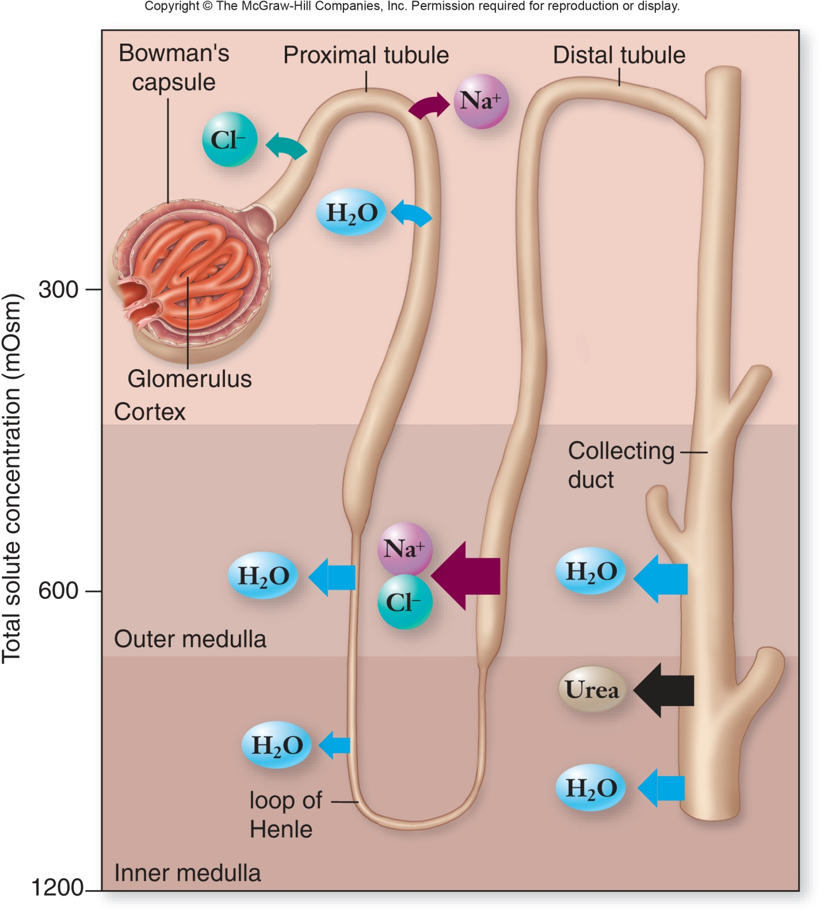

Slide 24
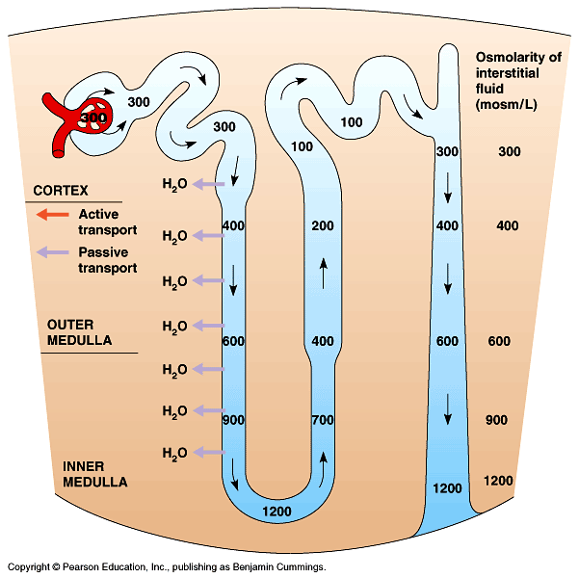
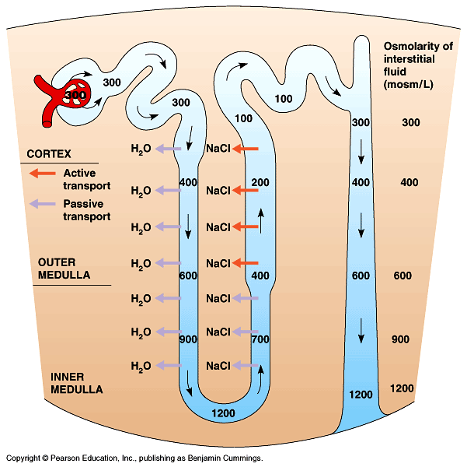
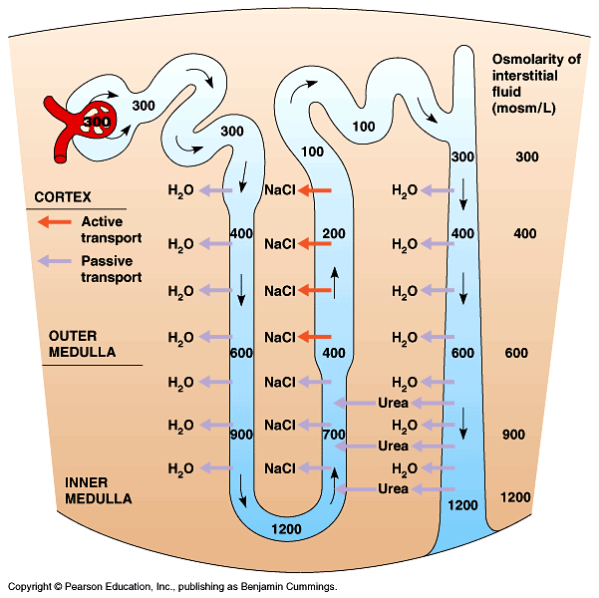
Osmotic control in nephron
How is all this re-absorption achieved?
  tight osmotic
  control to reduce
  the energy cost
  of excretion
  use diffusion
  instead of
  active transport
  wherever possible
Notes:
Descending limb of the loop of Henle.
Reabsorption of water continues as the filtrate moves into the descending limb of the loop of Henle.
This transport epithelium is freely permeable to water but not very permeable to salt and other small solutes. For water to move out of the tubule by osmosis, the interstitial fluid bathing the tubule must be hyperosmotic to the filtrate.
Because the osmolarity of the interstitial fluid does become progressively greater from the outer cortex to the inner medulla, the filtrate moving within the descending loop of Henle continues to loose water.
Ascending limb of the loop of Henle.
In contrast to the descending limb, the transport epithelium of the ascending limb is permeable to salt, not water.
As filtrate ascends the thin segment of the ascending limb, NaCl diffuses out of the permeable tubule into the interstitial fluid, increasing the osmolarity of the medulla.
The active transport of salt from the filtrate into the interstitial fluid continues in the thick segment of the ascending limb. By losing salt without giving up water, the filtrate becomes progressively more dilute as it moves up to the cortex in the ascending limb of the loop.

Slide 25
Summary
Not filtered out
  Cells, proteins
  remain in blood (too big)
Reabsorbed: active transport
  Na⁺ Cl⁻, amino acids, glucose
Reabsorbed: diffusion
  Na⁺, Cl–, H₂O
Excreted
  Urea, excess H₂O , excess solutes (glucose, salts), toxins, drugs, “unknowns”

Slide 26
Negative Feedback Loop
hormone or nerve signal
lowers
body condition
(return to set point)
gland or nervous system
high
sensor
specific body condition
sensor
low
raises
body condition
(return to set point)
gland or nervous system
hormone or nerve signal

Slide 27
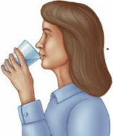
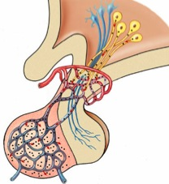
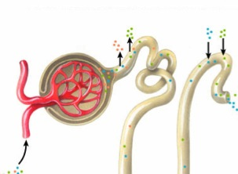
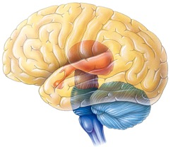
Blood Osmolarity
Endocrine System Control
ADH
pituitary
increased
water
reabsorption
increase
thirst
high
nephron
blood osmolarity
blood pressure
low
ADH =
AntiDiuretic Hormone

Slide 28
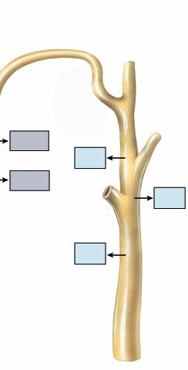
Maintaining Water Balance
High blood osmolarity level
  too many solutes in blood
    dehydration, high salt diet
  stimulates thirst = drink more
  release ADH from pituitary gland
    antidiuretic hormone
  increases permeability of collecting duct
  & reabsorption of water in kidneys
    increase water absorption back into blood
    decrease urination
H₂O
H₂O
Alcohol
suppresses ADH…
makes you
urinate a lot!
H₂O

Slide 29
Formation of urine
If blood is low in water content, ADH is secreted and more water is reabsorbed from the collecting duct into the blood
  Concentrated urine is formed and water is conserved
If blood is high in water content, ADH is not secreted and no more water is reabsorbed
  Dilute urine is formed

Slide 30
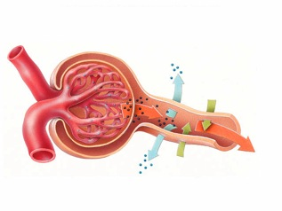
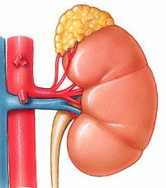
Blood Osmolarity
Endocrine System Control
ADH
pituitary
increased
water
reabsorption
increase
thirst
high
nephron
blood osmolarity
blood pressure
JuxtaGlomerular
Apparatus
low
increased
water & salt
reabsorption
adrenal
gland
nephron
renin
aldosterone
angiotensinogen
angiotensin

Slide 31
Comparing Solute Concentrations
Molecule | Amount in blood plasma (mg/100mL) | Amount in glomerular filtrate (mg/100mL) | Amount in urine (mg/100mL)
proteins | > 700 | 0 | 0
glucose | > 90 | > 90 | 0
urea | 30 | 30 | > 1800
Damon, A., McGonegal, R., Tosto, P., & Ward, W. (2007). Higher Level Biology. England: Pearson Education, Inc.

Slide 32
Diabetes & Glucose in Urine
People with uncontrolled diabetes can have a large amount of glucose in their blood
Glucose enters the glomerular filtrate and is reabsorbed by active transport
  There is a maximum rate at which reabsorption can occur
If there is too much glucose in the blood, reabsorption of all glucose from the glomerular filtrate cannot be achieved

Slide 33
Quick Check: Make Sure You Can
Define excretion & osmoregulation
Draw and label a diagram of the kidney
Explain the role of animal excretory systems in osmoregulation.
Diagram all important parts of a nephron and explain their functions.
Explain the processes of ultrafilatration, reabsorption, and secretion
Explain the role of ADH in the maintenance of the water balance of the blood.

