Slide 1
6.3 Assessment Statements |  | Obj.
6.3.1 | Define pathogen. | 1
6.3.2 | Explain why antibiotics are effective against bacteria but not viruses. | 3
6.3.3 | Outline the role of skin and mucous membranes in defense against pathogens. | 2
6.3.4 | Outline how phagocytic leucocytes ingest pathogens in the blood and body tissues. | 2
6.3.5 | Distinguish between antibodies and antigens. | 2
6.3.6 | Explain antibody production. | 3
6.3.7 | Outline the effects of HIV on the immune system. | 2
6.3.8 | Discuss the cause, transmission and social implications of AIDS. | 3
Command terms: http://i-biology.net/ibdpbio/command-terms/
Assessment statements from: Online IB Biology Subject Guide

Slide 2
Why an immune system?
Attack from outside
  lots of organisms want you for lunch!
  animals are a tasty nutrient- & vitamin-packed meal
    cells are packages of macromolecules
    no cell wall
      traded mobility for susceptibility
  animals must defend themselves against invaders
    viruses
      HIV, flu, cold, measles, chicken pox, SARS
    bacteria
      pneumonia, meningitis, tuberculosis
    fungi
      yeast
    protists
      amoeba, Lyme disease, malaria
Attack from inside
  defend against abnormal body cells = cancers
Mmmmm,
What’s in your
lunchbox?

Slide 3
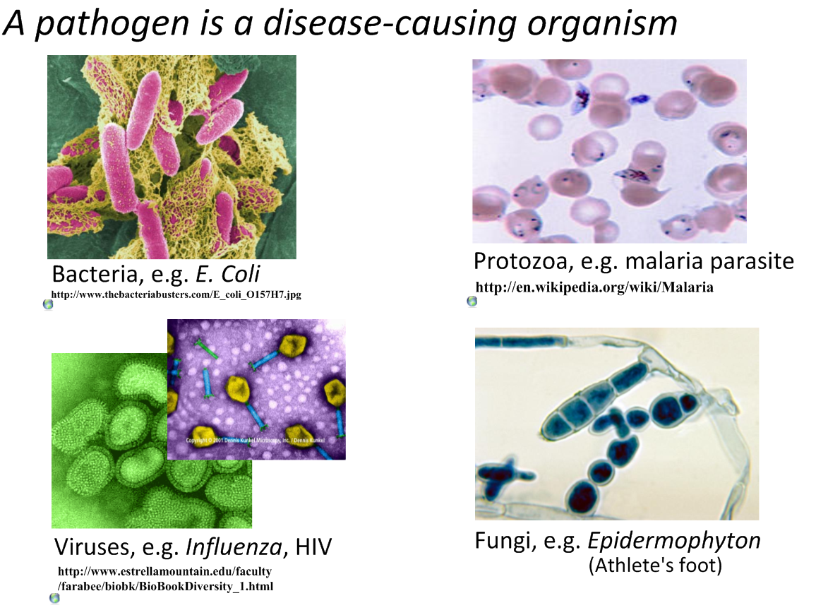

Slide 4
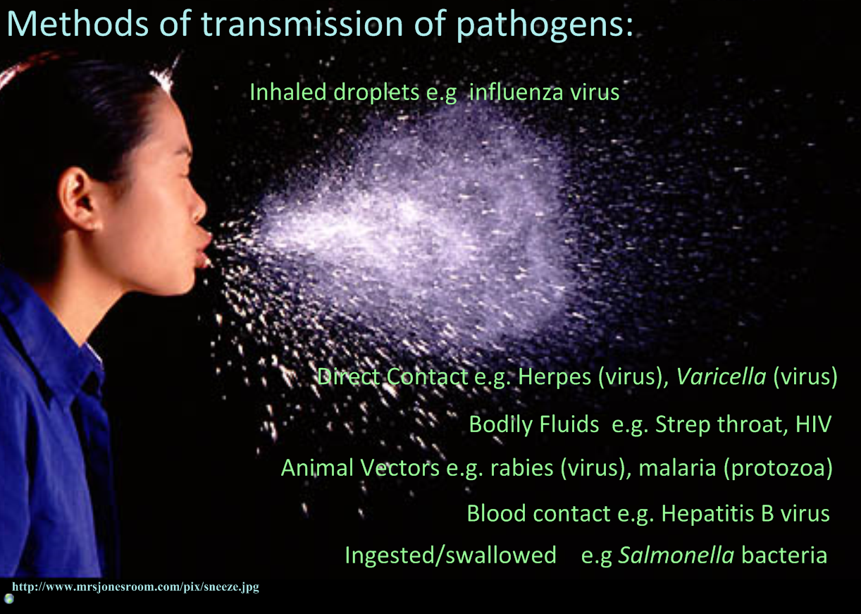

Slide 5
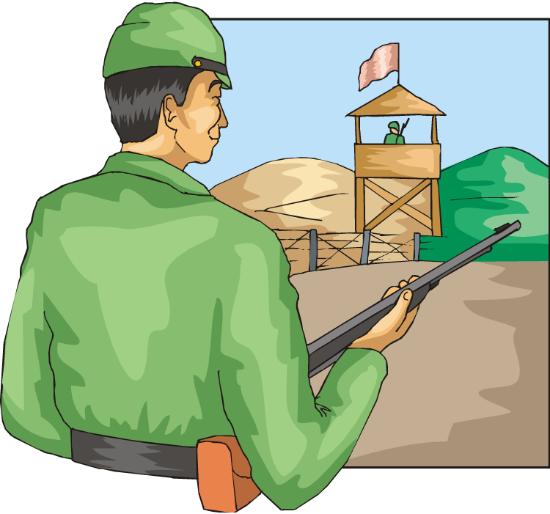
Lines of defense
1st line: Barriers
  broad, external defense
    “walls & moats”
  skin & mucus membranes
2nd line: Non-specific patrol
  broad, internal defense
    “patrolling soldiers”
  leukocytes = phagocytic WBC
    macrophages
3rd line: Immune system
  specific, acquired immunity
    “elite trained units”
  lymphocytes & antibodies
    B cells & T cells
Bacteria & insects
inherit resistance.
Vertebrates
acquire immunity!

Slide 6
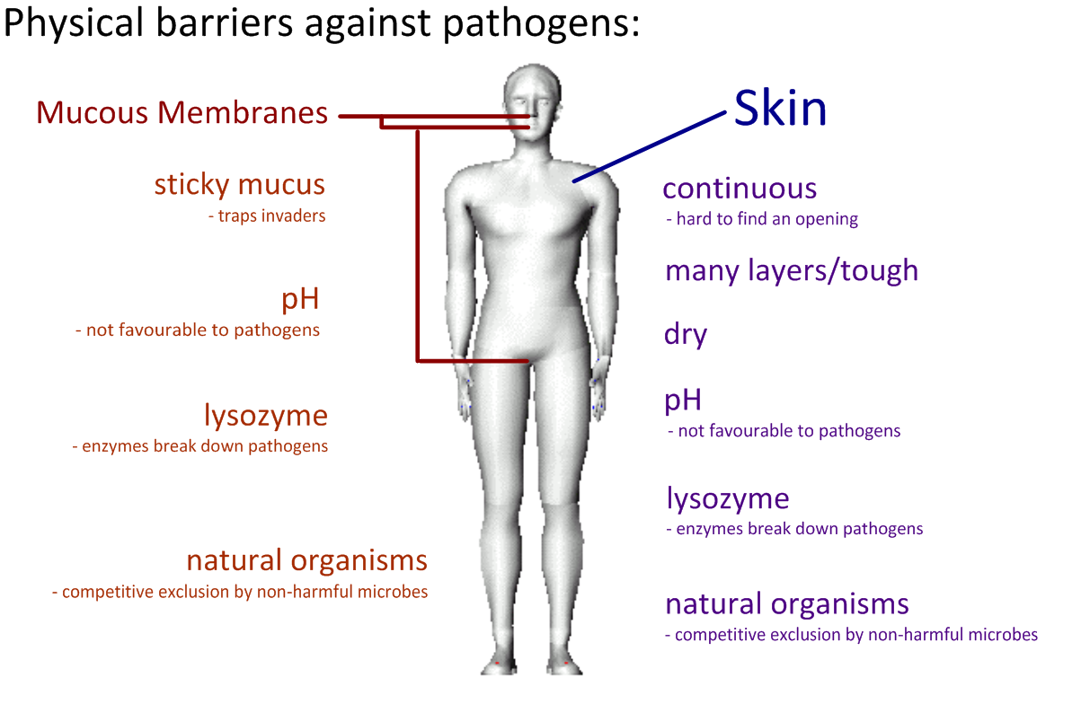

Slide 7
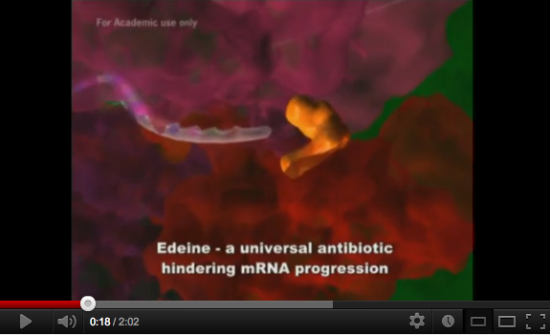
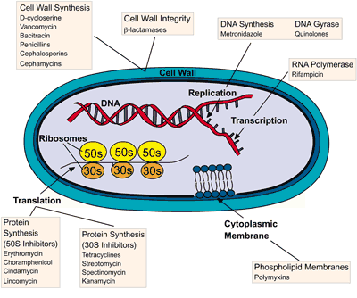
Antibiotics are ineffective against viruses!
Over-use of antibiotics is accelerating the evolution of more harmful bacteria. We are running out of antibiotics that work and are selecting for diseases such as MRSA.
http://www.youtube.com/watch?v=RedO6rLNQ2o
Antibiotics are designed to disrupt structures or metabolic pathways in bacteria and fungi:
cell walls and membranes
DNA synthesis (replication)
RNA polymerase
Translation
These do not exist or are very different in viruses, so the antibiotic will have no effect.
Bacterial drug resisance, from Wiley Essential Biochemistry. Find out more here:
http://www.wiley.com/college/pratt/0471393878/student/activities/bacterial_drug_resistance/index.html

Slide 8
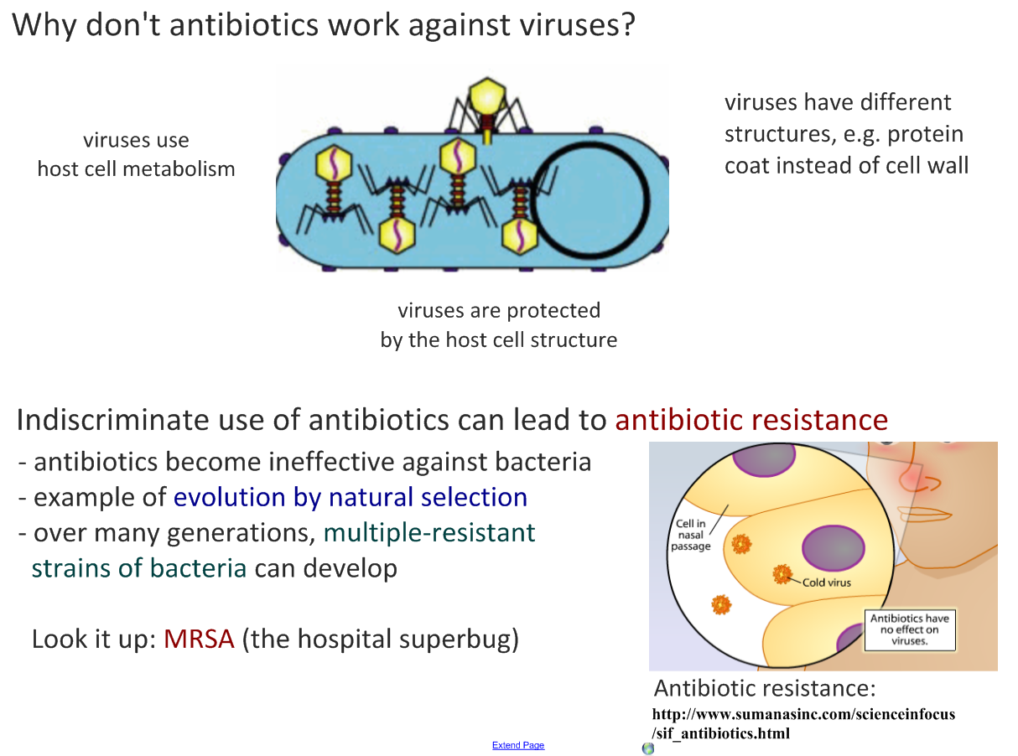
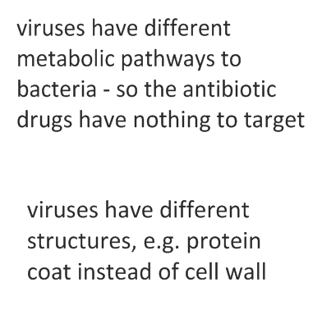
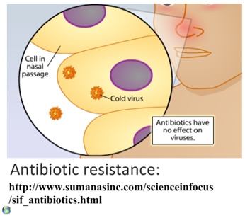

Slide 9
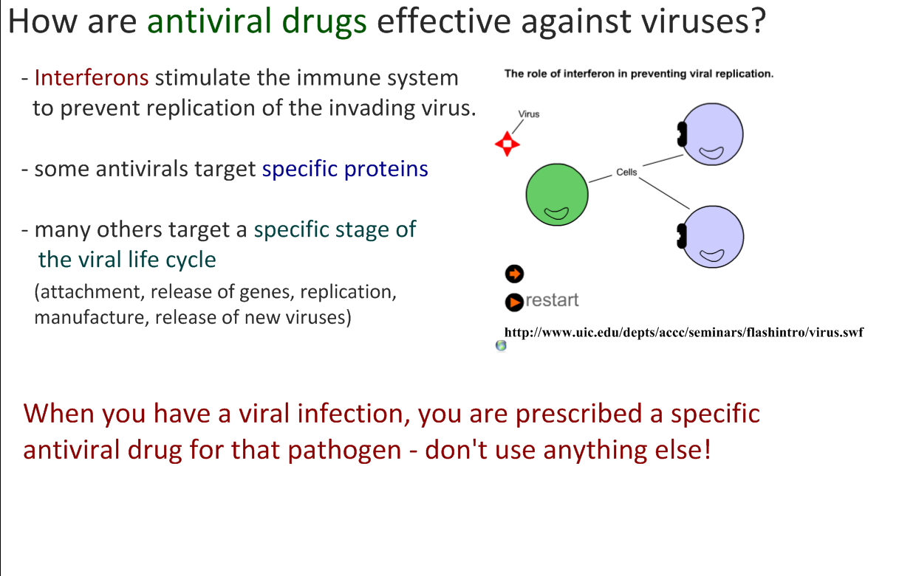
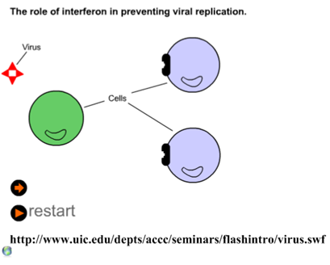

Slide 10
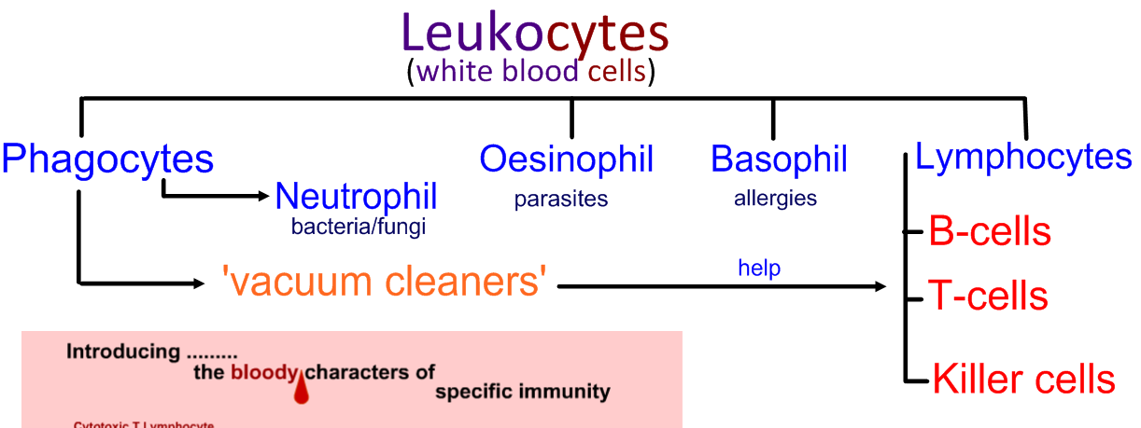
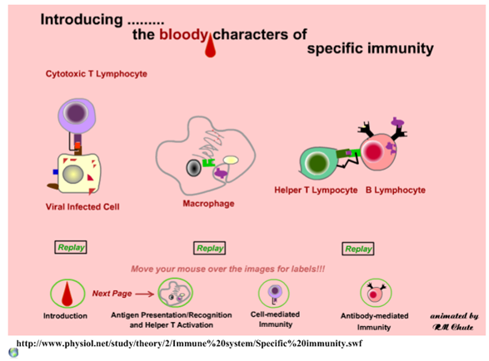
http://apchute.com/lymphatic/inflam.html

Slide 11
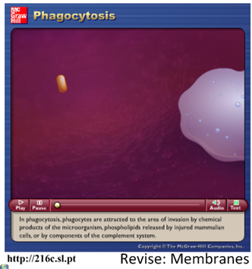
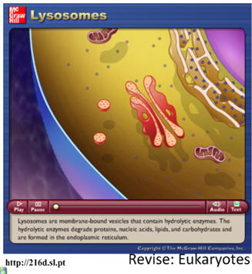
Phagocytic Leucocytes
“eating cell”
“white blood cells”
Chemotaxis (movement in response to chemicals) attracts the phagocytes to the area of invasion as response to:
proteins produced by the pathogen
phospholipids released by damaged cells
The phagocyte attaches to the pathogen’s cell surface proteins and then engulfs it. The fluid nature of the plasma membrane allows this to happen.
A phagosome forms. This is a vesicle that contains the pathogen. Lysosomes – vesicles of digestive enzymes – deposit the enzymes into the phagosome.
The digestive enzymes break down the pathogen and the waste products are expelled from the cell by exocytosis.
Review opportunity:
  Plasma membranes and vesicles
  Membrane fluidity and fusion
  Endo- and exo-cytosis

Slide 12
How are invaders recognized: antigens
Antigens
  proteins that serve as cellular name tags
    foreign antigens cause response from WBCs
      viruses, bacteria, protozoa, parasitic worms, fungi, toxins
      non-pathogens: pollen & transplanted tissue
B cells & T cells respond to different antigens
  B cells recognize intact antigens
    pathogens in blood & lymph
  T cells recognize antigen fragments
    pathogens which have already infected cells
“self”
“foreign”

Slide 13
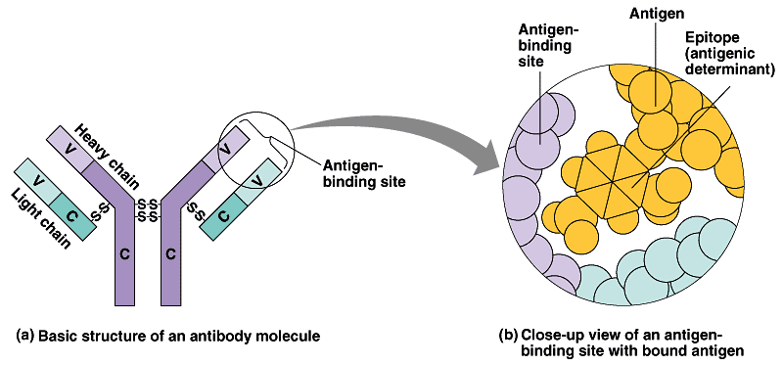
Antibodies
Y
Y
Y
Y
Y
Y
Y
Y
Y
Y
Y
Y
Y
Y
Y
Y
Y
Y
Y
Y
Y
Y
Proteins that bind to a specific antigen
  multi-chain proteins produced by B cells
  antibodies match molecular shape of antigens
  immune system has antibodies to respond to millions of foreign antigens
  tagging system
    “this is foreign!”
Y
Y
Y
Y
Y
Y
Y
Y
Y
Y
Y
Y
Y
Y
Y
Y
Y
Y
Y
antigen-
binding site on antibody
antigen
Y
variable
binding region
Y
Y
Y
Y
Y
each B cell
has ~100,000
antigen receptors

Slide 14
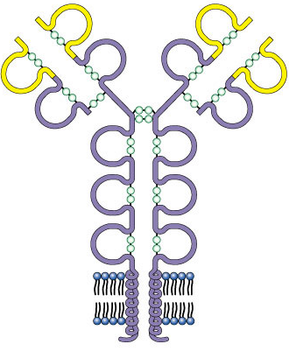
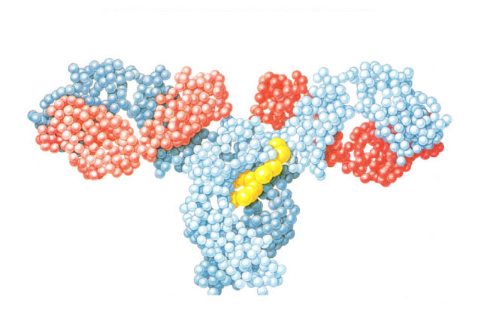
Structure of antibodies
Y
Y
Y
Y
Y
Y
Y
Y
Y
antigen-binding site
Y
Y
Y
s
s
variable region
Y
Y
Y
s
s
Y
Y
s
s
s
s
Y
Y
Y
Y
s
s
s
s
Y
s
s
Y
Y
s
s
s
s
s
s
Y
light
chain
s
s
s
s
light
chain
s
s
s
s
heavy
chains
s
s
light chains
s
s
s
s
s
s
B cell
membrane
antigen-binding
site
antigen-binding
site
heavy chains

Slide 15
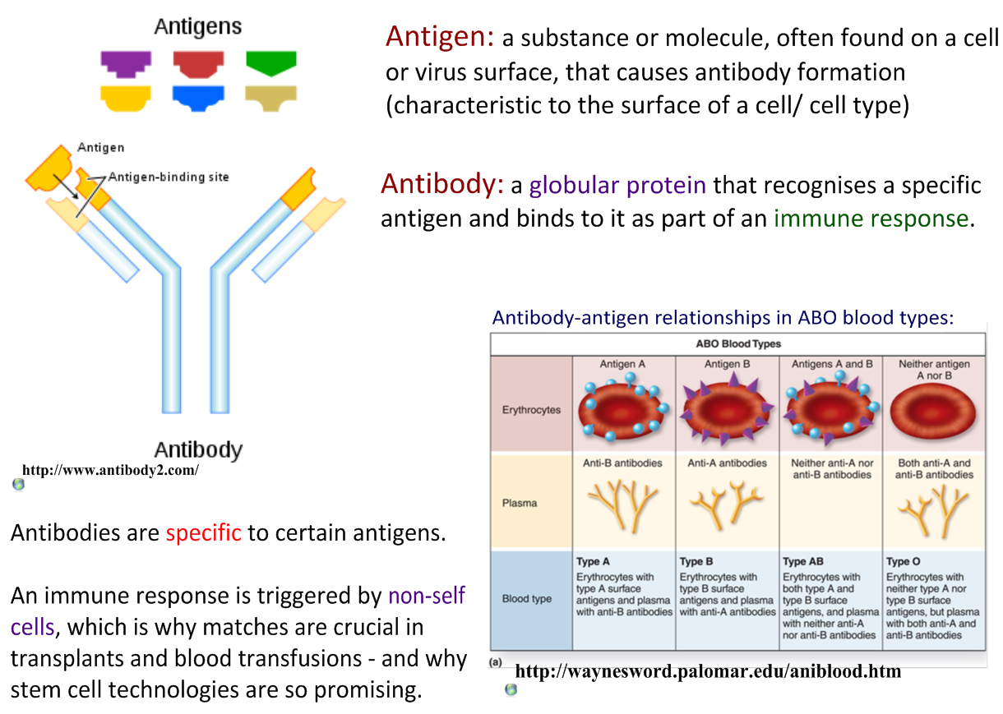
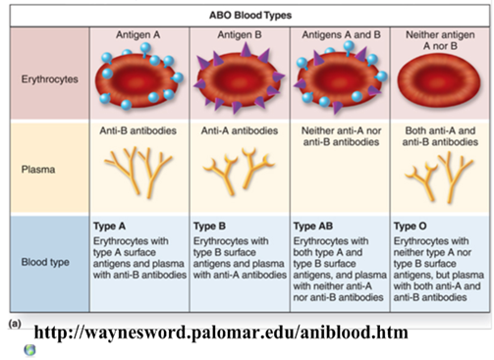

Slide 16
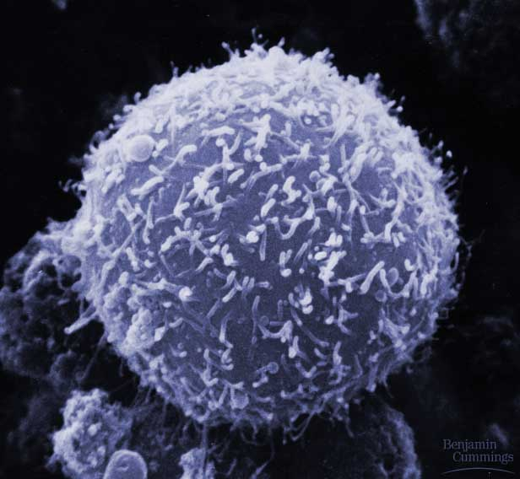
B cells
Humoral response = “in fluid”
  defense against attackers circulating freely
  in blood & lymph
Specific response
  produces antibodies against
  specific antigen
    tagging protein = immunogloblin
      millions of different B cells,
      each produces different antibodies,
      each recognizes a different antigen
  types of B cells
    plasma cells
      immediate production of antibodies
      rapid response, short term release
    memory cells
      long term immunity

Slide 17
B cell immune response
10 to 17 days for full response
Y
Y
Y
Y
Y
Y
Y
Y
Y
Y
tested by
B cells
(in blood & lymph)
Y
Y
Y
Y
Y
Y
Y
Y
Y
Y
Y
Y
Y
Y
Y
Y
Y
Y
Y
Y
Y
invader
(foreign antigen)
Y
Y
Y
Y
Y
Y
Y
Y
Y
Y
B cells + antibodies
Y
Y
Y
memory cells
“reserves”
Y
Y
Y
Y
Y
Y
Y
Y
Y
Y
Y
Y
Y
Y
Y
Y
Y
Y
Y
Y
Y
recognition
captured
invaders
Y
Y
Y
Y
Y
Y
Y
Y
Y
Y
Y
Y
Y
Y
Y
Y
Y
Y
Y
Y
Y
Y
Y
Y
Y
Y
Y
Y
Y
Y
Y
Y
Y
Y
Y
Y
Y
Y
Y
Y
Y
Y
Y
Y
Y
Y
Y
Y
Y
Y
Y
Y
Y
Y
Y
Y
Y
Y
Y
Y
Y
Y
Y
Y
Y
Y
Y
Y
Y
Y
Y
Y
Y
Y
Y
Y
Y
Y
Y
Y
Y
Y
Y
Y
Y
clone
1000s of clone cells
Y
Y
plasma cells
release antibodies
Y
Y
Y
Y
Y
Y
Y
Y
Y
Y
Y
Y

Slide 18
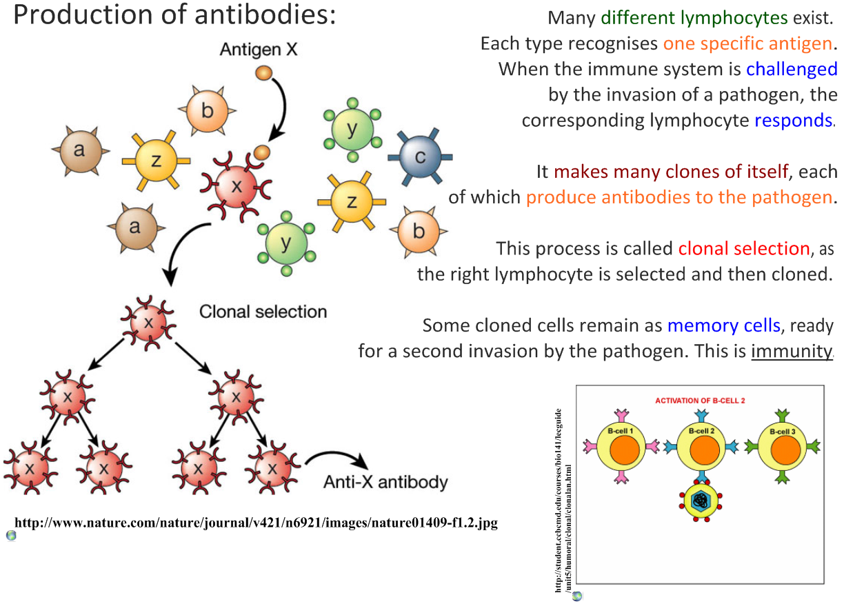
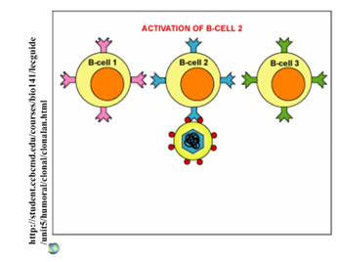

Slide 19
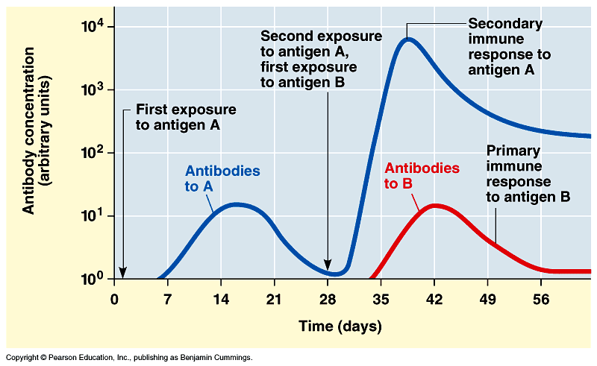
1° vs 2° response to disease
Memory B cells allow a rapid, amplified response with future exposure to pathogen

Slide 20
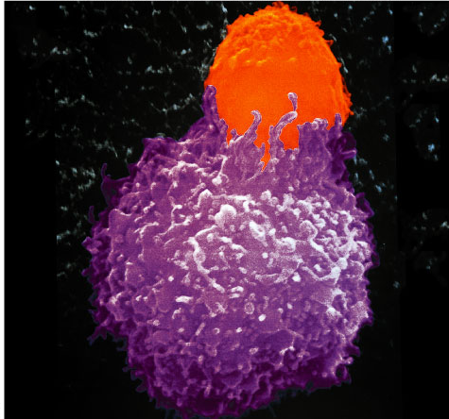
T cells
Cell-mediated response
  immune response to infected cells
    pathogens inside cells
    viruses, bacteria & parasites within cells
  defense against “non-self” cells
    cancer & transplant cells
Types of T cells
  helper T cells
    alerts immune system
  killer (cytotoxic) T cells
    attack infected body cells

Slide 21
How do T cells know a cell is infected
Infected cells digest pathogens & MHC proteins bind & carry pieces to cell surface
  “antigen presenting cells” (APC)
  alerts helper T cells
infected
cell
MHC proteins displaying
foreign antigens
T cell
T cell
antigen receptors

Slide 22
T cell response
infected cell
killer
T cell
helper
T cell
interleukin 2
activate
killer T cells
helper
T cell
interleukin 1
helper
T cell
or
stimulate
B cells &
antibodies
activated
macrophage
helper
T cell
interleukin 2
Y
Y
Y
Y
Y
Y
Y
Y
Y
helper
T cell
Y
Y
Y
Y
Y
Y
Y
Y
Y
Y
Y
Y
Y
Y
Y
Y
Y
Y
Y
Y
Y
Y
Y
Y
Y
Y
Y
Y
Y
Y
Y

Slide 23
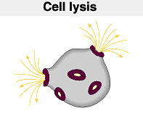
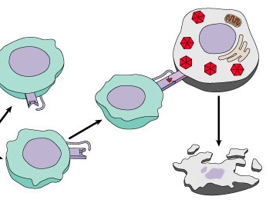
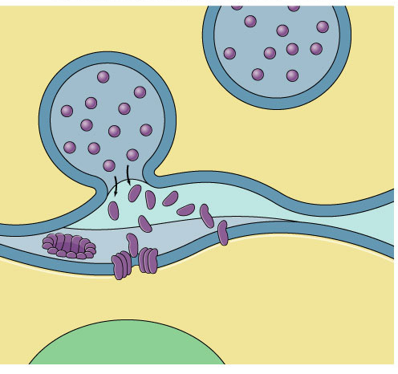
Attack of the Killer T cells
Destroys infected body cells
  binds to target cell
  secretes perforin protein
    punctures cell membrane of infected cell
vesicle
Killer T cell
Killer T cell
binds to
infected cell
cell
membrane
perforin
punctures
cell membrane
cell
membrane
infected cell
destroyed
target cell

Slide 24
Immune response
pathogen invasion
antigen
exposure
free antigens in blood
antigens on infected cells
humoral response
macrophages
cellular response
B cells
helper
T cells
T cells
plasma
B cells
memory
B cells
memory
T cells
cytotoxic
T cells
Y
Y
Y
Y
Y
Y
antibodies
Y
Y
Y
Y
Y

Slide 25
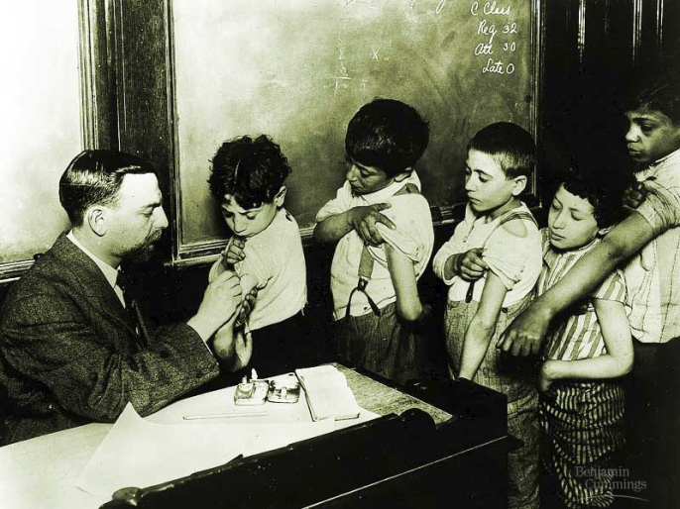
Vaccinations
Immune system exposed
to harmless version of pathogen
  triggers active immunity
  stimulates immune system to produce
  antibodies to invader
  rapid response if
  future exposure
Most successful
against viral diseases

Slide 26
Immune system malfunctions
Auto-immune diseases
  immune system attacks own molecules & cells
    lupus
      antibodies against many molecules released by normal breakdown of cells
    rheumatoid arthritis
      antibodies causing damage to cartilage & bone
    diabetes
      beta-islet cells of pancreas attacked & destroyed
    multiple sclerosis
      T cells attack myelin sheath of brain & spinal cord nerves
Allergies
  over-reaction to environmental antigens
    allergens = proteins on pollen, dust mites, in animal saliva
    stimulates release of histamine

Slide 27
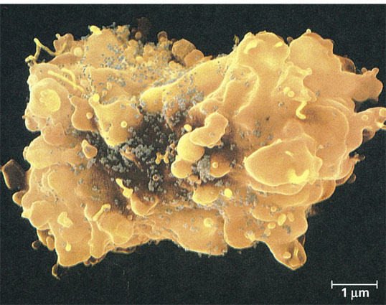
HIV & AIDS
Human Immunodeficiency Virus
  virus infects helper T cells
  helper T cells don’t activate rest of immune system: T cells & B cells
    also destroy T cells
Acquired ImmunoDeficiency Syndrome
  infections by opportunistic
  diseases
  death usually from other
  infections
    pneumonia, cancer

Slide 28
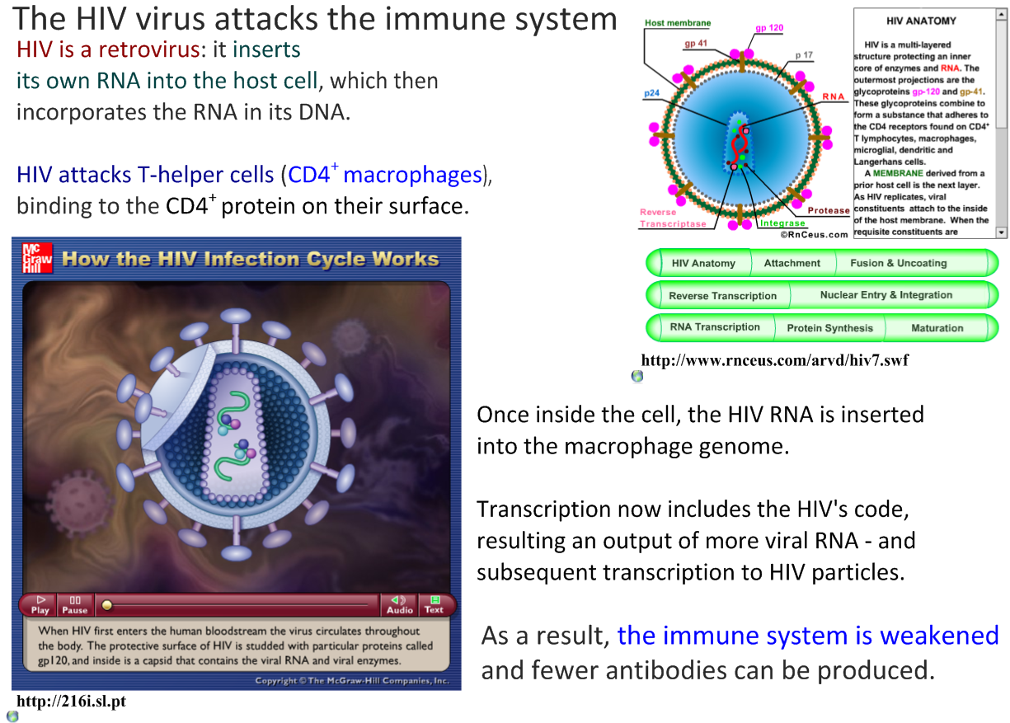
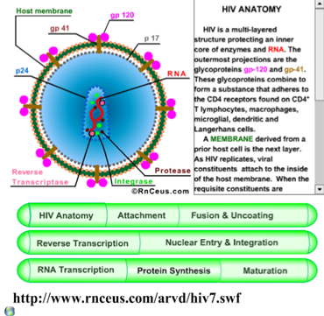
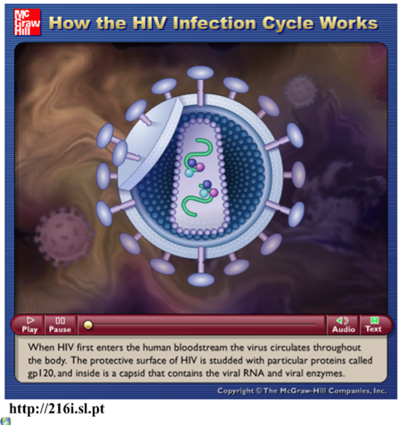

Slide 29
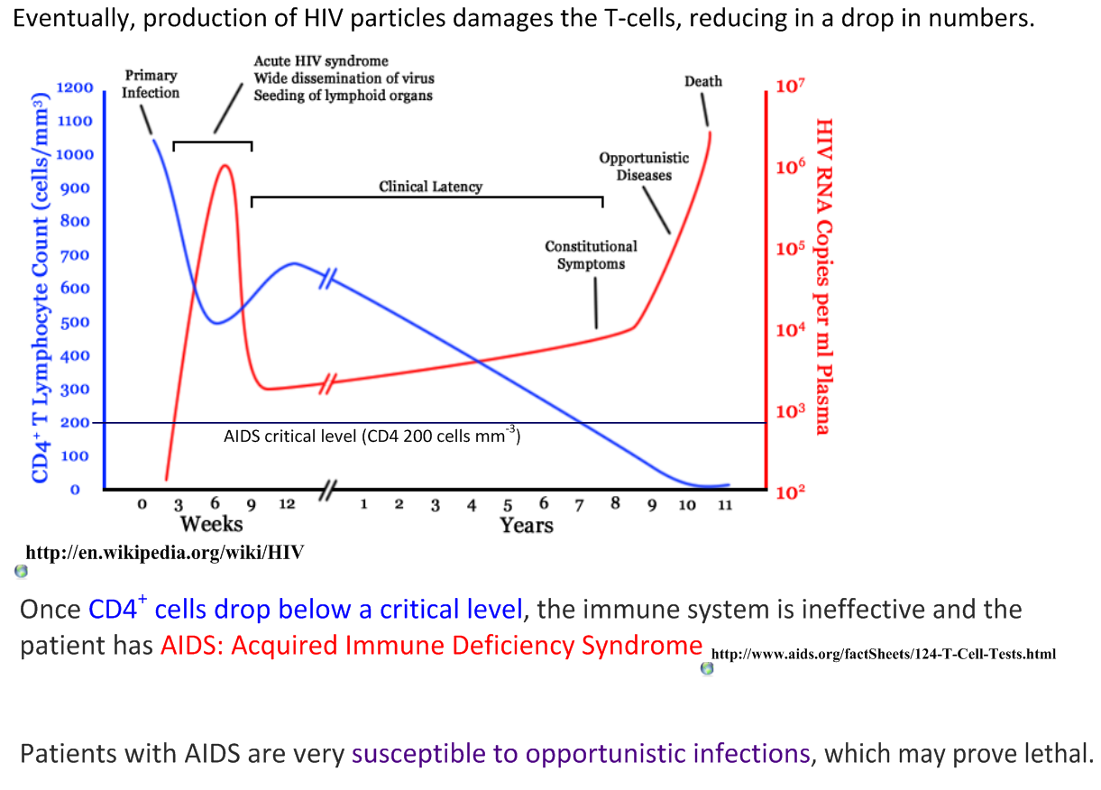

Slide 30
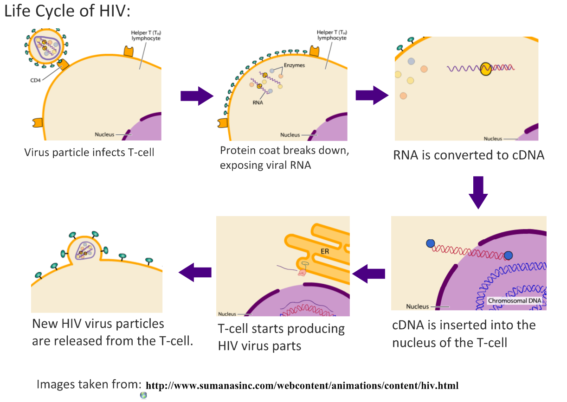

Slide 31
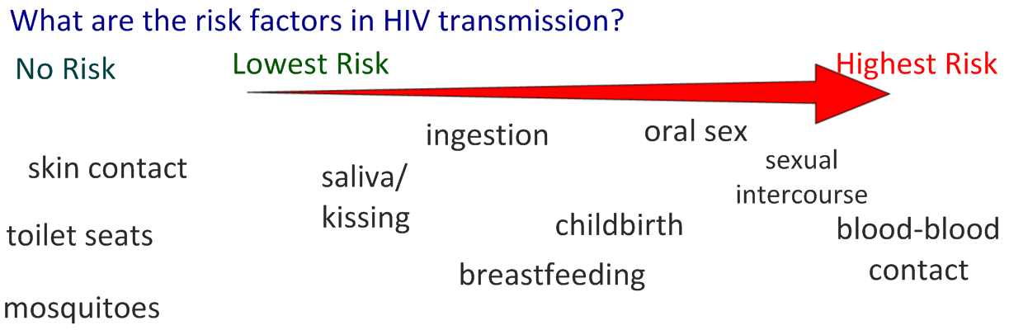
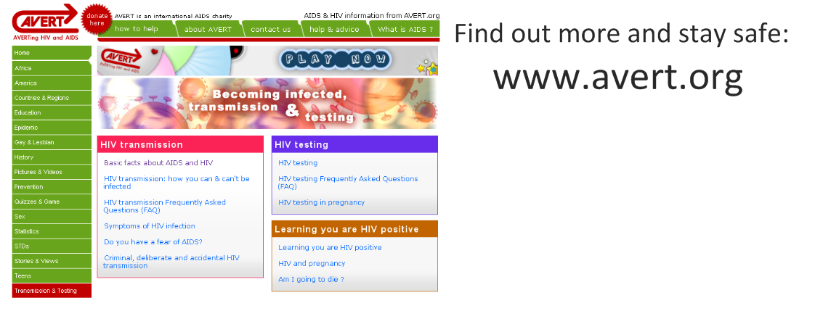

Slide 32
