Slide 1
11.1Assessment Statements |  | Obj.
11.1.1 | Describe the process of blood clotting | 2
11.1.2 | Outline the principle of challenge and response, clonal selection and memory cells as the basis of immunity | 2
11.1.3 | Define active and passive immunity | 1
11.1.4 | Explain antibody production | 3
11.1.5 | Describe the production of monoclonal antibodies and their use in diagnosis and treatment | 2
11.1.6 | Explain the principle of vaccination | 3
11.1.7 | Discuss the benefits and dangers of vaccination | 3

Slide 2
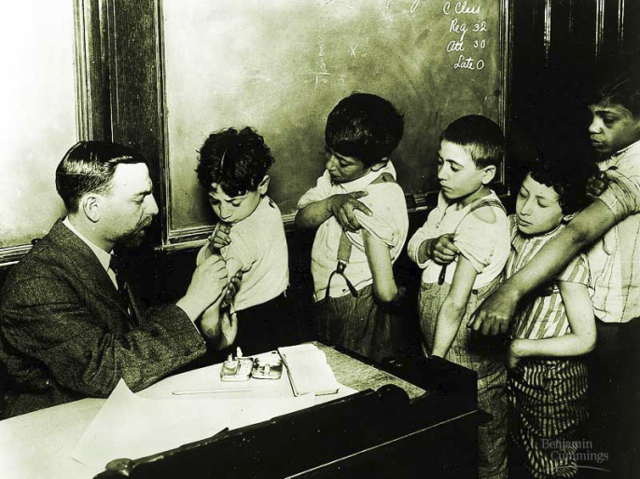
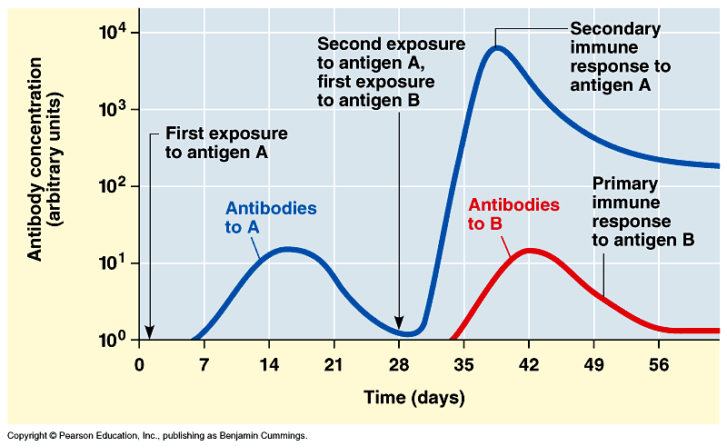
Vaccinations
Immune system exposed to harmless version of pathogen
triggers active immunity
stimulates immune system to produce antibodies to invader
rapid response if future exposure
Most successful against viral diseases

Slide 4
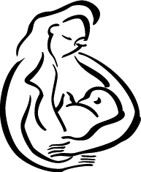
Passive immunity
Obtaining antibodies from another individual
Maternal immunity
antibodies pass from mother to baby across placenta or in mother’s milk
critical role of breastfeeding in infant health
mother is creating antibodies against pathogens baby is being exposed to
Injection
injection of antibodies
short-term immunity

Slide 5
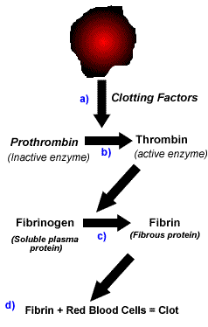
11.1.1 Blood Clotting HL
Clotting is the mechanism that prevents and blood loss
from broken blood vessels.
Mechanism
Platelets or damaged cells release a group of proteins
called clotting factors. These clotting factors are released
into the plasma a wound site.
b) Clotting factors activate the enzyme Thrombin from
its inactive form prothrombin
c) Thrombin turns the soluble plasma protein fibrinogen
into its insoluble fibrous form Fibrin.
d) Fibrin binds together platelets and blood cells to form
a solid 'plug' for the4 wound. This plug is called a clot.
http://biology-animations.blogspot.com/2008/01/hemophilia-video.html
http://biology-animations.blogspot.com/2008/01/for-detailed-information-httpen.html
Notes:
Damaged cells release an enzyme called Thrombokinase.
This as well as Factor X, Factor VII and Ca+ inos cause Prothrombin (inactive enzyme) to change to Thrombin (active enzyme)
Thrombin will hydrolyse soluble fibrinogen into fibrin which is insoluble.
Fibrin forms a network which traps erythrocytes and becomes a clot.
Anti haemophilia factors are VIII and IX – these are important in step a above.

Slide 7
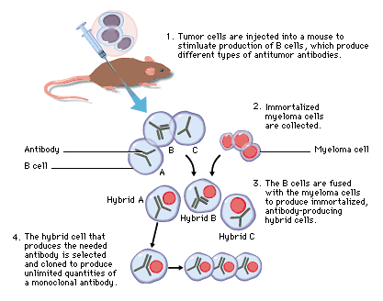
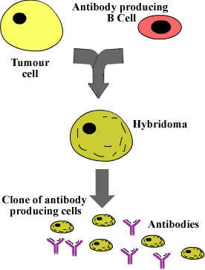
HL Production of monoclonal antibodies
Extract B cell that can produce the required antibodies
Hybridise with a tumour cell (capable of endless division)
In culture the hybridoma can produce large quantities of antibodies

Slide 8
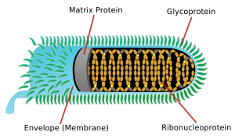
Production of monoclonal antibodies and their use
Use in diagnosis – will be covered in 11.4.10 (pregnancy diagnostic)
Treatment
Diagnosis: HIV infection can be diagnosed through a blood test
which assays for the presence of anti-HIV antibodies,
antibody produced through monoclonal antibody production is an anti-anti-HIV antibody!
Treatment:
Rabies Virus
monoclonal antibodies can be produced which selectively locate and adhere to cancer cells
anti-cancer drugs can be attached to the monoclonal antibodies
so that they deliver their effects directly to the targeted cancer cells

