Slide 1
Plant Science
9.3 – Reproduction in Angiospermophytes

Slide 2
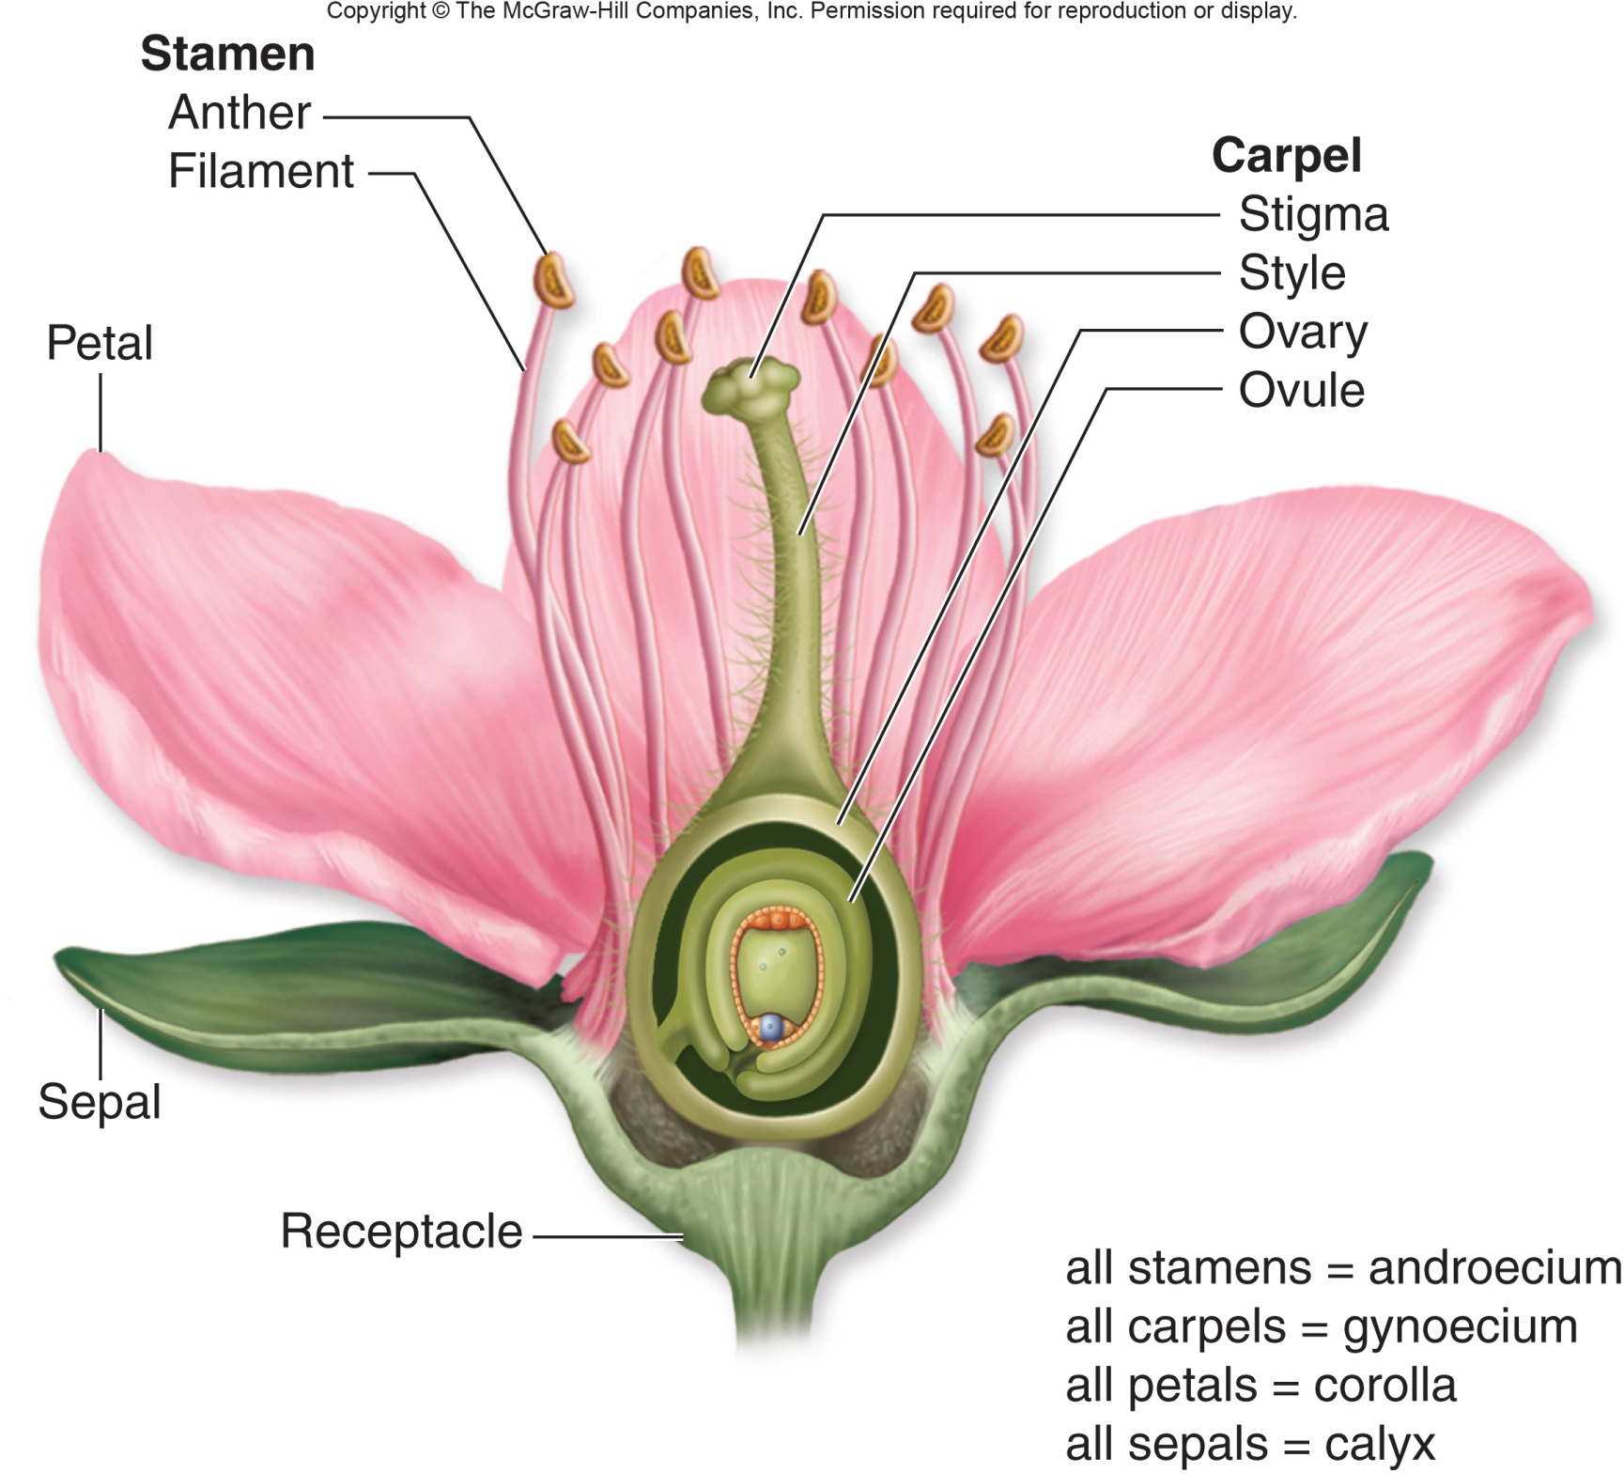

Slide 3
Flower structure & function
Flower part | Function
Sepals | Protect the developing flower while in the bud
Petals | Often are colourful to attract pollinators
Anther | Part of stamen which produces the male sex cells, pollen
Filament | Stalk of stamen that holds up the anther
Stigma | Sticky top of carpel on which pollen lands
Style | Structure of the carpel that supports the stigma
Ovary | Base of carpel in which the female sex cells develop
Damon, A., McGonegal, R., Tosto, P., & Ward, W. (2007). Higher Level Biology. England: Pearson Education, Inc.

Slide 4
Pollination & fertilization
Plants have two different generations in their life cycle:
Gametophyte generation = haploid
Sporophyte generation = diploid
Pollination: the transfer of pollen from the anther (male) to the stigma (female)
Cross pollination involves pollen from one plant landing on the stigma of another plant
Self pollination involves the transfer of a plants own pollen to its own stigma

Slide 5
Pollination & fertilization
Fertilization: the fusion of gametes (pollen & egg)
Pollen germinates to produce a pollen tube
The pollen tube grows down the style of the carpel
Within the growing pollen tube is the nucleus that will produce the sperm
The pollen tube completes its growth by entering an opening at the bottom of the ovary
The sperm moves from the tube to combine with the egg of the ovule to form a zygote

Slide 6
Pollination & fertilization
Seed dispersal: the removal of seeds from the fruit, away from the parent
Methods include:
Wind
Parachutes (maple tree)
Carried by animals (burrs with hooks)
Edible fruit (digestive tract)

Slide 7
Seed structure & function⁵

Slide 8
Seed structure & function
Seed part | Function
Testa | Tough, protective outer coat
Cotyledons | Seed leaves that function as nutrient storage structures
Micropyle | Scar of the opening where the pollen tube entered the ovule
Embryo root & embryo shoot | Become the new plant when germination occurs
Damon, A., McGonegal, R., Tosto, P., & Ward, W. (2007). Higher Level Biology. England: Pearson Education, Inc.

Slide 9
Seed germination
Germination: the growth or development from the seed
Moisture = to soften the seed coat
Temperature = low followed by high to activate enzymes
Oxygen = to carry out cellular respiration
Light = requirements vary by plant
Each seed requires its own combination of the above events

Slide 10
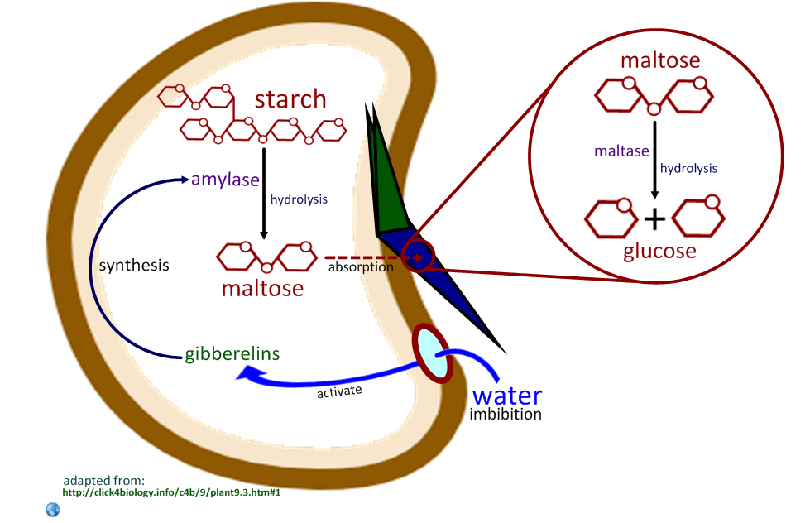

Slide 12
Seed germination
Absorption of water by the seed
Embryo releases gibberellin (a plant growth substance) in the embryo’s cotyledon
Triggers the production of amylase
Amylase converts starch → maltose
Maltose diffuses to the embryo where it is used for cellular respiration
Sugar content is increased causing more water to be absorbed
Seed coat softens and embryo emerges

Slide 13
Control of flowering plants
Plant type | Flowering & light | Examples
Long-day plants | Bloom when days are longest and nights shortest (midsummer) | Radishes, spinach, and lettuce
Short-day plants | Bloom in spring, late summer, and autumn when days are shorter | Poinsettias, chrysanthemums, and asters
Day-neutral plants | Flower without regard to day length | Roses, dandelions, and tomatoes
Damon, A., McGonegal, R., Tosto, P., & Ward, W. (2007). Higher Level Biology. England: Pearson Education, Inc.

Slide 14
Control of flowering plants
Length of night controls flowering process through the use of a blue-green pigment = phytochrome
Phytochrome has an active form (P_{fr}) and an inactive form (P_{r})
P_{r} → P_{fr} rapidly in red light (660nm)
P_{fr} → P_{r} rapidly in daylight and far-red light (730nm)
At night P_{fr} → P_{r} occurs slowly allowing plants to time the dark period
P_{fr} causes growth response
In long-day plants P_{fr} = promoter of flowering process
In short-day plants P_{fr} = inhibitor of flowering process

Slide 16
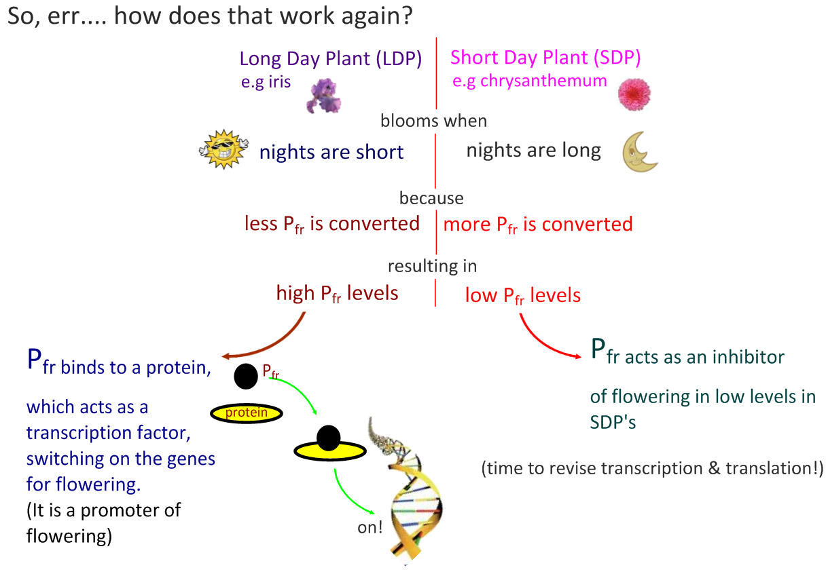

Slide 17
References
Damon, A., McGonegal, R., Tosto, P., & Ward, W. (2007). Higher Level Biology. England: Pearson Education, Inc.
Raven, P.H., Johnson, G.B., Losos, J.B., Mason, K.A., & Singer, S.R. (2008). Biology. (8th ed.). New York: McGraw-Hill Companies, Inc.
Dunlop, J., Francis, L., Gaspar, P., Gibbons, K., Grace, E., Mills, A., & Searle, S. (2010). Biology 11. Canada: McGraw-Hill Companies, Inc.
Dickinson, T., Edwards, L., Flood, N., Grace, E., Jackson, C., Mazza, M., & Ross, J. (2009). ON Science 10. Canada: McGraw-Hill Companies, Inc.
Encyclopedia Britannica Online. <www.britannica.com>

