Slide 1
Plant Science
9.2 – Transport in Angiospermophytes

Slide 2
Support of terrestrial plants
Support of terrestrial plants comes through:
Thickened cellulose in cell walls
Turgor pressure of cells
Lignified xylem

Slide 3
Xylem – transport of water & minerals
Transports water and minerals from roots to stems and leaves
Xylem tissue consists of long hollow tubes formed by non-living cells:
Trachieds: overlapping tubes that are longer, narrower, and tapered at the ends
Vessel elements: long, wide continuous tubes that are joined end-to-end
Have thicker, lignified walls to support the stem
More efficient than trachieds at transport

Slide 4
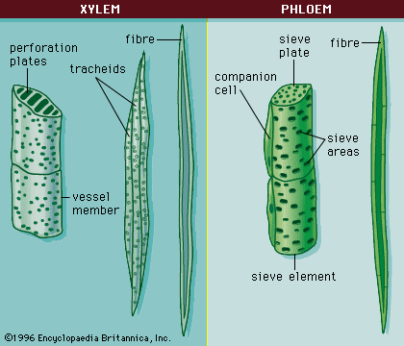

Slide 5
Uptake by roots
Branching increases the number of roots
Root hairs increase surface area and take in minerals (N, P, K) by active transport
Root hairs take in water by osmosis
Water moves from the roots hairs, through the cortex and into the xylem by one of two ways:
Symplastic route: water moves from cell to cell through the cytoplasm
Apoplastic route: water moves by capillary action through cell walls until it reaches the endodermis

Slide 6
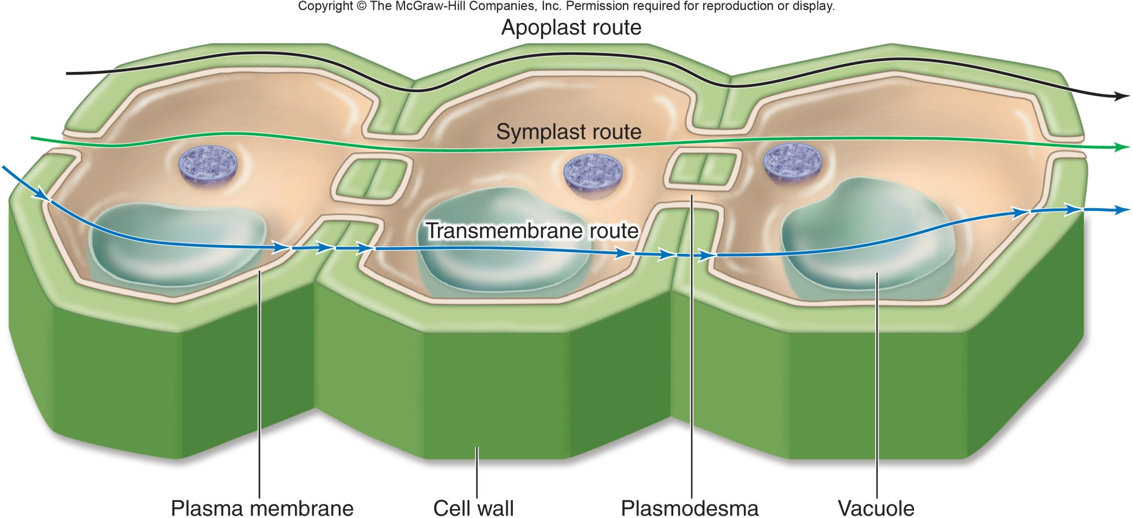

Slide 7
Uptake by roots
Mineral ions move from the soil into the roots through 3 main processes¹:
Diffusion of mineral ions AND the mass flow of water in the soil carrying these ions
Aid provided by fungal hyphae (mutualistic relationship)
Active transport

Slide 8
Uptake by roots
Mineral ion absorption¹
Proton pump uses energy from ATP to pump hydrogen ions out of cell
This results in a higher hydrogen ion concentration outside the cell than inside creating a negative charge inside the cell
This gradient results in the diffusion of hydrogen ions back into the cell
The voltage difference is called a membrane potential
The hydrogen ion gradient and the membrane potential represent forms of potential energy that can be used to absorb mineral ions

Slide 9
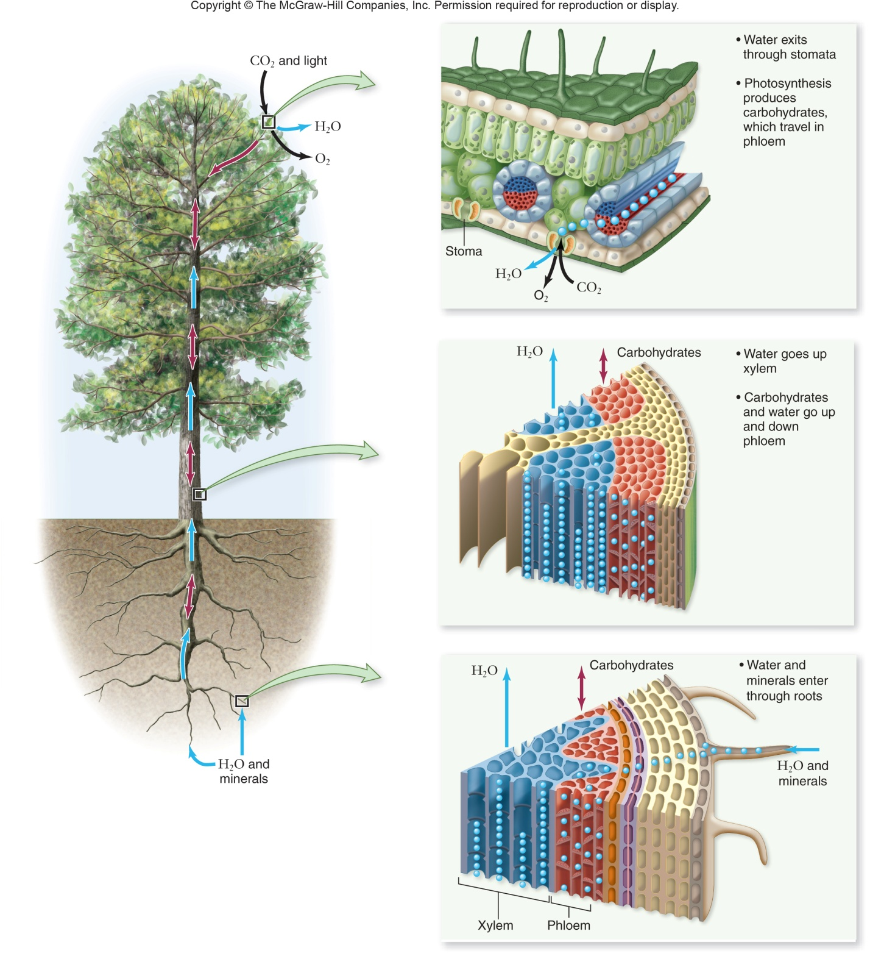

Slide 10
Transpiration
The loss of water vapour from the leaves and stems of plants through evaporation
Evaporation of water spongy mesophyll through stomata
This water is replaced by water molecules in the xylem
Water moves through xylem vessels by transpiration pull or cohesion-tension and adhesion
Water is pulled from the root cortex into the xylem cells
Water is pulled from the soil into the roots
This creates a continuous column of water from the roots to the leaves

Slide 13
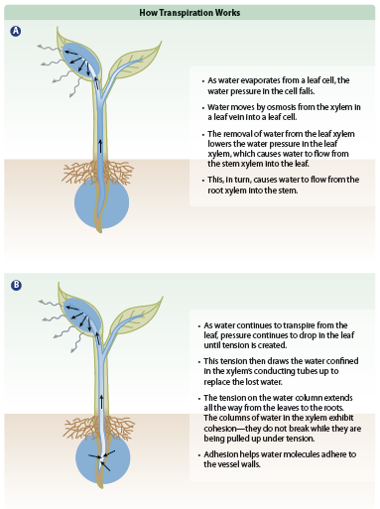

Slide 14
Role of stomata
Guard cells regulate transpiration by opening and closing stomata
Stomata open and close for gas exchange to occur (which regulates transpiration)
An increase in turgor pressure in the guard cells cause the stomata to open
A decrease in turgor pressure in the guard cells cause the stomata to close
Generally stomata are open during the day and closed at night

Slide 15
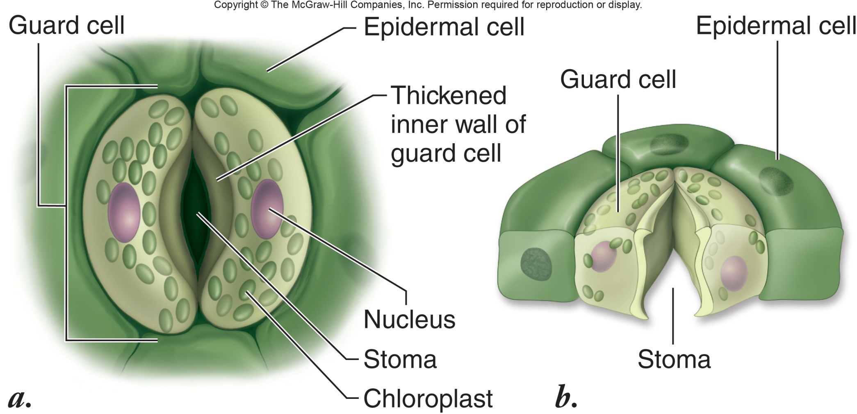

Slide 16
Role of stomata
Stomata must remain open much of the time because CO₂ must enter the leaf so photosynthesis can occur
The gain and loss of water in the guard cells is due to transport of K⁺ ions
The higher concentration of solute inside the cell causes water to move into the cell
The hormone abscisic acid causes K⁺ to rapidly diffuse out of the guard cell
This causes water to also leave and the stoma closes
Abscisic acid is produced in the roots during times of drought

Slide 17
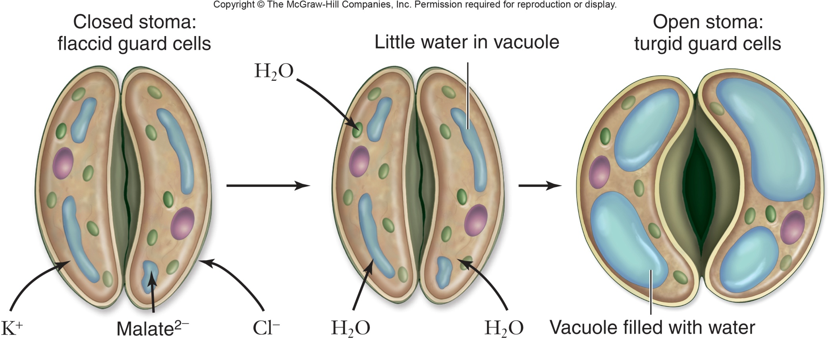

Slide 18
Effect of abiotic factors on transpiration
Environmental factor | Effect
Light | Speeds up transpiration by warming the leaf and opening stomata
Humidity | Decreasing humidity increases transpiration because of the greater difference in water concentration
Wind | Increases the rate of transpiration because humid air near the stomata is carried away
Temperature | Increasing temperature causes greater transpiration because more water evaporates
Soil water | If the intake of water at the roots does not keep up with transpiration, turgor loss occurs and the stomata close – this decreases transpiration
Carbon dioxide | High carbon dioxide levels in the air around the plant usually cause the guard cells to lose turgor and the stomata to close
Damon, A., McGonegal, R., Tosto, P., & Ward, W. (2007). Higher Level Biology. England: Pearson Education, Inc.

Slide 19
Adaptations of xerophytes
Xerophytes are plants that survive with very little water (desert plants) and have:
Deep roots to absorb water from deep underground
Rolled leaves that enclose stomata to reduce transpiration
Spines instead of leaves to minimize surface area = reduced transpiration
Reduced number of stomata to reduce transpiration
Stomata closed during midday
Thick waxy cuticle to reduce evaporation form leaf’s surface
Succulent tissues and thick cortex for increased water storage (often tastes bitter so animals do not drink it)
Alternative photosynthetic processes
E.g. cactus

Slide 20
Adaptations of hydrophytes
Hydrophytes are plants that survive in or on water (water plants) and have:
Large air spaces (thick spongy mesophyll) to allow leaves to float
Large numbers of stomata that are open most of the time
Stomata on upper surface of floating leaves
No stomata on submerged leaves
Thin cuticle so leaves will not dry out
Large flat leaves for flotation
Reduced roots since water can diffuse directly into leaves
E.g. water lily

Slide 21
Phloem – transport of sugars
Transports sugars (in the form of sucrose) through translocation from source (photosynthetic tissue, storage organs) to sink (roots, fruit, and seeds)
Unlike xylem, phloem is living tissue
Made up of sieve tubes = long, hollow tubes that have no nucleus, ribosomes or Golgi
Between sieve tubes are sieve plates that have large pores to facilitate transport
Sieve tubes have associated companion cells that have nuclei, direct activities and provide nutrients

Slide 23
Translocation
Transport of substances through phloem from one part of the plant (source – photosynthetic tissue, storage organs) to another part of the plant (sink – fruits, seeds, roots)
Phloem transports substances in two directions by active and passive transport
Example = maple syrup
In summer, phloem transports sugar from the leaves (source) to the roots (sink)
In spring, phloem transports sugar from the roots (source) to the branches (sink)

Slide 24
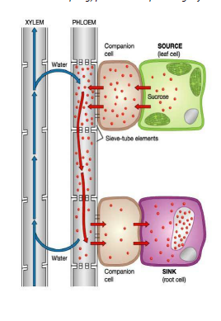

Slide 25
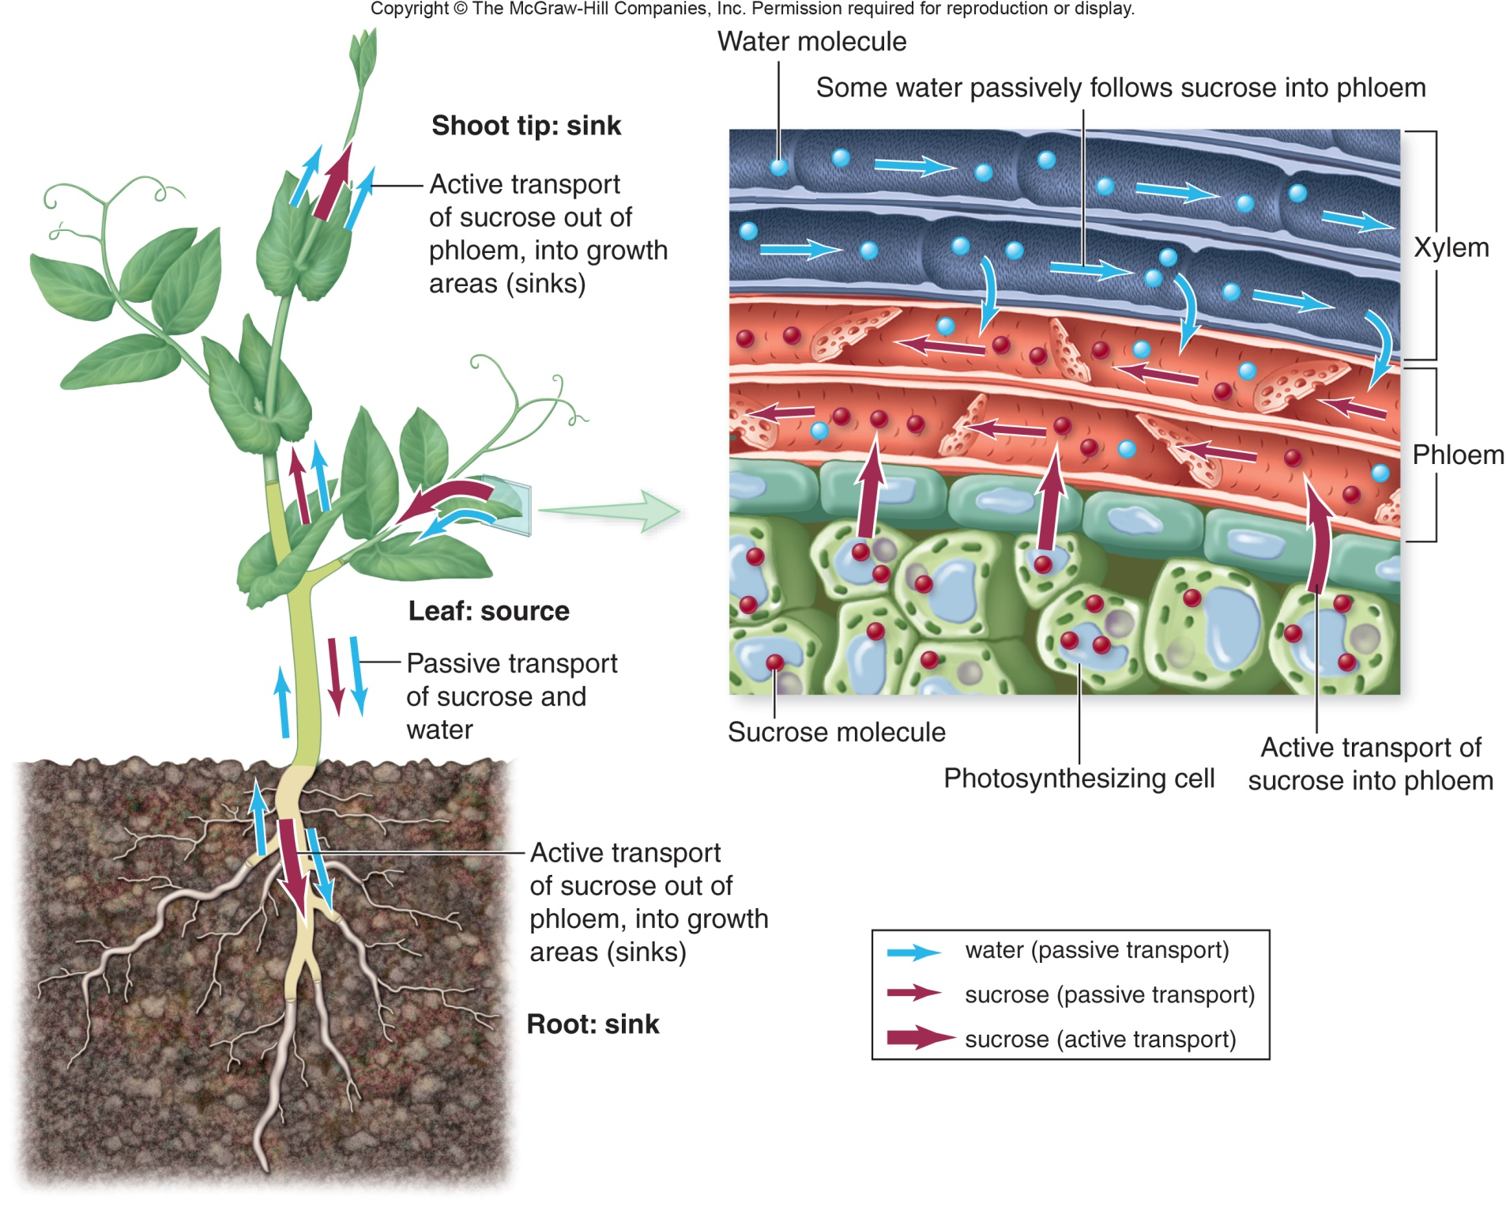

Slide 26
References
Damon, A., McGonegal, R., Tosto, P., & Ward, W. (2007). Higher Level Biology. England: Pearson Education, Inc.
Raven, P.H., Johnson, G.B., Losos, J.B., Mason, K.A., & Singer, S.R. (2008). Biology. (8th ed.). New York: McGraw-Hill Companies, Inc.
Dunlop, J., Francis, L., Gaspar, P., Gibbons, K., Grace, E., Mills, A., & Searle, S. (2010). Biology 11. Canada: McGraw-Hill Companies, Inc.
Dickinson, T., Edwards, L., Flood, N., Grace, E., Jackson, C., Mazza, M., & Ross, J. (2009). ON Science 10. Canada: McGraw-Hill Companies, Inc.
Encyclopedia Britannica Online. <www.britannica.com>

