Slide 1
Plant Science
9.1 – Plant Structure & Growth

Slide 2
Land plants
Plant group | Major features
Non-vascular land plants | No conducting tissue Often grouped together as bryophytes Usually small and grow close to the ground Include mosses, liverworts, and hornworts
Seedless vascular plants | Well-developed vascular tissue Do not produce seeds Include horsetails, ferns, club mosses, and whisk ferns (were once large specimens, but most of today’s representatives are relatively small)
Seeded vascular plants | Most living plant species are in this group Seeds contain an embryo, a supply of nutrients, and a protective outer coat Have extensive vascular tissue and include some of the world’s largest organisms
Damon, A., McGonegal, R., Tosto, P., & Ward, W. (2007). Higher Level Biology. England: Pearson Education, Inc.

Slide 3
Seeded vascular plants
Further divided into 2 categories:
Gymnosperms: a vascular plant with non-enclosed seeds³
Angiosperms: a vascular plant with seeds enclosed in protective tissue³
***Our focus will be on angiosperms***

Slide 4
Angiosperms
Monocotyledonous (Monocots) | Dicotyledonous (Dicots)
Parallel venation in leaves | Netlike venation pattern in leaves
3 flower parts or multiples of 3 | 4 or 5 flower parts or multiples of 4 or 5
Seeds contain only one cotyledon (seed leaf) | Seeds contain two cotyledons (seed leaves)
Vascular bundles arranged throughout the stem | Vascular bundles arranged as a ring in the stem
Root system mainly fibrous | Root system involves a taproot (main root)
Pollen grain with one opening | Pollen grain with three openings
Damon, A., McGonegal, R., Tosto, P., & Ward, W. (2007). Higher Level Biology. England: Pearson Education, Inc.

Slide 5
Angiosperms
Angiosperms generally have 3 types of tissue (with a 4th special tissue):
Dermal tissue: the outer layer of cells that form a protective covering for a plant; includes epidermis and periderm³
Ground tissue: a plant tissue that has multiple functions and that makes up most of the inside of a plant³
Vascular tissue: structures that transport sap (water, sugar, minerals) and provide vertical support for the plant’s body⁴
Meristematic tissue: the undifferentiated embryonic plant tissue from which all other plant tissues develop³

Slide 6
Vascular tissue
There are 2 main types of vascular tissue:
Xylem: vascular tissue that transports water and minerals from the roots to the leaves
Passive transport
Dead cells
Unidirectional
Phloem: vascular tissue that transports organic nutrients, often from the leaves to the roots, but also from roots and mature leaves to new leaves
Active and passive transport
Living cells
Bidirectional

Slide 7
Roots
Act as anchors, absorb water & mineral ions, and store carbohydrates
Each root has a protective end called a root cap
The epidermis layer (outer layer, 1 cell thick) of the root often have root hairs that help absorb water and minerals
Root hairs greatly increase surface area of the root
The next layer is called the cortex and stores starch molecules
The inner layer contains the vascular cylinder which contains the plant’s conducting tissues (xylem and phloem)

Slide 8
Roots⁵

Slide 9
Root modifications
Root modification | Description & example(s)
Prop roots | Thick adventitious roots that from from the lower part of the stem and brace the plant e.g. corn
Storage roots | Specialized cells within the root store large quantities of carbohydrates and water e.g. carrots and beets
Pneumatophores (air roots) | Produced by plants that live in wet places, these roots extend above the soil or water surface and facilitate oxygen uptake e.g. mangroves and cypress trees
Buttress roots | Large roots that develop near the bottom of trees to provide stability e.g. fig tree
Damon, A., McGonegal, R., Tosto, P., & Ward, W. (2007). Higher Level Biology. England: Pearson Education, Inc.

Slide 10
Stems
Connect leaves, roots and flowers
Transport materials
Support aerial parts of the plant
Contain vascular bundles (xylem, phloem and associated tissues) arranged in a ring around the outside of the stem
Xylem is located closer to the centre; phloem towards the outside
Between the xylem and phloem is a thin layer called the vascular cambium
The centre of the stem is called the pith
The outside of the stem is called the cortex

Slide 11
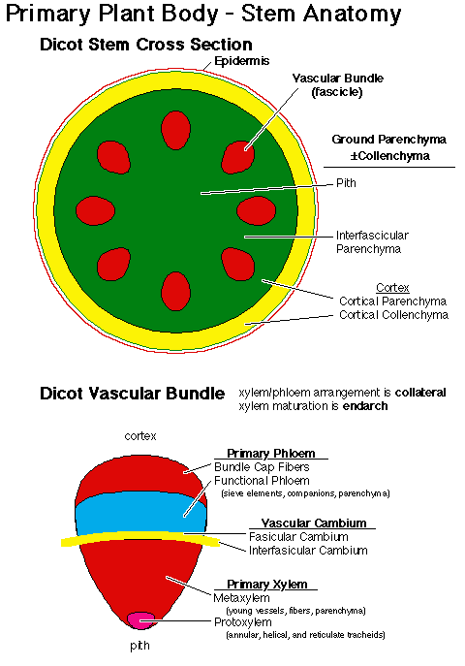
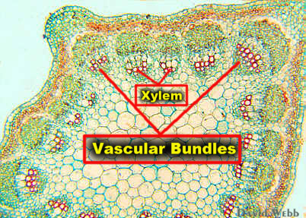
Stems⁵

Slide 12
Stem modifications
Stem modification | Description & example(s)
Bulbs | Vertical, underground stems consisting of enlarged bases of leaves that store food e.g. onions
Tubers | Horizontally growing stems below ground that are modified as carbohydrate-storage structures e.g. potatoes
Rhizomes | Horizontal stems that grow just below the surface to allow plant spreading e.g. ginger plant
Stolons | Horizontal stems growing above ground that allow a plant to reproduce asexually e.g. strawberry plants
Damon, A., McGonegal, R., Tosto, P., & Ward, W. (2007). Higher Level Biology. England: Pearson Education, Inc.

Slide 13
Leaves
Produce food by photosynthesis
Have a network of veins that transport sugar and water (vascular bundles form the stem)
Cuticle: a waxy covering that provides water resistance, protection, and reduces water loss
Mesophyll cells: cells of the leaf
Palisade layer: primary role is photosynthesis; upper layer of cells; very condensed
Spongy layer: primary role is gas exchange; lower layer of cells; has many air spaces

Slide 14
Leaves
Stoma (pl. stomata): openings in the leaf that control the passage of gases and allow water vapour to escape
Loss of water vapour is called transpiration
Stomata are surround by two guard cells = kidney shaped cells that control the opening and closing of the stomata
Water entering the guard cells causes them to swell, thus opening the stomata
Usually closed at night to prevent water loss

Slide 15
Leaves³

Slide 16
Leaves
Structure | Primary function
Palisade mesophyll | Absorption of light & photosynthesis
Spongy mesophyll | Gas exchange
Xylem | Transport water, minerals & nutrients to leaves
Phloem | Transport products of photosynthesis from leaves
Cuticle | Water conservation
Stomata | Gas exchange
Guard cells | Water conservation
Epidermis | Protection & support

Slide 17
Leaf modifications
Leaf modification | Description & example(s)
Tendrils | Structures that coil around objects to aid in support and climbing (may also be formed from modified stems) e.g. pea plants produce tendrils from leaves
Reproductive leaves | Produce tiny plants along the leaf margins that fall to the ground and take root in the soil e.g. kalanchoe plants
Bracts or floral leaves | Coloured modified leaves that surround flowers and attract insects for pollination e.g. poinsettia
Spines | Reduce water loss, may be associated with modified stems tha carry out photosynthesis e.g. cacti
Damon, A., McGonegal, R., Tosto, P., & Ward, W. (2007). Higher Level Biology. England: Pearson Education, Inc.

Slide 18
Meristems
Dicots have 2 types of meristems:
Apical: an area of embryonic tissue found at the root or shoot tips of a plant; root and shoot are the two types of apical meristem³
Root: extend the roots of a plant
Shoot: extend the shoots of a plant
Lateral: the area of embryonic tissue responsible for secondary growth (increased girth) in plants; vascular cambium and cork cambium are the two types of lateral meristem³
Vascular cambium: a thin layer of meristematic tissue found along the length of roots and stems in some plants; produces new vascular tissue and is necessary for secondary growth³
Cork cambium: a type of lateral meristem that produces the outer bark on woody plants³

Slide 19
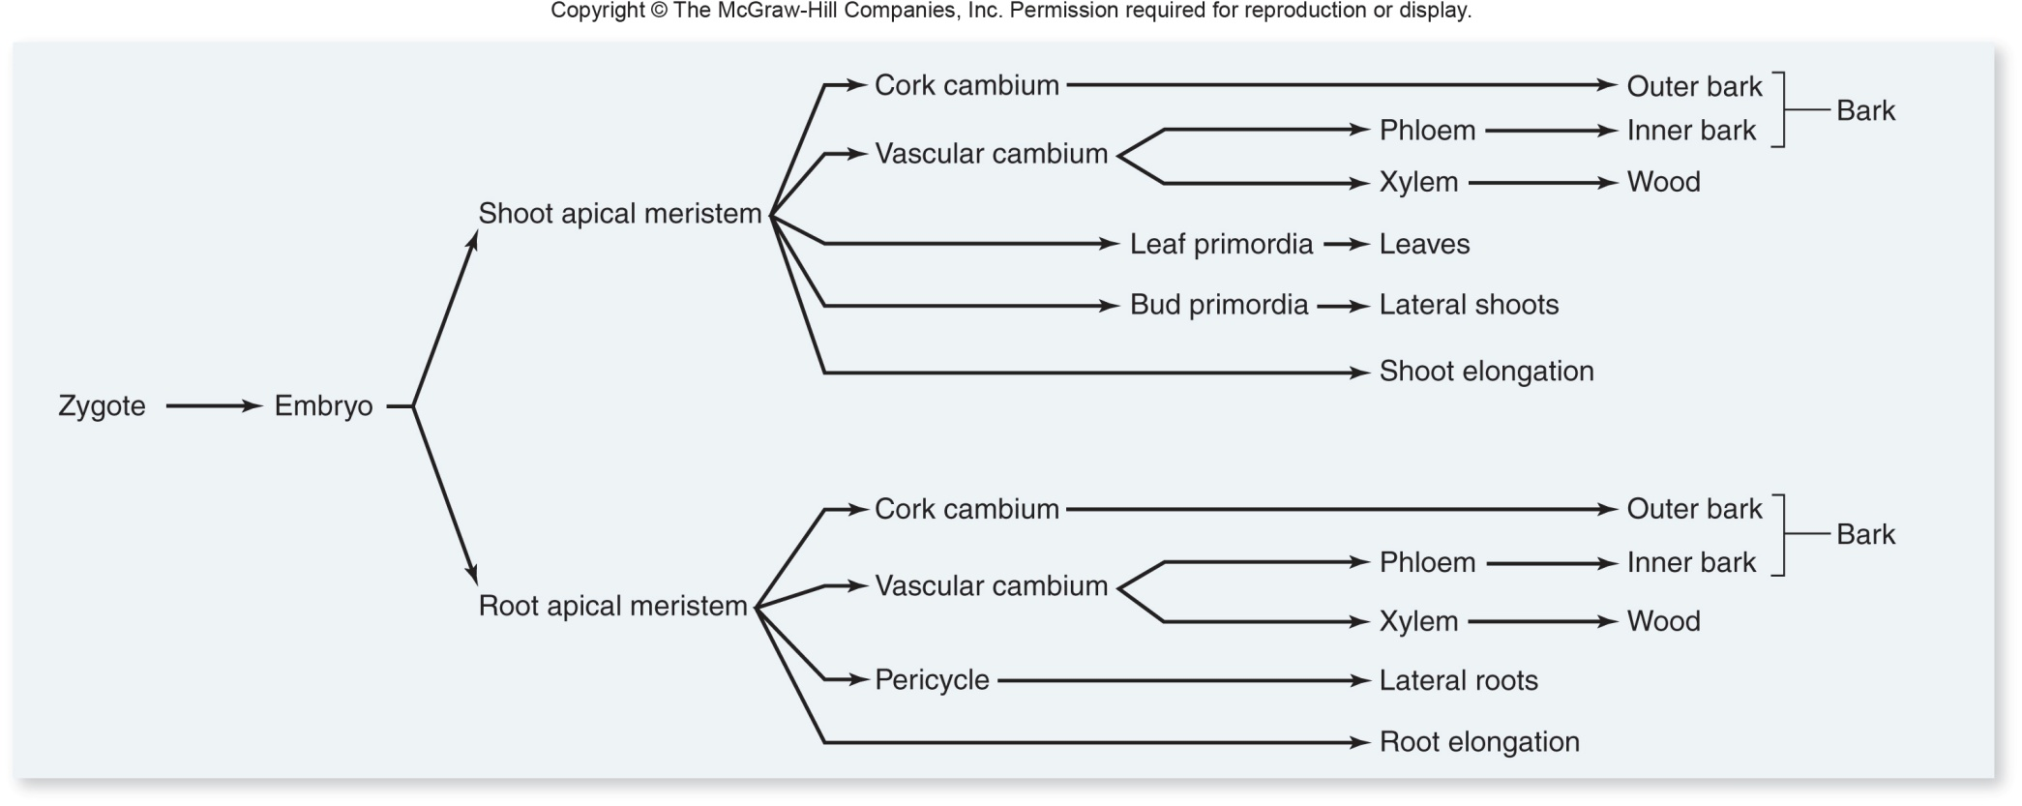
Meristems²

Slide 20
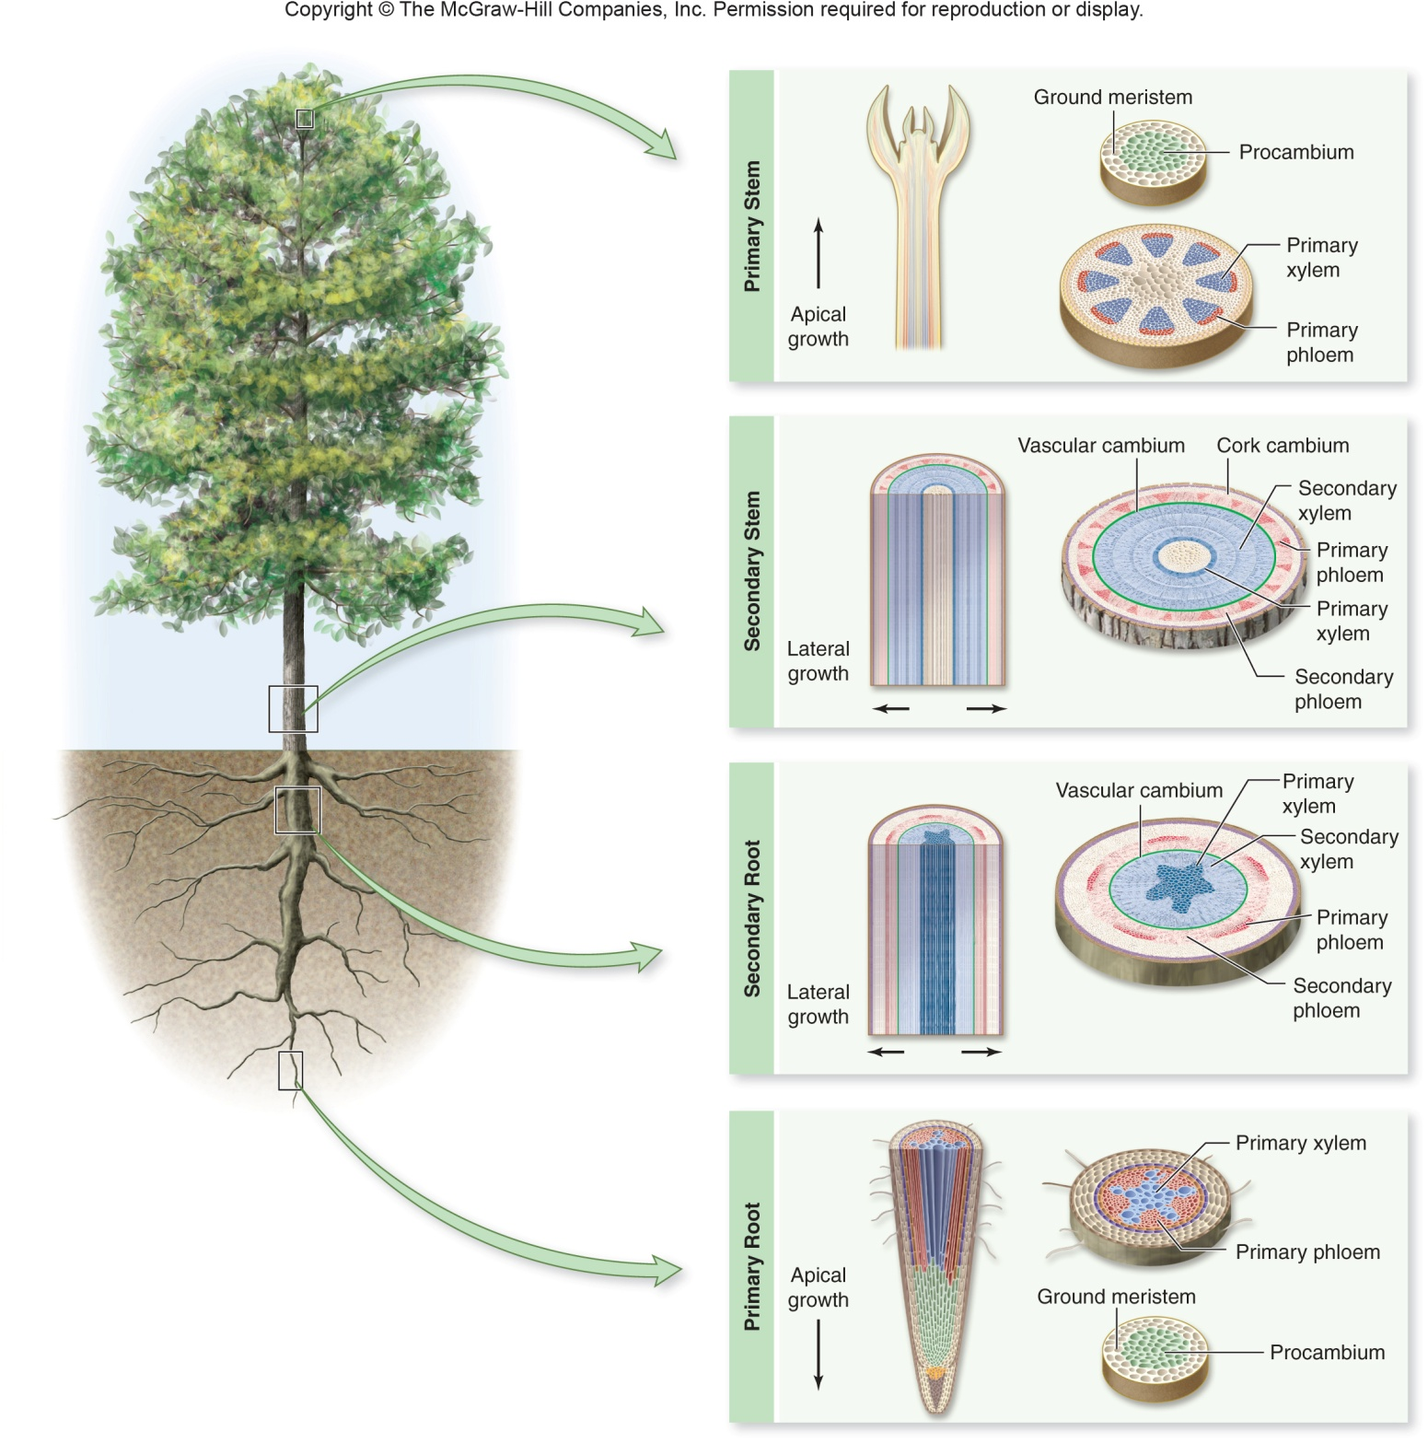
Meristems²

Slide 21
Auxins & phototropism
Tropisms: growth or movement responses to directional external stimuli¹
Positive = towards the stimulus
Negative = away from the stimulus
Auxins: plant hormones that cause the positive phototropism of plants shoots and seedlings¹
Only work on plant cells with auxin receptors
Found in:
Embryos of seeds
Meristems of apical buds
Young leaves

Slide 22
Auxins & phototropism
Auxins increase the flexibility of plant cell walls
Allows elongation on the side of the cell resulting in growth towards light
Not an increase in auxin; rather a redistribution of existing auxin
Available auxin moves away from the light source
Results in increased flexibility on side of cell (and thus plant structures) away from light causing curving of plant towards light
Plant auxin responsible = indoleacetic acid (IAA)

Slide 23
References
Damon, A., McGonegal, R., Tosto, P., & Ward, W. (2007). Higher Level Biology. England: Pearson Education, Inc.
Raven, P.H., Johnson, G.B., Losos, J.B., Mason, K.A., & Singer, S.R. (2008). Biology. (8th ed.). New York: McGraw-Hill Companies, Inc.
Dunlop, J., Francis, L., Gaspar, P., Gibbons, K., Grace, E., Mills, A., & Searle, S. (2010). Biology 11. Canada: McGraw-Hill Companies, Inc.
Dickinson, T., Edwards, L., Flood, N., Grace, E., Jackson, C., Mazza, M., & Ross, J. (2009). ON Science 10. Canada: McGraw-Hill Companies, Inc.
Encyclopedia Britannica Online. <www.britannica.com>

