Slide 1
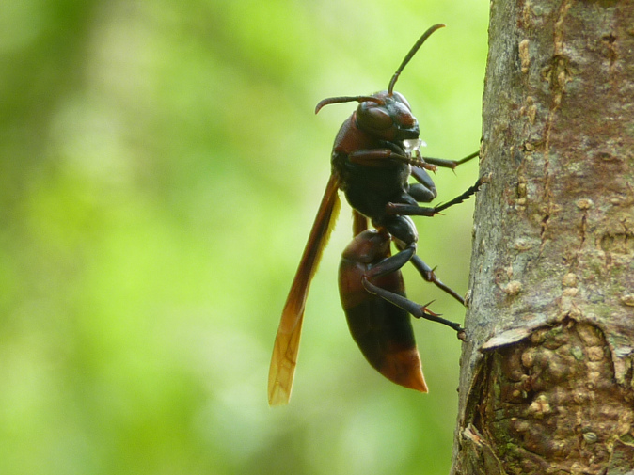
Ecosystems & Energy Flow (4.1-4.2)
IB Diploma Biology

Slide 2
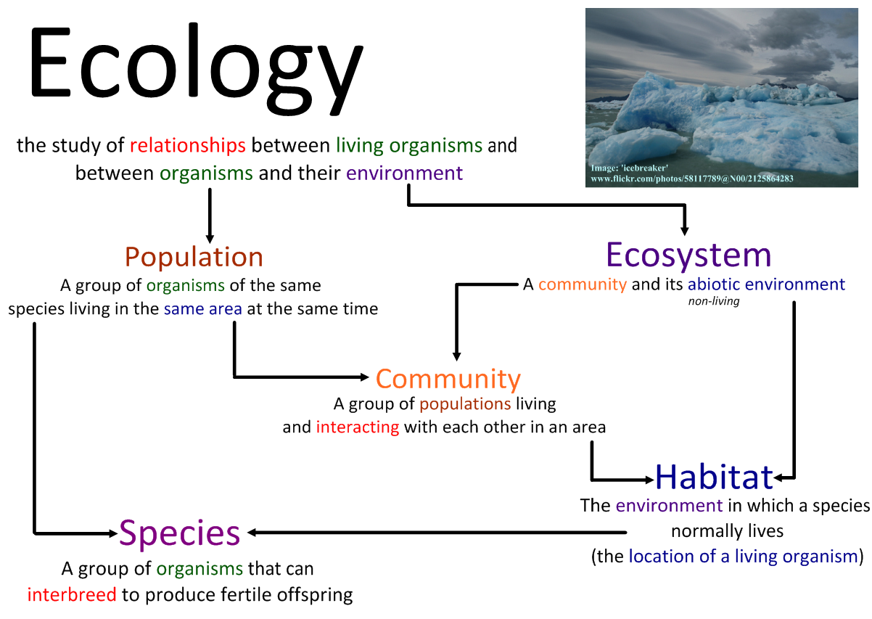

Slide 3
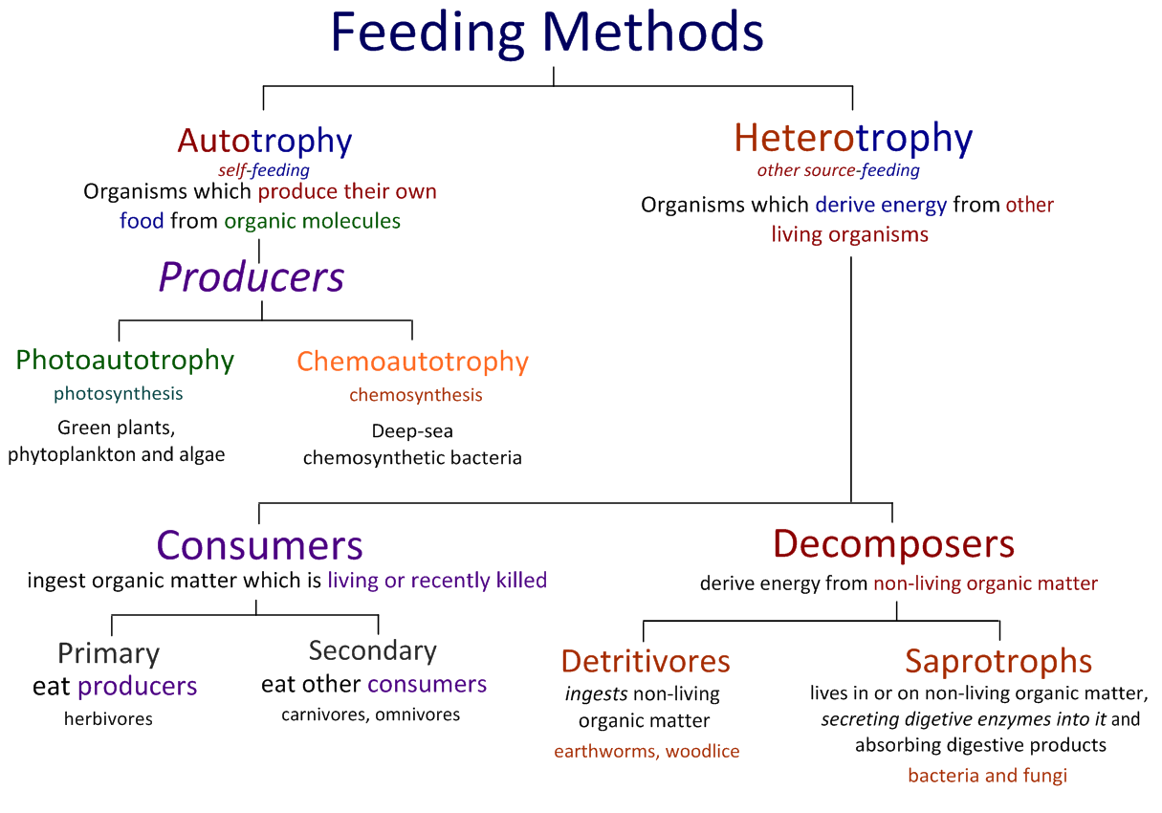

Slide 4
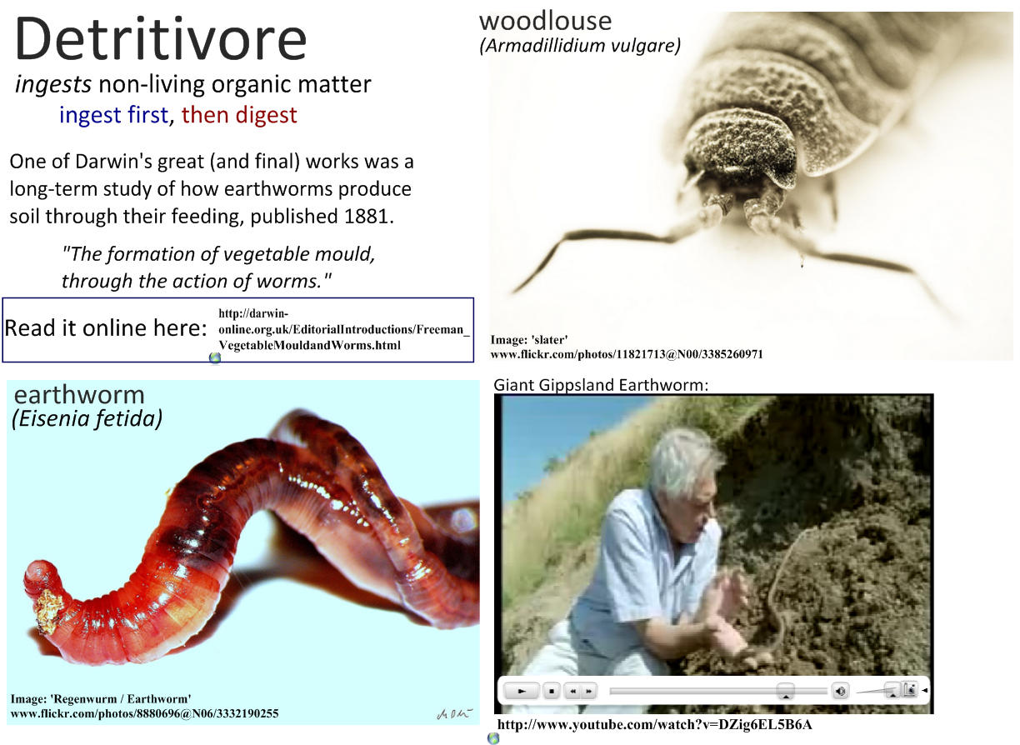

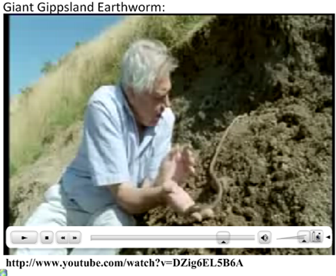

Slide 5
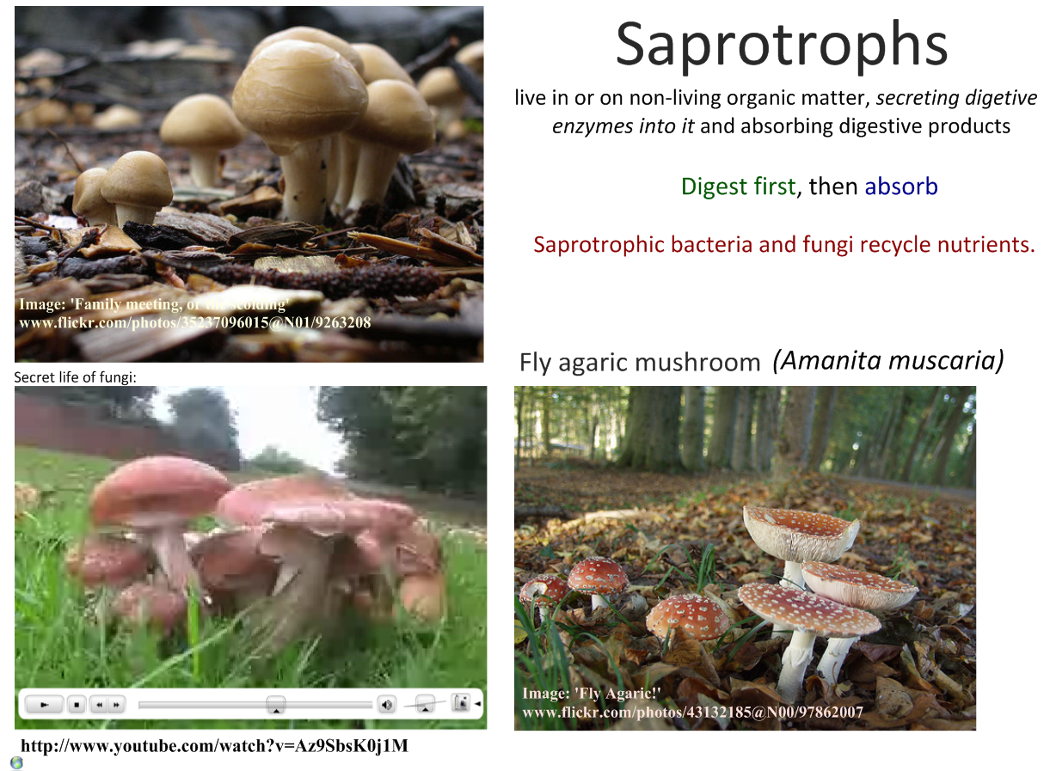
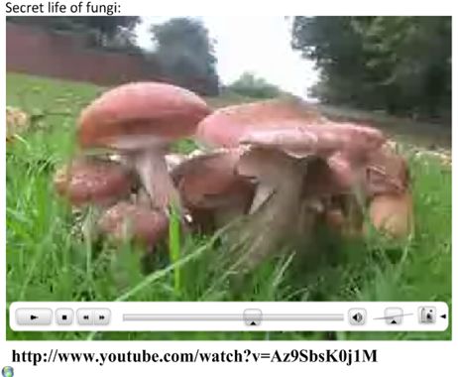

Slide 6
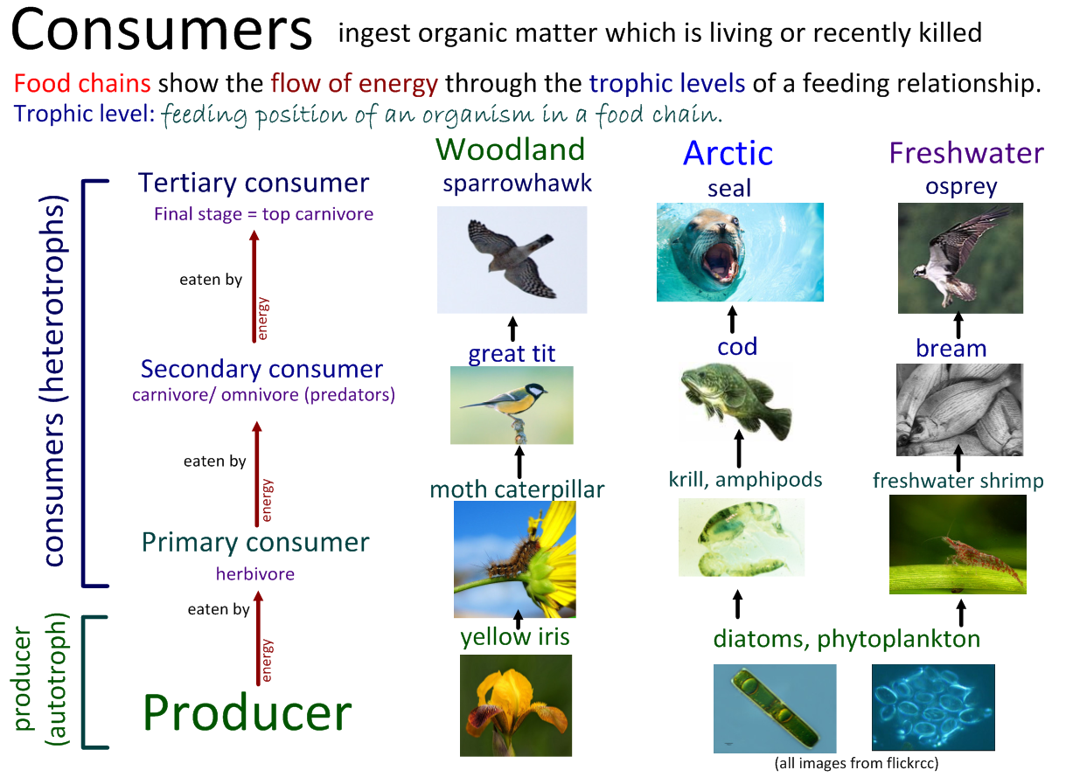

Slide 7
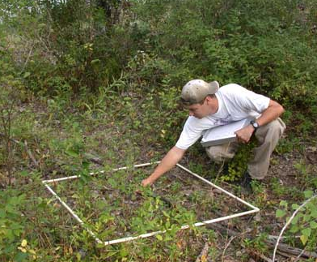
Quadrat Sampling
Quadrats are square sample areas, often marked by a quadrat frame
Quadrat sampling involves repeatedly placing a quadrat frame at random positions in a habitat and recording numbers of organisms present
Goal is to obtain realistic estimates of population sizes
Not useful for motile organisms

Slide 8
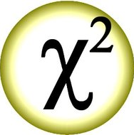
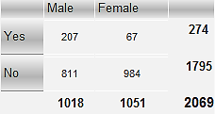
Chi-Squared Testing
Draw a contingency table of observed frequencies
Calculate the expected frequencies for each of the possible contingency table scenarios
  (Row Total) x (Column Total) / Grand Total
Calculate number of degrees of freedom
(# Rows – 1)(# Columns – 1) = df

Slide 9
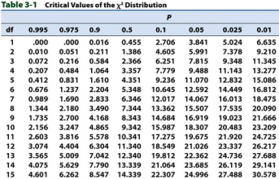
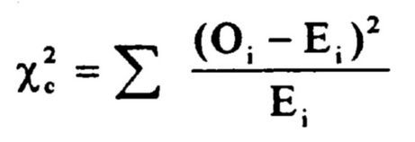
Chi-Squared Testing
Find the critical value for the Chi-squared test (0.05)
Calculate the Chi-Squared value:

Slide 10
Chi-Squared Testing
Compare the Chi-squared value with the Critical Value
If the X² < CV, then ACCEPT the Null Hypothesis
(i.e. there is NO Association between the variables)
If the X² > CV, then REJECT the Null Hypothesis
(i.e. there is a significant Association between the variables)…aka ACCEPT the Alternative Hypothesis

Slide 11
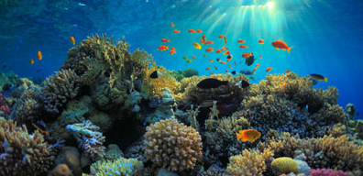
Ecosystem
A community and its abiotic environment

Slide 12
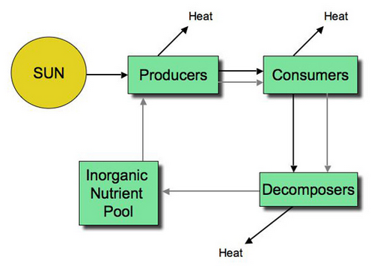
Nutrient Cycles
Nutrients are elements and compounds that promote growth in organisms
Nutrients are limited and have been recycled for at least 3 billion years
Nutrients flow through food chains and are then recycled into soil by decomposers

Slide 13

Sustainability of Ecosystems
Sustainable = able to continue indefinitely
Requirements of sustainable ecosystems:
  Nutrient availability
  Detoxification of waste
  Energy availability

Slide 14
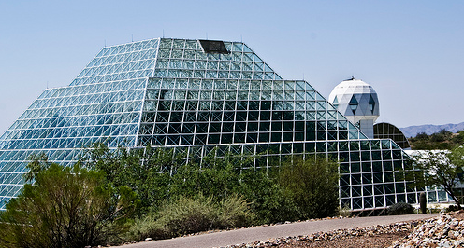
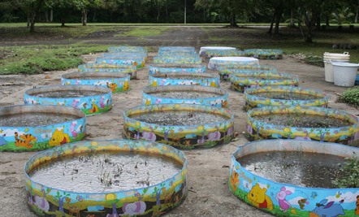
Mesocosms
Small, closed-off experimental systems set up as ecological experiments
Can be used to test effects of varying certain conditions on ecosystem stability as well as the sustainability of ecosystems

Slide 15
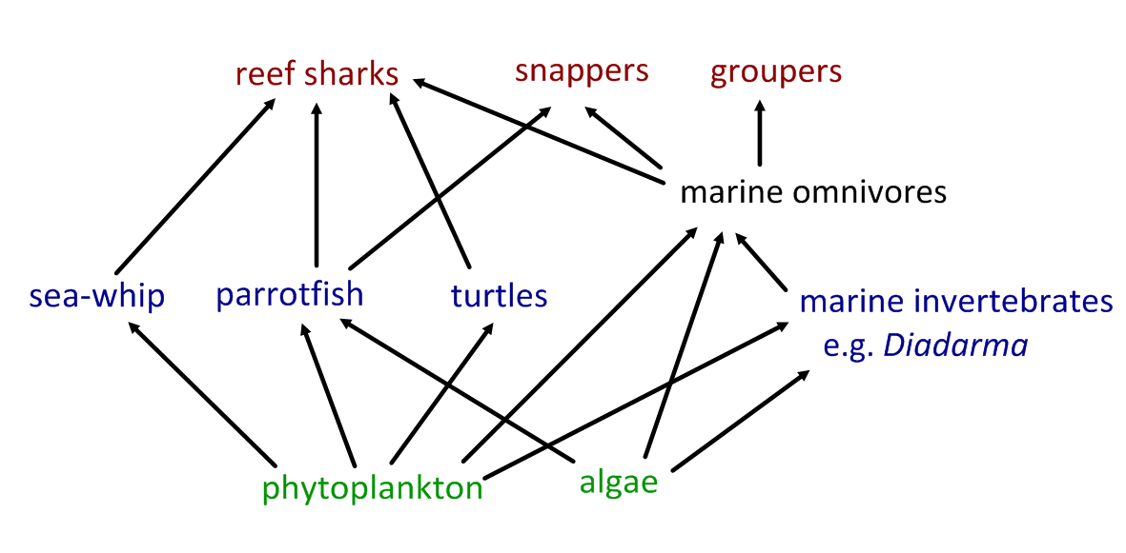
Food webs show all of the feeding relationships within a habitat.
Read this research article and generate a food web.
The state of the oceans, part 2: Delving deeper into the sea's bounty. John Tibbetts

Slide 16
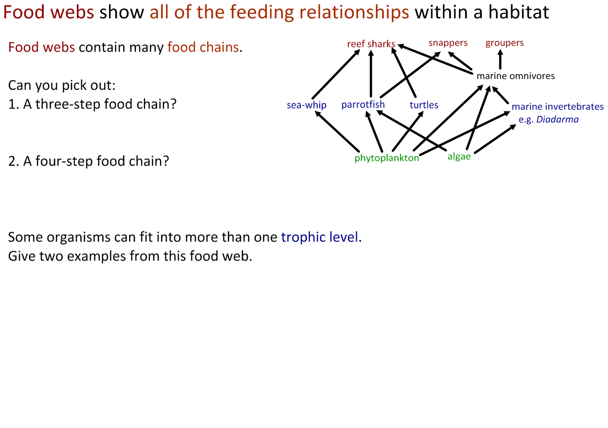
Food webs show all of the feeding relationships within a habitat.

Slide 17
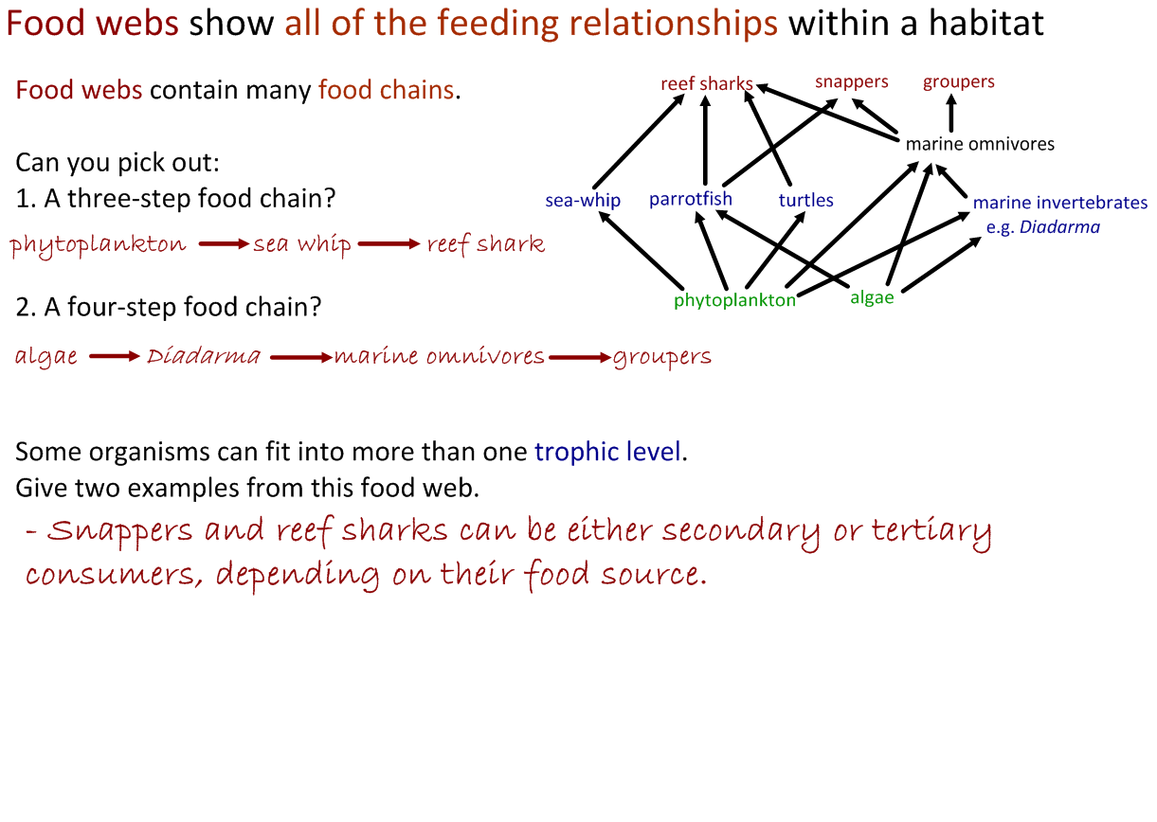
Food webs show all of the feeding relationships within a habitat.

Slide 18
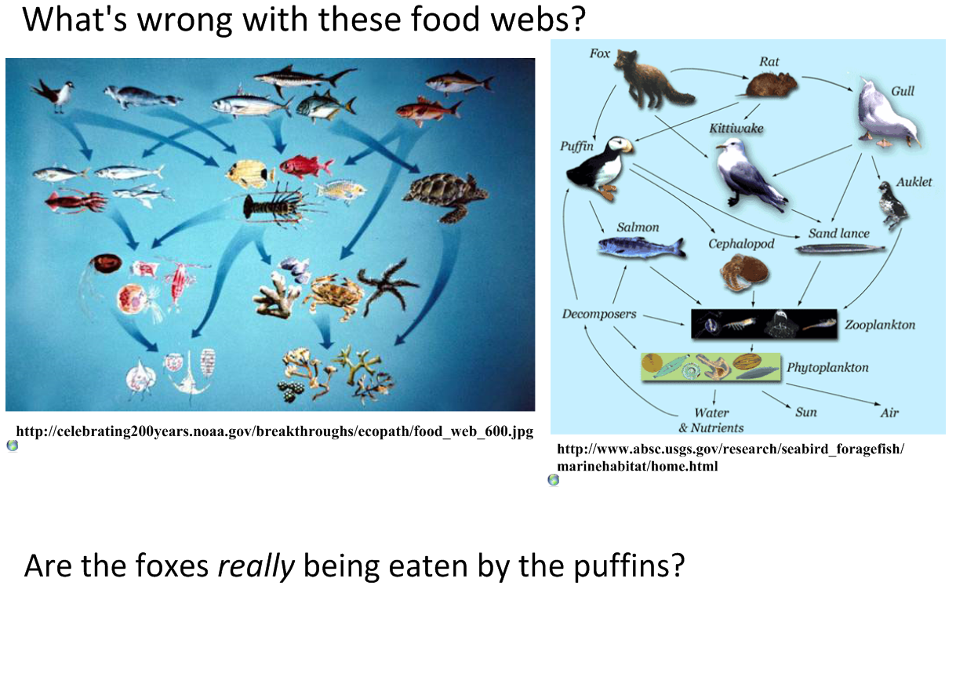

Slide 20
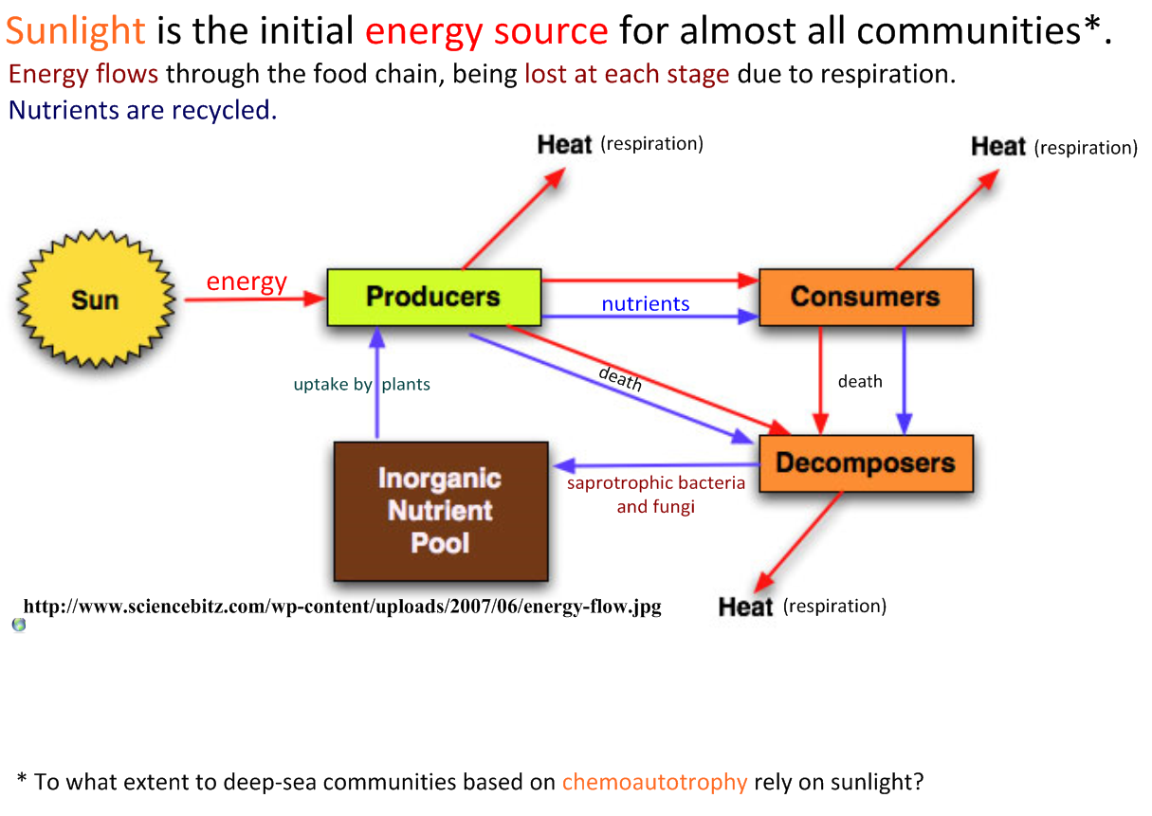

Slide 21
Energy Losses in Ecosystems
Respiration releases energy which is used by organisms and converted to heat
Heat energy is unusable to organisms and is lost from ecosystems
Reasons for energy loss between trophic levels:
  Heat energy lost from respiration
  Organic material not consumed
  Not all parts of consumed matter digested or absorbed by consumer
  Energy lost in feces and passes to decomposers instead
As a result, food chains are limited in length

Slide 22
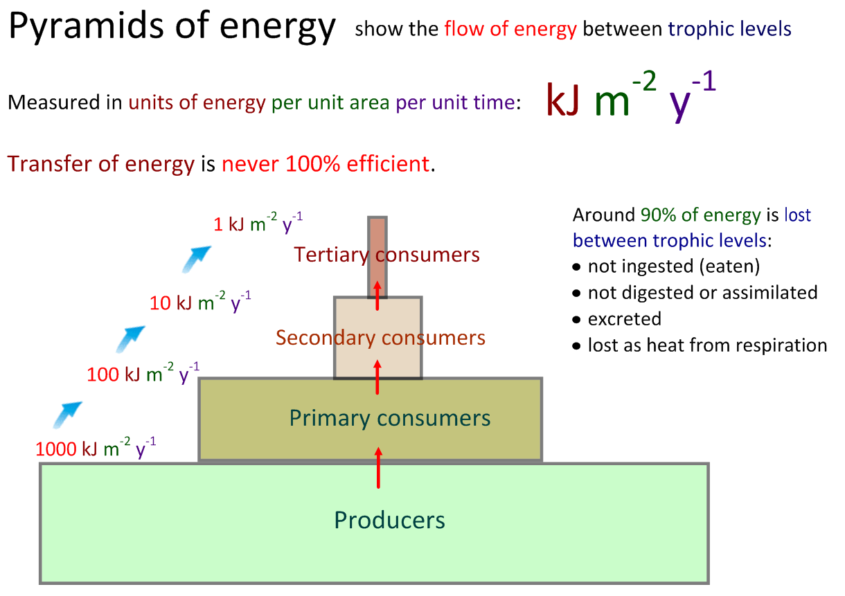

Slide 23
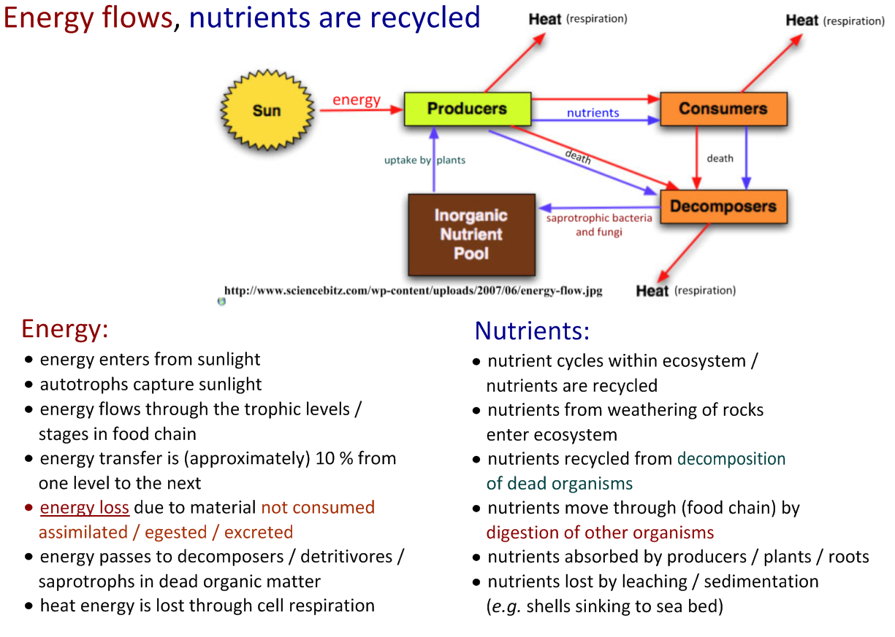

Slide 24


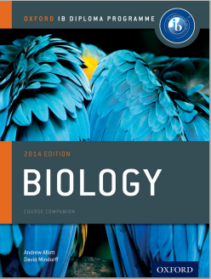


Bibliography / Acknowledgments
Jason de Nys
Chris Paine

