Slide 1
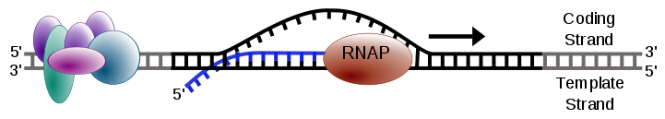
7.2 Transcription and gene expression
Essential idea: Information stored as a code in DNA is copied onto mRNA.
"The genetic code is frequently referred to as a blueprint because it contains the instructions a cell requires in order to sustain itself. We now know that there is more to these instructions than simply the sequence of letters in the nucleotide code, however. For example, vast amounts of evidence demonstrate that this code is the basis for the production of various molecules, including RNA and protein ... In transcription, a portion of the double-stranded DNA template gives rise to a single-stranded RNA molecule."
http://www.nature.com/scitable/topicpage/dna-transcription-426#
The image shows how DNA is used as a template to create portable molecules of genetic code, i.e. mRNA, that can leave the nucleus for translation in other regions of the cell.
https://commons.wikimedia.org/wiki/File:Simple_transcription_elongation1.svg

Slide 2
Understandings, Applications and Skills
 | Statement | Guidance
7.2.U1 | Transcription occurs in a 5’ to 3’ direction. | RNA polymerase adds the 5´ end of the free RNA nucleotide to the 3´ end of the growing mRNA molecule.
7.2.U2 | Nucleosomes help to regulate transcription in eukaryotes.
7.2.U3 | Eukaryotic cells modify mRNA after transcription.
7.2.U4 | Splicing of mRNA increases the number of different proteins an organism can produce.
7.2.U5 | Gene expression is regulated by proteins that bind to specific base sequences in DNA.
7.2.U6 | The environment of a cell and of an organism has an impact on gene expression.
7.2.A1 | The promoter as an example of non-coding DNA with a function.
7.2.S1 | Analysis of changes in the DNA methylation patterns.

Slide 3
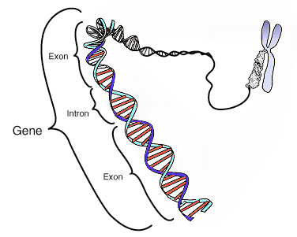
Review: 7.1.U6 Some regions of DNA do not code for proteins but have other important functions.
Between genes exist non-coding regions of DNA. Although such DNA does not code for polypeptides it can affect transcription of mRNA.
Promoters sequences are attachment points for RNA polymerase adjacent to the gene
Some other regions act as binding sites for particular proteins, which in turn affect transcription of the nearby gene:
Enhancers are sequences that increase the rate of transcription (when a protein is bound to it)
Silencers inhibit transcription (when a protein is bound to it)
http://commons.wikimedia.org/wiki/File:Gene.png

Slide 4

7.2.A1 The promoter as an example of non-coding DNA with a function.
Non-coding regions have important functions, for example promoters:
The promoter is a DNA sequence is located near a gene. It acts as the binding site for RNA polymerase.
The adjacent gene is transcribed, but the promoter region is not.
Operator is a region of DNA that can regulate transcription, typically inhibiting transcription (silencers are a type of operator)
RNA polymerase transcribes the gene into RNA, typically mRNA.
http://en.wikipedia.org/wiki/File:Lac_operon1.png
Edited from: http://commons.wikimedia.org/wiki/File:Lac_Operon.svg

Slide 5
7.2.U5 Gene expression is regulated by proteins that bind to specific base sequences in DNA.
One well known example of the regulation of gene expression by proteins is the metabolism of lactose in E. Coli bacterium. The diagram below illustrates this example.
RNA Polymerase
The repressor protein is bound to the operator preventing RNA Polymerase from transcription of the genes
DNA Strand
Operator is a region of DNA that can regulate transcription, typically inhibiting transcription, such as this silencer sequence.
Genes involved in the metabolism (breakdown) of lactose
The promoter is a DNA sequence is located near a gene. It acts as the binding site for RNA polymerase.
The consequence of the inhibition of the lactose metabolism is that the concentration of undigested lactose now increases in E. Coli …
Edited from: http://commons.wikimedia.org/wiki/File:Lac_Operon.svg

Slide 6
7.2.U5 Gene expression is regulated by proteins that bind to specific base sequences in DNA.
One well known example of the regulation of gene expression by proteins is the metabolism of lactose in E. Coli bacterium. The diagram below illustrates this example.
Lactose binds to the repressor protein inhibiting it: the repressor can no longer bind to the operator.
Lactose molecules build up inside the E. Coli
With the synthesis of lactase the lactose is broken down, as it’s concentration decreases the inhibition of the repressor molecules will decrease ‘silencing’ the gene again.
RNA polymerase binds with the promoter, and express the genes (by transcribing them), which in turn synthesizes lactase

Slide 7
7.2.U5 Gene expression is regulated by proteins that bind to specific base sequences in DNA.
Summary of common types of regulating proteins and associated sequences found in eukaryotes.
DNA Sequence | Binding protein | Function
Enhancers | Activator | Activator proteins bind to enhancer sequences of DNA to greatly increase the rate of transcription of a gene.
Silencers | Repressor | Repressor proteins bind to non-coding regions of DNA to either block or reduce the transcription of a gene.
Promoter | RNA Polymerase | A region of DNA located close to a specific gene. Once bound to the sequence RNA polymerase transcribes the gene.

Slide 8
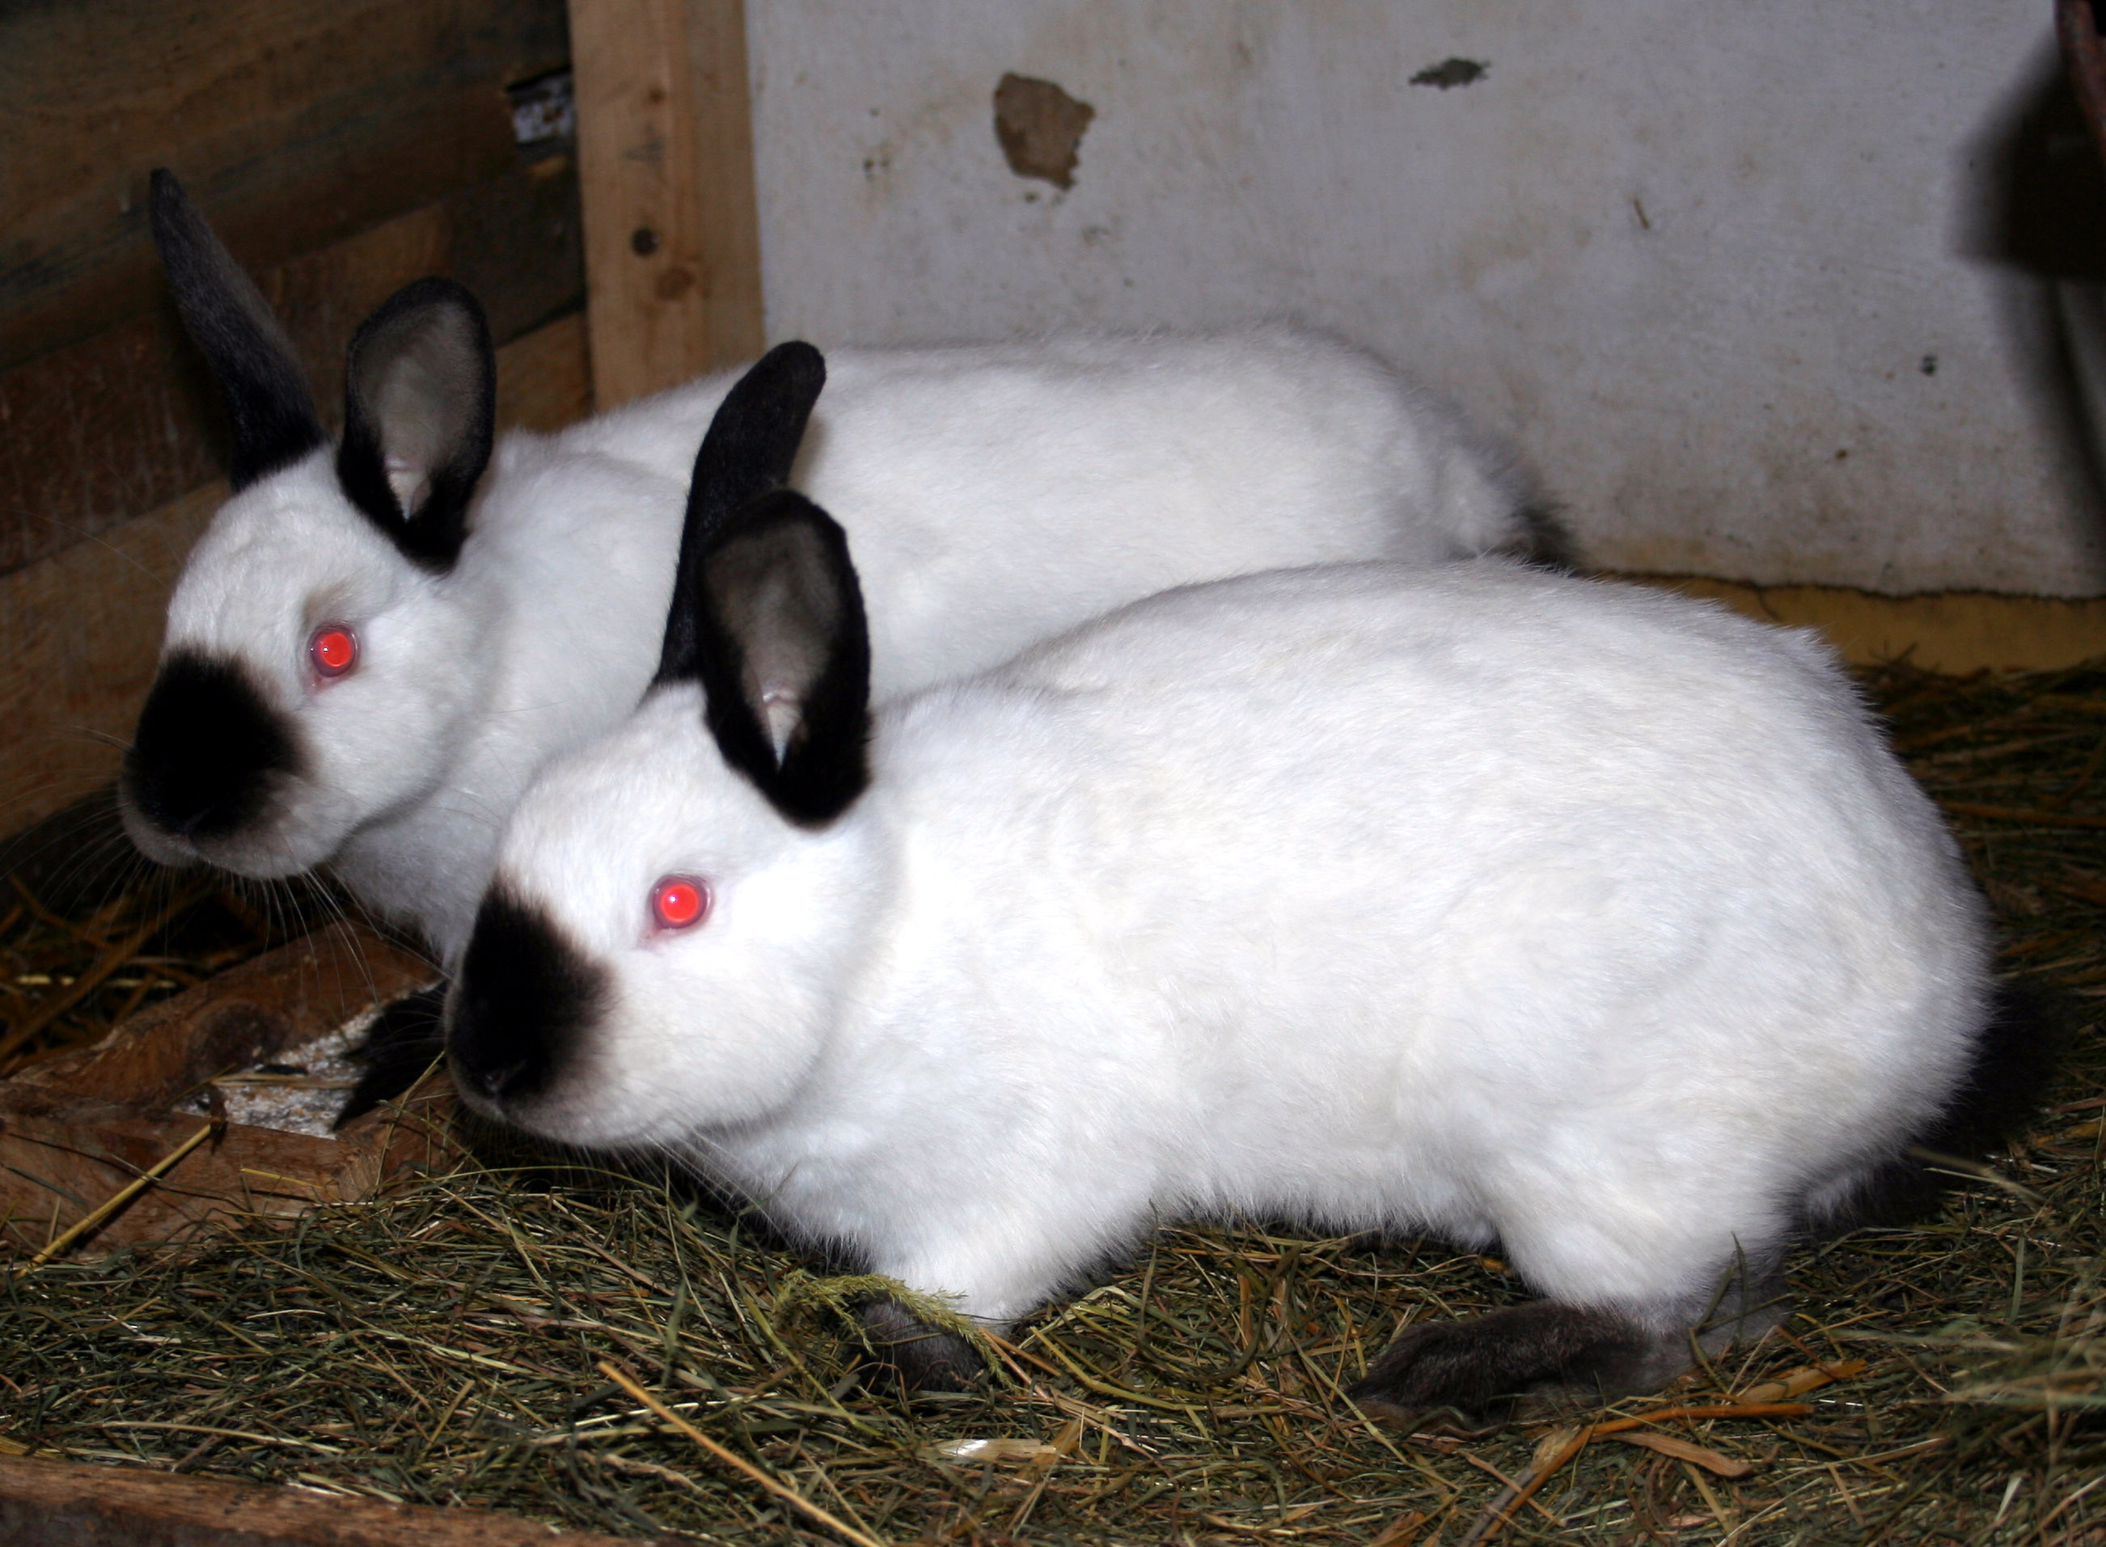
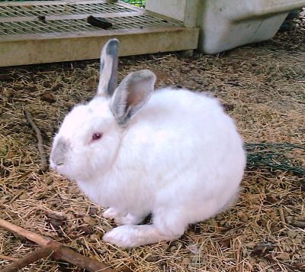
7.2.U6 The environment of a cell and of an organism has an impact on gene expression.
The environment of an organism impacts gene expression. For example human hair and skin colour are impacted by the exposure to sunlight and high temperatures.
Similarly pigments in the fur of Himalayan rabbits (Oryctolagus cuniculus) are regulated by temperature.
Gene C controls fur pigmentation in Himalayan rabbits. The gene is active when environmental temperatures are between 15 and 25°C. At higher temperatures the gene is inactive.
  In the warm weather no pigment is produced and the fur is white
  In low temperatures Gene C becomes active in the rabbit's colder extremities (ears, nose, and feet) and produces a black pigment.
Can you suggest a reason why this is a useful adaptation?
http://upload.wikimedia.org/wikipedia/commons/0/06/Kr%C3%B3liki_kalifornijskie_666.jpg
http://www.alpinecommunitynetwork.com/wp-content/uploads/himalayan-bunny-5-19-11-1_opt4.jpg

Slide 9
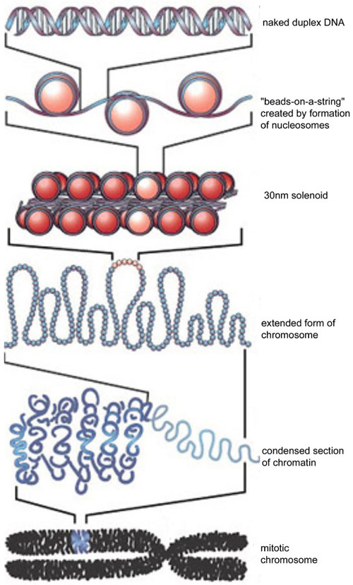
Review: 7.1.U1 Nucleosomes help to supercoil the DNA.
Eukaryotic DNA supercoiling is organised by nucleosomes
Nucleosomes both protect DNA and allow it to be packaged, this in turn allows DNA to be supercoiled.
Nucleosomes are formed by wrapping DNA around histone proteins
n.b. Prokaryotic DNA is, like eukaryotic DNA, supercoiled, but differently: Prokaryotic DNA maybe associated with proteins, but it is not organised by histones and is therefore sometimes referred as being ‘naked’.
http://en.wikipedia.org/wiki/File:DNA_to_Chromatin_Formation.jpg

Slide 10
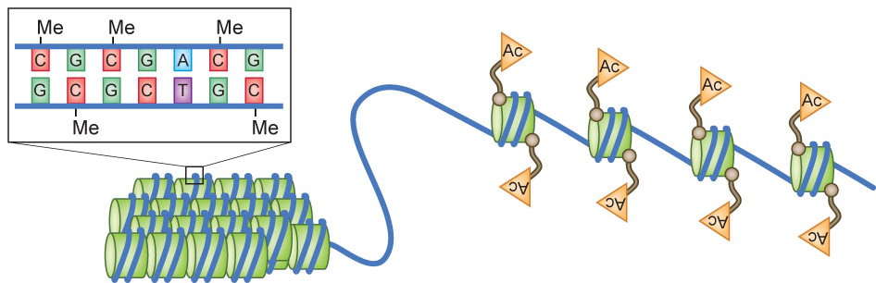
7.2.U2 Nucleosomes help to regulate transcription in eukaryotes.
Methylation is the addition of methyl groups to DNA
Acetylation is the addition of Acetyl groups to histones
Edited from: http://www.nature.com/neuro/journal/v13/n4/images/nn0410-405-F1.jpg

Slide 11
7.2.U2 Nucleosomes help to regulate transcription in eukaryotes.
Methylation is the addition of methyl groups to DNA
Methylation of DNA inhibits transcription
Processes that inhibit transcription bind the DNA more tightly to the histone making it less accessible to transcription factors (forming heterochromatin).
*Chromatin is a complex of DNA, protein and RNA. Tightly packed chromatin which cannot be transcribed is referred to as heterochromatin.
Edited from: http://www.nature.com/neuro/journal/v13/n4/images/nn0410-405-F1.jpg

Slide 12
7.2.U2 Nucleosomes help to regulate transcription in eukaryotes.
Acetylation is the addition of Acetyl groups to histones
Processes that promote transcription bind the DNA more loosely to the histone making it more accessible to transcription factors (forming euchromatin*).
Acetylation promotes transcription
n.b. Methylation of histones can also occur, this process can both promote and inhibit transcription.
*Chromatin is a complex of DNA, protein and RNA. Loosely packed chromatin which can be transcribed is referred to as euchromatin.
Edited from: http://www.nature.com/neuro/journal/v13/n4/images/nn0410-405-F1.jpg

Slide 13
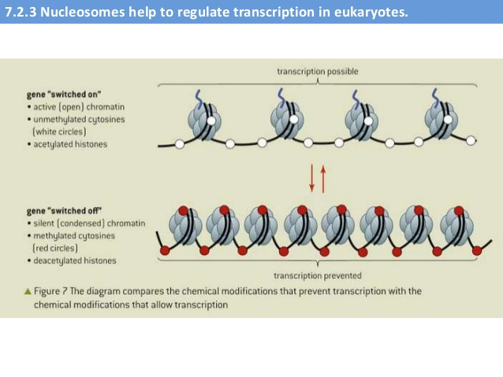

Slide 14
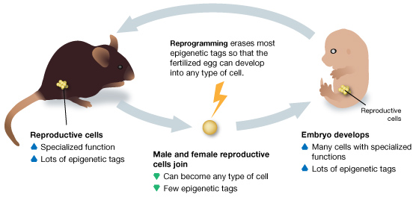
7.2.U2 Nucleosomes help to regulate transcription in eukaryotes.
Changes in the environment affect the cell metabolism, this in turn can directly or indirectly affect processes such as Acetylation & Methylation.
Methylation and acetylation mark the DNA to affect transcription. These these markers are known as epigenetic tags*.
For a new organism to grow it needs unmarked DNA that can develop into lots of different specialised cell types.
Reprogramming scours the genome and erases the epigenetic tags to return the cells to a genetic "blank slate”.
For a small number of genes, epigenetic tags make it through this process unchanged hence get passed from parent to offspring.
*The branch of genetics concerned with hertible changes not caused by DNA is called Epigenetics.
http://learn.genetics.utah.edu/content/epigenetics/inheritance/images/Reprogramming.jpg

Slide 15
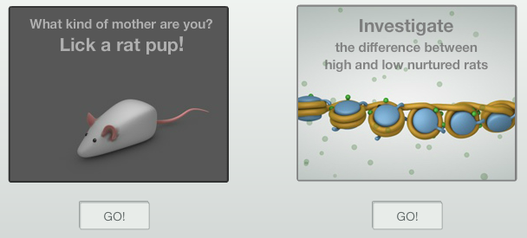
Nature of Science: Looking for patterns, trends and discrepancies - there is mounting evidence that the environment can trigger heritable changes in epigenetic factors. (3.1)
Use the excellent Learn.Genetics resources to learn more about Epigenetics and it’s importance.
http://learn.genetics.utah.edu/content/epigenetics/rats/
What evidence can you find that supports the idea that the environment can trigger heritable changes?

Slide 16


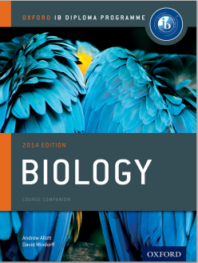

Bibliography / Acknowledgments
Bob Smullen

