Slide 1
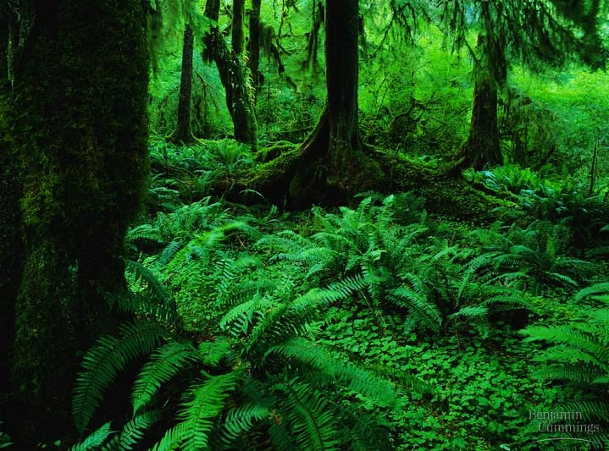
Photosynthesis 1: The Light Reactions
(Ch. 10)

Slide 2
Big Questions
How does the structure and functions of photosynthetic cells allow for autotrophic nutrition?
How does the structure and functions of plants allow for the maintenance of photosynthetic cells?
Why do plants need to convert the free energy of sunlight into chemical bonds?

Slide 3
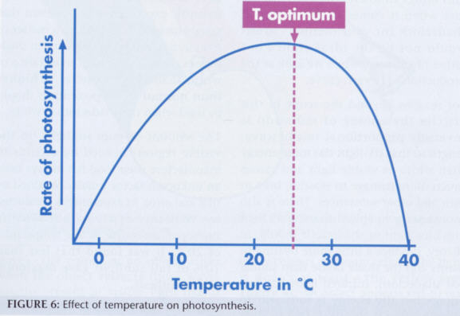
Factors affecting photosynthesis
1. Temperature
  Increases the rate of photosynthesis
  Most plants have an optimal range
  Higher temperatures denature the enzymes
Notes:
http://www.ont.co.za/Focus200307.jpg

Slide 4
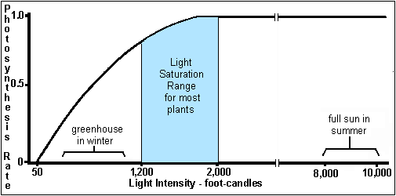
Factors affecting Photosynthesis
2. Light intensity
  increasing intensity increases the rate of photosynthesis

Slide 5
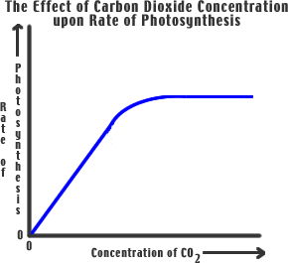
Factors affecting Photosynthesis
3. Carbon dioxide
  Increasing carbon dioxide increases photosynthesis

Slide 6
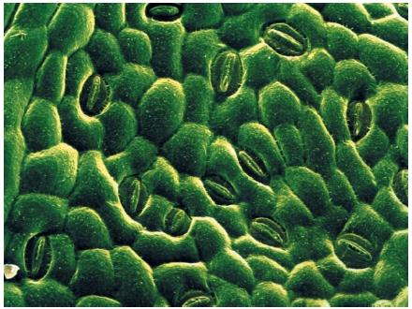
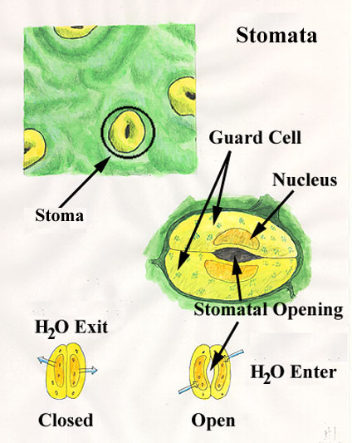
Factors affecting Photosynthesis
4. Water
  If water is not available, stomata close and there is decreased CO2

Slide 7
What does it mean to be a plant?
Need to…
  collect light energy
    transform it into chemical energy
  store light energy
    in a stable form to be moved around
    the plant or stored
  need to get building block atoms
  from the environment
    C,H,O,N,P,K,S,Mg
  produce all organic molecules
  needed for growth
    carbohydrates, proteins, lipids, nucleic acids
ATP
glucose
CO₂
H₂O
N
K
P
…

Slide 8
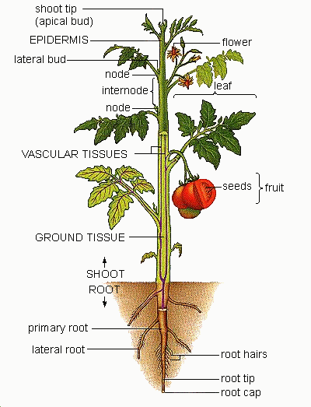
Plant structure
Obtaining raw materials
  sunlight
    leaves = solar collectors
  CO₂
    stomates = gas exchange
  H₂O
    uptake from roots
  nutrients
    N, P, K, S, Mg, Fe…
    uptake from roots

Slide 9
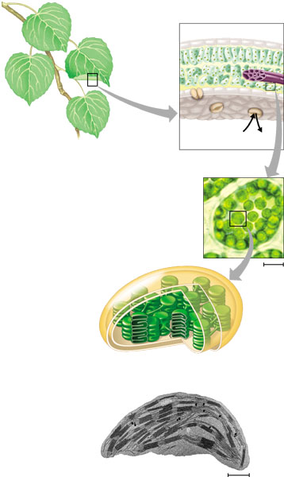
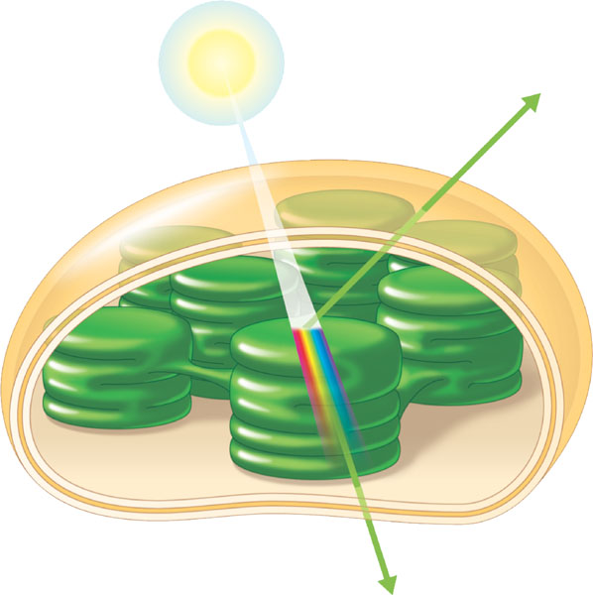
Chloroplasts
cross section
of leaf
absorb
sunlight & CO₂
leaves
CO₂
chloroplasts
in plant cell
chloroplasts
contain
chlorophyll
chloroplast
make
energy & sugar

Slide 10
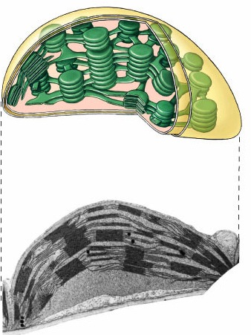
Plant structure
chloroplast
H⁺
H⁺
H⁺
H⁺
H⁺
H⁺
H⁺
H⁺
H⁺
Chloroplasts
  double membrane
  stroma
    fluid-filled interior
  thylakoid sacs
  grana stacks
Thylakoid membrane contains
  chlorophyll molecules
  electron transport chain
  ATP synthase
    H⁺ gradient built up within thylakoid sac
ATP
H⁺
H⁺
thylakoid
outer membrane
inner membrane
stroma
thylakoid
granum
Notes:
A typical mesophyll cell has 30-40 chloroplasts, each about 2-4 microns by 4-7 microns long.
Each chloroplast has two membranes around a central aqueous space, the stroma.
In the stroma are membranous sacs, the thylakoids.
These have an internal aqueous space, the thylakoid lumen or thylakoid space.
Thylakoids may be stacked into columns called grana.

Slide 11
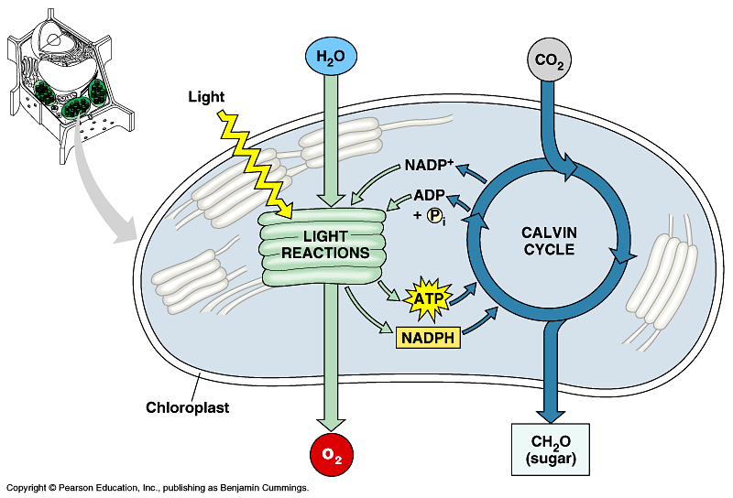

Photosynthesis
Light reactions
  light-dependent reactions
  energy conversion reactions
    convert solar energy to chemical energy
    ATP & NADPH
Calvin cycle
  light-independent reactions
  sugar building reactions
    uses chemical energy (ATP & NADPH) to reduce CO₂ & synthesize C₆H₁₂O₆
It’s not the
Dark Reactions!

Slide 12
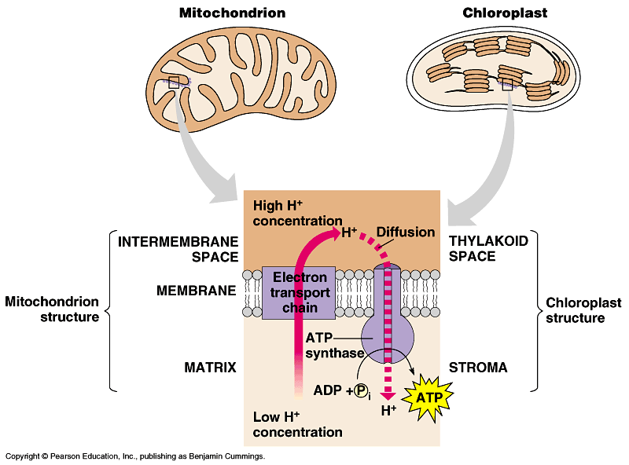
Light reactions
chloroplast
thylakoid
H⁺
H⁺
H⁺
H⁺
H⁺
H⁺
H⁺
H⁺
H⁺
H⁺
H⁺
H⁺
H⁺
H⁺
H⁺
H⁺
ATP
H⁺
H⁺
H⁺
H⁺
H⁺
H⁺
Electron Transport Chain
    like in cellular respiration
  proteins in organelle membrane
  electron acceptors
    NADPH
  proton (H⁺)
  gradient across
  inner membrane
  ATP synthase
  enzyme
Notes:
Not accidental that these 2 systems are similar, because both derived from the same primitive ancestor.

Slide 13

Light-Dependent phase
Occurs in grana
Sunlight energy hits chlorophyll exciting electrons.
The return of electrons to ground state provides energy for 2 processes:
  A) Photolysis "light splitting"
  B) Phosphorylation "formation of ATP"

Slide 14
A) Photolysis
Splitting of water into oxygen and hydrogen
H₂O → O₂ + H+ + Energy
  Oxygen is a waste product and diffuses out of chloroplast
  Provides electrons that will be excited when light is absorbed and fuel ATP formation.
Hydrogen excess drives the rest of the reaction.
  Extra hydrogen picked up by H carrier: NADP
  NADP → NADPH₂
  NADPH2 diffuses out into stroma for use in the Light independent phase (Calvin Cycle)

Slide 15
B) Phosphorylation
Formation of ATP through an electron transport chain and the production of an H+ gradient across the thylakoid membrane
ATP used in dark phase
Formation of NADPH from NADP through redox reactions

Slide 16
The Overview

Slide 17
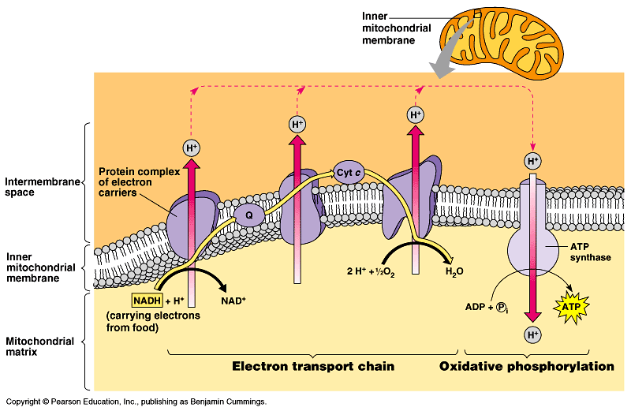
ETC of Respiration
Mitochondria transfer chemical energy from food molecules into chemical energy of ATP
  use electron carrier NADH
generates H₂O
Notes:
NADH is an input
ATP is an output
O₂ combines with H⁺’s to form water
Electron is being handed off from one electron carrier to another -- proteins, cytochrome proteins & quinone lipids
So what if it runs in reverse??

Slide 18
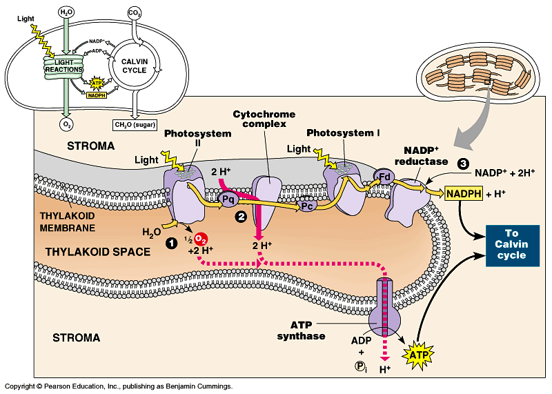
ETC of Photosynthesis
Chloroplasts transform light energy into chemical energy of ATP
  use electron carrier NADPH
generates O₂
Notes:
Two places where light comes in.
Remember photosynthesis is endergonic -- the electron transport chain is driven by light energy.
Need to look at that in more detail on next slide

Slide 19
Chloroplasts vs. Mitochondria
Chloroplasts and mitochondria generate ATP by the same mechanism: chemiosmosis.
  An electron transport chain pumps protons across a membrane as electrons are passed along a series of more electronegative carriers.
  This builds the proton-motive force in the form of an H⁺ gradient across the membrane.
  ATP synthase molecules harness the proton-motive force to generate ATP as H⁺ diffuses back across the membrane.
Mitochondria transfer chemical energy from food molecules to ATP and chloroplasts transform light energy into the chemical energy of ATP.

Slide 20
Chloroplasts vs. Mitochondria

Slide 21
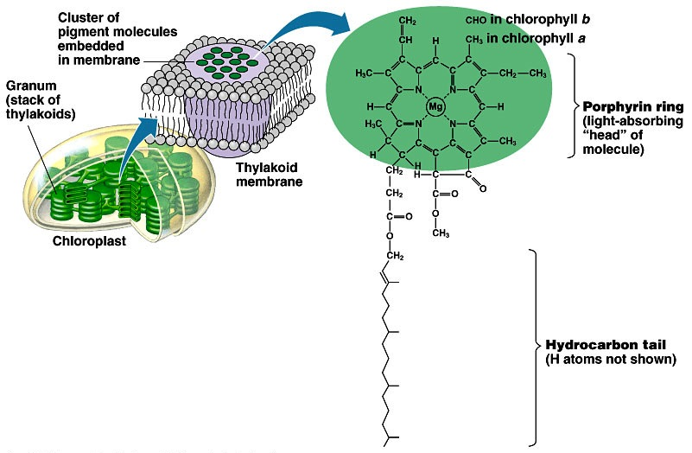
Pigments of photosynthesis
How does this
molecular structure
fit its function?
Chlorophylls & other pigments
  embedded in thylakoid membrane
  arranged in a “photosystem”
    collection of molecules
  structure-function relationship

Slide 22
Excited Chlorophyll
When photons of light are absorbed by the pigments, the energy cannot disappear.
Instead, the electrons in the pigments are excited and move to a higher orbital.
This excitement cannot last for long, and this energy needs to be stored in energy storing molecules.

Slide 23
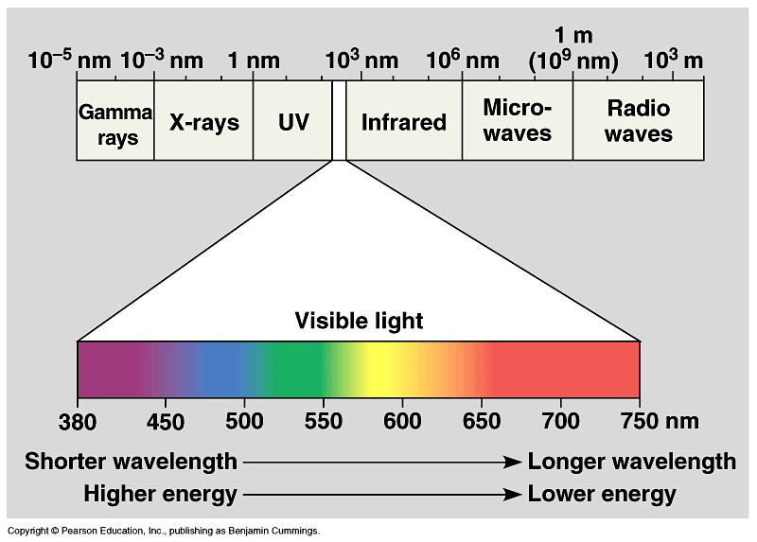
A Look at Light
The spectrum of color
V
I
B
G
Y
O
R

Slide 24
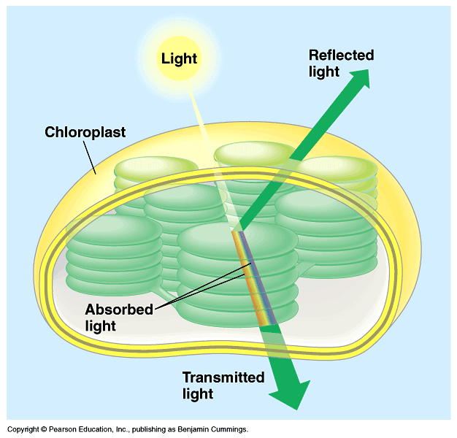
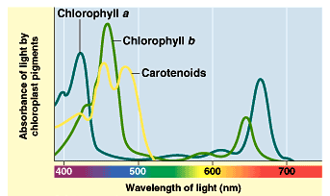
Light: absorption spectra
Photosynthesis gets energy by absorbing wavelengths of light
  chlorophyll a
    absorbs best in red & blue wavelengths & least in green
  accessory pigments with different structures absorb light of different wavelengths
    chlorophyll b, carotenoids, xanthophylls
Why are
plants green?

Slide 25
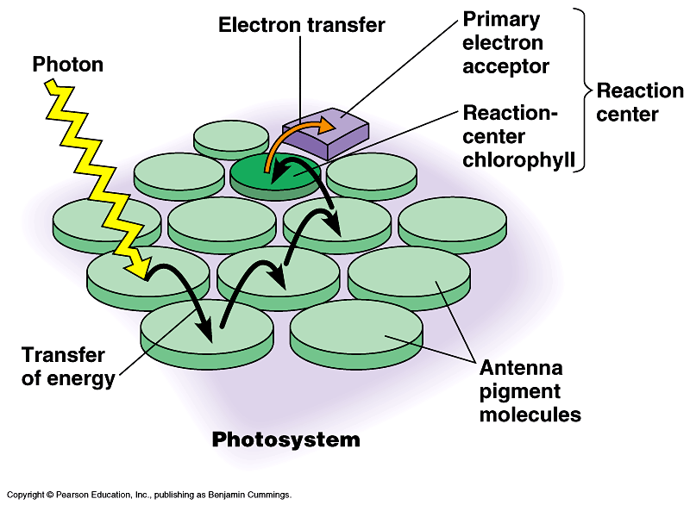
Photosystems of photosynthesis
2 photosystems in thylakoid membrane
  collections of chlorophyll molecules
  act as light-gathering molecules
  Photosystem II
    chlorophyll a
    P₆₈₀ = absorbs 680nm
    wavelength red light
  Photosystem I
    chlorophyll b
    P₇₀₀ = absorbs 700nm
    wavelength red light
reaction
center
antenna
pigments
Notes:
Photons are absorbed by clusters of pigment molecules (antenna molecules) in the thylakoid membrane.
When any antenna molecule absorbs a photon, it is transmitted from molecule to molecule until it reaches a particular chlorophyll a molecule = the reaction center.
At the reaction center is a primary electron acceptor which removes an excited electron from the reaction center chlorophyll a.
This starts the light reactions.
Don’t compete with each other, work synergistically using different wavelengths.

Slide 26
ETC of Photosynthesis
chlorophyll a
Photosystem II
chlorophyll b
Photosystem I
Notes:
Two places where light comes in.
Remember photosynthesis is endergonic -- the electron transport chain is driven by light energy.
Need to look at that in more detail on next slide

Slide 27
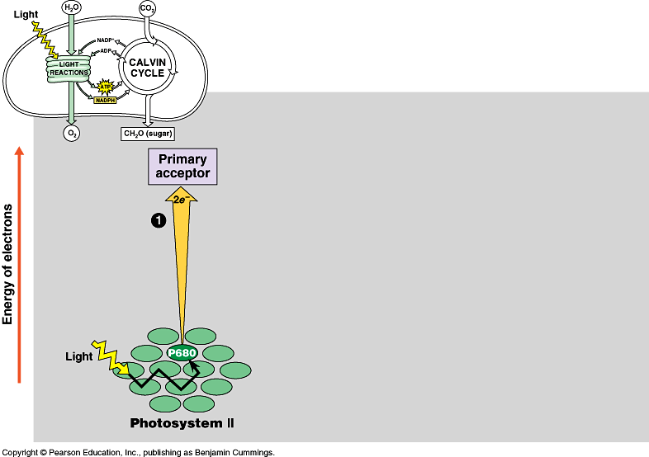
ETC of Photosynthesis
sun
1
e
e
Photosystem II
P680
chlorophyll a
Notes:
PS II absorbs light
Excited electron passes from chlorophyll to the primary electron acceptor
Need to replace electron in chlorophyll
An enzyme extracts electrons from H₂O & supplies them to the chlorophyll
This reaction splits H₂O into 2 H⁺ & O⁻ which combines with another O⁻ to form O₂
O₂ released to atmosphere
Chlorophyll absorbs light energy (photon) and this moves an electron to a higher energy state
Electron is handed off down chain from electron acceptor to electron acceptor
In process has collected H⁺ ions from H₂O & also pumped by Plastoquinone within thylakoid sac.
Flow back through ATP synthase to generate ATP.

Slide 28
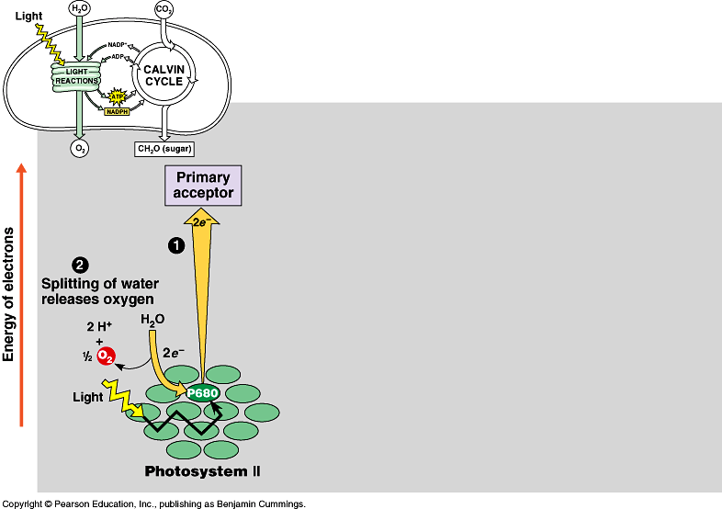
Inhale, baby!
ETC of Photosynthesis
chloroplast
thylakoid
H⁺
H⁺
H⁺
H⁺
H⁺
H⁺
H⁺
H⁺
H⁺
H⁺
H⁺
H⁺
H⁺
H⁺
H⁺
H⁺
ATP
H⁺
H⁺
H⁺
H⁺
H⁺
H⁺
Plants SPLIT water!
1
H
H
2
O
e
e
O
H
H
O
e⁻
H⁺
+H
e⁻
e
e
fill the ^{–e} vacancy
Photosystem II
P680
chlorophyll a

Slide 29
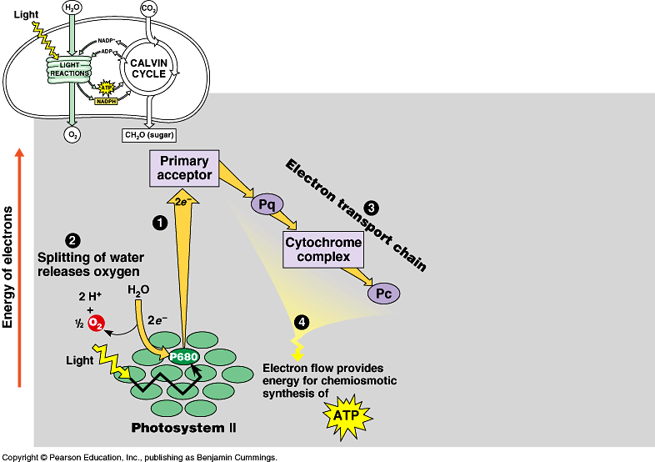
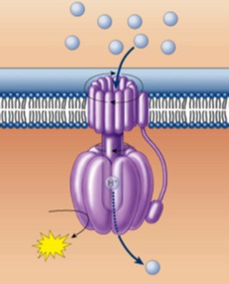
ETC of Photosynthesis
chloroplast
thylakoid
H⁺
H⁺
H⁺
H⁺
H⁺
H⁺
H⁺
H⁺
H⁺
H⁺
H⁺
H⁺
H⁺
H⁺
H⁺
H⁺
ATP
H⁺
H⁺
H⁺
H⁺
H⁺
H⁺
e
e
3
1
2
H⁺
e
e
ATP
4
H⁺
to Calvin Cycle
H⁺
H⁺
H⁺
H⁺
H⁺
H⁺
H⁺
H⁺
energy to build
carbohydrates
Photosystem II
P680
chlorophyll a
ATP
ADP + P_{i}
H⁺

Slide 30
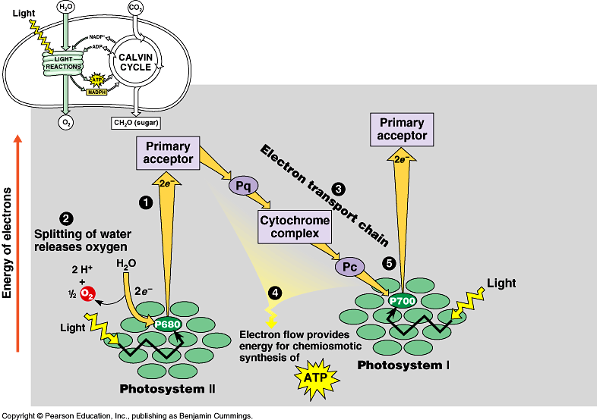
ETC of Photosynthesis
e
e
e
sun
e
fill the e– vacancy
e
5
e
e
e
Photosystem I
P700
chlorophyll b
Photosystem II
P680
chlorophyll a
Notes:
Need a 2nd photon -- shot of light energy to excite electron back up to high energy state.
2nd ETC drives reduction of NADP to NADPH.
Light comes in at 2 points.
Produce ATP & NADPH

Slide 31
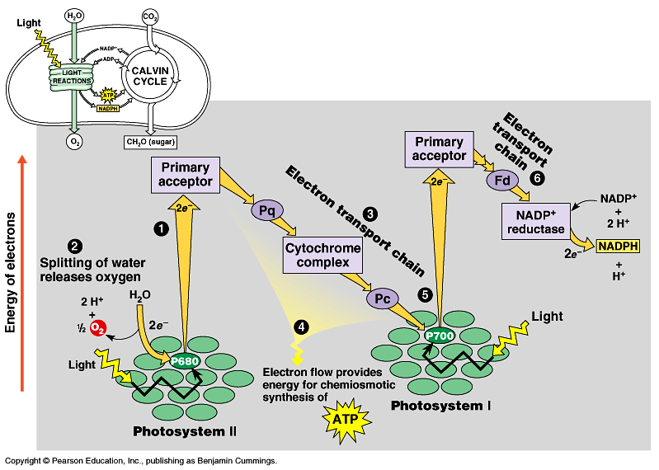

ETC of Photosynthesis
electron carrier
e
e
6
e
e
5
sun
NADPH to
Calvin Cycle
Photosystem I
P700
chlorophyll b
Photosystem II
P680
chlorophyll a
$$ in the bank…
reducing power!
Notes:
Need a 2nd photon -- shot of light energy to excite electron back up to high energy state.
2nd ETC drives reduction of NADP to NADPH.
Light comes in at 2 points.
Produce ATP & NADPH

Slide 32

ETC of Photosynthesis
sun
sun
e
e
e
e
H⁺
H⁺
H⁺
O
H⁺
H⁺
H⁺
H⁺
H⁺
to Calvin Cycle
H⁺
H⁺
H⁺
split H₂O
ATP
Notes:
Two places where light comes in.
Remember photosynthesis is endergonic -- the electron transport chain is driven by light energy.
Need to look at that in more detail on next slide

Slide 33
ETC of Photosynthesis
ETC uses light energy to produce
  ATP & NADPH
    go to Calvin cycle
PS II absorbs light
  excited electron passes from chlorophyll to “primary electron acceptor”
  need to replace electron in chlorophyll
  enzyme extracts electrons from H₂O & supplies them to chlorophyll
    splits H₂O
    O combines with another O to form O₂
    O₂ released to atmosphere
    and we breathe easier!

Slide 34
Experimental evidence
Where did the O₂ come from?
  radioactive tracer = O₁₈
Experiment 1
light
energy
→
6CO₂
+
6H₂O
+
light
energy
→
+
6O₂
6CO₂
+
6H₂O
+
C₆H₁₂O₆
+
6O₂
C₆H₁₂O₆
Experiment 2
6CO₂
+
6H₂O
+
light
energy
→
C₆H₁₂O₆
+
6O₂
Proved O₂ came from H₂O not CO₂ = plants split H₂O!

Slide 35
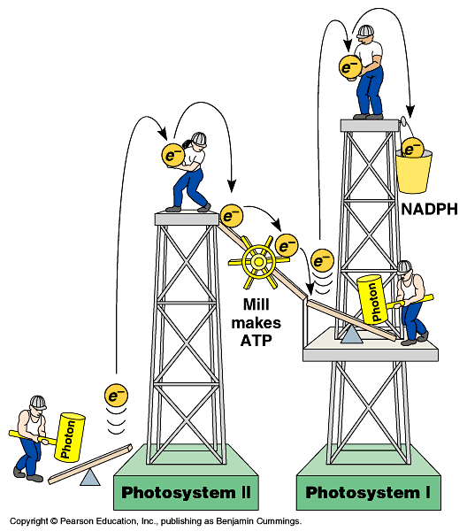

Noncyclic Photophosphorylation
Light reactions elevate electrons in
2 steps (PS II & PS I)
  PS II generates
  energy as ATP
  PS I generates
  reducing power as NADPH
ATP
Notes:
1 photosystem is not enough.
Have to lift electron in 2 stages to a higher energy level. Does work as it falls.
First, produce ATP -- but producing ATP is not enough.
Second, need to produce organic molecules for other uses & also need to produce a stable storage molecule for a rainy day (sugars). This is done in Calvin Cycle!

Slide 36
Cyclic photophosphorylation
If PS I can’t pass electron to NADP…it cycles back to PS II & makes more ATP, but no NADPH
  coordinates light reactions to Calvin cycle
  Calvin cycle uses more ATP than NADPH

ATP
18 ATP +
12 NADPH
→
1 C₆H₁₂O₆

Slide 37
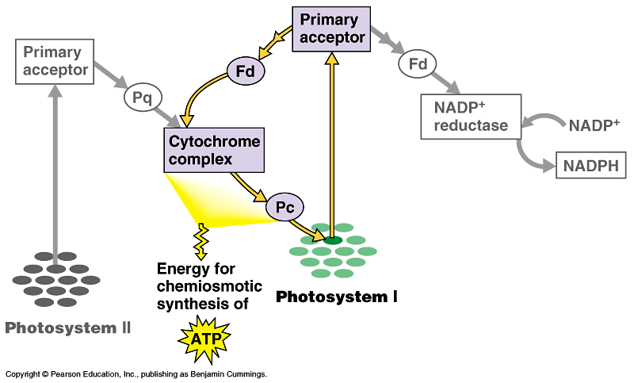
Photophosphorylation
cyclic
photophosphorylation
NADP
NONcyclic
photophosphorylation
ATP

Slide 38
Photosynthesis summary
Where did the energy come from?
Where did the electrons come from?
Where did the H₂O come from?
Where did the O₂ come from?
Where did the O₂ go?
Where did the H⁺ come from?
Where did the ATP come from?
What will the ATP be used for?
Where did the NADPH come from?
What will the NADPH be used for?
…stay tuned for the Calvin cycle
Notes:
Where did the energy come from? The Sun
Where did the electrons come from? Chlorophyll
Where did the H₂O come from?
The ground through the roots/xylem
Where did the O₂ come from? The splitting of water
Where did the O₂ go? Out stomates to air
Where did the H⁺ come from? The slitting of water
Where did the ATP come from?
Photosystem 2: Chemiosmosis (H+ gradient)
What will the ATP be used for?
The work of plant life! Building sugars
Where did the NADPH come from?
Reduction of NADP (Photosystem 1)
What will the NADPH be used for? Calvin cycle / Carbon fixation

Slide 39
Review Questions

Slide 40
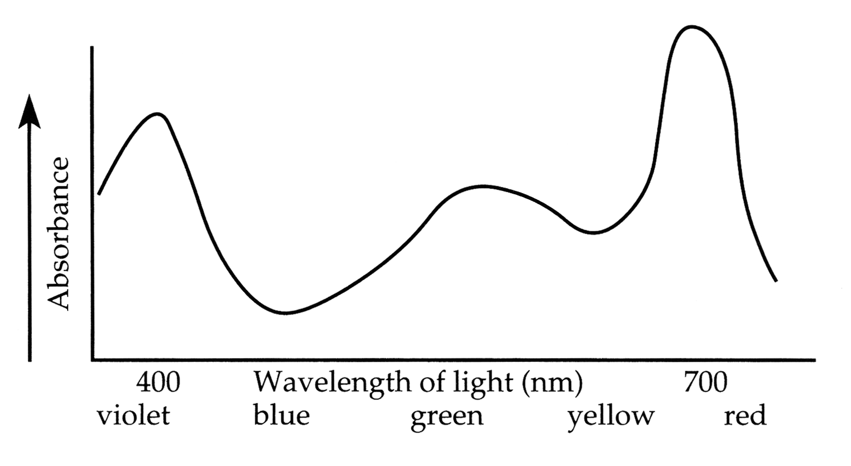
0
1. Below is an absorption spectrum for an unknown pigment molecule. What color would this pigment appear to you?
  violet
  blue
  green
  yellow
  red
Notes:
Answer: b
Source: Taylor - Student Study Guide for Biology, Sixth Edition, Test Your Knowledge Question #6

Slide 41
0
2. In green plants, most of the ATP for synthesis of proteins, cytoplasmic streaming, and other cellular activities comes directly from
  photosystem I.
  the Calvin cycle.
  oxidative phosphorylation.
  noncyclic photophosphorylation.
  cyclic photophosphorylation.
Notes:
Answer: c
Source: Taylor - Student Study Guide for Biology, Sixth Edition, Test Your Knowledge Question #15

Slide 42
0
3. What portion of an illuminated plant cell would you expect to have the lowest pH?
  nucleus
  vacuole
  chloroplast
  stroma of chloroplast
  thylakoid space
Notes:
Answer: e
Source: Taylor - Student Study Guide for Biology, Sixth Edition, Test Your Knowledge Question #19

Slide 43
0
4. A new flower species has a unique photosynthetic pigment. The leaves of this plant appear to be reddish yellow. What wavelengths of visible light are not being absorbed by this pigment?
  red and yellow
  blue and violet
  green and yellow
  blue, green, and red
  green, blue, and violet
Notes:
Answer: a
Source: Barstow - Test Bank for Biology, Sixth Edition, Question #8

Slide 44
0
5. Assume a thylakoid is somehow punctured
so that the interior of the thylakoid is no longer separated from the stroma. This damage will have the most direct effect on which of the following processes?
  the splitting of water
  the absorption of light energy by chlorophyll
  the flow of electrons from photosystem II to photosystem I
  the synthesis of ATP
  the reduction of NADP⁺
Notes:
Answer: d
Source: Barstow - Test Bank for Biology, Sixth Edition, Question #24

Slide 45
0
6. Which of the following conclusions does not follow from studying the absorption spectrum for chlorophyll a and the action spectrum for photosynthesis?
  Not all wavelengths are equally effective for photosynthesis.
  There must be accessory pigments that broaden
  the spectrum of light that contributes energy for photosynthesis.
  The red and blue areas of the spectrum are most effective in driving photosynthesis.
  Chlorophyll owes its color to the absorption of
  green light.
  Chlorophyll a has two absorption peaks.
Notes:
Answer: d
Source: Campbell/Reece - Biology, Sixth Edition, EOC Self-Quiz Question #3

Slide 46
0
Diagram Time!
Draw a symbolic representation of the chloroplast electron transport chain (include the stroma and the thylakoid space).
Show the interactions of light, NADPH, electrons, protons, ADP, Pi, and ATP with the electron transport chain that lead to photophosphorylation.
Notes:
Answer: d
Source: Campbell/Reece - Biology, Sixth Edition, EOC Self-Quiz Question #3

