Slide 1
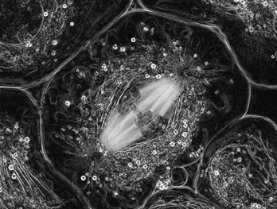
Meiosis (3.3) IB Diploma Biology
Essential Idea: Meiosis produces genetically-varied, haploid cells needed for sexual reproduction

Slide 2
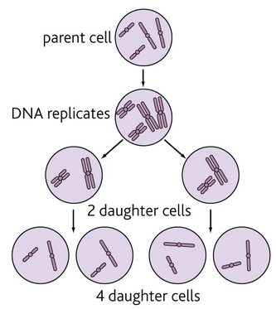
3.3.1 One diploid nucleus divides by meiosis to produce four haploid nuclei
Meiosis is a process that divides one diploid eukaryotic nucleus to form four haploid nuclei
The original diploid cell is divided twice in this process – Meiosis I and Meiosis II
Since the chromosome number is halved, Meiosis is called a reduction division

Slide 3
3.3.1 One diploid nucleus divides by meiosis to produce four haploid nuclei

Slide 4
3.3.1 One diploid nucleus divides by meiosis to produce four haploid nuclei

Slide 5
3.3.1 One diploid nucleus divides by meiosis to produce four haploid nuclei

Slide 6
3.3.1 One diploid nucleus divides by meiosis to produce four haploid nuclei

Slide 7
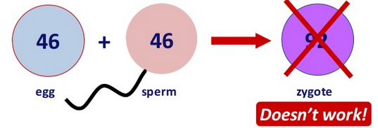
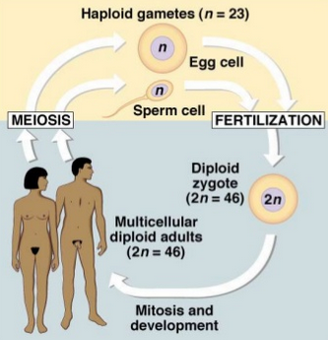
3.3.2 The halving of the chromosome number allows a sexual life cycle with fusion of gametes
In asexual reproduction, offspring have same chromosomes as parents and are genetically-identical
In sexual reproduction, there are differences between parent and offspring chromosomes which creates genetic diversity
Fertilization, the union of gametes, doubles chromosome number – so to prevent chromosome number from doubling each generation, sex cells must be haploid.
Meiosis enables the sexual life cycle of eukaryotes by producing such haploid cells.

Slide 8
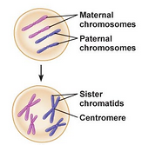
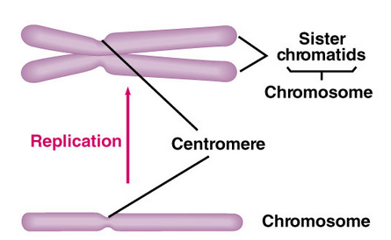
3.3.3 DNA is replicated before meiosis so that all chromosomes consist of two sister chromatids
DNA is replicated during the Synthesis (S) phase of Interphase, before Meiosis
As a result, the nucleus of the diploid cell undergoing division contains duplicated chromosomes, each with two identical ‘sister’ chromatids

Slide 9
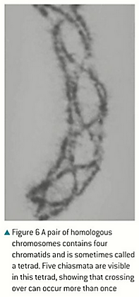
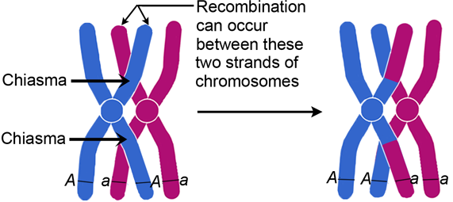
3.3.4 The early stages of meiosis involve pairing of homologous chromosomes and crossing over followed by condensation
At the starts of Meiosis homologous chromosomes pair up to form a bivalent – this process is called synapsis
After synapsis, Crossing Over occurs in which a sister chromatid from each of the homologous chromosomes form a junction at random point(s) to exchange genes
Crossing over results in chromatids with new allele combinations – one way Meiosis increases variation

Slide 10
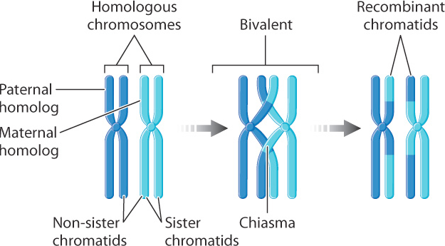
3.3.4 The early stages of meiosis involve pairing of homologous chromosomes and crossing over followed by condensation

Slide 11
3.3.5 Orientation of pairs of homologous chromosomes prior to separation is random
Unlike Metaphase of Mitosis (where all 46 chromosomes line up down the middle of the cell), in Metaphase I of Meiosis, the bivalents (or homologous pairs) line up to be separated by the spindle fibers
The orientation of the bivalents is random and affects which of the homologous chromosomes will be assorted into which sex cell
There are $2^{23}$ ways the 23 pairs could arrange at this stage, giving more than 8 million possible ways of dividing the bivalents – another source of variation!
http://highered.mheducation.com/sites/0072495855/student_view0/chapter28/animation__random_orientation_of_chromosomes_during_meiosis.html

Slide 12
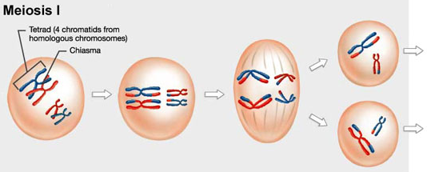
3.3.6 Separation of pairs of homologous chromosomes in the first division of meiosis halves the chromosome number.
The separation of homologous chromosome pairs in Anaphase I (called disjunction), is called the reduction division since it halves the chromosome number of the nucleus.

Slide 13
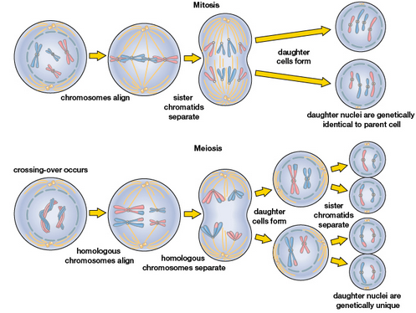
3.3.6 Separation of pairs of homologous chromosomes in the first division of meiosis halves the chromosome number.

Slide 14
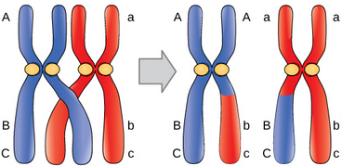
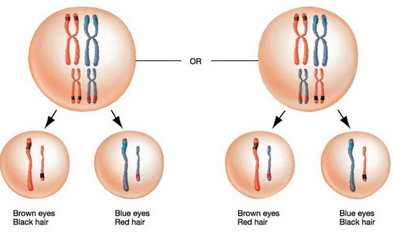
3.3.7 Crossing over and random orientation promotes genetic variation
Offspring of sexual reproduction are always an unpredictable blend of the characteristics of the two parents – much of this randomness is due to Meiosis
Each gamete produced by a parent has a different combination of alleles due to two major features of Meiosis:
Crossing Over: Swapping of alleles between homologous chromosomes means infinite new combinations of alleles can be created and passed down to offspring
Random Orientation of Bivalents: Which one chromosome of each homologous pair that a gamete receives is random based on their orientation in Metaphase I.

Slide 15
3.3.8 Fusion of gametes from different parents promotes genetic variation
The fusion of a male and female gamete to form a zygote results in a mixture of alleles that has likely never existed before…
Crossing over and random assortment of bivalents in meiosis in both parents results in essentially-infinite possibilities for the combination of alleles that each one will pass to their offspring through their gamete
Thus, genetic similarities to parents are maintained while also promoting important genetic variation within a species (key to survival and evolution!)

Slide 16
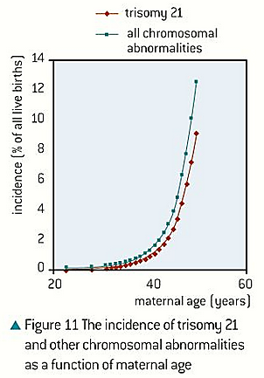
3.3.9 Non-disjunction can cause Down syndrome and other chromosomal abnormalities. Studies showing age of parents influences chances of non-disjunction.
Meiosis is prone to error. In some cases, chromosomes fail to split properly in either Anaphase I or Anaphase II.
This is called Non-Disjunction
The result is the production of a gamete with an extra chromosome (Trisomy) or a missing chromosome (Monosomy)
Incidences of Non-Disjunction are strongly correlated with maternal age…

Slide 17
3.3.9 Non-disjunction can cause Down syndrome and other chromosomal abnormalities.

Slide 18
3.3.9 Non-disjunction can cause Down syndrome and other chromosomal abnormalities.

Slide 19
3.3.9 Non-disjunction can cause Down syndrome and other chromosomal abnormalities.

Slide 20
3.3.9 Non-disjunction can cause Down syndrome and other chromosomal abnormalities.

Slide 21
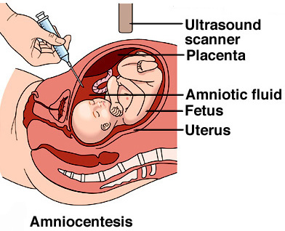
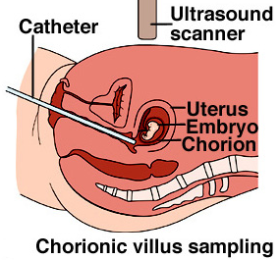
3.3.10 Methods used to obtain cells for karyotype analysis (chorionic villus sampling and amniocentesis) and the associated risks
 | Amniocentesis | Chorionic Villus Sampling
Where are cells sampled from? | Fetal cells obtained from fluid in the amniotic sac where the fetus is held during the pregnancy | Fetal cells obtained from the chorion – a part of the placenta
How are cells obtained? | Ultrasound is used to guide a large needle through the abdomen into the amniotic sac | A sampling tool enters through the vagina – can be done earlier in the pregnancy
Risk of miscarriage? | 1% | 2%

Slide 22
3.3.11 Draw diagrams to show the stages of meiosis resulting in the formation of four haploid cells

Slide 23
3.3.11 Draw diagrams to show the stages of meiosis resulting in the formation of four haploid cells

Slide 24
3.3.11 Draw diagrams to show the stages of meiosis resulting in the formation of four haploid cells

Slide 25
3.3.11 Draw diagrams to show the stages of meiosis resulting in the formation of four haploid cells

Slide 26
3.3.11 Draw diagrams to show the stages of meiosis resulting in the formation of four haploid cells

Slide 27
3.3.11 Draw diagrams to show the stages of meiosis resulting in the formation of four haploid cells

Slide 28
3.3.11 Draw diagrams to show the stages of meiosis resulting in the formation of four haploid cells

Slide 29
3.3.11 Draw diagrams to show the stages of meiosis resulting in the formation of four haploid cells

Slide 30
3.3.11 Draw diagrams to show the stages of meiosis resulting in the formation of four haploid cells

Slide 31
3.3.11 Draw diagrams to show the stages of meiosis resulting in the formation of four haploid cells

Slide 32
3.3.11 Draw diagrams to show the stages of meiosis resulting in the formation of four haploid cells

Slide 33
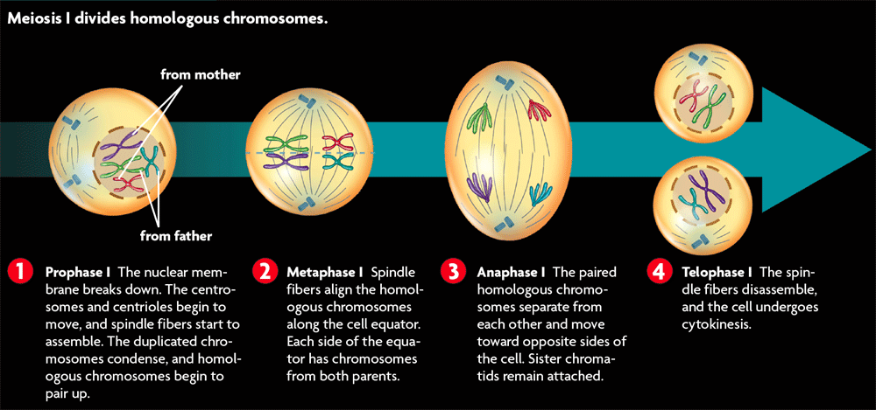
3.3.11 Draw diagrams to show the stages of meiosis resulting in the formation of four haploid cells

Slide 34
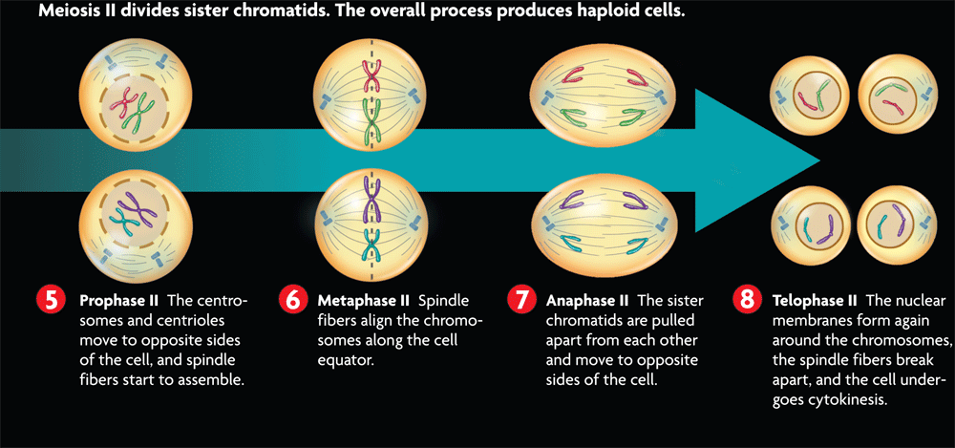
3.3.11 Draw diagrams to show the stages of meiosis resulting in the formation of four haploid cells

Slide 35
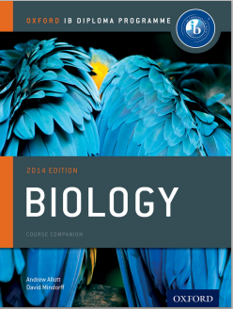
Bibliography / Acknowledgments
Bob Smullen

