Slide 1
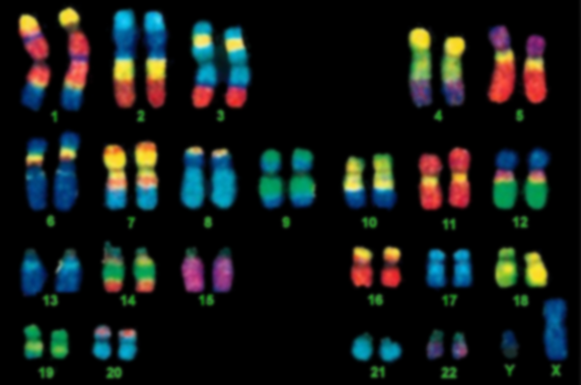
Chromosomes (3.2) IB Diploma Biology
Essential Idea: The genetic material of organisms is packaged into units called chromosomes

Slide 2
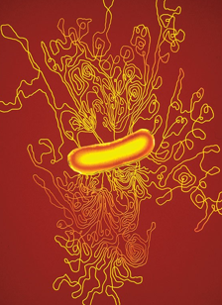
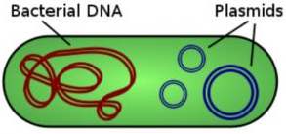
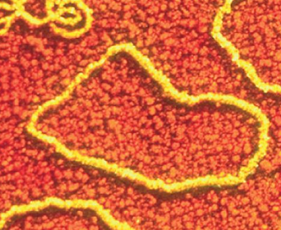
3.2.1 Prokaryotes have one chromosome consisting of a circular DNA molecule
Micrograph showing the release of DNA from a lysed bacterial cell
Prokaryotic cells only have one chromosome:
Chromosome is circular (compared to linear eukaryotic chromosomes)
One copy of each gene, except during cell division (Binary Fission!)
Chromosome is “naked” (i.e. not associated with histone proteins like eukaryotic chromosomes)

Slide 3
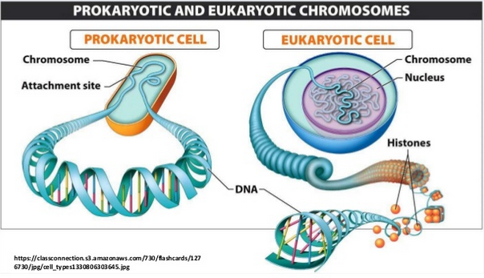
3.2.1 Prokaryotes have one chromosome consisting of a circular DNA molecule

Slide 4
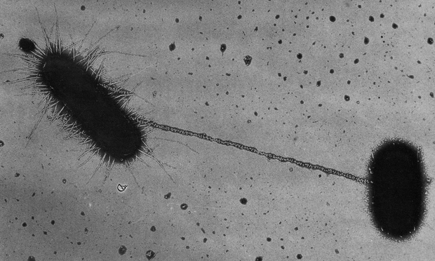
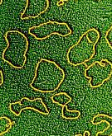
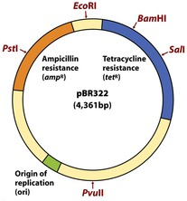
3.2.2 Some prokaryotes also have plasmids but eukaryotes do not
Plasmids are small extra DNA molecules often found in prokaryotic cells
Usually circular and ‘naked’ DNA
Contain a few genes that are not essential to cell function but may be useful to the cell
i.e. Genes for antibiotic resistance
Not replicated at same time as the chromosome, so a cell may contain many copies of a plasmid
Easily transferred between cells
Two bacterial cells, joined by a pilus, engaged in plasmid transfer

Slide 5
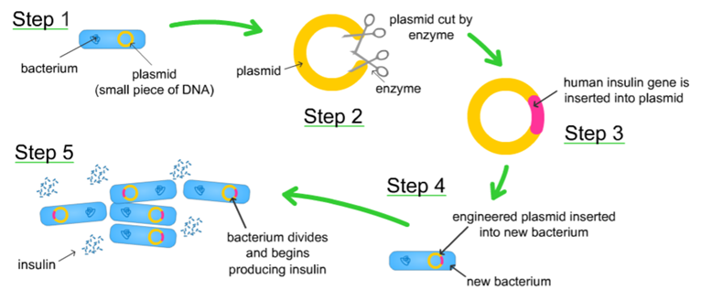
3.2.2 Some prokaryotes also have plasmids but eukaryotes do not
Plasmids are also used by scientists to artificially transfer genes between species (ex. E. coli modified to produce human Insulin)

Slide 6
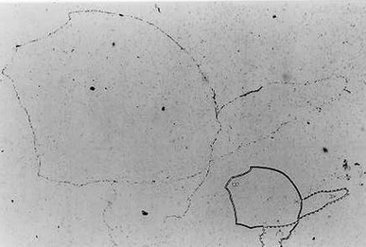
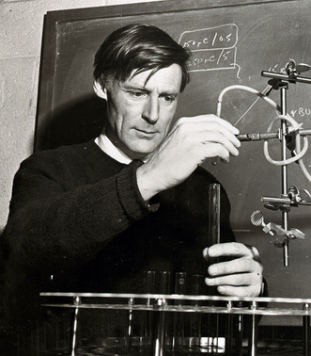
3.2.11 Cairn’s technique for measuring the length of DNA molecules by autoradiography
John Cairn, British biochemist (1922- )
Used autoradiography to visualize and measure DNA molecules in E. coli in 1963
E. coli grown with Thymine nucleotides that contained radioactive Hydrogen isotope, Tritium
Thymine used so only DNA labeled
Cells placed on dialysis membrane and lysed with lysozyme enzymes
Coated in photographic emulsion and left in dark room for 2 months
High energy electrons from tritium decay reacted with film emulsion, leaving dark lines showing DNA outline
Image showed E. coli had circular chromosome, ~1,100 µm long (E. coli cell is only 2 µm)

Slide 7
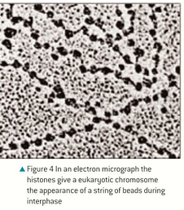
3.2.3 Eukaryotic chromosomes are linear DNA molecules associated with histone proteins
Eukaryotic cells contain linear chromosomes associated with protein:
DNA molecules are wrapped around globular histone proteins to form units called nucleosomes
Coiled into chromatin during Interphase
Supercoiled to form characteristic chromosome shape during Mitosis

Slide 8
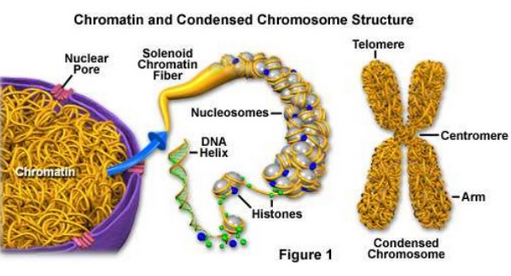
3.2.3 Eukaryotic chromosomes are linear DNA molecules associated with histone proteins

Slide 9
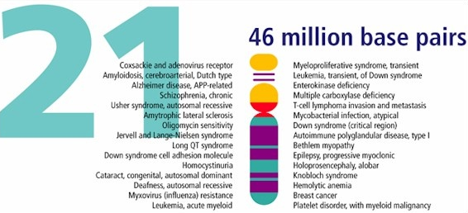
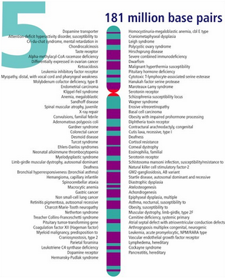
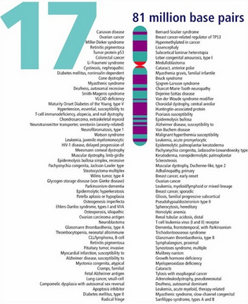
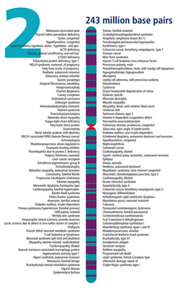
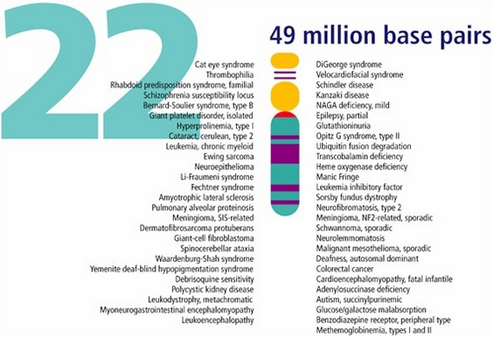
3.2.4 In a eukaryotic species there are different chromosomes that carry different genes
Eukaryotic cells contain different types of chromosomes with different genes
Chromosomes differ in length and position of the centromere
Humans have 23 different types of chromosomes
22 pairs of Autosomes (1-22)
1 pair of Sex Chromosomes (23)
Each chromosome carries a different set of genes in a specific order
The location of each gene on the chromosome is the gene locus

Slide 10
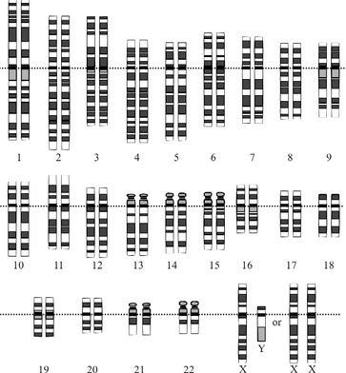
3.2.5 Homologous chromosomes carry the same sequence of genes but not necessarily the same alleles of those genes
Homologous Chromosomes:
Chromosomes of the same size and structure, with the same sequence of genes (i.e. same genes at the same gene loci)
Despite having the same genes, may have different alleles for the gene!
In humans, one of each chromosome type comes from the mother and one of each type comes from the father to make 22-23 homologous pairs*
In order to interbreed, two organisms must have homologous chromosome sets…
*Since males have one X and one Y chromosome as their 23rd pair, it is technically not homologous…

Slide 11
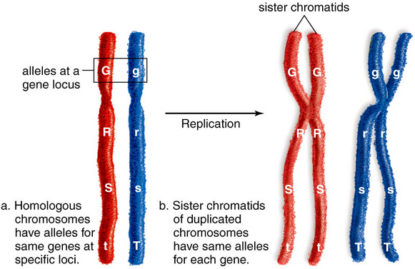
3.2.5 Homologous chromosomes carry the same sequence of genes but not necessarily the same alleles of those genes

Slide 12
3.2.5 Homologous chromosomes carry the same sequence of genes but not necessarily the same alleles of those genes

Slide 13
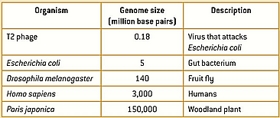
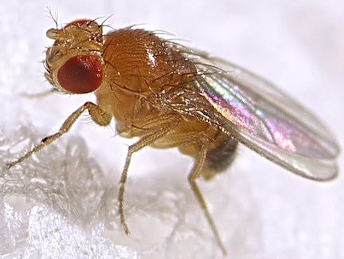
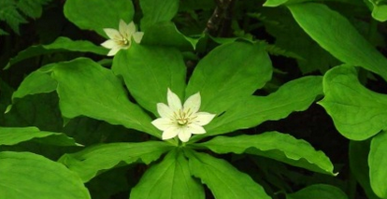
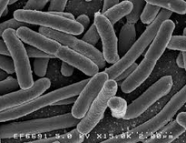
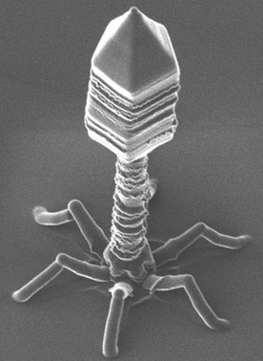
3.2.12 Comparison of genome size in T2 phage, Escherichia coli, Drosophila melanogaster, Homo sapiens, and Paris japonica
Genome sizes vary greatly among organisms
Viruses have smallest genomes (not living, though)
Genome size correlates with organism complexity but not directly…
Proportion of DNA that acts as functional genes is variable, as are the numbers of duplicated genes (i.e. strawberries have 8 copies of each chromosome)

Slide 14
3.2.15 Use of online databases to identify locus of a human gene and its protein product
Gene Name | Description | Chromosome
DRD4 | Gene codes for a Dopamine receptor implicated in a variety of neurological conditions, including bipolar disorder, Parkinson’s, Anorexia, etc. | 11
CFTR | Gene that codes for a chloride channel membrane protein. A mutated allele of this gene causes Cystic Fibrosis. | 7
HBB | Gene codes for the beta globin subunit of Hemoglobin. A mutated allele of this gene causes Sickle Cell Anemia. | 11
F8 | Gene codes for blood clotting Factor VIII. A mutated allele of this gene causes Hemophilia. | X
TDF | Testis determining factor – Gene that codes for a fetus to develop as a male | Y

Slide 15
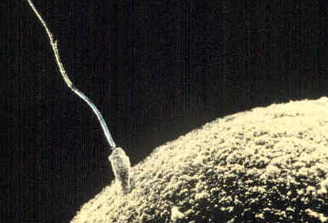
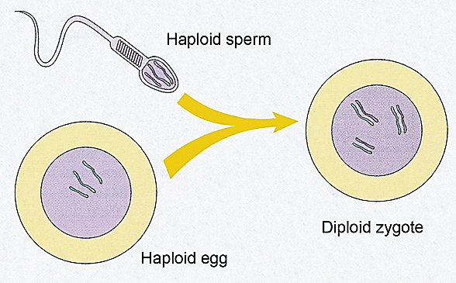
3.2.7 Haploid nuclei have one chromosome of each pair
Haploid Nuclei:
One of each chromosome type
In humans, haploid cells contain 23 chromosomes
Haploid cells are sex cells (gametes) that fuse together during sexual reproduction – egg and sperm
Haploid = “Half” of a full set of chromosomes…

Slide 16
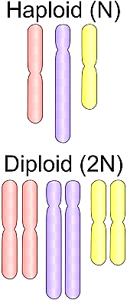
3.2.6 Diploid nuclei have pairs of homologous chromosomes
Diploid Nuclei:
Two of each chromosome type (and so 2 copies of each gene*)
In humans, haploid cells contain 46 chromosomes (2 x 23)
Haploid sperm and egg fuse in fertilization to produce diploid Zygote, which then divides by Mitosis to form embryo
Diploid cells are body cells (somatic cells)
*Males only have one copy of each gene on the X and Y sex chromosome

Slide 17
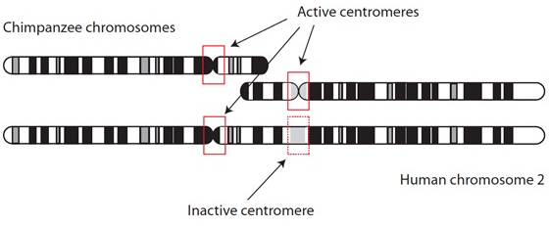
3.2.8 The number of chromosomes is a characteristic feature of members of a species
Chromosome number is a fundamental feature that defines a species
All members of a species have the same chromosome number
Chromosome number tends to be conserved across millions of years of evolution
In rare cases chromosomes can fuse together or split to change chromosome number of a species…
During human evolution, two ancestral ape chromosomes fused to form modern day Chromosome 2 (As a result, humans have 23 types of chromosomes, while ape species have 24)

Slide 18
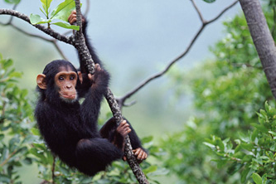
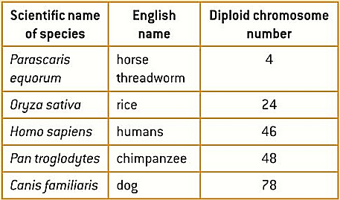
3.2.13 Comparison of diploid chromosome numbers of Homo sapiens, Pan troglodytes, Canis familiaris, Oryza sativa, and Parascaris equorum

Slide 19
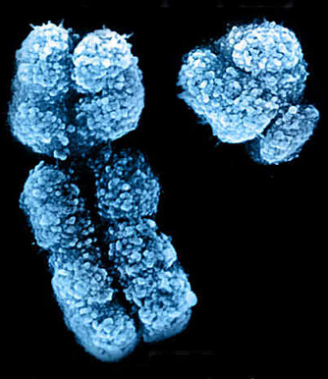
3.2.10 Sex is determined by sex chromosomes and autosomes are chromosomes that do not determine sex
In humans, the 23rd set of chromosomes determine gender:
The X chromosome is large with a centromere in the middle (2000+ genes)
The Y chromosome is small with a centromere near the top (less than 100 genes)
The X chromosome carries genes necessary to human development
Y chromosome carries genes needed for male development
The other 44 chromosomes are called Autosomes and they carry only non-sex-related genes
Homologous pairs 1-22

Slide 20
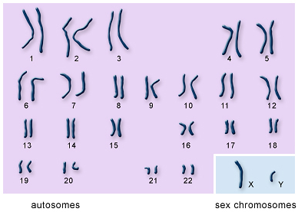
3.2.10 Sex is determined by sex chromosomes and autosomes are chromosomes that do not determine sex

Slide 21
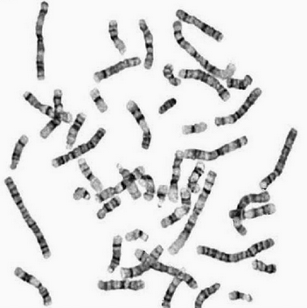
3.2.9 A karyogram (karyotype) shows the chromosomes of an organism in homologous pairs of decreasing length

Slide 22
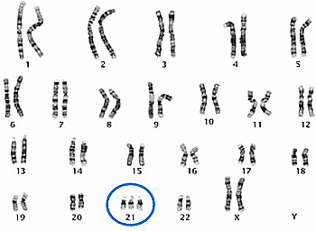
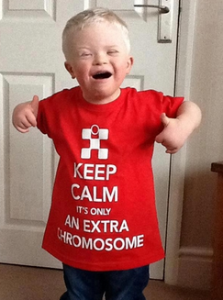
3.2.14 Use of karyotypes to deduce sex and diagnose Down syndrome in humans.
Deducing Sex:
XX = Female
XY = Male
Deducing Chromosomal Abnormalities
Errors in Meiosis can lead to the formation of zygotes with abnormal chromosome numbers (In humans, this is any number that is not 46 – 44 Autosomes, 2 Sex chromosomes)
Trisomy: Having a third (extra) chromosome
Monosomy: Having only one chromosome
Down Syndrome results from Trisomy of the 21st chromosome…
The most common genetic condition
Causes physical and mental development delays
50-60 year life expectancy
~6,000 babies each year in the U.S.
Risk is strongly correlated with maternal age

Slide 25
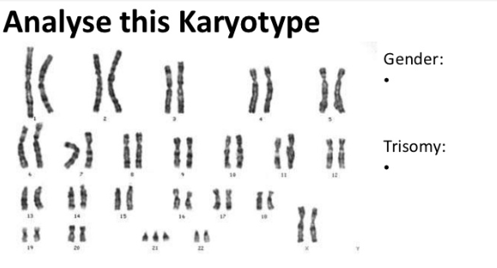

Slide 29
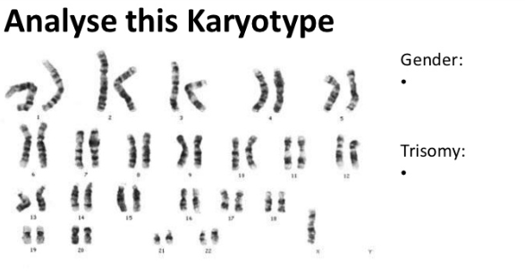

Slide 31
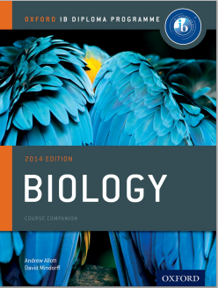
Bibliography / Acknowledgments
Bob Smullen

