Slide 1
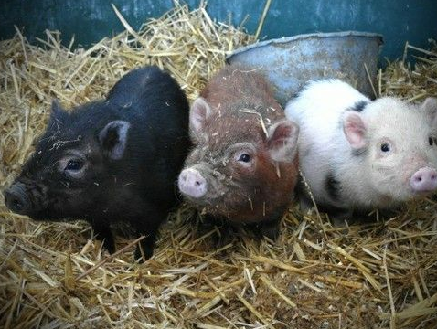
Genes (3.1) IB Diploma Biology
Essential Idea: Heritable traits are passed down to offspring through genes

Slide 2
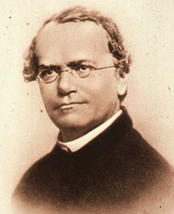
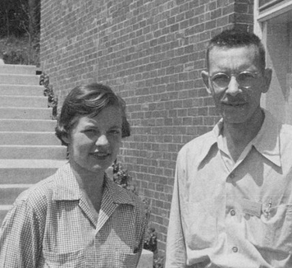
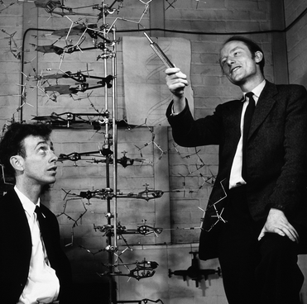
3.1.1 A gene is a heritable factor that consists of a length of DNA and influences a specific characteristic.
Genetics (from ‘genesis’) is the area of Biology concerned with how information in organisms is passed from parents to offspring / progeny
19th century scientists showed that there were factors within organisms that determined their characteristics and that these factors were heritable
The word gene was used to describe these factors
20th century scientists showed that these genes were made up of DNA
Human cells contain 46 DNA molecules (chromosomes) with ~23,000 genes
Today it is understood that genes are segments of a DNA molecule that influence or directly code for specific traits

Slide 3
3.1.1 A gene is a heritable factor that consists of a length of DNA and influences a specific characteristic.

Slide 4
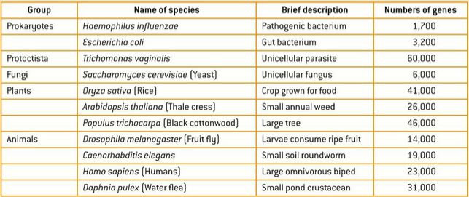
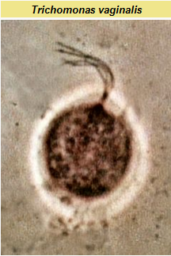
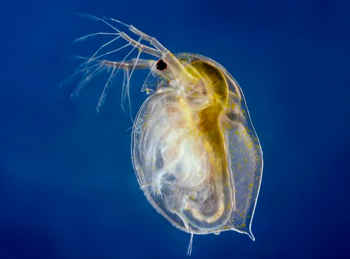
3.1.9 Comparison of the number of genes in humans with other species.

Slide 5
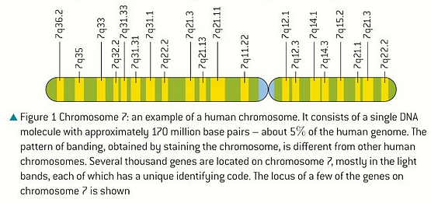
3.1.2 A gene occupies a specific position (locus) on one type of chromosome.
Genes are distributed amongst an organisms chromosomes
The location of a gene on a chromosome is called the locus of the gene
All members of a species have the same chromosome number with the same genes in the same loci along their chromosomes

Slide 6
3.1.2 A gene occupies a specific position (locus) on one type of chromosome.

Slide 7
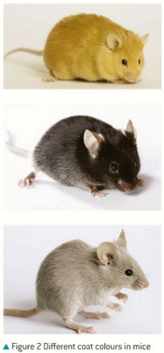
3.1.3 The various specific forms of a gene are alleles.
Alleles are alternative versions of the same gene. They occupy the same position (locus) on one type of chromosome
Mendel first observed and names ‘alleles’ in his study of pea plant traits
Most animals and plants have 2 alleles for each gene (often one ‘dominant’ and one ‘recessive’)
Some genes, like one for fur color in mice or ABO blood type in humans, have more than 2 alleles (aka ‘Multiple Alleles’)

Slide 8
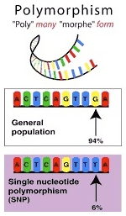
3.1.4 Alleles differ from each other by one or a few bases only.
A gene consists of a length of DNA that can be hundreds or thousands of bases in length
Alleles of a gene often differ only very slightly in their base sequence (sometimes by just 1-2 DNA letters, i.e. one allele contains an Adenine where the other has a Cytosine)
These base differences are called Single Nucleotide Polymorphisms (SNPs, or ‘snips’)

Slide 9
3.1.10 Use of a database to determine differences in the base sequence of a gene in two species.
One outcome of Human Genome Project is fast, computer based methods of gene sequencing (AHL 7.1)
Web-based programs like GenBank and BLAST allow for the easy comparison of nucleotide sequences in genes that are shared between different species
Based on the differences / similarities, timelines of evolutionary relationships can be deduced (Flashback – 5.4 Cladistics!)

Slide 10
3.1.5 New alleles are formed by mutation.
https://www.youtube.com/watch?v=kp0esidDr-c

Slide 11
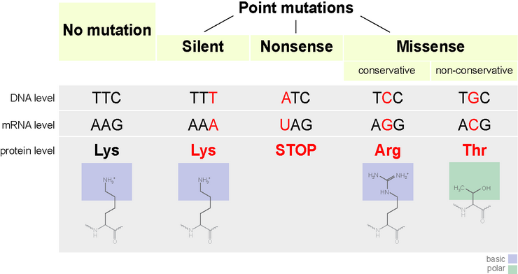
3.1.5 New alleles are formed by mutation.
Base substitution (point mutations) are most common and will only change one DNA letter and therefore, one mRNA codon
Maybe no effect on protein (degeneracy of the genetic code!)
Maybe change one Amino Acid (Missense mutation)
Maybe code for an early stop codon (Nonsense mutation)

Slide 12
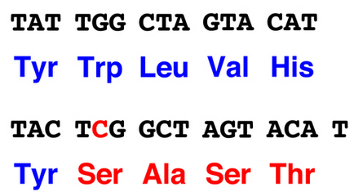
3.1.5 New alleles are formed by mutation.
Frameshift mutations are due to extra letters inserted or deleted
This changes the entire reading frame of the mRNA codons and can have massive effects for protein production
Mutations that develop in body cells are eliminated when the individual organism dies
Mutations in gametes (sex cells) are passed on to offspring and can be causes of genetic disease (sperm cells have a higher rate of mutation than egg cells…)
Human mutation rate is ~100-200 mutations per generation

Slide 13
3.1.8 The causes of sickle cell anemia, including a base substitution mutation, a change to the base sequence of mRNA transcribed from it, and a change to the sequence of a polypeptide in hemoglobin.

Slide 14
3.1.8 The causes of sickle cell anemia, including a base substitution mutation, a change to the base sequence of mRNA transcribed from it, and a change to the sequence of a polypeptide in hemoglobin.

Slide 15
3.1.8 The causes of sickle cell anemia, including a base substitution mutation, a change to the base sequence of mRNA transcribed from it, and a change to the sequence of a polypeptide in hemoglobin.

Slide 16
3.1.8 The causes of sickle cell anemia, including a base substitution mutation, a change to the base sequence of mRNA transcribed from it, and a change to the sequence of a polypeptide in hemoglobin.

Slide 17
3.1.8 The causes of sickle cell anemia, including a base substitution mutation, a change to the base sequence of mRNA transcribed from it, and a change to the sequence of a polypeptide in hemoglobin.

Slide 18
3.1.8 The causes of sickle cell anemia, including a base substitution mutation, a change to the base sequence of mRNA transcribed from it, and a change to the sequence of a polypeptide in hemoglobin.

Slide 19
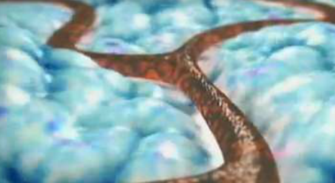
3.1.8 The causes of sickle cell anemia, including a base substitution mutation, a change to the base sequence of mRNA transcribed from it, and a change to the sequence of a polypeptide in hemoglobin.
https://www.hhmi.org/biointeractive/sickle-cell-anemia

Slide 20
3.1.8 The causes of sickle cell anemia, including a base substitution mutation, a change to the base sequence of mRNA transcribed from it, and a change to the sequence of a polypeptide in hemoglobin.

Slide 21
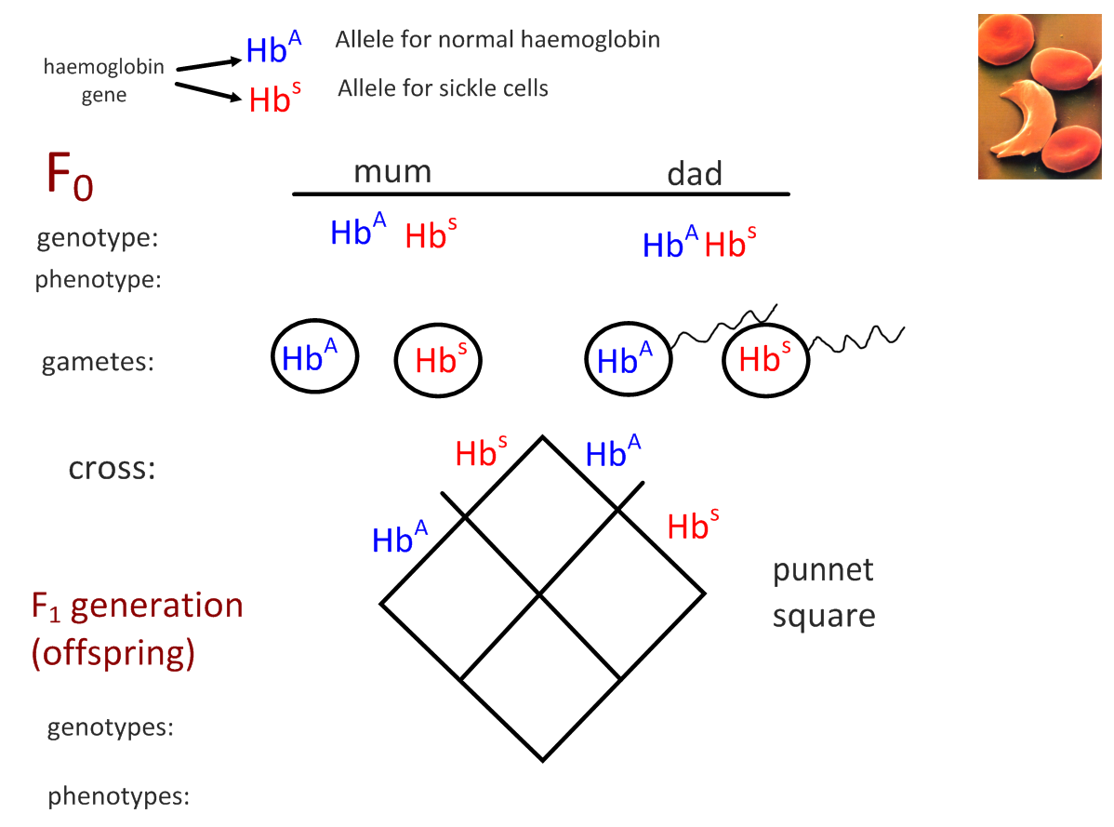

Slide 22
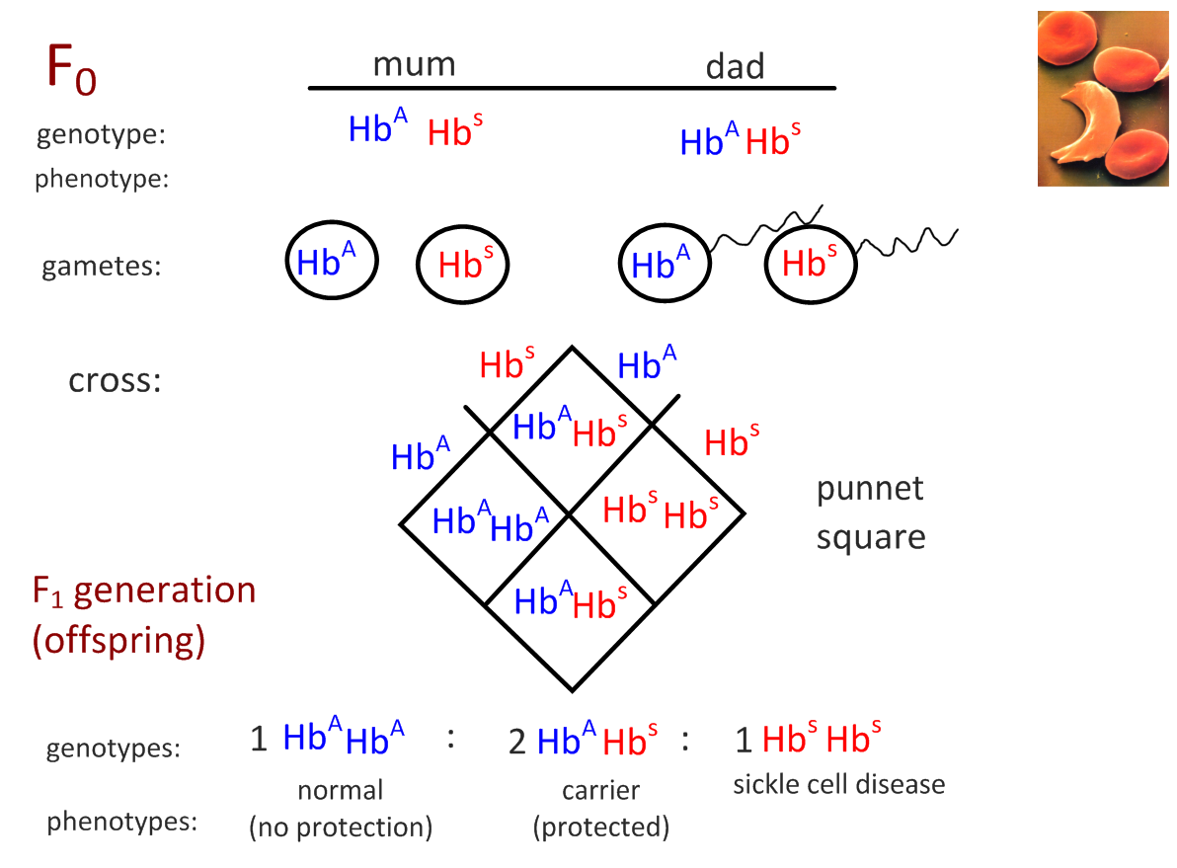

Slide 23
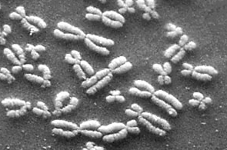
3.1.6 The genome is the whole of the genetic information of an organism.
Genome: the whole genetic information of an organism
In humans:
46 chromosomes in nucleus plus mitochondrial DNA*
In plants:
Chromosomes in the nucleus plus DNA in the mitochondria and chloroplasts*
In prokaryotes:
Much smaller genome consisting of DNA in a circular chromosome and any plasmids
*Flashback to 1.5: Mitochondria and Chloroplasts contain their own DNA (evidence of endosymbiosis)

Slide 24
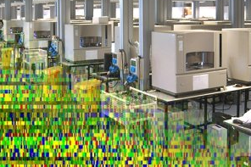
3.1.7 The entire base sequence of human genes was sequenced in the Human Genome Project.
The Human Genome Project (HGP) began in 1990 and produced a full copy of a human genome in 2003…
All humans genomes vary due to SNPs, but 99.9% of the genome is identical among all humans
Public / private competition and collaboration drove incredibly rapid biotech research and development
HGP produced a vast set of data in the form of the ~3.2 billion base letter sequence of human DNA
Scientists are still in the process of decoding these sequences to ID specific genes
~23,000 genes were identified (much fewer than predicted!)
Discovered much of the genome is NOT transcribed
Highly-repetitive sequences originally-called “junk DNA” but now recognized as having a number of key functions

Slide 25
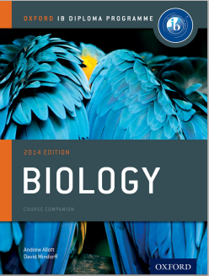
Bibliography / Acknowledgments
Jason de Nys
Chris Paine

