Slide 1
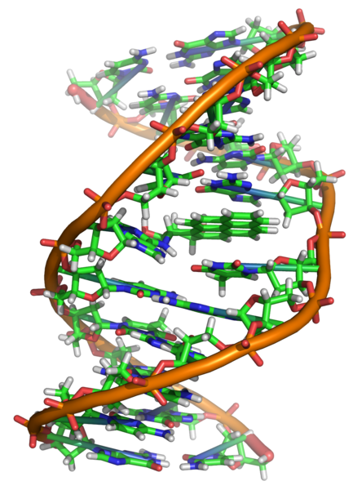
The Discovery of
DNA as the Source
of Heredity

Slide 2
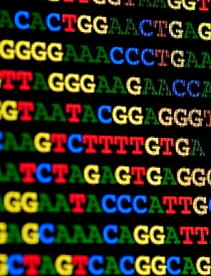
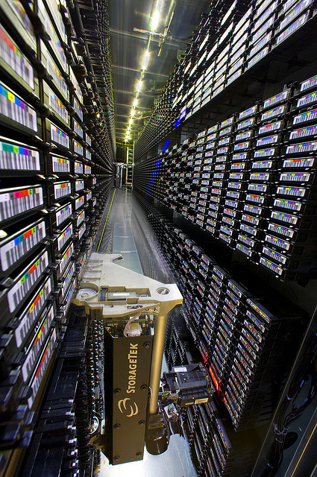
The human genome project which has decoded the base sequence for the whole 6 feet of the human genome requires a data warehouse (pictured) to store the information electronically.
Scientists have programmed nearly 500,000 DVD’s worth of data into 1 gram of DNA!

Slide 3
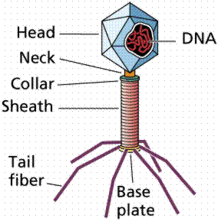
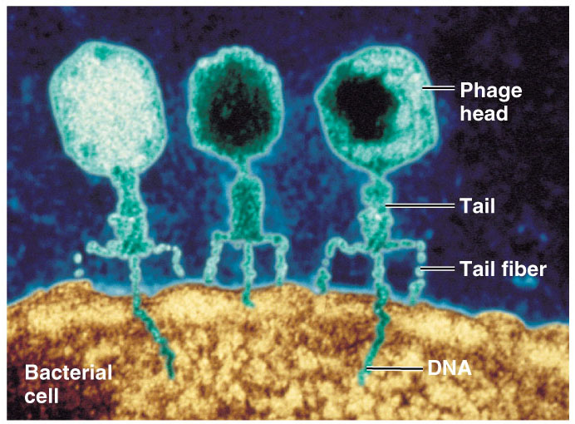
Confirmation of DNA
1952 | 1969
Hershey
Hershey & Chase
classic “blender” experiment
worked with bacteriophage
viruses that infect bacteria
grew phages in 2 media, radioactively labeled with either
³⁵S in their proteins
³²P in their DNA
infected bacteria phages
Why use Sulfur vs. Phosphorus?

Slide 4
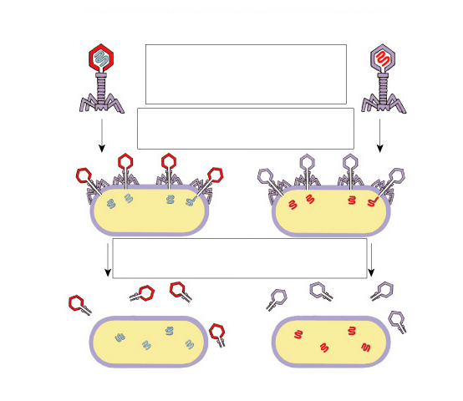
Hershey & Chase
Protein coat labeled
with ³⁵S
DNA labeled with ³²P
T2 bacteriophages
are labeled with
radioactive isotopes
S vs. P
bacteriophages infect
bacterial cells
bacterial cells are agitated
to remove viral protein coats
Which radioactive marker is found inside the cell?
Which molecule carries viral genetic info?
³⁵S radioactivity
found in the medium
³²P radioactivity found in the bacterial cells

Slide 5
Blender experiment
Radioactive phage & bacteria in blender
³⁵S phage
radioactive proteins stayed in supernatant
therefore viral protein did NOT enter bacteria
³²P phage
radioactive DNA stayed in pellet
therefore viral DNA did enter bacteria
Confirmed DNA is “transforming factor”

Slide 6
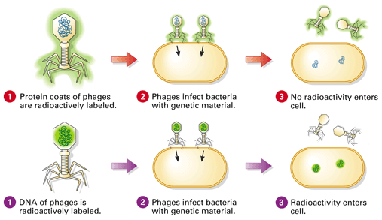
7.1.10 Analysis of results of the Hershey and Chase experiment providing evidence that DNA is the genetic material.
http://highered.mheducation.com/olcweb/cgi/pluginpop.cgi?it=swf::535::535::/sites/dl/free/0072437316/120076/bio21.swf::Hershey%20and%20Chase%20Experiment

Slide 7
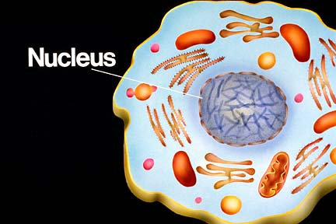
Nucleic Acids
There are TWO types of nucleic acids in living organisms:
DNA (DeoxyriboNucleic Acid) – the instructions for creating an organism are stored in digital code along coiled chains of DNA
RNA (RiboNucleic Acid) – reads the information in DNA and transports it to the protein-building apparatus of the cell
DNA and RNA is found in the nucleus of cells!!!!

Slide 8
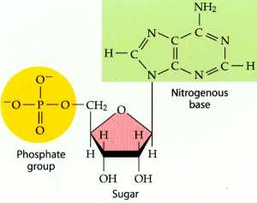
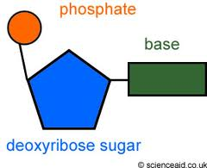
Nucleotide
Each nucleotide is made up of:
A 5 carbon sugar
a phosphate group
a nitrogenous base
DNA is slightly acidic and composed of large amounts of phosphorus and nitrogen. The phosphate group is negatively charged.

Slide 9
Directionality of DNA
You need to number the carbons!
it matters!
nucleotide
PO₄
N base
5′
CH₂
This will be IMPORTANT!!
O
4′
1′
ribose
3′
2′
OH

Slide 10
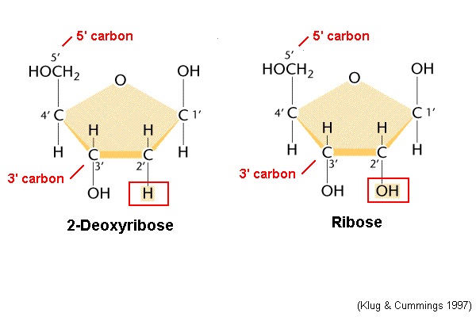
DNA v. RNA
DNA contains the sugar DEOXYRIBOSE whereas RNA contains the sugar RIBOSE.
The only difference between these two sugars is the lack of oxygen at carbon 2 in deoxyribose – this accounts for its name.
DNA
RNA

Slide 11
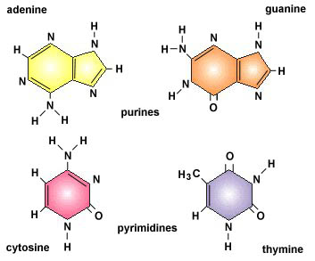
DNA nitrogen bases
Purines have a double-ringed structure.
Pyrimidines have a single-ringed structure.

Slide 12
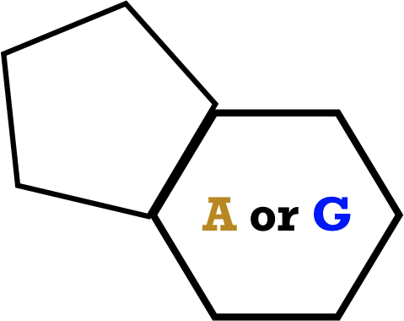
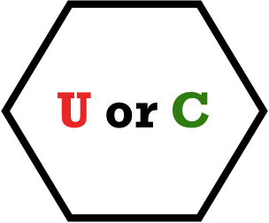
RNA nitrogen bases
PURINES
1. Adenine (A)
2. Guanine (G)
PYRIMIDINES
3. Uracil (U)
4. Cytosine (C)
Which base is found in DNA that is NOT found in RNA?

Slide 13
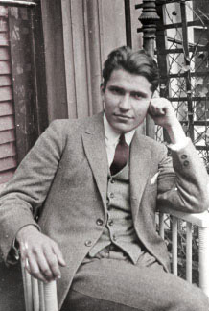
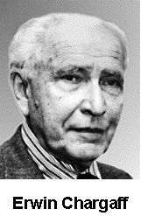
Erwin Chargaff
1947
DNA composition: “Chargaff’s rules”
varies from species to species
all 4 bases not in equal quantity
bases present in characteristic ratio
humans:
A = 30.9%
T = 29.4%
G = 19.9%
C = 19.8%
Rules A = T
C = G
That’s interesting! What do you notice?

Slide 14
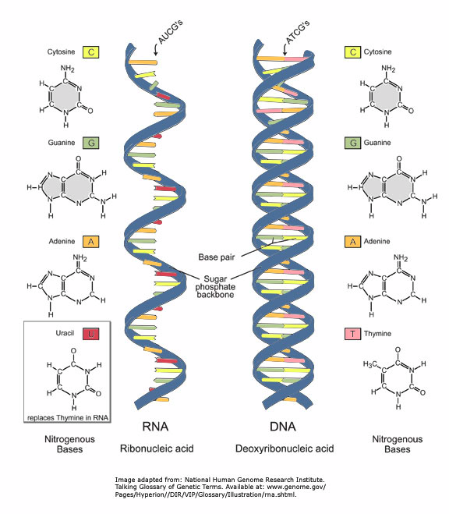
DNA v. RNA

Slide 15
DNA v. RNA
DNA Structure Compared to RNA Structure
 | DNA | RNA
Sugar | Deoxyribose | Ribose
Bases | Adenine, guanine, thymine, cytosine | Adenine, guanine, uracil, cytosine
Strands | Double stranded with base paring | Single stranded
Helix | Yes | No

Slide 16
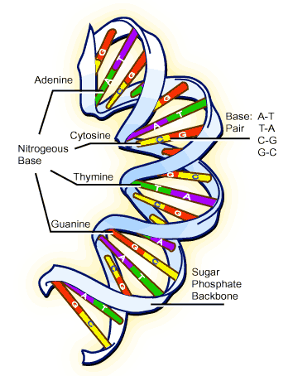
DNA Structure
Double Helix
1
“Rungs of ladder”
Nitrogen
Base (A,T,G or C)
“Legs of ladder”
Phosphate &
Sugar Backbone
main function
ENERGY
STORAGE
short-term

Slide 17
Covalent bond: phosphodiester bond
5
O
Hydrogen bonds
3
3
O
P
5
P
5
O
G
C
1
2
3
4
4
2
1
3
5
P
O
P
T
A
3
5
O
O
5
P
P
3

Slide 18
Chargaff’s Rule
Adenine must pair with Thymine
Guanine must pair with Cytosine
G
C
T
A

Slide 19
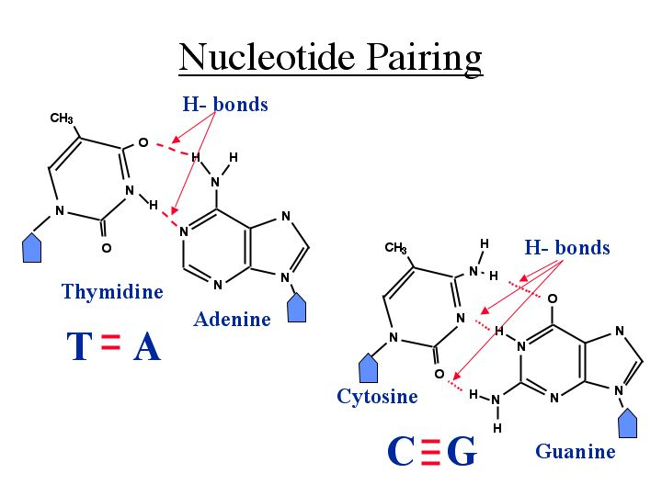
Nucleotide Pairing
Complimentary base pairing causes the diameter of the DNA helix to remain constant ie: 2nm.
The large number of hydrogen bonds between DNA strands account for its structural stability.

Slide 20
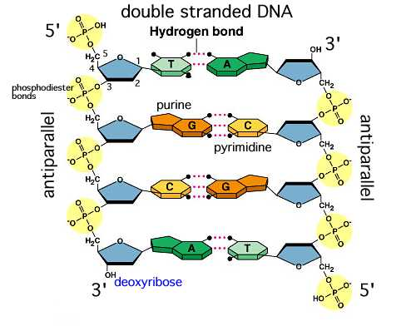
Antiparallel strands
The phosphate group of one nucleotide is linked to the sugar of another via a PHOSPHODIESTER BOND.
The end that terminates in a PHOSPHATE GROUP is labelled the 5’ end.
The end that terminates in a HYDROXYL GROUP is labelled the 3’ end.
Complimentary strands are said to be ANTIPARALLEL.
The bond that links the sugar to its nitrogenous base is referred to as a GLYCOSYL BOND.

Slide 21
Nucleic Acids
Hydrogen bonds
5’
P
G
C
P
P
C
G
P
P
C
G
P
P
A
T
P
P
T
A
3’
P
P
T
A
P

Slide 22
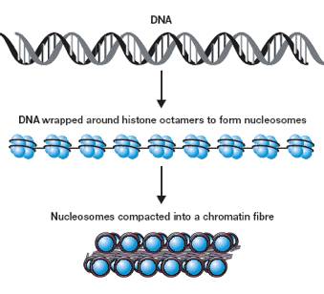
Organization of Genetic Material

Slide 23
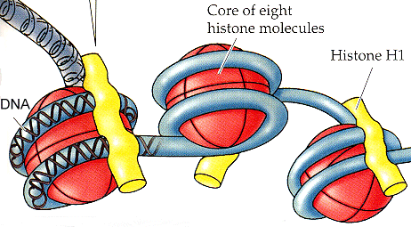
Histones
• Eukaryotic cells contain more than 2 m of DNA (over 6 billion base
pairs)
• DNA is wound twice around 8 histone proteins with an additional
histone holding it all together.
• This is called a nucleosome
• This is further wound into chromatin fibres

Slide 24
DNA – double helix
Rosalind Franklin and Maurice Wilkins used X-ray diffraction to determine structure of DNA. Pattern was presented to James Watson and Francis Crick.

Slide 25
X-Ray Diffraction of DNA

Slide 26
1953- Watson and Crick built model of DNA using work of Chargaff and Rosalind Franklin
Nobel prize- 1962 – Watson, Crick, Wilkins
Proposed right-handed model of DNA i.e. turns in clockwise direction
Makes one complete turn every 10 base pairs.

Slide 27
Sugar + phosphate = backbone
2 strands run antiparallel i.e. one strand runs 5’ to 3’ – other strand 3’ to 5’
i.e. 5’-ATGCCGTTA-3’
3’-TACGGCAAT-5’
This is called complimentary base pairing

Slide 29
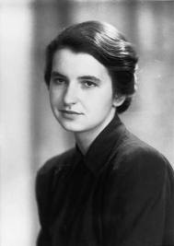
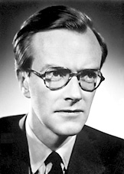
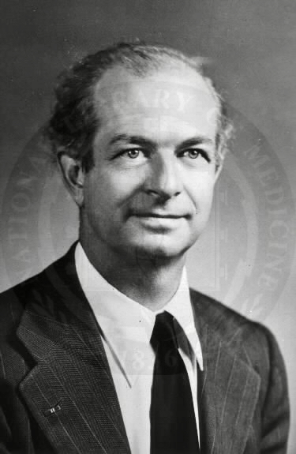
Structure of DNA
1953 | 1962
Watson & Crick
developed double helix model of DNA
other leading scientists working on question:
Rosalind Franklin
Maurice Wilkins
Linus Pauling
Franklin
Wilkins
Pauling
Notes:
Watson & Crick’s model was inspired by 3 recent discoveries:
Chargaff’s rules
Pauling’s alpha helical structure of a protein
X-ray crystallography data from Franklin & Wilkins

Slide 30
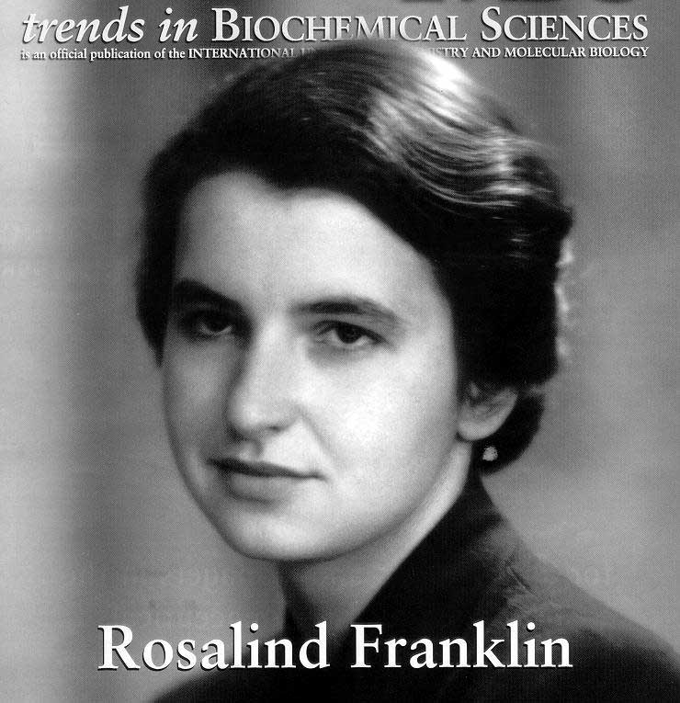
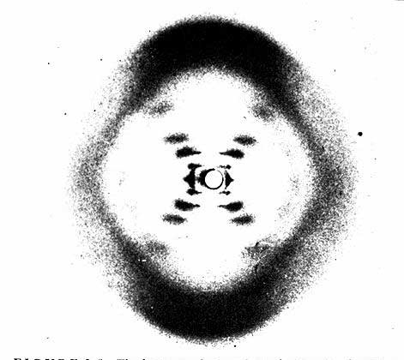
Rosalind Franklin (1920-1958)
Notes:
A chemist by training, Franklin had made original and essential contributions to the understanding of the structure of graphite and other carbon compounds even before her appointment to King's College. Unfortunately, her reputation did not precede her. James Watson's unflattering portrayal of Franklin in his account of the discovery of DNA's structure, entitled "The Double Helix," depicts Franklin as an underling of Maurice Wilkins, when in fact Wilkins and Franklin were peers in the Randall laboratory. And it was Franklin alone whom Randall had given the task of elucidating DNA's structure. The technique with which Rosalind Franklin set out to do this is called X-ray crystallography. With this technique, the locations of atoms in any crystal can be precisely mapped by looking at the image of the crystal under an X-ray beam. By the early 1950s, scientists were just learning how to use this technique to study biological molecules. Rosalind Franklin applied her chemist's expertise to the unwieldy DNA molecule. After complicated analysis, she discovered (and was the first to state) that the sugar-phosphate backbone of DNA lies on the outside of the molecule. She also elucidated the basic helical structure of the molecule.
After Randall presented Franklin's data and her unpublished conclusions at a routine seminar, her work was provided - without Randall's knowledge - to her competitors at Cambridge University, Watson and Crick. The scientists used her data and that of other scientists to build their ultimately correct and detailed description of DNA's structure in 1953. Franklin was not bitter, but pleased, and set out to publish a corroborating report of the Watson-Crick model. Her career was eventually cut short by illness. It is a tremendous shame that Franklin did not receive due credit for her essential role in this discovery, either during her lifetime or after her untimely death at age 37 due to cancer.

Slide 31
Scientific History
T.H. Morgan (1908): genes are on chromosomes
Frederick Griffith (1928): a transforming factor can change phenotype
Avery, McCarty & MacLeod (1944): transforming factor is DNA
Erwin Chargaff (1947): Chargaff rules: A = T, C = G
Hershey & Chase (1952): confirmation that DNA is genetic material
Watson & Crick (1953): determined double helix structure of DNA
Meselson & Stahl (1958): semi-conservative replication

