Slide 1
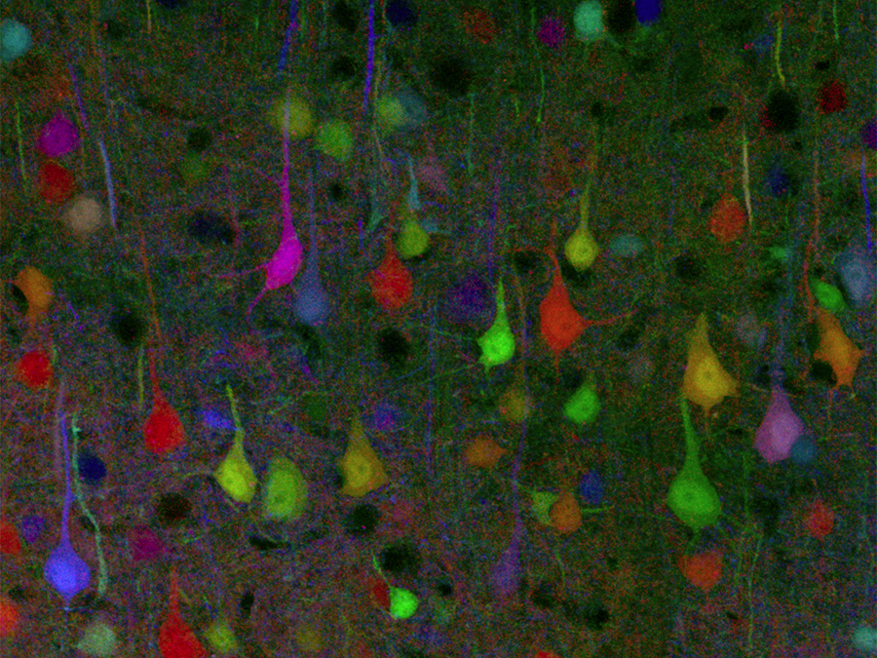
Nervous Systems
Notes:
Every time you move a muscle & every time you think a thought, your nerve cells are hard at work. They are processing information: receiving signals, deciding what to do with them, & dispatching new messages off to their neighbors. Some nerve cells communicate directly with muscle cells, sending them the signal to contract. Other nerve cells are involved solely in the bureaucracy of information, spending their lives communicating only with other nerve cells. But unlike our human bureaucracies, this processing of information must be fast in order to keep up with the ever-changing demands of life.

Slide 2
Your Brain and Nervous System
How does it work?
Close your eyes….
How does your brain control the organs, tell your muscles to move, and recall memories?
Think about nerves/neurons. What do they look like? How are they structured inside the body? How are they connected? What is their purpose? How do these neurons communicate?
https://www.youtube.com/embed/vyNkAuX29OU?rel=0

Slide 3
Big Questions
How do nervous systems help animals coordinate and control their physiology?
Why are nervous systems an “animals only” phenomenon?

Slide 4
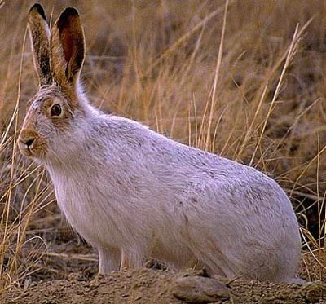
Why do animals need a nervous system?
What characteristics do animals need in a nervous system?
fast
accurate
reset quickly

Slide 5
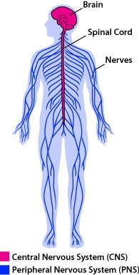
The Vertebrate Nervous System

Slide 6
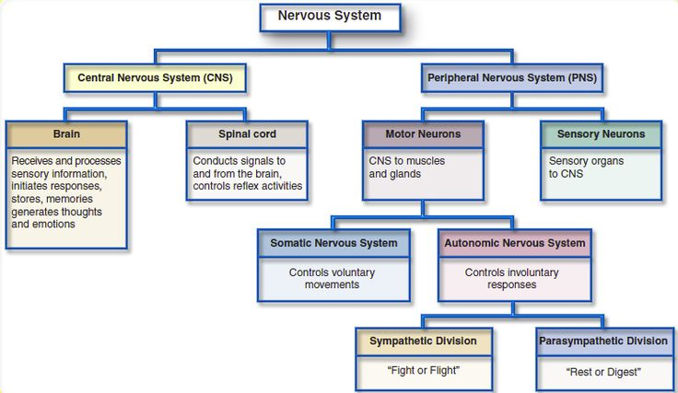
Hierarchy of Vertebrate Nervous System

Slide 7
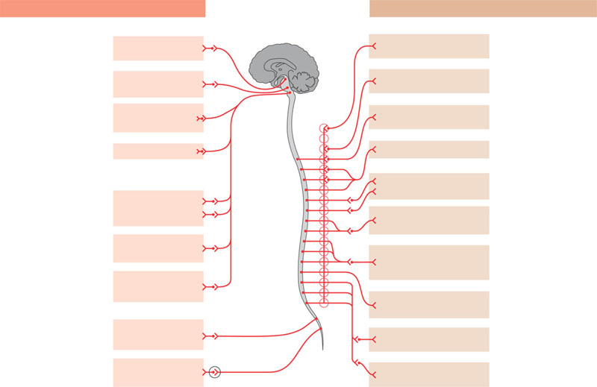
The parasympathetic and sympathetic divisions of the autonomic nervous system
Parasympathetic division
Sympathetic division
Action on target organs:
Action on target organs:
Location of
preganglionic neurons:
brainstem and sacral
segments of spinal cord
Constricts pupil
of eye
Dilates pupil
of eye
Location of
preganglionic neurons:
thoracic and lumbar
segments of spinal cord
Stimulates salivary
gland secretion
Inhibits salivary
gland secretion
Sympathetic
ganglia
Neurotransmitter
released by
preganglionic neurons:
acetylcholine
Constricts
bronchi in lungs
Relaxes bronchi
in lungs
Neurotransmitter
released by
preganglionic neurons:
acetylcholine
Cervical
Slows heart
Accelerates heart
Inhibits activity of
stomach and intestines
Location of
postganglionic neurons:
in ganglia close to or
within target organs
Stimulates activity
of stomach and
intestines
Thoracic
Location of
postganglionic neurons:
some in ganglia close to
target organs; others in
a chain of ganglia near
spinal cord
Inhibits activity
of pancreas
Stimulates activity
of pancreas
Stimulates glucose
release from liver;
inhibits gallbladder
Neurotransmitter
released by
postganglionic neurons:
acetylcholine
Stimulates
gallbladder
Lumbar
Stimulates
adrenal medulla
Neurotransmitter
released by
postganglionic neurons:
norepinephrine
Promotes emptying
of bladder
Inhibits emptying
of bladder
Promotes erection
of genitalia
Sacral
Promotes ejaculation and
vaginal contractions
Synapse

Slide 8
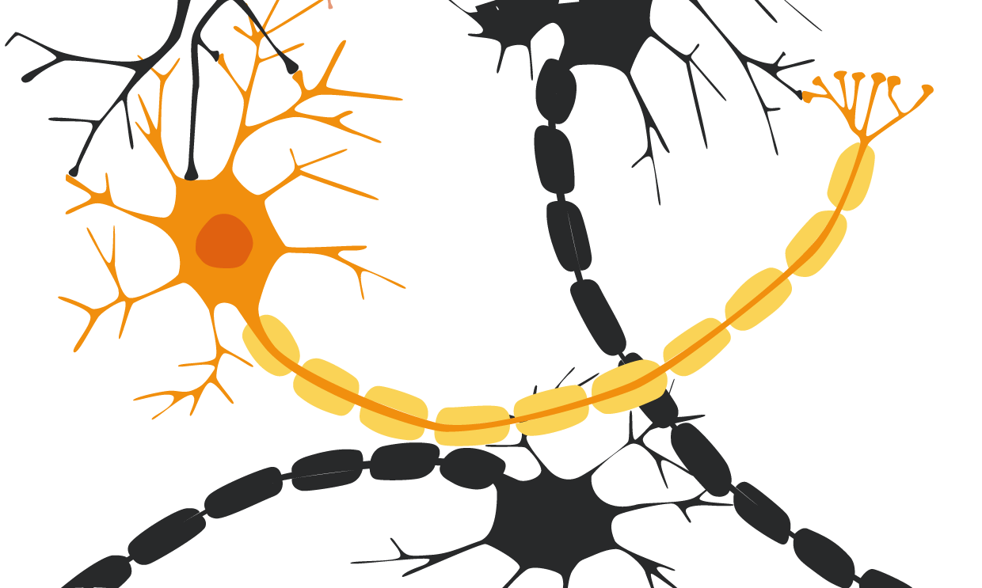
Structure of a Neuron
the cells of the nervous system are called neurons
axon terminals
(nerve endings)
dendrites
myelin sheath
cell body
nucleus
axon

Slide 9
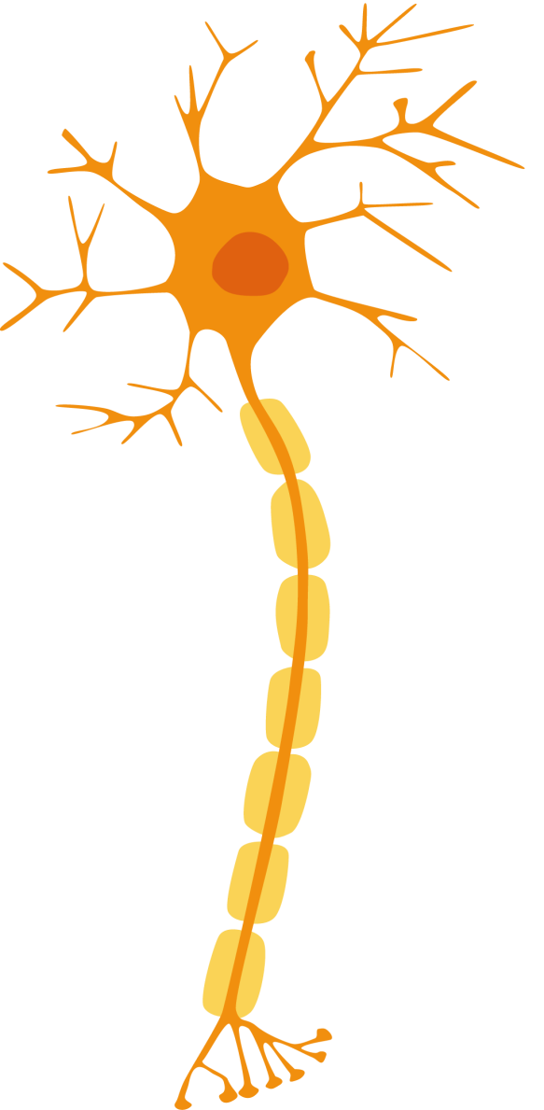
there are different types of neurons
sense organ
dendrites
direction of electrical signal
cell body
myelin sheath
axon
muscle
nerve endings
motor neuron
sensory neuron
relay neuron
sends signals to your muscles to tell them to move
sends signals from your sense organs
connects neurons to other neurons
Which major division of the nervous system can these be found?

Slide 10
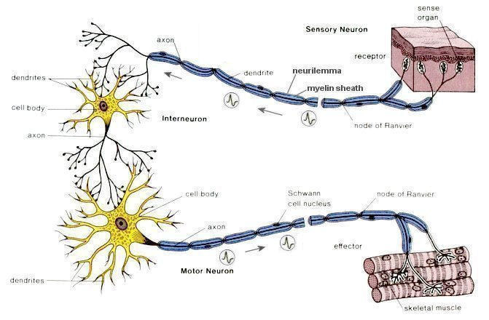

Slide 11
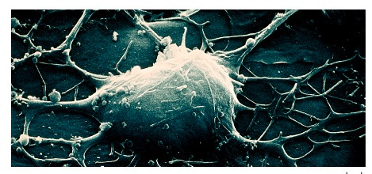
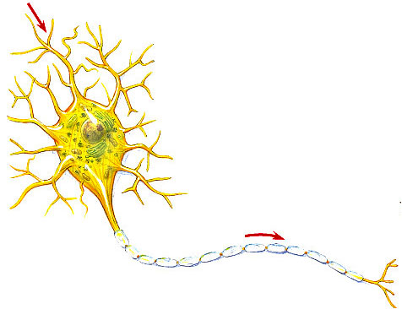
Nervous system cells
Neuron
a nerve cell
signal
direction
dendrites
cell body
Structure fits function
many entry points for signal
one path out
transmits signal
axon
signal direction
synaptic terminal
myelin sheath
synapse
dendrite → cell body → axon → synaptic terminal → synapse

Slide 12
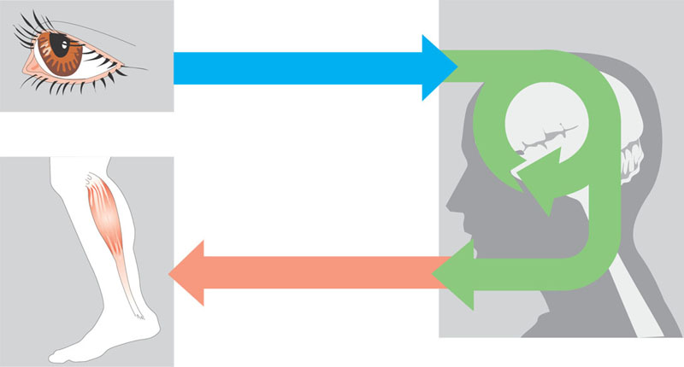
Overview of information processing by nervous systems
Sensory input
Integration
Sensor
Motor output
Effector
Peripheral nervous system (PNS)
Central nervous system (CNS)

Slide 13
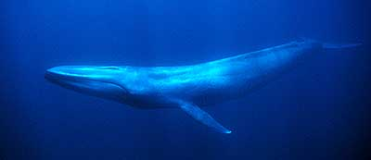
Fun facts about neurons
Most specialized cell in animals
Longest cell
blue whale neuron
10-30 meters
giraffe axon
5 meters
human neuron
1-2 meters
Nervous system allows for 1 millisecond response time

Slide 14
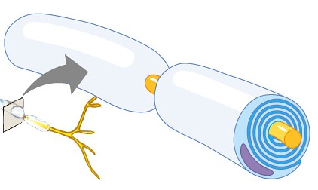
Myelin sheath
Axon coated with Schwann cells
insulates axon
speeds signal
signal hops from node to node
saltatory conduction
150 m/sec vs. 5 m/sec (330 mph vs. 11 mph)
Multiple Sclerosis: immune system attacks myelin sheath
signal
direction
myelin sheath
https://www.youtube.com/watch?v=VIoDr8ugbqI

Slide 15
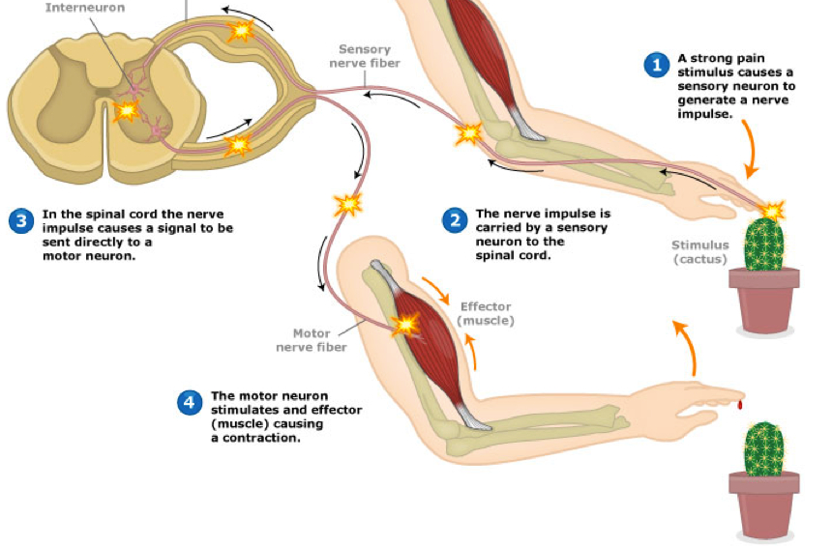

Slide 16
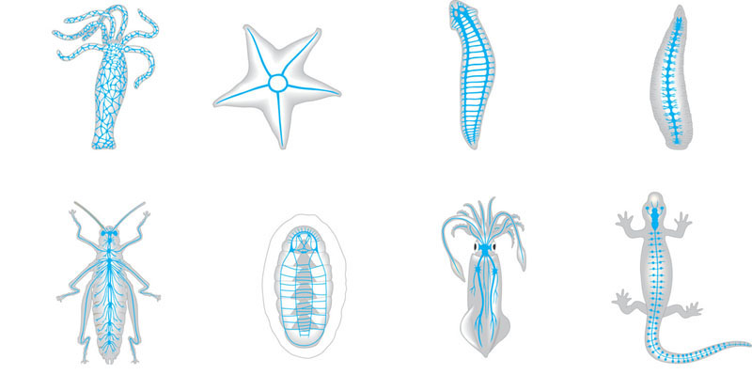
Organization of some nervous systems
Eyespot
Brain
Brain
Radial nerve
Nerve cord
Ventral nerve cord
Nerve ring
Transverse nerve
Nerve net
Segmental ganglion
(a) Hydra (cnidarian)
(b) Sea star (echinoderm)
(c) Planarian (flatworm)
(d) Leech (annelid)
Brain
Brain
Ganglia
Ventral nerve cord
Anterior nerve ring
Brain
Spinal cord
(dorsal nerve
cord)
Sensory ganglion
Longitudinal nerve cords
Ganglia
Segmental ganglia
(e) Insect (arthropod)
(f) Chiton (mollusc)
(g) Squid (mollusc)
(h) Salamander (chordate)

Slide 17
Quick Check: Make Sure You Can
Explain the relationships between the major divisions of the nervous system.
Give examples of the sympathetic & parasympathetic nervous systems
Label all parts of a neuron.
Describe the differences between sensory neurons, motor neurons, and interneurons.
Describe how a reflex arc is different from normal neural transmission.

