Slide 1
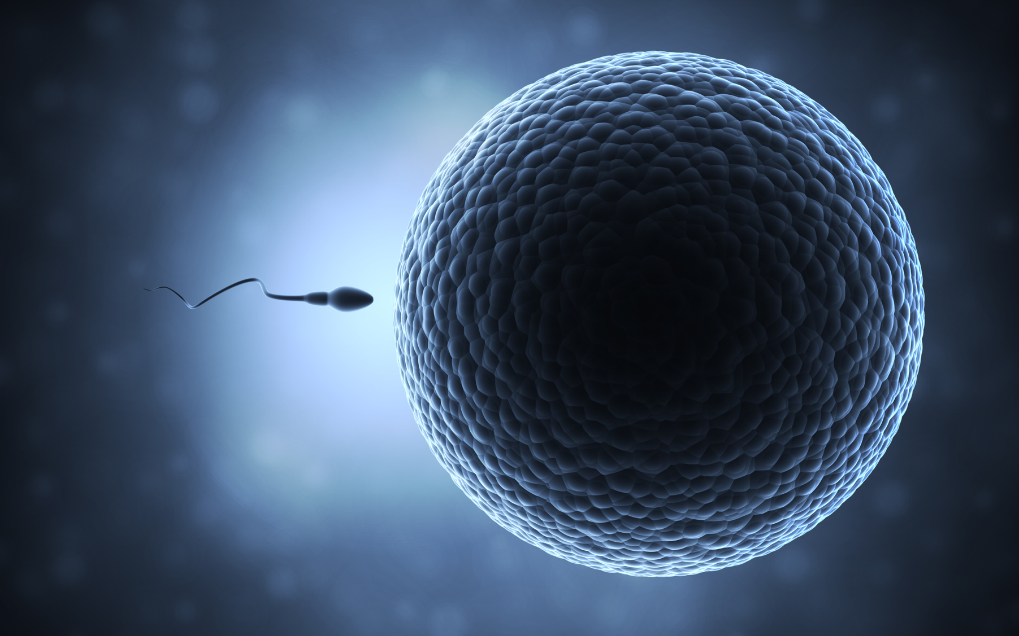
Human Health & Physiology
Essential idea:
Sexual reproduction involves the development and fusion of haploid gametes.
11.4 – Sexual Reproduction

Slide 2
Understandings
 | Statement | Guidance
11.4.U1 | Spermatogenesis and oogenesis both involve mitosis, cell growth, two divisions of meiosis and differentiation.
11.4.U2 | Processes in spermatogenesis and oogenesis result in different numbers of gametes with different amounts of cytoplasm.
11.4.U3 | Fertilization in animals can be internal or external.
11.4.U4 | Fertilization involves mechanisms that prevent polyspermy. | Fertilization involves the acrosome reaction, fusion of the plasma membrane of the egg and sperm and the cortical reaction.
11.4.U5 | Implantation of the blastocyst in the endometrium is essential for the continuation of pregnancy.
11.4.U6 | HCG stimulates the ovary to secrete progesterone during early pregnancy.
11.4.U7 | The placenta facilitates the exchange of materials between the mother and fetus.
11.4.U8 | Estrogen and progesterone are secreted by the placenta once it has formed.
11.4.U9 | Birth is mediated by positive feedback involving estrogen and oxytocin.

Slide 3
Applications and Skills
 | Statement | Guidance
11.4.A1 | The average 38-week pregnancy in humans can be positioned on a graph showing the correlation between animal size and the development of the young at birth for other mammals.
11.4.S1 | Annotation of diagrams of seminiferous tubule and ovary to show the stages of gametogenesis.
11.4.S2 | Annotation of diagrams of mature sperm and egg to indicate functions.

Slide 4
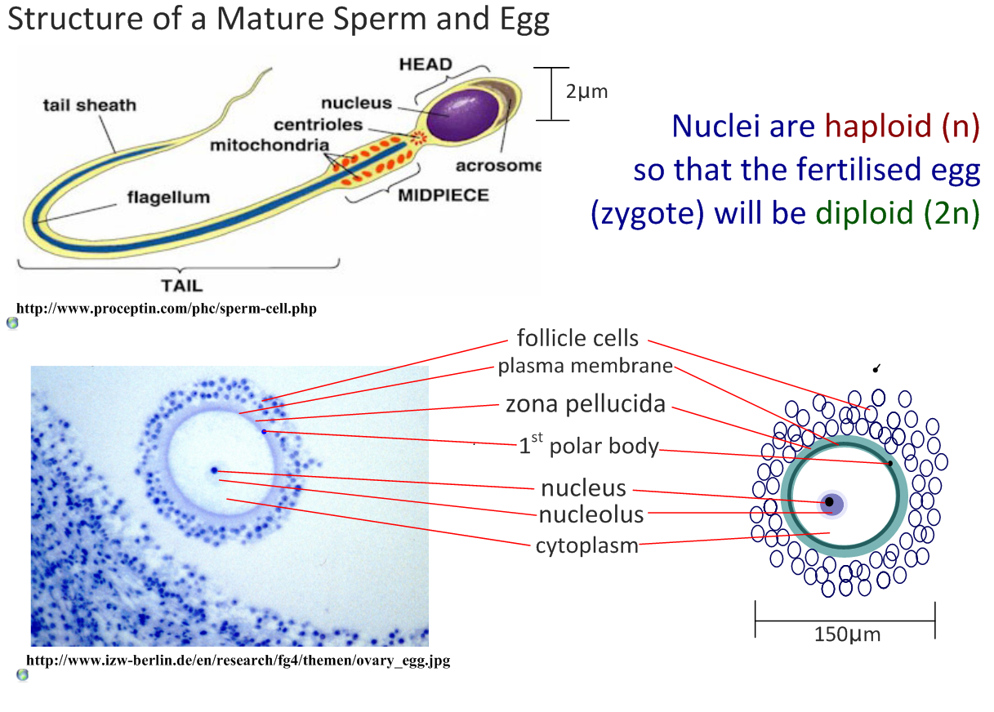
11.4.S2 Annotation of diagrams of mature sperm and egg to indicate functions.

Slide 5
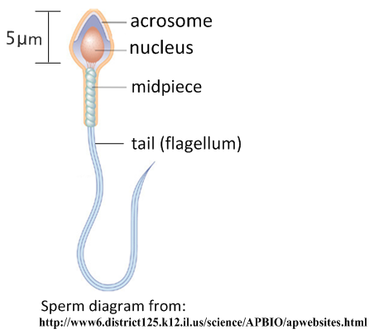
11.4.S2 Annotation of diagrams of mature sperm and egg to indicate functions.
Structure of the mature sperm
Contains enzymes which can digest the zona pellucida
Haploid (n), contains 23 chromosomes to be passed from father to child
Possesses helical mitochondria with provide the ATP (energy) for swimming (and other processes)
Contains protein fibres and microtubules to strengthen and allow the tail to move respectively.

Slide 6
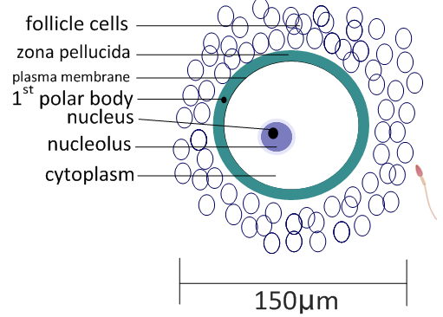
11.4.S2 Annotation of diagrams of mature sperm and egg to indicate functions.
Structure of the mature egg
Provides nutrients to support the early development of fertilised egg
Consists of a glycoprotein that protects the egg and prevents the entry of sperm.
Not required – will break down
Haploid (n) contains 23 chromosomes to be passed from mother to child
Contains nutrients to support the early development of fertilised egg
Cortical
granules
Makes the zona pellucida impenetrable to sperm (after fertilisation) to prevent polyspermy*
Diagram from: http://www.slideshare.net/gurustip/reproduction-ahl-1062218

Slide 7
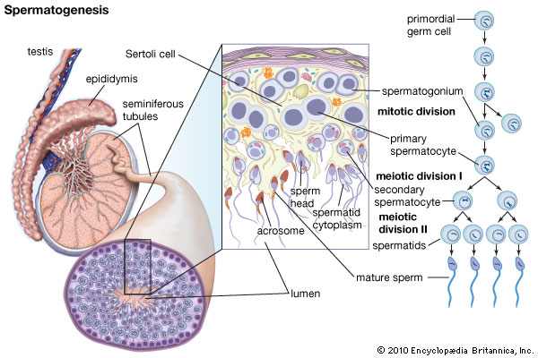

Slide 8
Spermatogenesis
Production of sperm cells takes place in the seminiferous tubules of the testes
Developing sperm are nourished by Sertoli cells
Testosterone is produced by interstitial cells
Mitosis produces 1° spermatocytes (2n)

Slide 9
Spermatogenesis
Meiosis I produces 2° spermatocytes (n)
Meiosis II produces sermatids (n) which differentiate into mature spermatozoa
RESULT = 4 haploid sperm cells
Produced ongoing from puberty until death

Slide 10
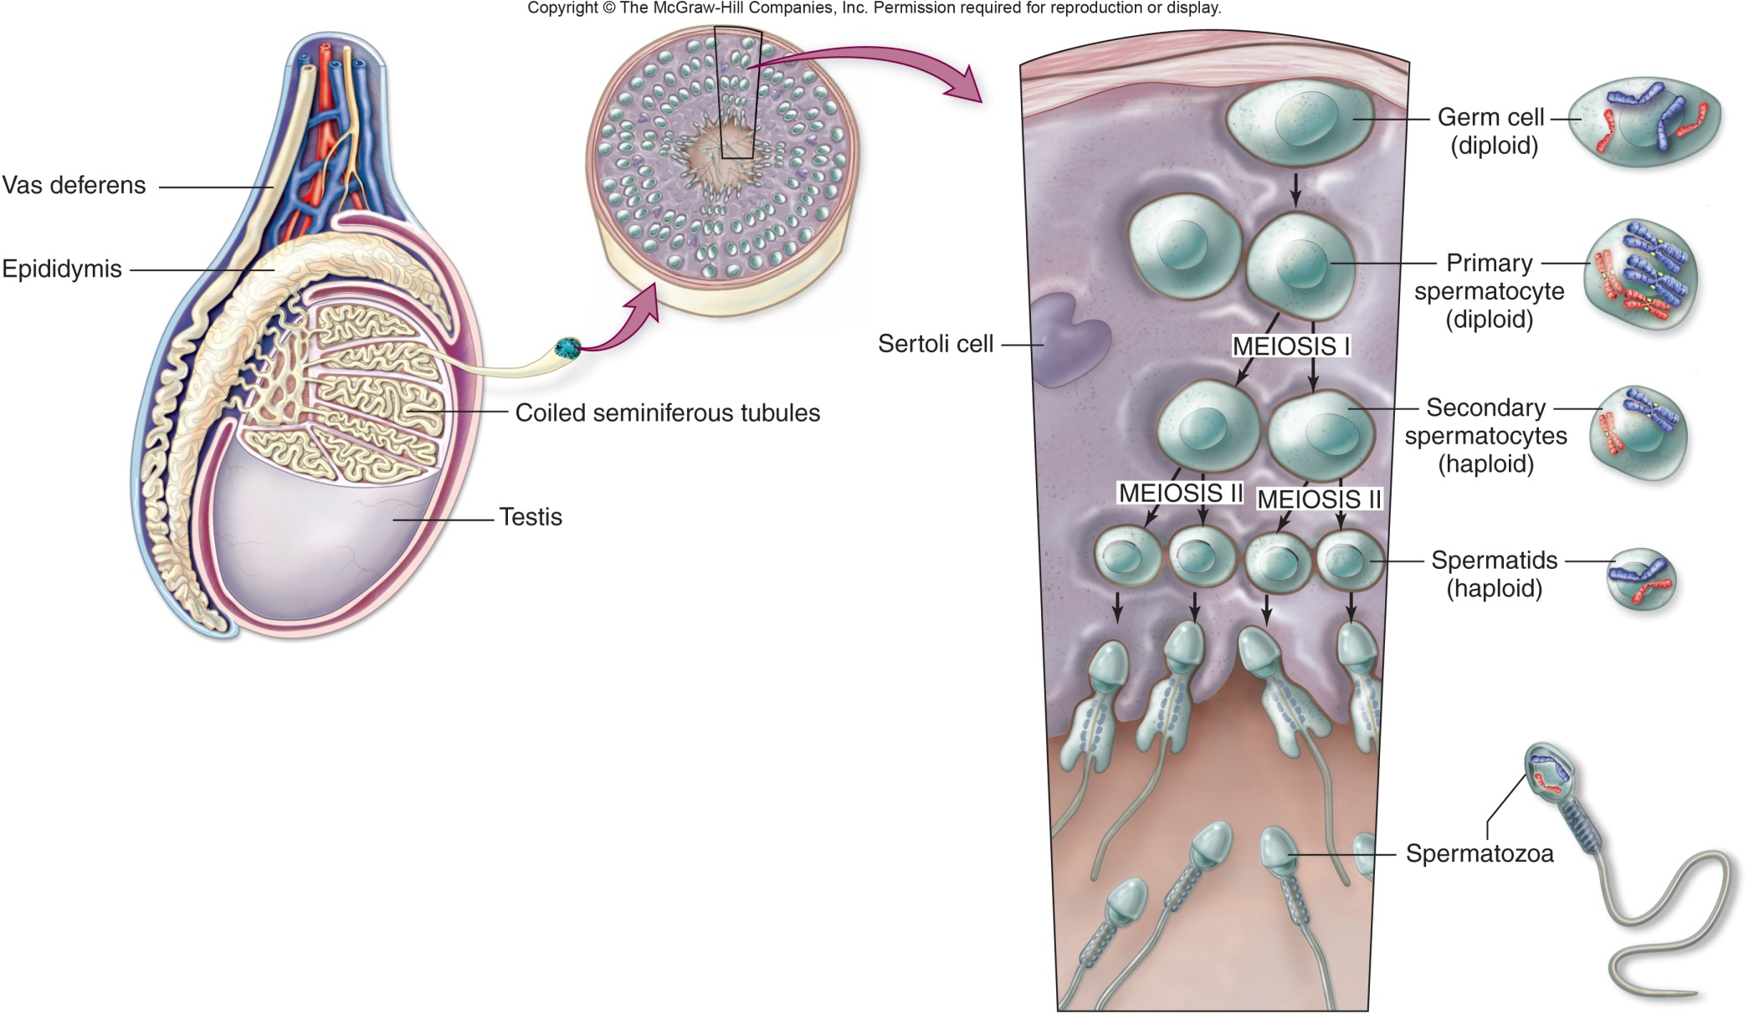

Slide 11
Spermatogenesis
Roles of hormones
FSH – stimulate 1° spermatocytes to mature into 2° spermatocytes
LH – stimulate interstitial cells to produce testosterone
Testosterone – stimulate maturation of 2° spermatocytes into spermatozoa

Slide 12
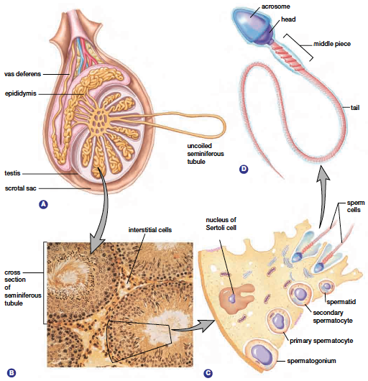

Slide 13
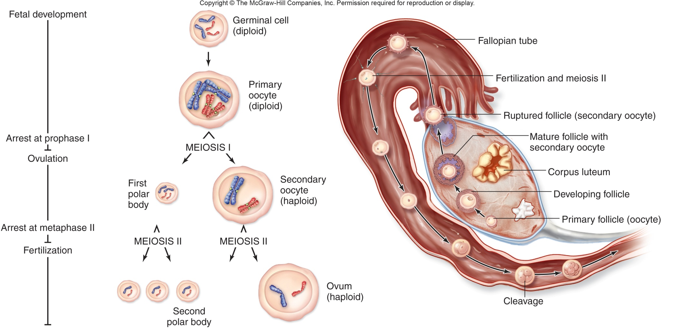

Slide 14
Oogenesis
Production of ova (eggs) occurs in the ovaries
Mitosis produces 1° oocytes (2n) before birth
Meiosis I stops at prophase I until puberty
Meiosis I results in a 2° oocyte (n) and a polar body

Slide 15
Oogenesis
Meiosis II produces an ovum and possibly 2 polar bodies
The ovum will only progress to the end of meiosis if fertilized
Polar bodies do not go beyond metaphase II

Slide 16
Oogenesis
RESULT = 1 mature egg cell(+3 polar bodies)
400 000 primary follicles at birth
Mature at puberty
Released once a month until menopause

Slide 17
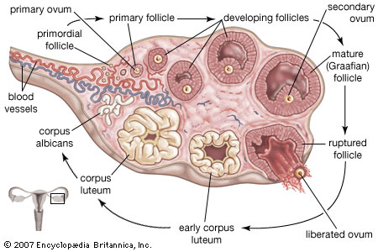

Slide 18
Comparison of spermatogenesis & oogenesis
Spermatogenesis | Oogenesis
Millions of sperm cells are produced every day | Typically, one secondary oocyte is ovulated per menstrual cycle
Four gametes are produced for each germinal cell which begins meiosis | One gamete is produced for each germinal cell which begins meiosis (plus polar bodies)
The resulting gametes are very small | The resulting gametes are very large
Occurs within testis (gonad tissue) | Occurs within ovaries (gonad tissue)
Damon, A., McGonegal, R., Tosto, P., & Ward, W. (2007). Higher Level Biology. England: Pearson Education, Inc.

Slide 19
Comparison of spermatogenesis & oogenesis
Spermatogenesis | Oogenesis
Spermatozoa are released during ejaculation | Secondary oocyte is released during ovulation
Haploid nucleus results from meiosis | Haploid nucleus results from meiosis
Spermatogenesis continues all through life (starting at puberty) | Ovulation starts at puberty, occurs with each menstrual cycle, then stops during menopause
Begins with mitosis | Begins with mitosis
Damon, A., McGonegal, R., Tosto, P., & Ward, W. (2007). Higher Level Biology. England: Pearson Education, Inc.

Slide 20
11.4.U1 Spermatogenesis and oogenesis both involve mitosis, cell growth, two divisions of meiosis and differentiation. AND
11.4.U2 Processes in spermatogenesis and oogenesis result in different numbers of gametes with different amounts of cytoplasm.
Compare and contrast the processes of spermatogenesis and oogenesis
(8 marks)
 | Oogenesis | Spermatogenesis
Cell division | Begin with mitosis and later on involve meiosis
Growth | Involve cell enlargement before meiosis
Product | Haploid cells (gametes)
Differentiation | Produce specialised gametes
Location | Eggs/ova produced in the ovaries | Sperm produced in the testes
Initiated | During development of fetus | During puberty
Pauses | During prophase I and between prophase II and metaphase II | None
cytokinesis | Unequal, producing polar bodies | Equal
Number of gametes | One ova, polar bodies degenerate | Four sperm
Release | 14th day, midpoint of the menstrual cycle | Continuous production, released during sexual intercourse
Ceases | At the menopause | Continuous until death

Slide 21
Acrosome reaction
Fertilization is the union of egg and sperm to produce a zygote
Fertilization occurs in the fallopian tubes
One sperm will penetrate the egg
The sperm initially bind to receptors on the outside of the egg
Enzymes in the acrosome will degrade the zone pellucida

Slide 22
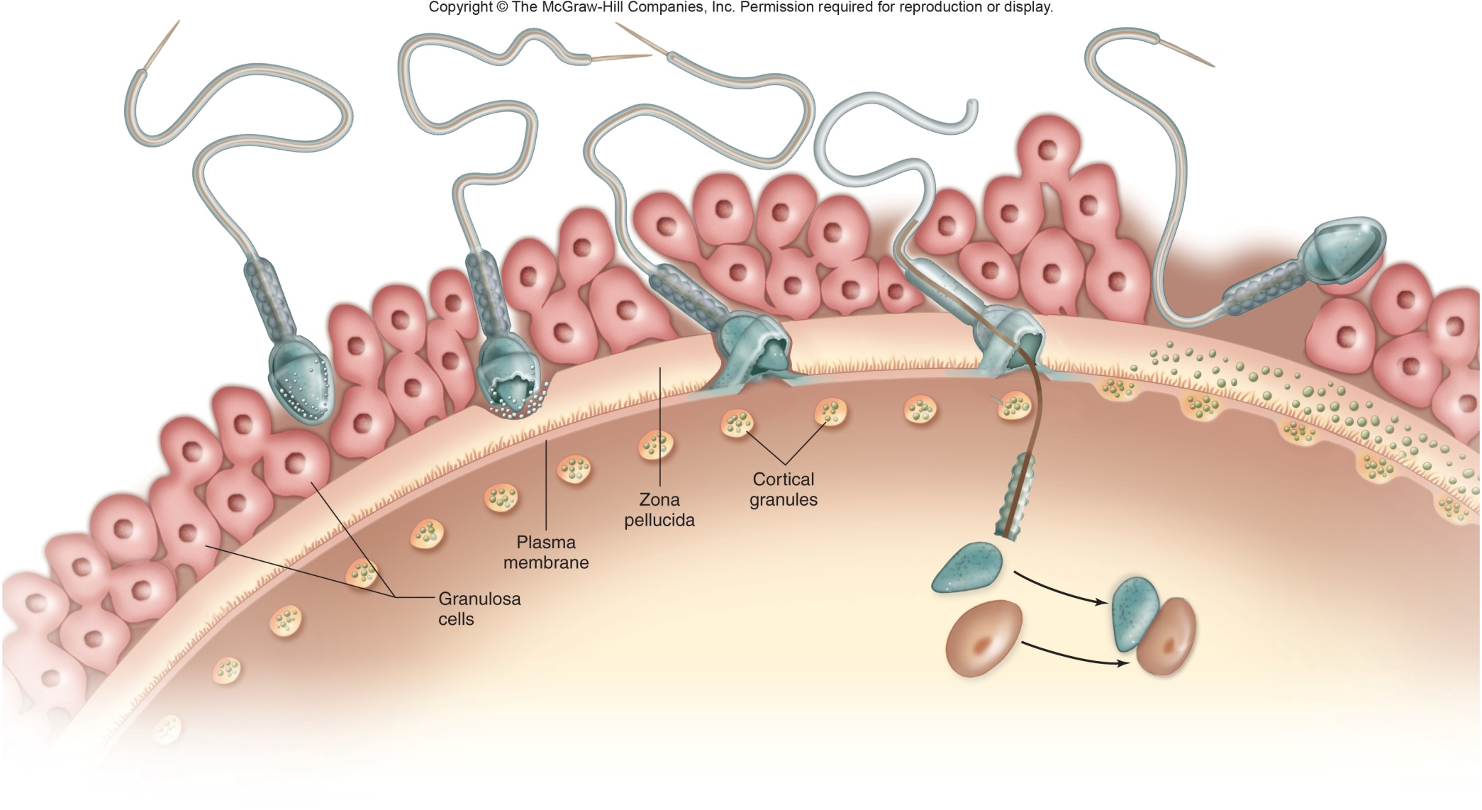
Animation - http://www.abpischools.org.uk/res/coResourceImport/modules/genome/en-flash/fertilisation.swf

Slide 23
Acrosome reaction
Plasma membranes from the sperm and egg fuse
Cortical granules release enzymes that harden the zona pellucida preventing any other sperm from entering
The sperm nucleus enters the egg and combines with the egg nucleus

Slide 24
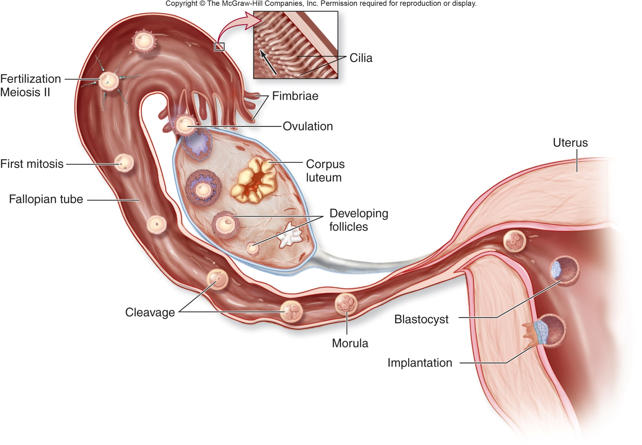

Slide 25
Early embryo development
After the first mitotic division occurs there is a cleavage division in which no cell growth occurs
A hollow ball of cells called a morula forms
This travels to the uterus (~4 days)
Unequal divisions occur and form a fluid filled ball of cells called the blastocyst

Slide 26
Early embryo development
The inner cell mass will form into the embryo
The fluid filled space will form the amnion
Around 7 days after fertilization, the blastocyst will implant into the uterine wall
The developing fetus is surrounded by an amniotic sac filled with amniotic fluid
This offers protection and support for the fetus

Slide 27
Role of HCG in early pregnancy
HCG = Human Chorionic Gonadotropin
Hormone secreted by the blastocyst
Stimulates the corpus luteum to continue to produce progesterone and estrogen which maintains the uterine lining (endometrium) and inhibits FSH and LH
HCG levels will increase during the first 8-10 weeks of pregnancy
HCG is excreted into the urine = pregnancy test

Slide 28
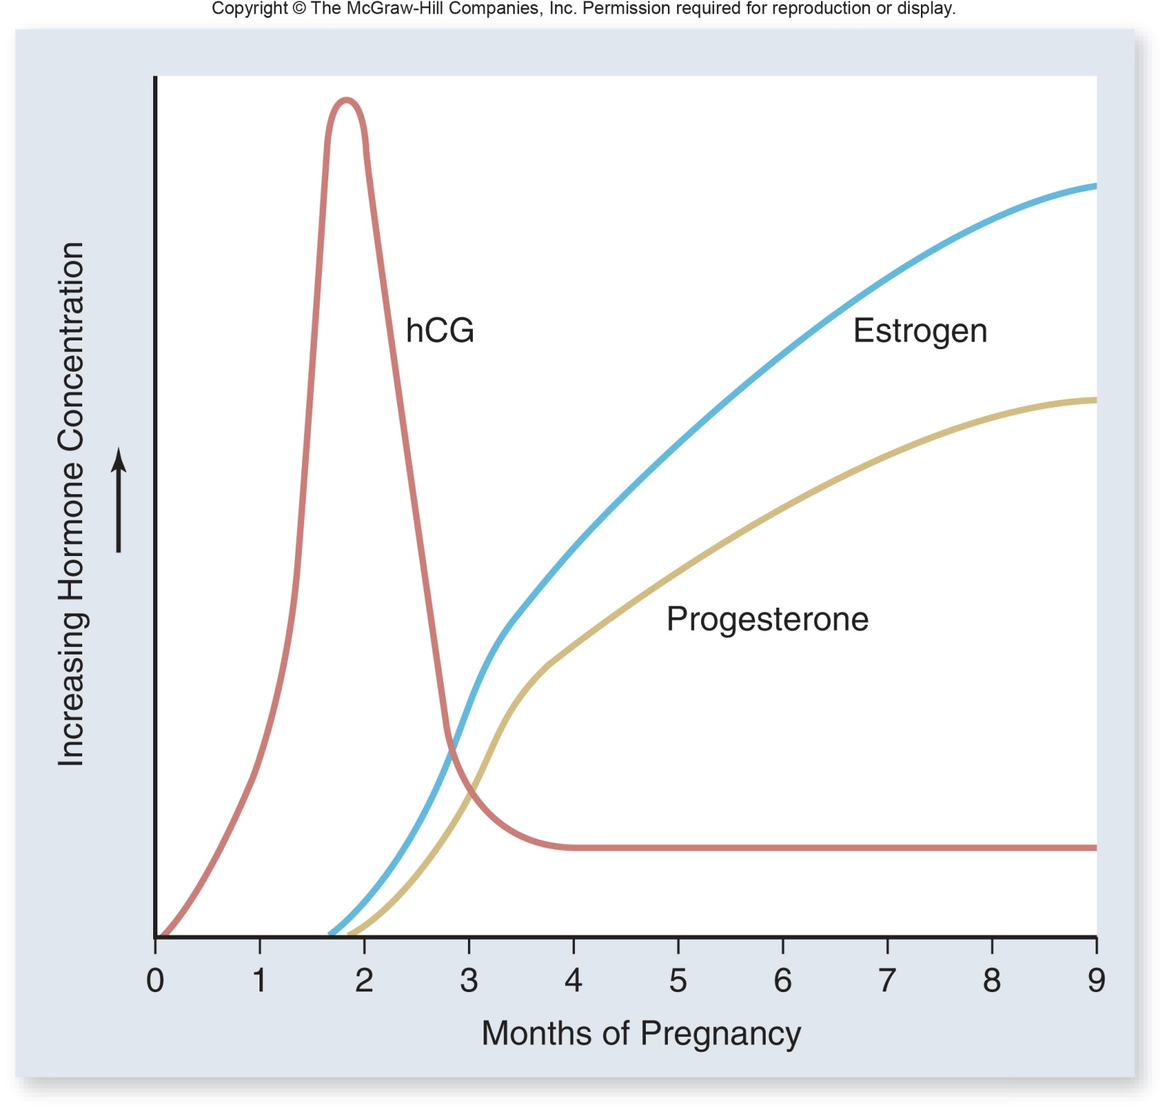

Slide 29
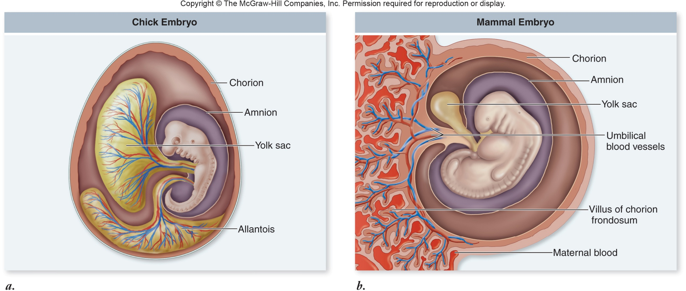

Slide 30
Structure & role of placenta
The placenta connects the mother to the fetus through the umbilical cord
The placenta runs through a cavity of maternal blood
Two umbilical arteries carry deoxygenated blood to the placenta
One umbilical vein carries oxygenated blood to the fetus

Slide 31
Structure & role of placenta
Site for exchange of nutrients and waste between the mother and fetus
Will take over the role of producing progesterone and estrogen throughout pregnancy
Levels will rise throughout gestation
A drop in the production of progesterone is the signal for labour to begin

Slide 32
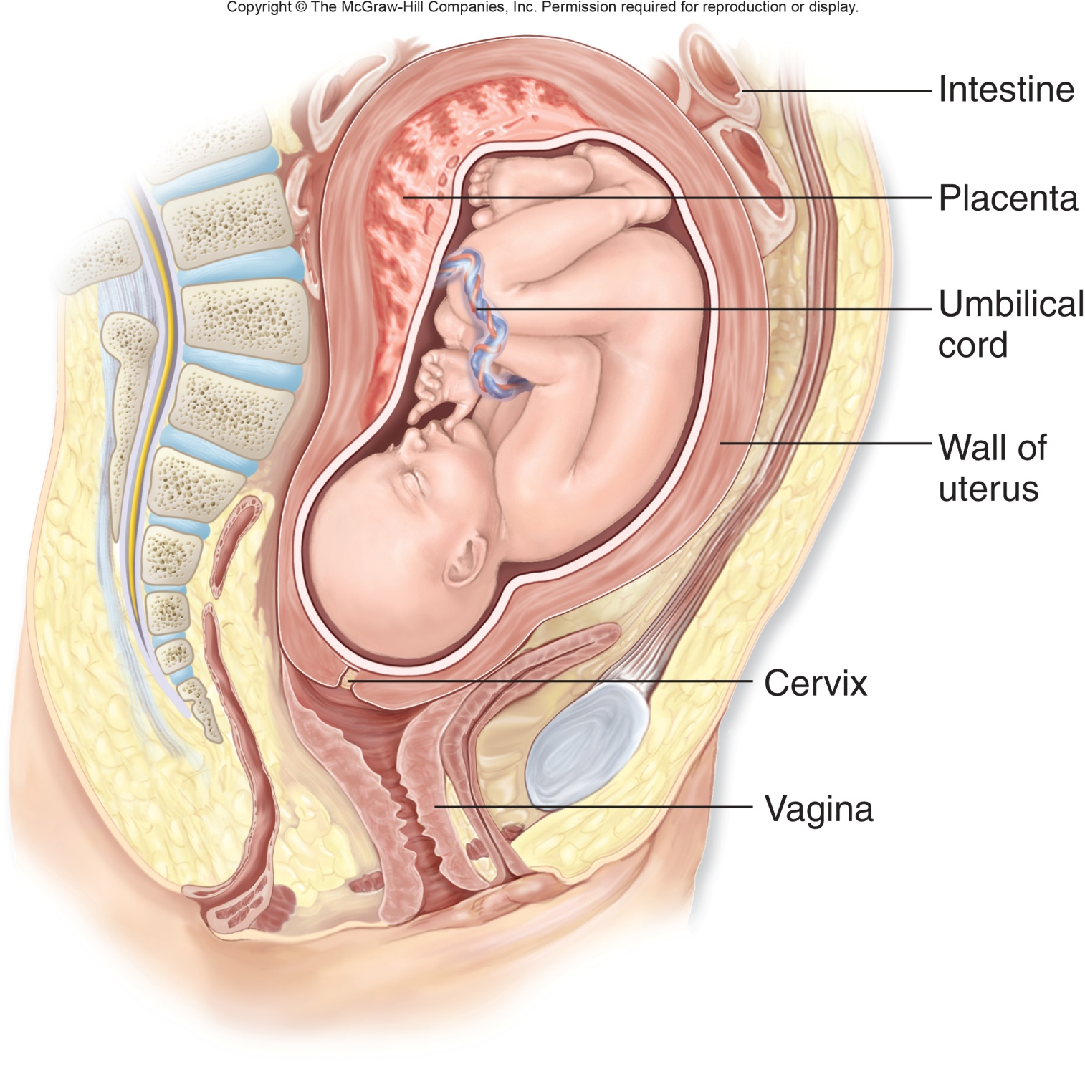

Slide 33
Birth process
Progesterone levels drop
Prostaglandins are secreted from the fetus (placenta) to initiate contractions and stimulate the pituitary gland
Oxytocin is produced when the baby’s head pushes against the cervix
Oxytocin blocks progesterone and causes uterine contractions

Slide 34
Birth process
Contractions of the uterus push the fetus against the cervix which in turn causes more oxytocin production = positive feedback
Strength of uterine contractions increase as more oxytocin is produced
Contractions continue until the placenta is delivered after birth

Slide 35
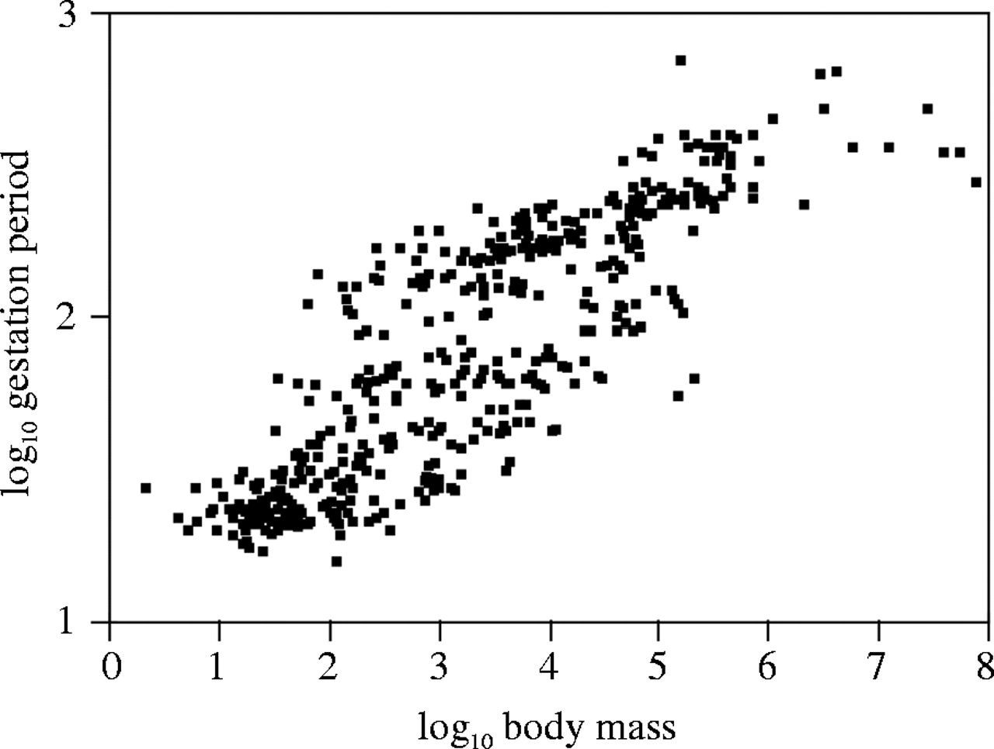
11.4.A1 The average 38-week pregnancy in humans can be positioned on a graph showing the correlation between animal size and the development of the young at birth for other mammals.
Adult size and development of newborn young in mammals
Altricial mammals give birth to relatively helpless, incompletely developed offspring. Precocial mammals give birth to offspring that are mobile and able to defend themselves. These are in reality extremes on a scale.
(days)
humans
The graph shows the relationship between (adult) body mass and gestation period (pregnancy) in a range of mammals.
(g)
Although there is a definite positive correlation between body mass and gestation period there are mammals with the same gestation period but widely varying body masses (by an order greater than 10³).
The general rule is that animals with a long gestation periods give birth to offspring who are more developed at the time of birth.
http://jeb.biologists.org/content/208/9/1731

Slide 36
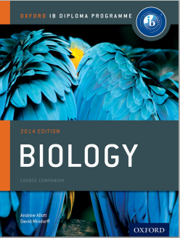
Bibliography / Acknowledgments
Bob Smullen
Chris Paine - Bioknowlegy

