Slide 1
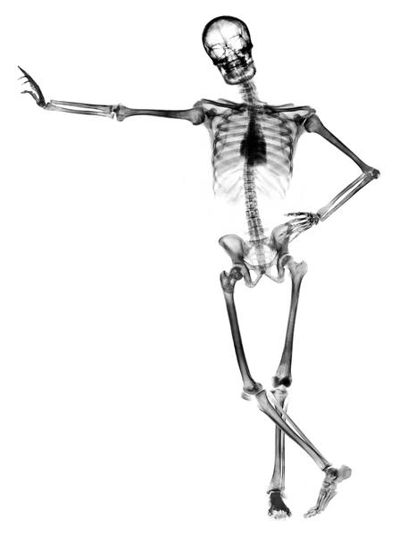
Human Health & Physiology
11.2 – Muscles & movement
(New Syllabus)
Essential idea: The roles of the musculoskeletal system are movement, support and protection.

Slide 2
Understandings
 | Statement | Guidance
11.2.U1 | Bones and exoskeletons provide anchorage for muscles and act as levers.
11.2.U2 | Synovial joints allow certain movements but not others.
11.2.U3 | Movement of the body requires muscles to work in antagonistic pairs.
11.2.U4 | Skeletal muscle fibres are multinucleate and contain specialized endoplasmic reticulum.
11.2.U5 | Muscle fibres contain many myofibrils.
11.2.U6 | Each myofibril is made up of contractile sarcomeres.
11.2.U7 | The contraction of the skeletal muscle is achieved by the sliding of actin and myosin filaments.
11.2.U8 | ATP hydrolysis and cross bridge formation are necessary for the filaments to slide.
11.2.U9 | Calcium ions and the proteins tropomyosin and troponin control muscle contractions.

Slide 3
Applications and Skills
 | Statement | Guidance
11.2.A1 | Antagonistic pairs of muscles in an insect leg.
11.2.S1 | Annotation of a diagram of the human elbow. | Elbow diagram should include cartilage, synovial fluid, joint capsule, named bones and named antagonistic muscles.
11.2.S2 | Drawing labelled diagrams of the structure of a sarcomere. | Drawing labelled diagrams of the structure of a sarcomere should include Z lines, actin filaments, myosin filaments with heads, and the resultant light and dark bands.
11.2.S3 | Analysis of electron micrographs to find the state of contraction of muscle fibres. | Measurement of the length of sarcomeres will require calibration of the eyepiece scale of the microscope.

Slide 4
11.2.U1 Bones and exoskeletons provide anchorage for muscles and act as levers.

Slide 5
Muscles & movement
Movement is generated by the stimulation of nerve impulses and contraction of muscle cells
Signals from the brain travel along the nerves to the muscle causing it to contract
The muscle fibers shorten
Contraction of the muscles causes the bone to move
Muscle fibre: A long, cylindrical, multinucleated cell containing numerous myofibrils, which is capable of contraction when stimulated

Slide 6
Muscles & movement
Bones: the levers of the skeletal system
Joints: provide the pivot point
Muscles exist and work in antagonistic pairs
In an antagonistic pair, one muscle (or set of muscles) functions to produce movement opposite to the opposing muscle (or set of muscles)

Slide 7
Muscles & movement
Some useful definitions¹:
Flexion: decrease in angle between connecting bones
Extension: increase in angle between connecting bones
Abduction: movement of bone away from body midline
Adduction: movement of bone toward body midline
Circumduction: distal or far end of a limb moves in a circle
Rotation: a bone revolves around its own longitudinal axis

Slide 8
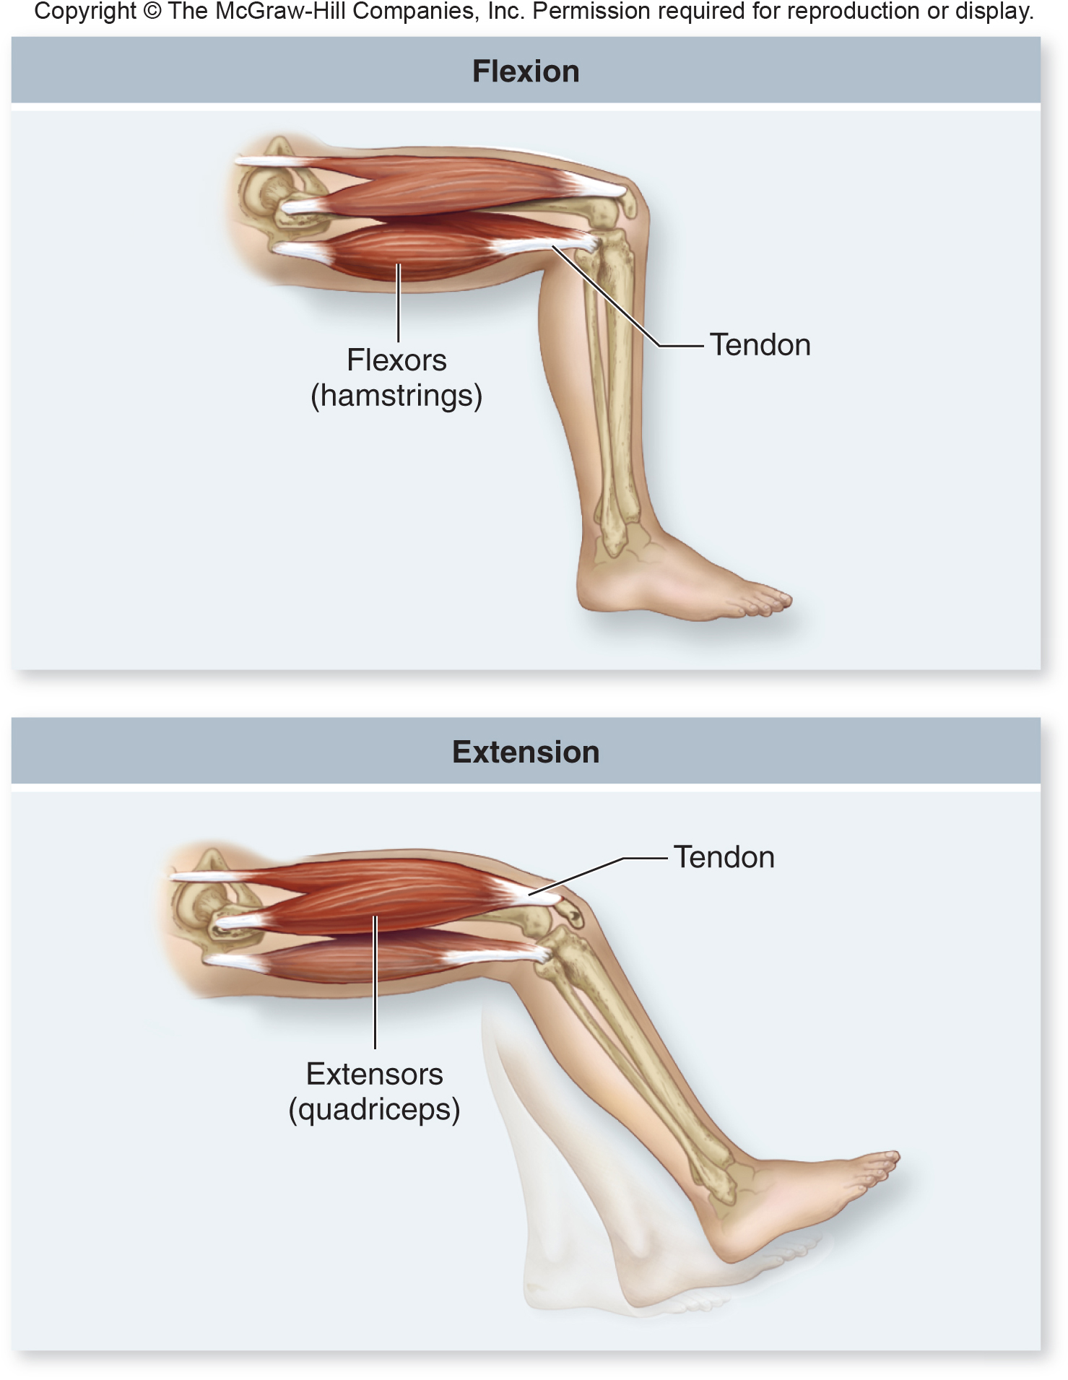

Slide 9
Joints
There are generally four types of joints – we will focus on only 2:
Ball & socket joint
Hip joint located between the pelvic bone and femur
Shoulder joint located between the humerus and scapula
Allows movement in all planes = flexion, extension, circumduction, and rotation
Hinge joint
Knee joint located between the femur and tibia
Allows movement in only one plane = flexion and extension

Slide 10
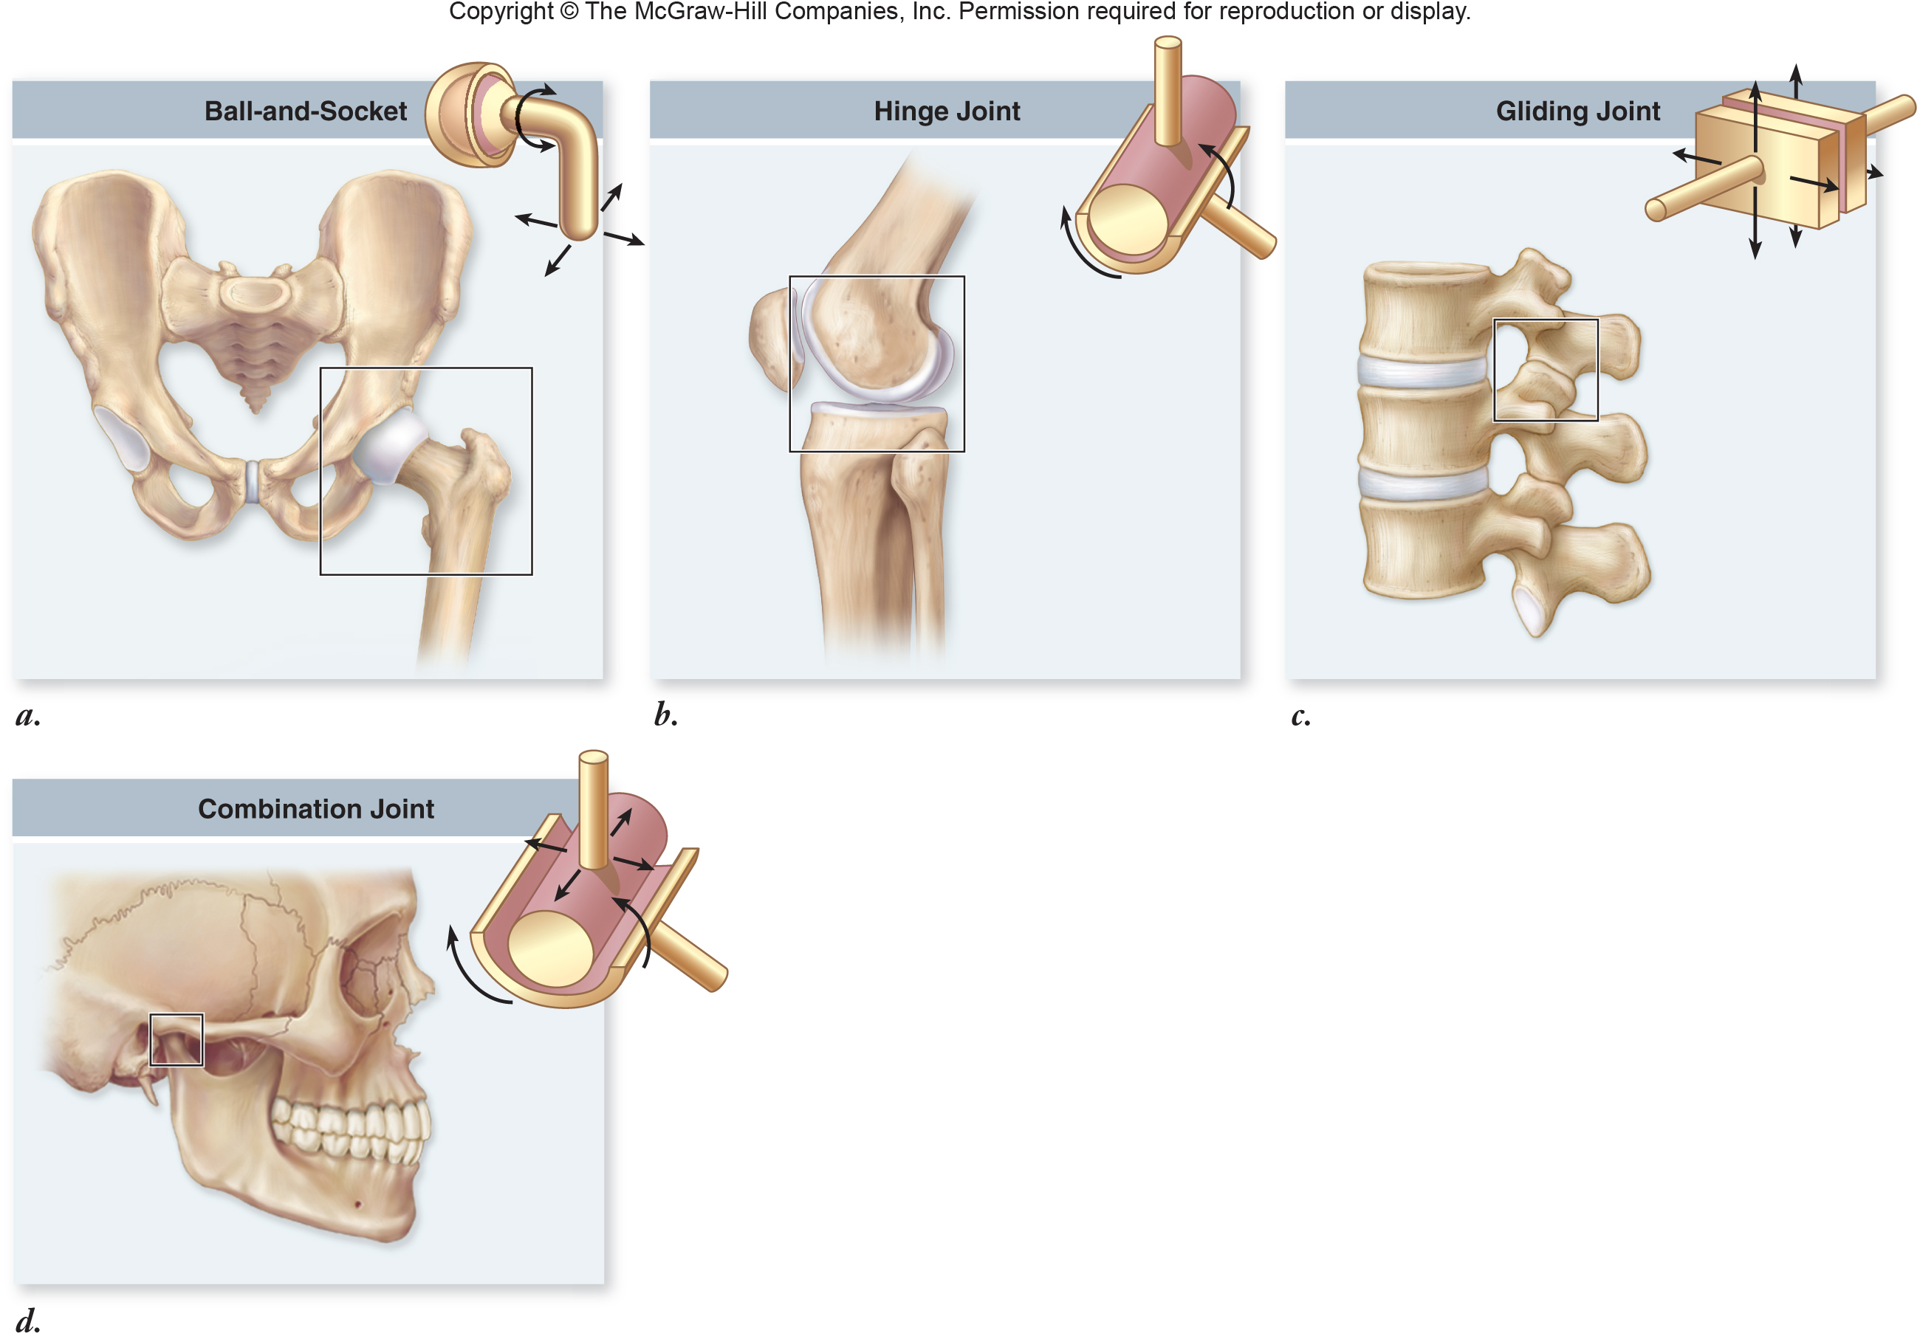

Slide 11
Human Elbow Joint
Wapole, B., Merson-Davies, A., Dann, L., (2011). Biology for the IB Diploma. United Kingdom: Cambridge University Press

Slide 12
Human Elbow Joint¹
Joint part | Function
Cartilage | Reduces friction and absorbs compression
Synovial fluid | Lubricates to reduce friction and provides nutrients to the cells of the cartilage
Joint capsule | Surrounds the joint, encloses the synovial cavity, and unites the connecting bones
Tendons | Attach muscle to bone
Ligaments | Connect bone to bone
Damon, A., McGonegal, R., Tosto, P., & Ward, W. (2007). Higher Level Biology. England: Pearson Education, Inc.

Slide 13
Human Elbow Joint¹
Joint part | Function
Biceps muscle | Contracts to bring about flexion (bending) of the arm
Triceps muscle | Contracts to cause extension (straightening) of the arm
Humerus | Acts as a lever that allows anchorage of the muscles of the elbow
Radius | Acts as a lever for the biceps muscle
Ulna | Acts as a lever for the triceps muscle
Damon, A., McGonegal, R., Tosto, P., & Ward, W. (2007). Higher Level Biology. England: Pearson Education, Inc.

Slide 14
Human Knee Joint
Wapole, B., Merson-Davies, A., Dann, L., (2011). Biology for the IB Diploma. United Kingdom: Cambridge University Press

Slide 15
Human Hip Joint
Wapole, B., Merson-Davies, A., Dann, L., (2011). Biology for the IB Diploma. United Kingdom: Cambridge University Press

Slide 16
Comparison of Knee & Hip Joints
Hip joint | Knee joint
Freely movable | Freely movable
Angular motions in many directions and rotational movements | Angular motion in one direction
Motions possible are flexion, extension, abduction, adduction, circumduction and rotation | Motions possible are flexion and extension
Ball-like structure fits into a cup-like depression | Convex surface fits into a concave surface
Virtual hip replacement surgery | Virtual knee replacement surgery
Damon, A., McGonegal, R., Tosto, P., & Ward, W. (2007). Higher Level Biology. England: Pearson Education, Inc.

Slide 17
Structure of Skeletal Muscle
Skeletal muscles are made up of fibre bundles, which contain hundreds of myofibrils
Each fibre is a single multinucleate cell extending the length of the muscle
Myofibrils carry out the contraction
Myofibrils are composed of individual units called sarcomeres
Muscle fibre cells are held together by the plasma membrane referred to as the sarcolemma.

Slide 18
Structure of Skeletal Muscle
Sarcomeres contain a sarcoplasmic reticulum - specialized ER that stores calcium ions and pumps them into the sarcoplasm (the cytoplasm of a muscle cell) when the muscle is stimulated
Mitochondria are found between the myofibrils – Why??
Structure of skeletal muscle fibre
Sarcomeres are made up of thin actin filaments and thick myosin filaments
These filaments overlap to give a distinct banding pattern when seen with an electron microscope (striated muscle)

Slide 19
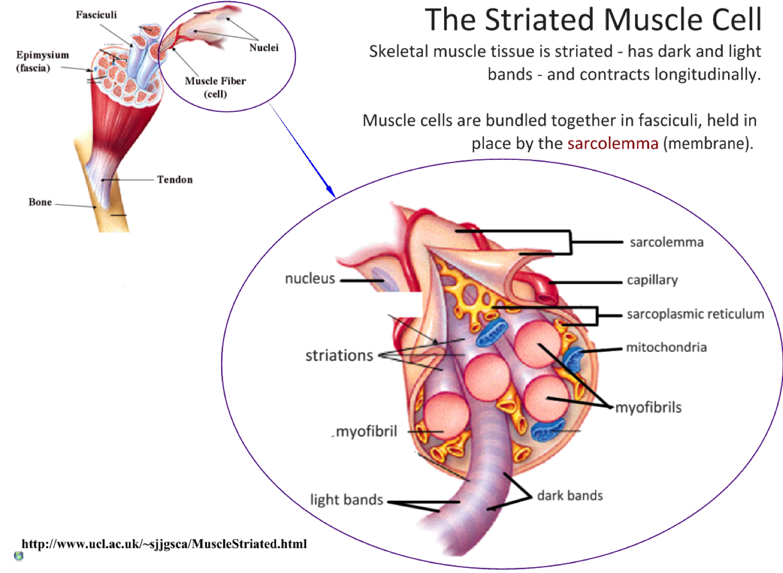
11.2.U4 Skeletal muscle fibres are multinucleate and contain specialized endoplasmic reticulum. AND 11.2.U5 Muscle fibres contain many myofibrils.
Muscle fibre cells are held together by the plasma membrane referred to as the sarcolemma.
A single skeletal muscle cell is multinucleated, with nuclei positioned along the edges
Many mitochondria are present due to the high demand for ATP
edited from: http://www.slideshare.net/gurustip/muscles-and-movement

Slide 20
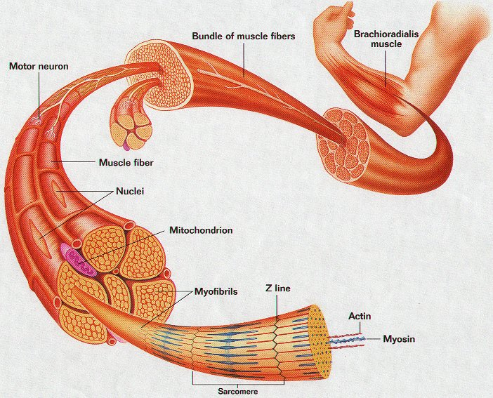

Slide 21
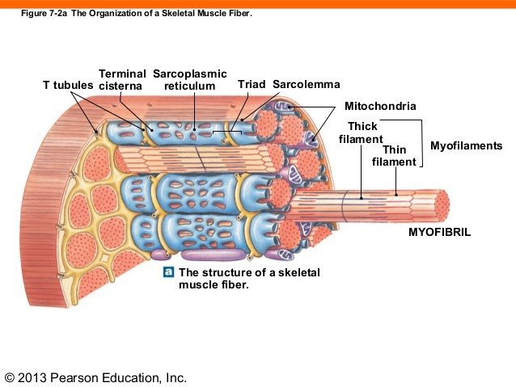

Slide 22
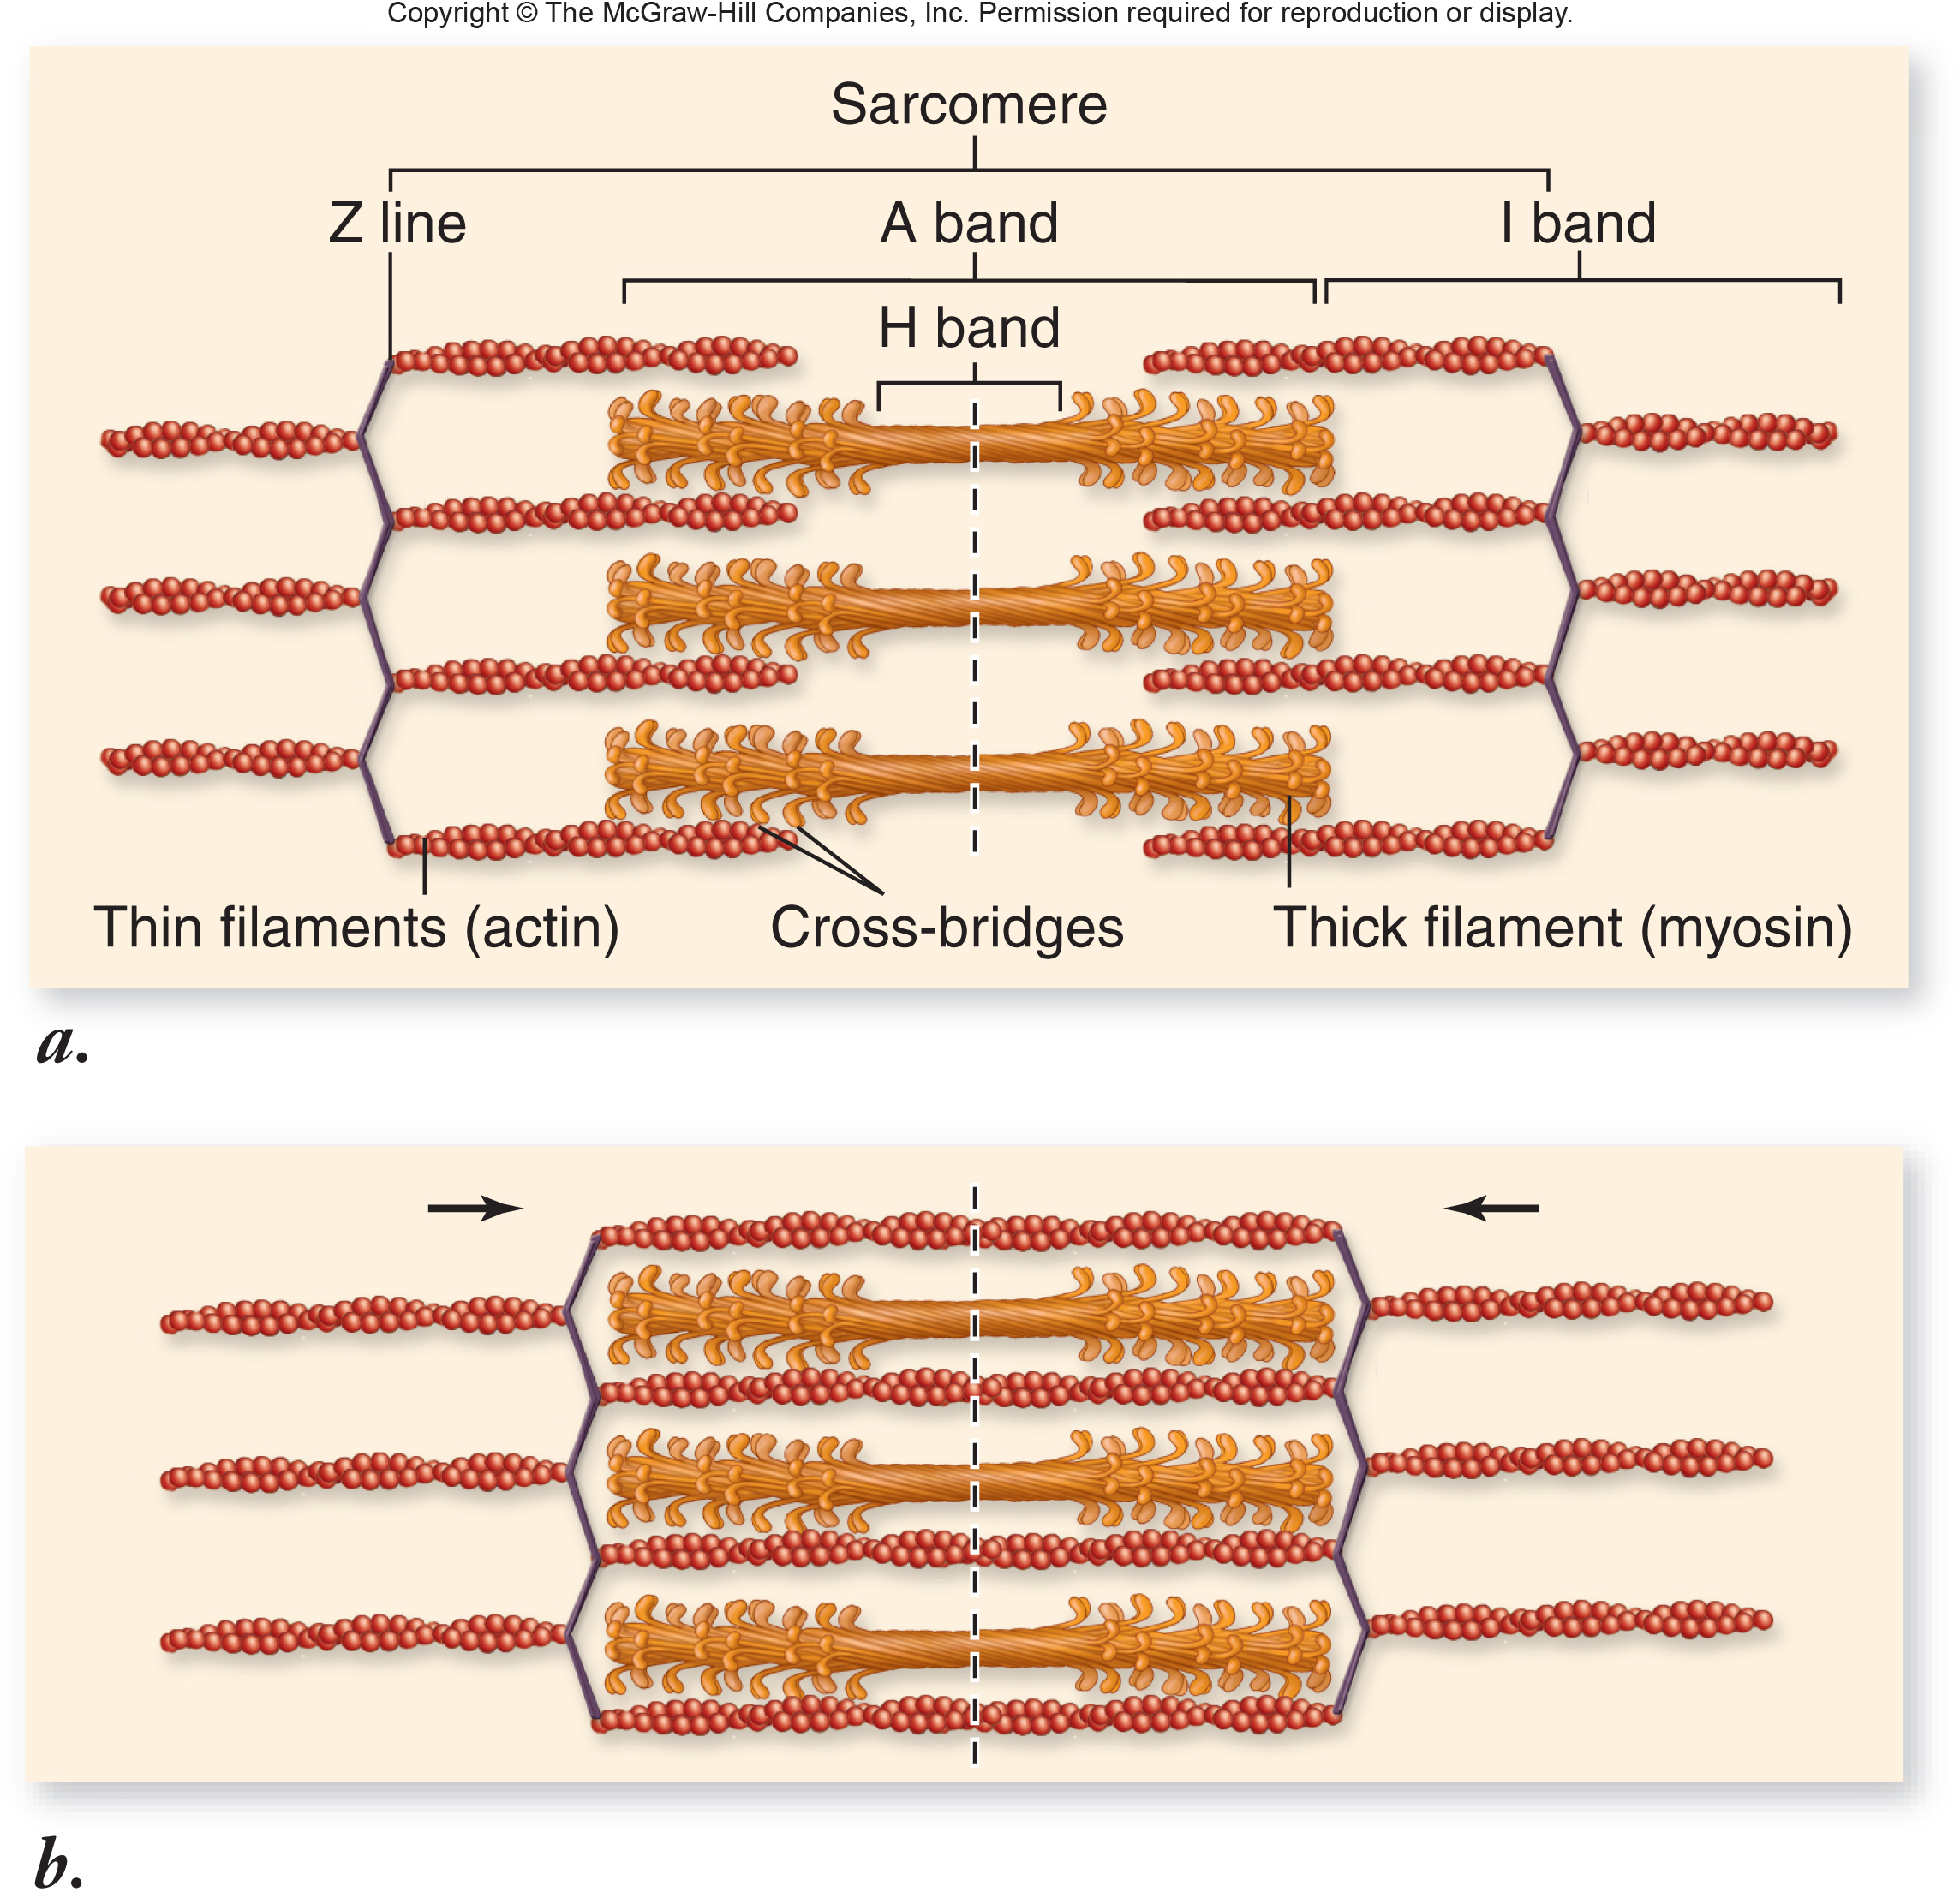

Slide 23
Muscle Fibre Contractions

Slide 24
Muscle Fibres
Actin | Myosin
Thin filaments (8nm in diameter) | Thick filaments (16nm in diameter)
Contains myosin-binding sites | Contains myosin heads that have actin-binding sites
Individual molecules form helical structures | Individual molecules form a common shaft-like region with outward protruding heads
Includes two regulatory proteins, tropomyosin and troponin | Heads are referred to as cross-bridges and contain ATP-binding sites and ATPase enzymes
Damon, A., McGonegal, R., Tosto, P., & Ward, W. (2007). Higher Level Biology. England: Pearson Education, Inc.

Slide 25
Sliding Filament Model
When the muscle contracts the actin and myosin filaments slide past one another, shortening the muscle
Myosin heads attach to binding sites on the actin filaments
This forms cross-bridges with the actin filament
The myosin head bends, pulling on the actin filaments causing them to slide toward the centre of the sarcomere
ATP is used for this “power stroke”

Slide 26
Sliding Filament Model
ATP supplies the energy for the contraction
It is required for the sliding of filaments as well as the separation of the actin and myosin which relaxes the muscle
The cross-bridge cycle continues
Grab → pull → release
When the muscle relaxes, the heads detach and the actin filaments move back

Slide 27
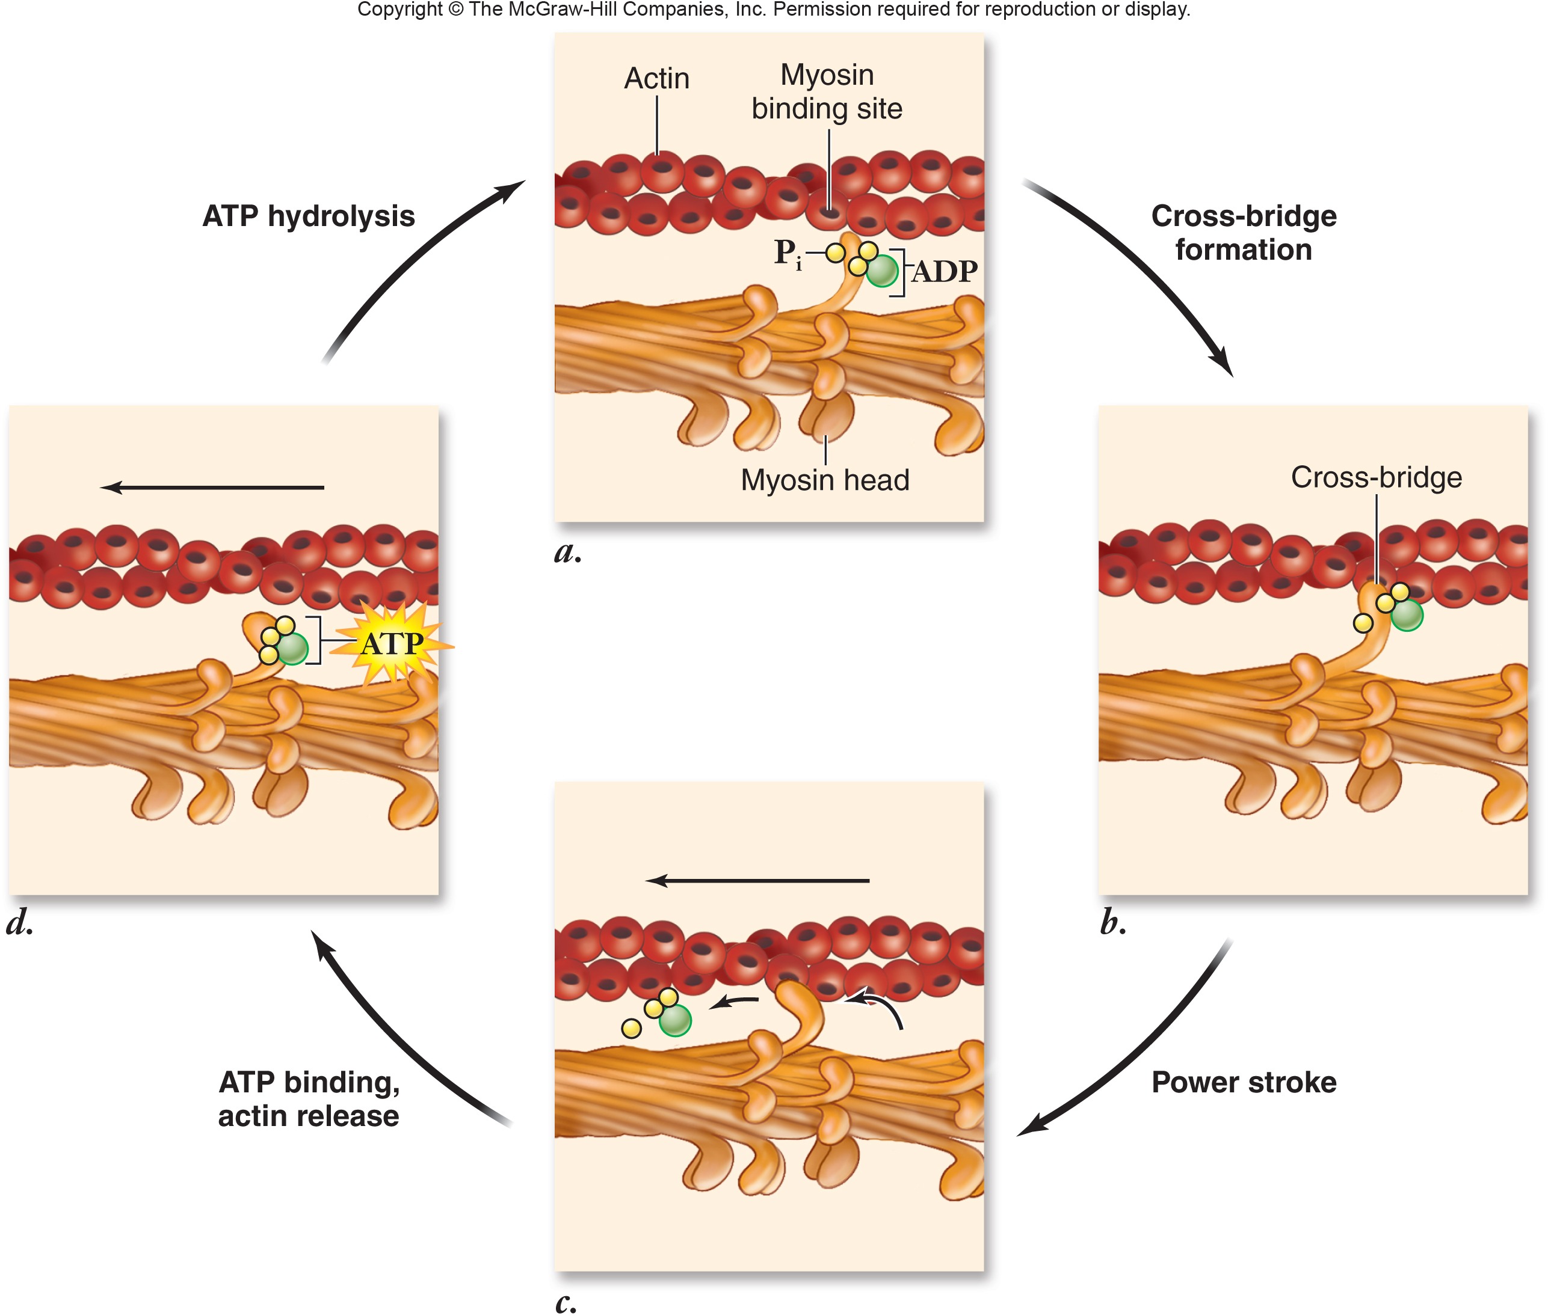

Slide 28
Role of Calcium Ions
Muscle contraction is driven by ATP and triggered by the release of Ca²⁺ from the sarcoplasmic reticulum
At rest, the protein tropomyosin winds around the actin, covering the myosin binding sites
When stimulated by a nerve impulse, actylcholine is released causing calcium ion channels to open
Ca²⁺ ions are released from the sarcoplasmic reticulum

Slide 29
Role of Calcium Ions
The Ca²⁺ binds to a second protein, troponin, which causes the tropomyosin to move to the side
This exposes the myosin binding sites
If ATP is present, the cross-bridges will form and the muscle will contract
After contraction, the Ca²⁺ ions are actively pumped back into the sarcoplasmic reticulum

Slide 30
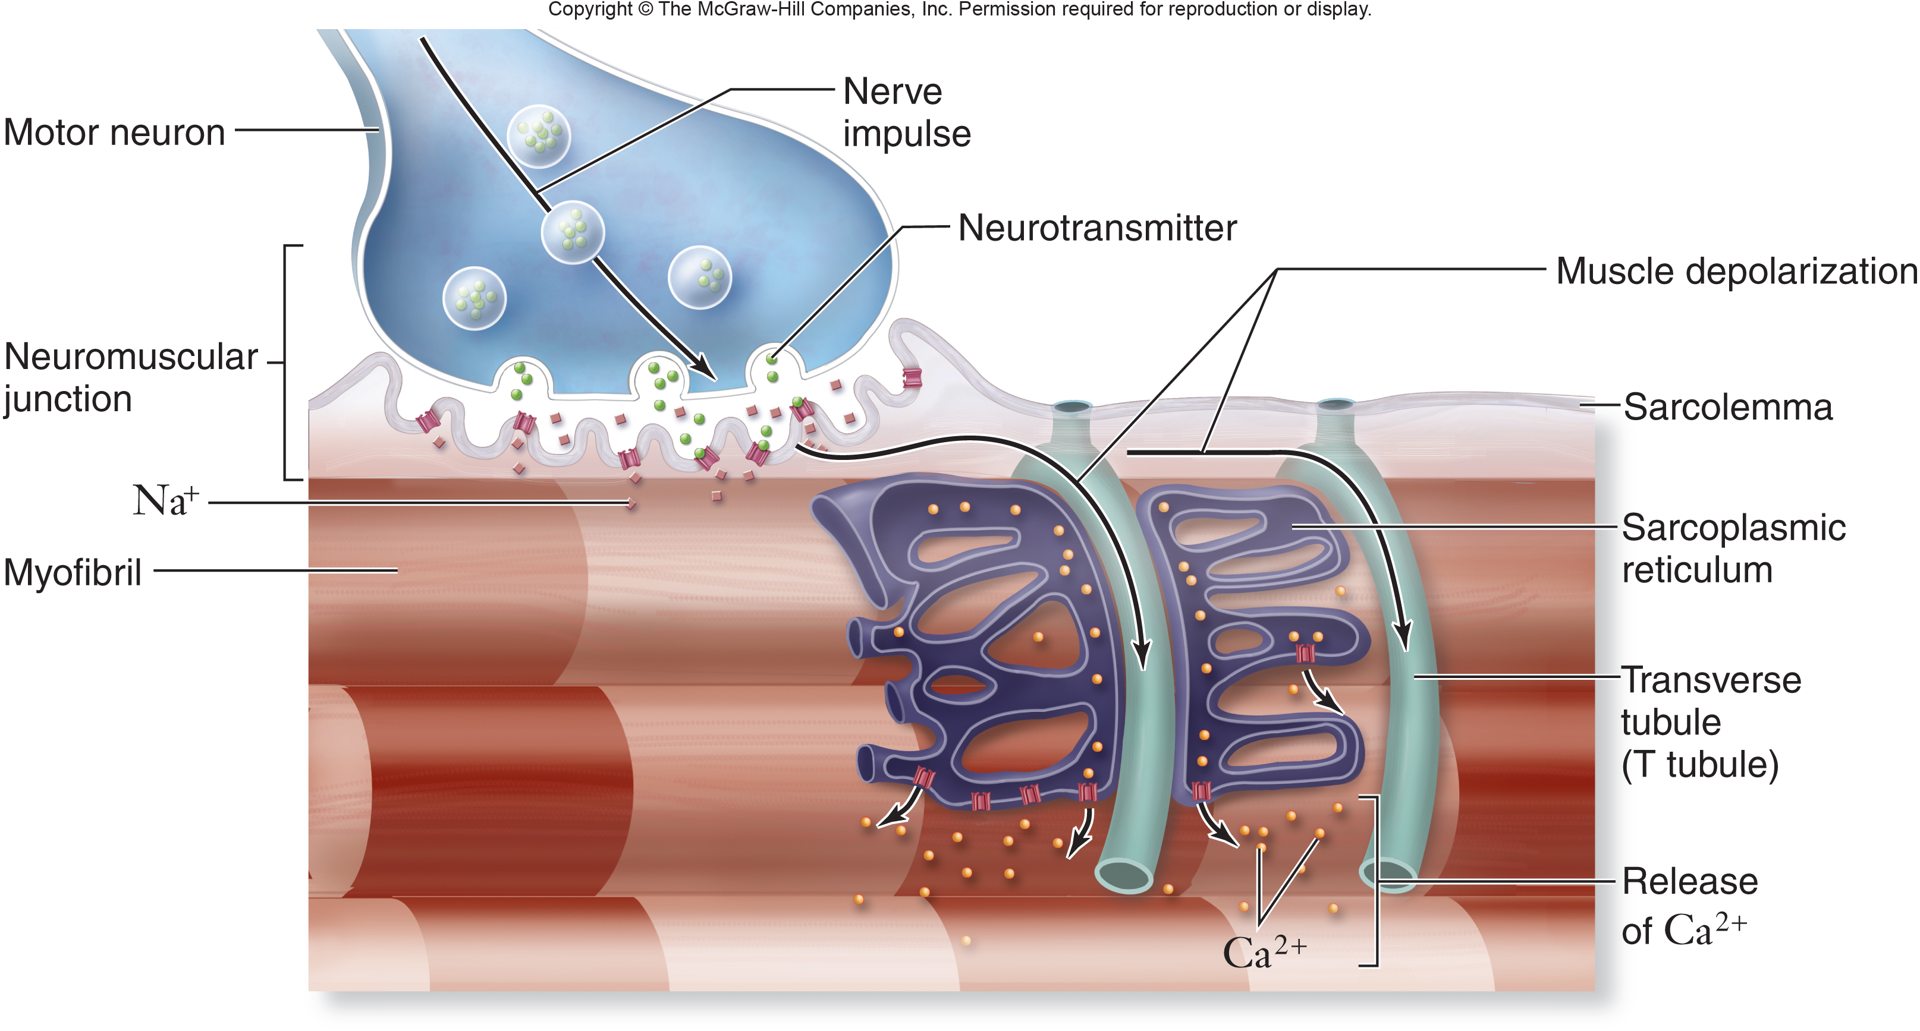

Slide 33
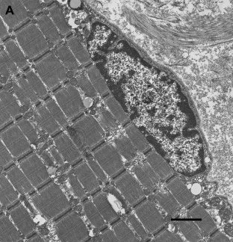
11.2.S3 Analysis of electron micrographs to find the state of contraction of muscle fibres.
Electron micrograph of human skeletal muscle
Analyse the micrograph and use it to answer the following:
Deduce whether the myofibrils are contracted or relaxed
Calculate the magnification of the electron micrograph
Measuring an individual sarcomere accurately is difficult due to their small size. Commonly scientists use the formula below: = total length of n sacromeres n
Measure the total length of five sarcomere from z-line to z-line
Calculate the mean length of a sarcomere
mean sarcomere length (μm)
1μm
http://darwin.wcupa.edu/beneski/bio-515/f12/westervelt/Main/ImageAnalysis?p=2

Slide 34
References
Damon, A., McGonegal, R., Tosto, P., & Ward, W. (2007). Higher Level Biology. England: Pearson Education, Inc.
Raven, P.H., Johnson, G.B., Losos, J.B., Mason, K.A., & Singer, S.R. (2008). Biology. (8th ed.). New York: McGraw-Hill Companies, Inc.
Wapole, B., Merson-Davies, A., Dann, L., (2011). Biology for the IB Diploma. United Kingdom: Cambridge University Press

Slide 35
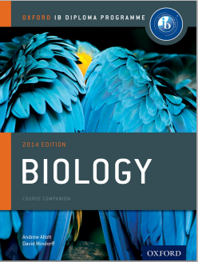
Bibliography / Acknowledgments
Bob Smullen

