Slide 1
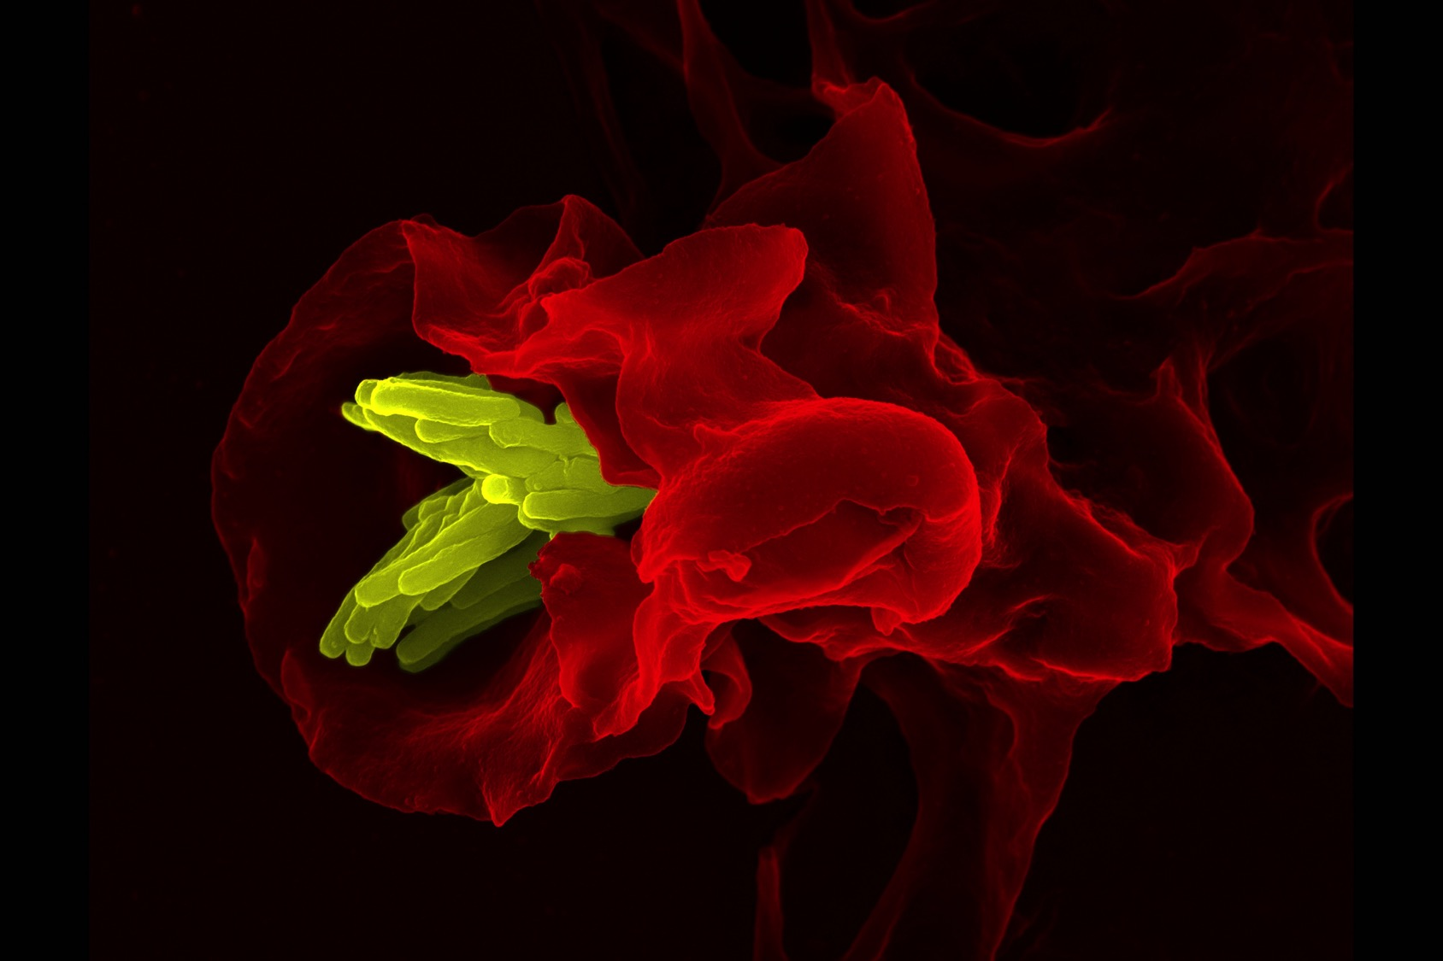
11.1 Antibody production and vaccination
The false coloured electron micrograph shows a macrophage (red) engulfing tuberculosis bacteria (yellow). After the bacteria are engulfed and digested the bacterial surface antigens (molecules that provoke an immune response) are attached to the cell membrane and presented to lymphocytes hence generating a specific immune response.
Essential idea: Immunity is based on recognition of self and destruction of foreign material.
By Chris Paine
https://bioknowledgy.weebly.com/
https://www.flickr.com/photos/zeissmicro/8765512496

Slide 2
Understandings
 | Statement | Guidance
11.1.U1 | Every organism has unique molecules on the surface of its cells.
11.1.U2 | Pathogens can be species-specific although others can cross species barriers.
11.1.U3 | B lymphocytes are activated by T lymphocytes in mammals. | Limit the immune response to mammals.
11.1.U4 | Activated B cells multiply to form clones of plasma cells and memory cells.
11.1.U5 | Plasma cells secrete antibodies.
11.1.U6 | Antibodies aid the destruction of pathogens.
11.1.U7 | White cells release histamine in response to allergens.
11.1.U8 | Histamines cause allergic symptoms.
11.1.U9 | Immunity depends upon the persistence of memory cells.
11.1.U10 | Vaccines contain antigens that trigger immunity but do not cause the disease.
11.1.U11 | Fusion of a tumour cell with an antibody-producing plasma cell creates a hybridoma cell.
11.1.U12 | Monoclonal antibodies are produced by hybridoma cells.

Slide 3
Applications and Skills
 | Statement | Guidance
11.1.A1 | Smallpox was the first infectious disease of humans to have been eradicated by vaccination.
11.1.A2 | Monoclonal antibodies to HCG are used in pregnancy test kits.
11.1.A3 | Antigens on the surface of red blood cells stimulate antibody production in a person with a different blood group.
11.1.S1 | Analysis of epidemiological data related to vaccination programmes.

Slide 4
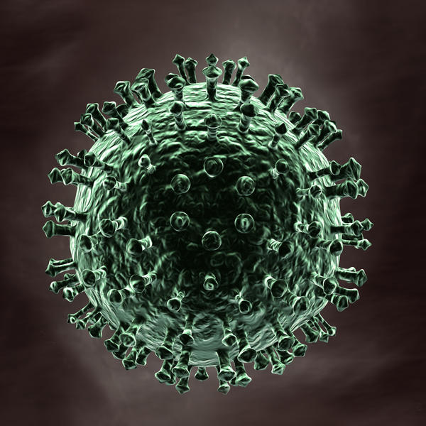
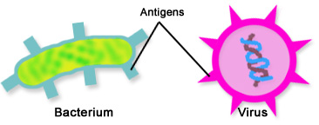
11.1.U1 Every organism has unique molecules on the surface of its cells.
The surface of an organisms’ cells are covered in uniquely shaped molecules, examples include the polysaccharides of a bacterium’s cell wall and the glyco-proteins embedded in the plasma membrane of a eukaryote. The protein coat (capsid) of a virus also contains uniquely shaped molecules.
Surface molecules have a wide range of functions this includes host binding for pathogens.
An organism recognises surface molecules present on it’s own cells, therefore unfamiliar surface molecules are regarded as foreign and provoke a specific immune response (antibody production).
Unfamiliar surface molecules that cause the production of antibodies are called antigens.
http://www2a.cdc.gov/nip/isd/ycts/mod1/courses/genrec/images/10110g1.jpg
https://edc2.healthtap.com/ht-staging/user_answer/reference_image/7600/large/Antigen.jpeg?1386669177

Slide 5
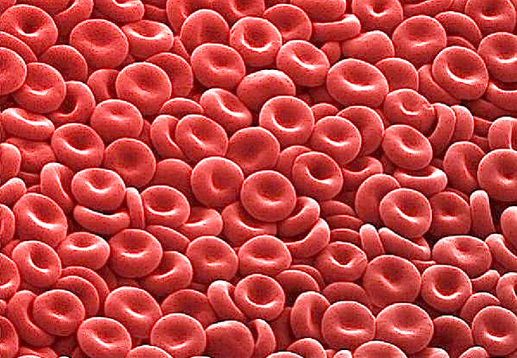
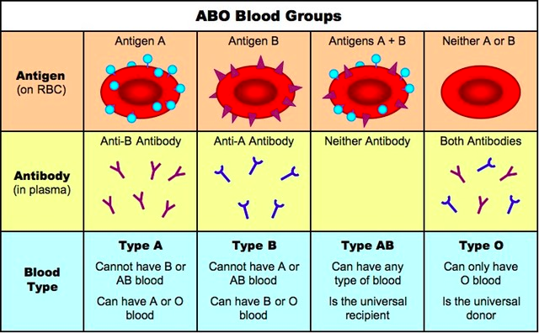
Review: 3.4.A1 Inheritance of ABO blood groups. AND 11.1.A3 Antigens on the surface of red blood cells stimulate antibody production in a person with a different blood group.
The ABO blood type classification system uses the presence or absence of certain antigen on red blood cells to categorize blood into four types.
Distinct molecules called agglutinogens (a type of antigen) are attached to the surface of red blood cells. There are two different types of agglutinogens, type "A" and type "B”.
http://www.ib.bioninja.com.au/_Media/abo_blood_groups_med.jpeg
http://www.anatomybox.com/tag/erythrocytes/

Slide 6
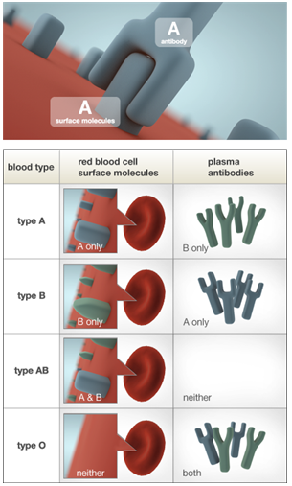
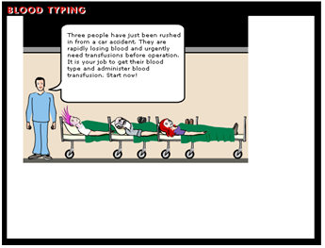

Review: 3.4.A1 Inheritance of ABO blood groups. AND 11.1.A3 Antigens on the surface of red blood cells stimulate antibody production in a person with a different blood group.
More about blood typing
A Nobel breakthrough in medicine.
Antibodies (immunoglobulins) are specific to antigens.
The immune system recognises 'foreign' antigens and produces antibodies in response - so if you are given the wrong blood type your body might react fatally as the antibodies cause the blood to clot.
Blood type O is known as the universal donor, as it has no antigens against which the recipient immune system can react. Type AB is the universal recipient, as the blood has no antibodies which will react to AB antigens.
Blood typing game from Nobel.org:
http://nobelprize.org/educational/medicine/landsteiner/readmore.html
Images and more information from:
http://learn.genetics.utah.edu/content/begin/traits/blood/

Slide 7
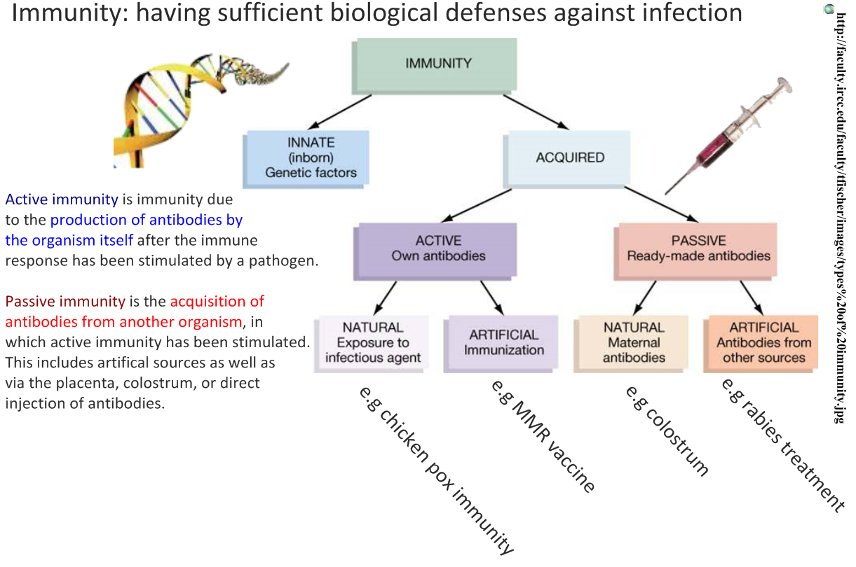

Slide 8
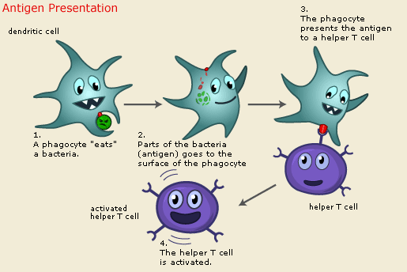
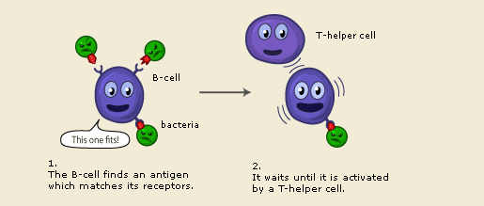
11.1.U3 B lymphocytes are activated by T lymphocytes in mammals.
Antigen presentation and T lymphocyte activation
Helper T cells are the major driving force and the main regulators of the immune defense. Their primary task is to activate B-cells and killer T cells (not dealt with in this syllabus).
n.b. there are many different Helper T cells and B-cells which response to different antigens.
B lymphocyte activation
The B-cell searches for antigen matching its receptors. If it finds such antigen it connects to it, but the B-cell needs proteins produced by helper T cells to become fully activated.
http://www.nobelprize.org/educational/medicine/immunity/immune-detail.html

Slide 9
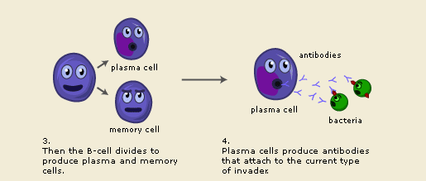
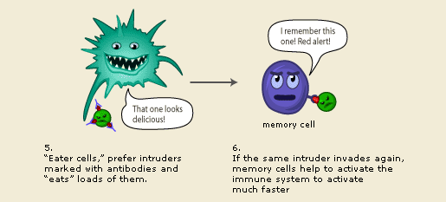
11.1.U4 Activated B cells multiply to form clones of plasma cells and memory cells. AND 11.1.U5 Plasma cells secrete antibodies. AND 11.1.U6 Antibodies aid the destruction of pathogens.
Plasma cell and antibody production
Plasma cells are specialized in producing a specific antibody that matched the B-cell receptor. Plasma cells can produce tens of thousands of antibodies per second!!
Pathogen destruction and the formation of memory cells
T-cells can also produce memory cells with an even longer life span than B memory cells. Subsequent infections by the same pathogen therefore provoke a much more rapid immune response. If little or no symptoms are experienced the organism is said to be immune.
http://www.nobelprize.org/educational/medicine/immunity/immune-detail.html

Slide 10
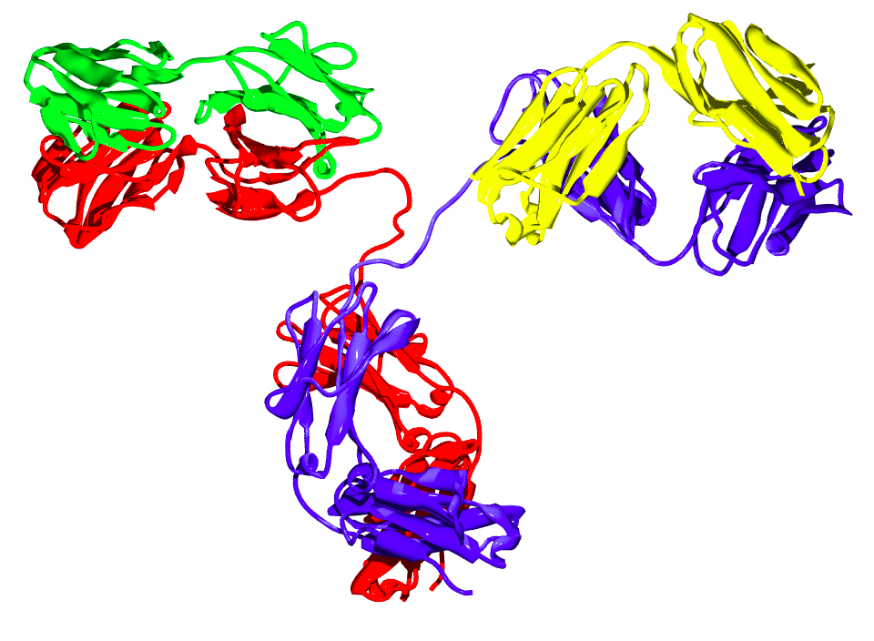
11.1.U6 Antibodies aid the destruction of pathogens.
Antibodies (aka immunoglobulins) are large, Y-shaped protein produced mainly by plasma cells.
From the image what can you deduce about the structure of immunoglobulins?
https://commons.wikimedia.org/wiki/File:Antibody_IgG2.png

Slide 11

11.1.U6 Antibodies aid the destruction of pathogens.
Antibodies (aka immunoglobulins) are large, Y-shaped protein produced mainly by plasma cells.
Antibodies function in different ways, but all functions are a consequence of their initial attachment to the antigen:
Neutralisation – attachment stops toxins from effecting or entering cells, viruses from invading cells, and bacteria from efficiently functioning and therefore attacking cells
Opsonization – through attachment antibodies mark the pathogens making them easily identifiable by other immune cells, e.g. so macrophages can find and engulf and digest them
Agglutination – antibodies attach to each other causing a clumping of the pathogen (enhancing the effects of neutralisation and opsonization)
Complement activation – antibodies ‘encourage’ other components to attach to the pathogen attacking it e.g. breaking the bacterial membrane and lysing the cell
n.b. antibodies can also cause inflammation in the effected area, this an enhanced non-specific immune response to help combat the pathogen.
https://commons.wikimedia.org/wiki/File:Antibody_IgG2.png

Slide 12
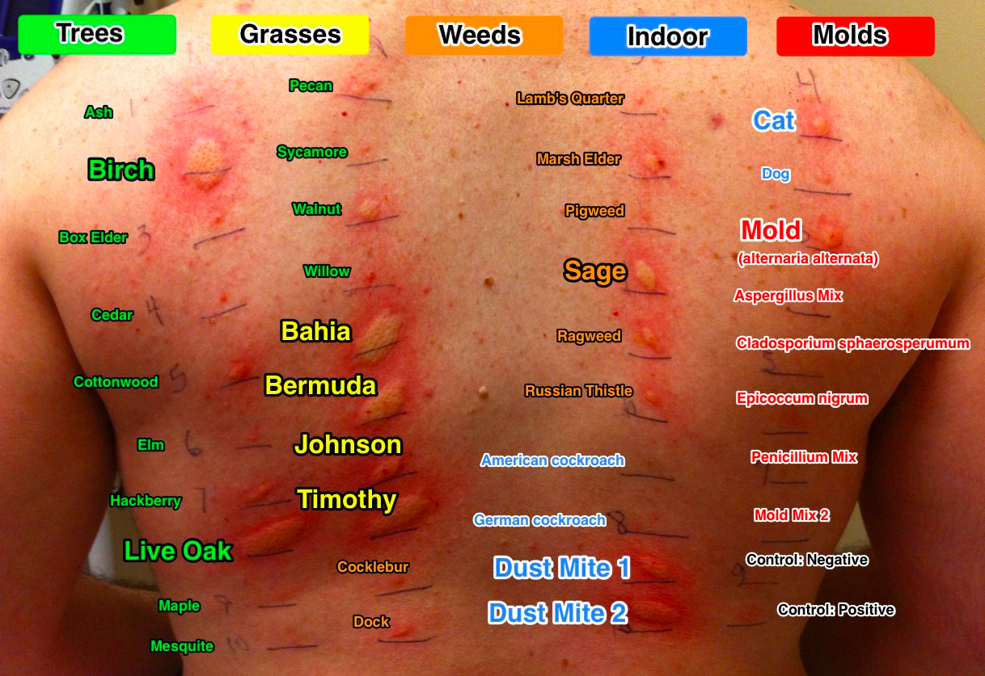
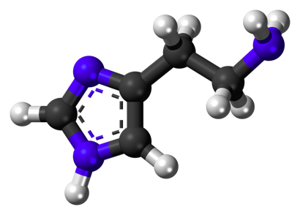
11.1.U7 White cells release histamine in response to allergens. AND 11.1.U8 Histamines cause allergic symptoms.
Histamine is a small organic molecules produced by two types of leukocyte: basophils and mast cells
Mast cells are found in connective tissues. If stimulated by an infection they release histamine in the infected area.*
Histamine has a number of effects upon the body the key effect in the immune response is it increases the permeability of the capillaries to white blood cells and some proteins (e.g. antibodies).
This allows the components of the immune to engage the pathogen early at the site of infection.
*Basophils circulate and hence release histamine into the blood and causing symptoms at secondary sites.
http://3.bp.blogspot.com/-QUrnbwqwVi0/UeLihZuiUkI/AAAAAAAAkQA/sA1a4BwpfJ8/s1600/allergy_test.jpg
https://commons.wikimedia.org/wiki/File:Histamine_3D_ball.png

Slide 13
11.1.U7 White cells release histamine in response to allergens. AND 11.1.U8 Histamines cause allergic symptoms.
Histamine is a small organic molecules produced by two types of leukocyte, basophils and mast cells
The loss of fluid from capillaries into surrounding tissues causes the response symptoms:
Inflammation / hives
Itching
Sneezing
Watery eyes
Allergies are a group of conditions caused by hypersensitivity of the immune system to something in the environment that causes little or no problem in most people.
Antihistamine is a drug that opposes the activity of histamine receptors.
http://3.bp.blogspot.com/-QUrnbwqwVi0/UeLihZuiUkI/AAAAAAAAkQA/sA1a4BwpfJ8/s1600/allergy_test.jpg
https://commons.wikimedia.org/wiki/File:Histamine_3D_ball.png

Slide 14
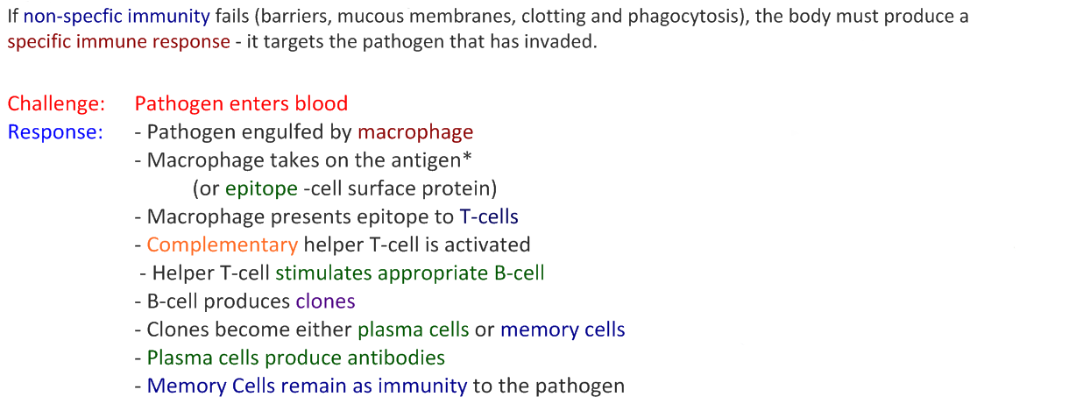
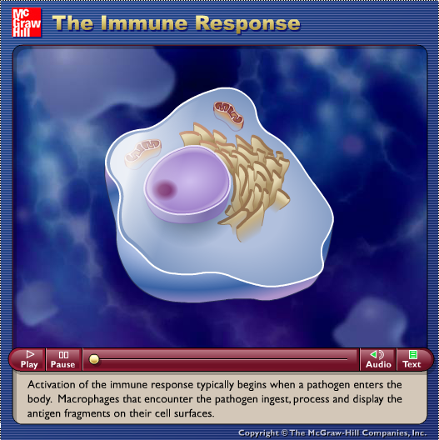
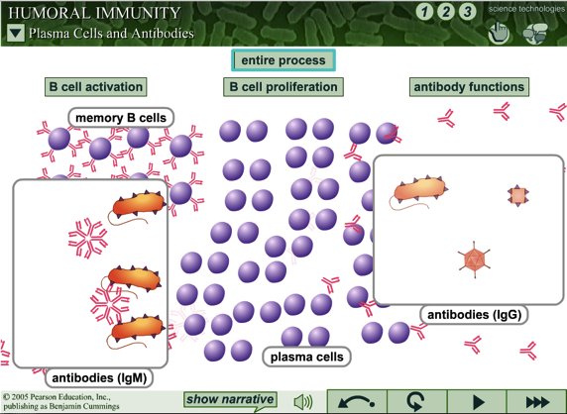
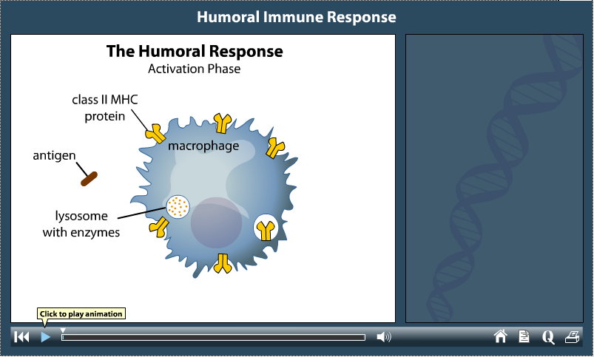
11.1.U3 B lymphocytes are activated by T lymphocytes in mammals. AND 11.1.U4 Activated B cells multiply to form clones of plasma cells and memory cells. AND 11.1.U5 Plasma cells secrete antibodies. AND 11.1.U6 Antibodies aid the destruction of pathogens.
The specific Immune response – more resources
http://highered.mheducation.com/sites/0072507470/student_view0/chapter22/animation__the_immune_response.html
http://web.biosci.utexas.edu/psaxena/MicrobiologyAnimations/Animations/HumoralImmunity/micro_humoral.swf
http://life9e.sinauer.com/life9e/pages/42/422003.html

Slide 15
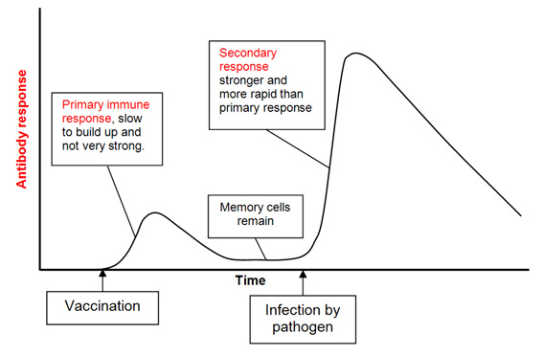
11.1.U10 Vaccines contain antigens that trigger immunity but do not cause the disease. AND 11.1.U9 Immunity depends upon the persistence of memory cells.
Vaccination
allows an individual to become immune to a disease without experiencing it.
Vaccines contain antigens in various forms that should not cause symptoms in a healthy person.
A person is exposed to the vaccine orally or by injection
The by initiating a primary immune response, resulting in the production of memory cells that can produce antibodies in response to the antigen
http://www.saburchill.com/IBbiology/chapters04/images/130307001.jpg

Slide 16
11.1.U10 Vaccines contain antigens that trigger immunity but do not cause the disease. AND 11.1.U9 Immunity depends upon the persistence of memory cells.
Vaccination
allows an individual to become immune to a disease without experiencing it.
Vaccines contain antigens in various forms* that should not cause symptoms in a healthy person:
attenuated (weakened) or inactivated viruses
weakened toxins (produced by bacterial pathogens)
subunits – this could be the antigen or part of the pathogen carrying the antigen
A person is exposed to the vaccine orally or by injection
The by initiating a primary immune response, resulting in the production of memory cells that can produce antibodies in response to the antigen
Sometimes a series of vaccinations are needed to stimulate the production of sufficient memory cells
When exposed to the actual pathogen memory cells trigger a secondary immune response that is much faster and stronger – therefore little or no symptoms are experienced
Vaccines provide long-term immunity, but memory cells may not survive a life time therefore booster shots may be required
* DNA vaccines are being developed that introduce DNA that encodes for antigens rather than the antigen itself. Can you suggest how this would work?
http://www.saburchill.com/IBbiology/chapters04/images/130307001.jpg

Slide 17
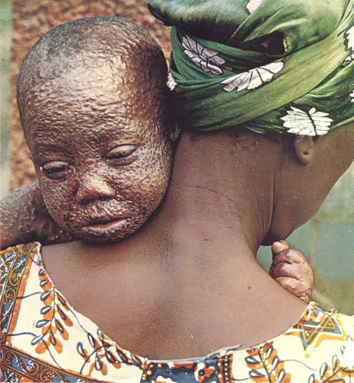
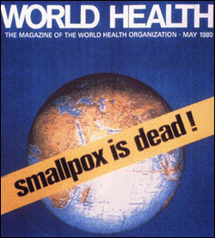
11.1.A1 Smallpox was the first infectious disease of humans to have been eradicated by vaccination.
Smallpox (caused by the virus variola) was the first infectious disease of humans to have been eradicated by vaccination.
This was achieved by a worldwide vaccination programme. 1977 saw the last ever naturally occurring case of the disease in Somalia and in 1980 the World Health Organisation (WHO) declared the disease ‘dead’.
Erradication programmes for other diseases has reduced the number of cases, but has been less successful:
Polio and measles become contagious before symptoms are easy to detect
Immunity to Malaria is not complete and hence it can infect the same person a number of times
Yellow fever has an animal reservoir, it can also affect monkeys
http://raylemire.com/wp-content/uploads/2015/12/smallpox-eradication.jpg
http://www.museumofhealthcare.ca/images/exhibits/vaccinations/smallpox/large/17.jpg

Slide 18
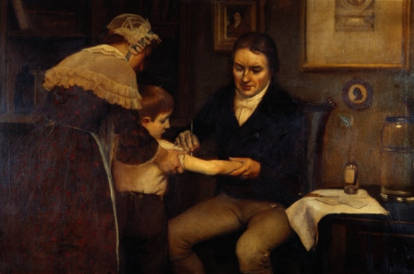
Nature of science: Consider ethical implications of research - Jenner tested his vaccine for smallpox on a child. (4.5)
Smallpox (caused by the virus variola) was the first infectious disease of humans to have been eradicated by vaccination.
Cowpox is a mild viral infection of cows, which is very similar to smallpox
In 1796 Edward Jenner deliberately infected an eight-year old boy with cowpox from pocks/blisters of a milkmaid with this disease.
Jenner then attempted to infect the boy with smallpox, but found that he was immune.
Jenner repeated his initial on himself and a small group of people
Modern medicine would consider Jenner’s testing procedure unethical:
no prior research had be done prior to human testing to determine the effectiveness and possible side-effects
informed consent was not given and the choice of a child who was to young to understand the dangers was even more questionable
http://raylemire.com/wp-content/uploads/2015/12/smallpox-eradication.jpg
http://www.museumofhealthcare.ca/images/exhibits/vaccinations/smallpox/large/17.jpg

Slide 19
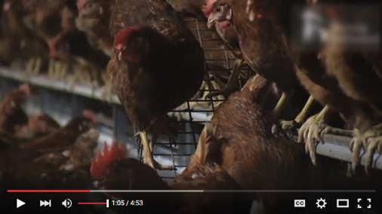
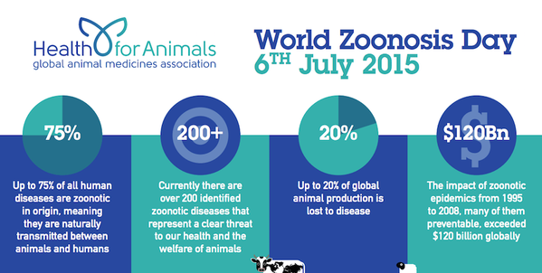
11.1.U2 Pathogens can be species-specific although others can cross species barriers.
Some pathogens are species-specific. Polio, Measles and Syphilis only affect humans.
However many others such as Flu, Ebola and Salmonella can be transmitted between humans and other animals.
A zoonosis is any disease or infection that is naturally transmissible from vertebrate animals to humans.
https://youtu.be/up7ye3yvzyY
http://www.wsava.org/sites/default/files/hfa%20zd.png

Slide 20
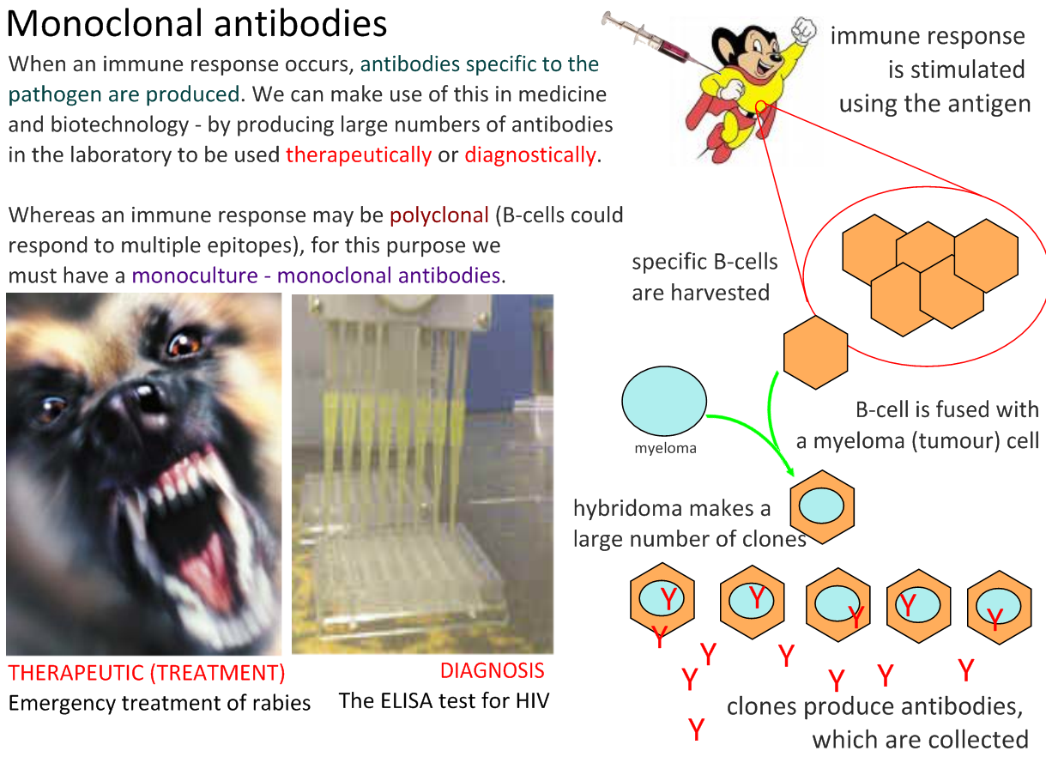
11.1.U11 Fusion of a tumour cell with an antibody-producing plasma cell creates a hybridoma cell. AND 11.1.U12 Monoclonal antibodies are produced by hybridoma cells.

Slide 21
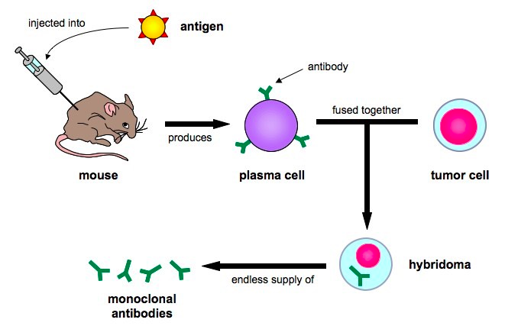
11.1.U11 Fusion of a tumour cell with an antibody-producing plasma cell creates a hybridoma cell. AND 11.1.U12 Monoclonal antibodies are produced by hybridoma cells.
The production of monoclonal antibodies – a summary
An animal (often a mouse) is injected with an antigen and in response produces specific plasma cells
The plasma cells are harvested from the spleen of the animal
Harvested plasma cells fused with tumor cells (which are capable of endless divisions) forming a hybridoma cells
The hybridoma cells are screened to determine which ones are producing useful antibodies
The selected hybridoma is allowed to divide to produce clones
Hybridomas are then used to synthesise large quantities of a single (monoclonal) antibodies for use in diagnostic tests and treatment
http://www.ib.bioninja.com.au/higher-level/topic-11-human-health-and/111-defence-against-infecti.html

Slide 22
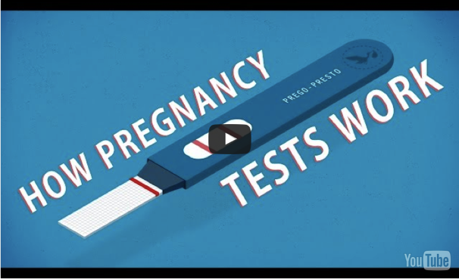
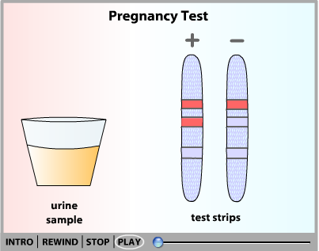
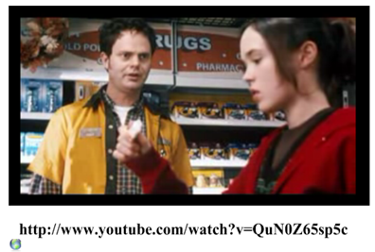
11.1.A2 Monoclonal antibodies to HCG are used in pregnancy test kits.
Pregnancy tests use monoclonal antibodies
Use the animations to find out how they work
http://ed.ted.com/lessons/how-do-pregnancy-tests-work-tien-nguyen
http://www.sumanasinc.com/webcontent/animations/content/pregtest.html
https://youtu.be/QuN0Z65sp5c

Slide 23
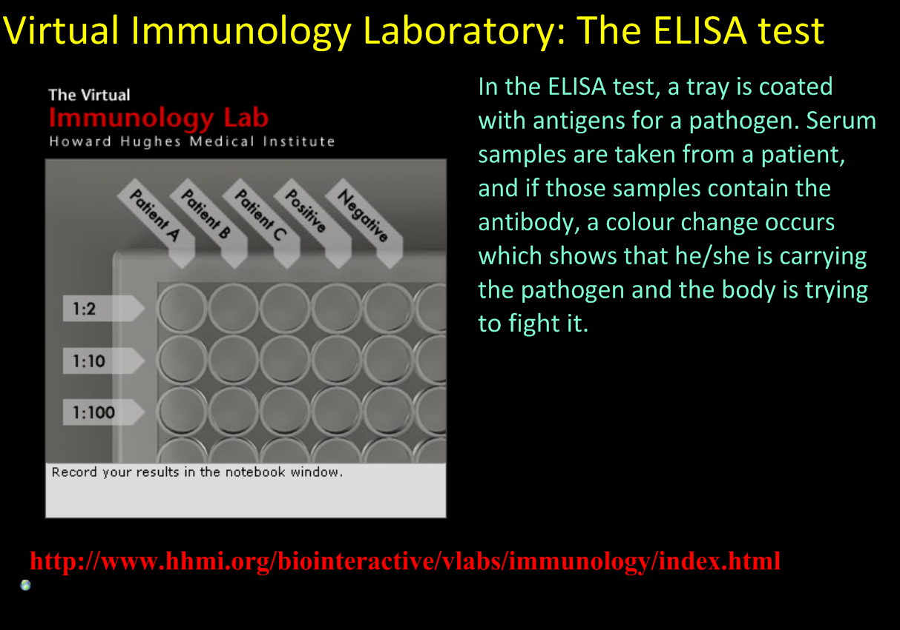
http://www.hhmi.org/biointeractive/immunology-virtual-lab

Slide 24
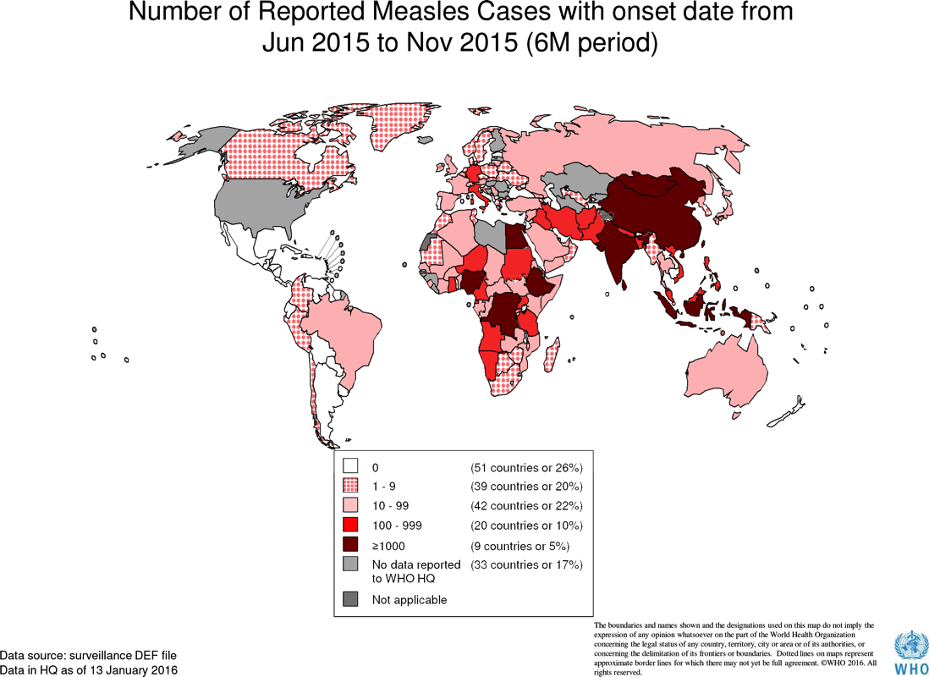
11.1.S1 Analysis of epidemiological data related to vaccination programmes.
Epidemiology is the study of the incidence, distribution, and possible control of diseases
Surveillance is critical to the control of Measles. Identifying and confirming suspected measles cases allows:
early detection of outbreaks
analysis of transmission helps to create more effective vaccination measures
Estimation true measles incidence on reported data – reported incidence reflects a small proportion of the true number of incidences as many affected do not seek health care
Most Member States submit monthly reports on suspected and confirmed measles cases identified through their national disease surveillance systems to the WHO.
http://www.who.int/immunization/monitoring_surveillance/burden/vpd/surveillance_type/active/measles_monthlydata/en/

Slide 25
11.1.S1 Analysis of epidemiological data related to vaccination programmes.
Epidemiology is the study of the incidence, distribution, and possible control of diseases
 | Africa |  | Eastern Mediterranean |  | South-East Asia
 | Americas |  | Europe |  | Western Pacific

Slide 26
11.1.S1 Analysis of epidemiological data related to vaccination programmes.
Epidemiology is the study of the incidence, distribution, and possible control of diseases
Using the Measles case distribution by month. Analyse the date to answer the following questions:
Outline the annual pattern in the data seen across all regions
Identify the regions impacted mostly greatly by outbreaks.
Since 2010 identify the regions in which the incidence of measles is:
  decreasing
  Increasing
  remaining constant
Despite having an established vaccination programme in most countries Europe has seen a peak in Measles incidence between 2010 and 2013. Suggest a reason for this (hint: try an internet search on measles vaccination in Europe, in particular the UK).

Slide 27
11.1.S1 Analysis of epidemiological data related to vaccination programmes.
Epidemiology is the study of the incidence, distribution, and possible control of diseases
Using the Measles case distribution by month. Analyse the date to answer the following questions:
Outline the annual pattern in the data seen across all regions
Outbreaks start annually in January peaking in April/May then quickly declining in the summer months
Identify the regions impacted mostly greatly by outbreaks.
SE Asia, Western Pacific and Africa show similar levels on incidence to other regions outside of outbreaks, but dominate the case count during outbreaks.
Since 2010 identify the regions in which the incidence of measles is:
  decreasing
  Western Europe
  Increasing
  SE Asia, Western Pacific
  remaining constant
  Other regions show too greater variation to reliably judge an overall trend
Despite having an established vaccination programme in most countries Europe has seen a peak in Measles incidence between 2010 and 2013. Suggest a reason for this (hint: try an internet search on measles vaccination in Europe, in particular the UK).
The autism scare about the MMR vaccine wrongly lead people to choose not to have their children vaccinated – the evidence to support the scare was found to be false. This lead to outbreaks of Measles over a period of years when previously the disease had been well controlled.

Slide 28


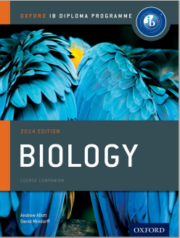
Bibliography / Acknowledgments

