Slide 1
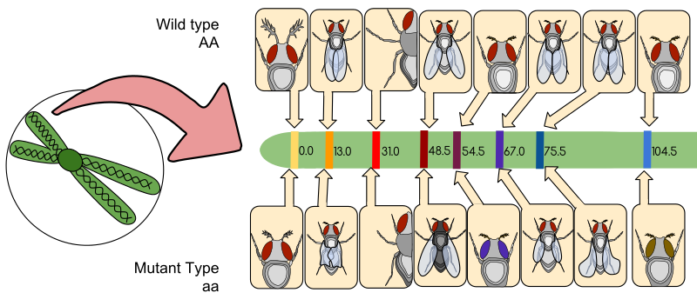
10.2 Inheritance (AHL)
Essential idea: Genes may be linked or unlinked and are inherited accordingly.
The diagram shows a gene map of a fruit fly (Drosophila melanogaster) chromosome. All the gene loci occur on the same chromosome and so all will be inherited together, unless crossing over occurs during meiosis: the closer together the loci, the stronger the gene linkage.
By Chris Paine
https://bioknowledgy.weebly.com/
https://commons.wikimedia.org/wiki/File:Drosophila_Gene_Linkage_Map.svg

Slide 2
Understandings, Applications and Skills
 | Statement | Guidance
10.2.U1 | Gene loci are said to be linked if on the same chromosome.
10.2.U2 | Unlinked genes segregate independently as a result of meiosis.
10.2.U3 | Variation can be discrete or continuous.
10.2.U4 | The phenotypes of polygenic characteristics tend to show continuous variation.
10.2.U5 | Chi-squared tests are used to determine whether the difference between an observed and expected frequency distribution is statistically significant.
10.2.A1 | Morgan’s discovery of non-Mendelian ratios in Drosophila.
10.2.A2 | Completion and analysis of Punnett squares for dihybrid traits. | Alleles are usually shown side by side in dihybrid crosses, for example, TtBb.
10.2.A3 | Polygenic traits such as human height may also be influenced by environmental factors.
10.2.S1 | Calculation of the predicted genotypic and phenotypic ratio of offspring of dihybrid crosses involving unlinked autosomal genes.
10.2.S2 | Identification of recombinants in crosses involving two linked genes. | In representing crosses involving linkage, show genotypes as vertical pairs seperated by horizontal lines repesenting the chromosomes.
10.2.S3 | Use of a chi-squared test on data from dihybrid crosses.

Slide 3
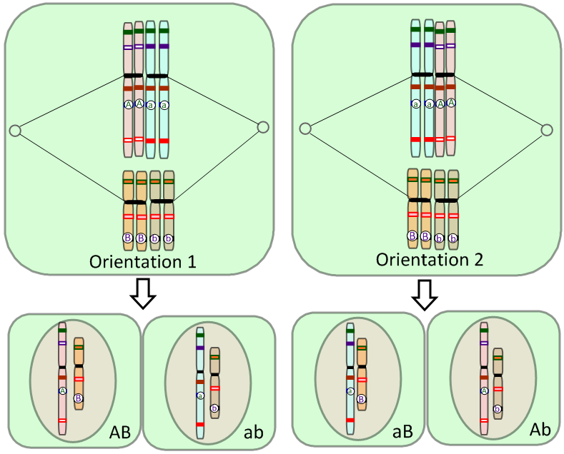
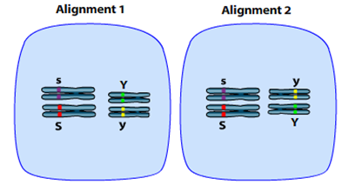
Review: 10.1.U7 Independent assortment of genes is due to the random orientation of pairs of homologous chromosomes in meiosis I.
Random Orientation vs Independent Assortment
“The presence of an allele of one of the genes in a gamete has no influence over which allele of another gene is present.”
Random Orientation refers to the behaviour of homologous pairs of chromosomes (metaphase I) or pairs of sister chromatids (metaphase II) in meiosis.
Independent assortment refers to the behaviour of alleles of unlinked genes as a result of gamete production (meiosis).
Due to random orientation of the chromosomes in metaphase I, the alleles of these unlinked genes have become independently assorted into the gametes.
Animation from Sumanas:
http://www.sumanasinc.com/webcontent/animations/content/independentassortment.html

Slide 4
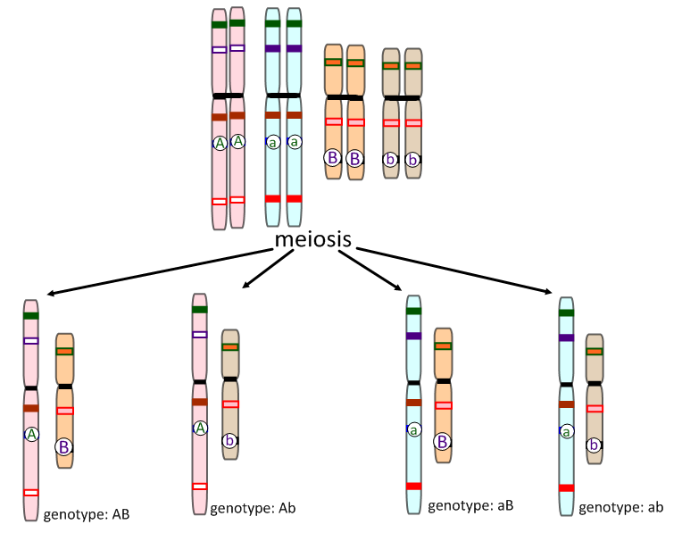
Review: 10.1.U7 Independent assortment of genes is due to the random orientation of pairs of homologous chromosomes in meiosis I.
Mendel’s Law of Independent Assortment
“The presence of an allele of one of the genes in a gamete has no influence over which allele of another gene is present.”
A and B are different genes on different chromosomes.
A is dominant over a.
B is dominant over b.
This only holds true for unlinked genes (genes on different chromosomes).
All four genotypes are possible therefore 10.2.U2 Unlinked genes segregate independently as a result of meiosis.

Slide 5
Dihybrid Crosses
10.2.A2 Completion and analysis of Punnett squares for dihybrid traits. AND 10.2.S1 Calculation of the predicted genotypic and phenotypic ratio of offspring of dihybrid crosses involving unlinked autosomal genes.
Consider two traits, each carried on separate chromsomes (the genes are unlinked).
In this example of Lathyrus odoratus (sweet pea),
we consider two traits: pea colour and pea surface.
What is the predicted phenotype ratio for a cross between two pea plants which are heterozygous at both loci?
Key to alleles:
Y = yellow
y = green
S = smooth
s = rough
F₀
Phenotype:
Heterozygous at both loci
Heterozygous at both loci
Genotype:
Punnet Grid:
gametes
F₁

Slide 6
Dihybrid Crosses
10.2.A2 Completion and analysis of Punnett squares for dihybrid traits. AND 10.2.S1 Calculation of the predicted genotypic and phenotypic ratio of offspring of dihybrid crosses involving unlinked autosomal genes.
Consider two traits, each carried on separate chromsomes (the genes are unlinked).
In this example of Lathyrus odoratus (sweet pea),
we consider two traits: pea colour and pea surface.
What is the predicted phenotype ratio for a cross between two pea plants which are heterozygous at both loci?
Key to alleles:
Y = yellow
y = green
S = smooth
s = rough
F₀
Phenotype:
Smooth, yellow
Smooth, yellow
Heterozygous at both loci
Heterozygous at both loci
Genotype:
SsYy
SsYy
Punnet Grid:
gametes
F₁

Slide 7
Dihybrid Crosses
10.2.A2 Completion and analysis of Punnett squares for dihybrid traits. AND 10.2.S1 Calculation of the predicted genotypic and phenotypic ratio of offspring of dihybrid crosses involving unlinked autosomal genes.
Consider two traits, each carried on separate chromsomes (the genes are unlinked).
In this example of Lathyrus odoratus (sweet pea),
we consider two traits: pea colour and pea surface.
What is the predicted phenotype ratio for a cross between two pea plants which are heterozygous at both loci?
Key to alleles:
Y = yellow
y = green
S = smooth
s = rough
F₀
Phenotype:
Smooth, yellow
Smooth, yellow
Heterozygous at both loci
Heterozygous at both loci
Genotype:
SsYy
SsYy
Punnet Grid:
gametes | SY | Sy | sY | sy
SY | SSYY | SSYy | SsYY | SsYy
Sy | SSYy | SSyy | SsYy | Ssyy
sY | SsYY | SsYy | ssYY | ssYy
sy | SsYy | Ssyy | ssYy | ssyy
F₁

Slide 8
Dihybrid Crosses
10.2.A2 Completion and analysis of Punnett squares for dihybrid traits. AND 10.2.S1 Calculation of the predicted genotypic and phenotypic ratio of offspring of dihybrid crosses involving unlinked autosomal genes.
Consider two traits, each carried on separate chromsomes (the genes are unlinked).
In this example of Lathyrus odoratus (sweet pea),
we consider two traits: pea colour and pea surface.
What is the predicted phenotype ratio for a cross between two pea plants which are heterozygous at both loci?
Key to alleles:
Y = yellow
y = green
S = smooth
s = rough
F₀
Phenotype:
Smooth, yellow
Smooth, yellow
Heterozygous at both loci
Heterozygous at both loci
Genotype:
SsYy
SsYy
Punnet Grid:
gametes | SY | Sy | sY | sy
SY | SSYY | SSYy | SsYY | SsYy
Sy | SSYy | SSyy | SsYy | Ssyy
sY | SsYY | SsYy | ssYY | ssYy
sy | SsYy | Ssyy | ssYy | ssyy
F₁
Phenotypes: 9 Smooth, yellow : 3 Smooth, green : 3 Rough, yellow : 1 Rough, green

Slide 9
Dihybrid Crosses
10.2.A2 Completion and analysis of Punnett squares for dihybrid traits. AND 10.2.S1 Calculation of the predicted genotypic and phenotypic ratio of offspring of dihybrid crosses involving unlinked autosomal genes.
Consider two traits, each carried on separate chromsomes (the genes are unlinked).
In this example of Lathyrus odoratus (sweet pea),
we consider two traits: pea colour and pea surface.
Calculate the predicted phenotype ratio for:
Key to alleles:
Y = yellow
y = green
S = smooth
s = rough
F₀
Phenotype:
Heterozygous at both loci
Heterozygous for S, homozygous dominant for Y
Genotype:
Punnet Grid:
F₁
Phenotypes:

Slide 10
Dihybrid Crosses
10.2.A2 Completion and analysis of Punnett squares for dihybrid traits. AND 10.2.S1 Calculation of the predicted genotypic and phenotypic ratio of offspring of dihybrid crosses involving unlinked autosomal genes.
Consider two traits, each carried on separate chromsomes (the genes are unlinked).
In this example of Lathyrus odoratus (sweet pea),
we consider two traits: pea colour and pea surface.
Calculate the predicted phenotype ratio for:
Key to alleles:
Y = yellow
y = green
S = smooth
s = rough
F₀
Phenotype:
Smooth, yellow
Smooth, yellow
Heterozygous at both loci
Heterozygous for S, homozygous dominant for Y
Genotype:
SsYy
SsYY
Punnet Grid:
F₁
Phenotypes:

Slide 11
Dihybrid Crosses
10.2.A2 Completion and analysis of Punnett squares for dihybrid traits. AND 10.2.S1 Calculation of the predicted genotypic and phenotypic ratio of offspring of dihybrid crosses involving unlinked autosomal genes.
Consider two traits, each carried on separate chromsomes (the genes are unlinked).
In this example of Lathyrus odoratus (sweet pea),
we consider two traits: pea colour and pea surface.
Calculate the predicted phenotype ratio for:
Key to alleles:
Y = yellow
y = green
S = smooth
s = rough
F₀
Phenotype:
Smooth, yellow
Smooth, yellow
Heterozygous at both loci
Heterozygous for S, homozygous dominant for Y
Genotype:
SsYy
SsYY
Punnet Grid:
gametes | SY | sY
SY
Sy
sY
sy
F₁
Phenotypes:

Slide 12
Dihybrid Crosses
10.2.A2 Completion and analysis of Punnett squares for dihybrid traits. AND 10.2.S1 Calculation of the predicted genotypic and phenotypic ratio of offspring of dihybrid crosses involving unlinked autosomal genes.
Consider two traits, each carried on separate chromsomes (the genes are unlinked).
In this example of Lathyrus odoratus (sweet pea),
we consider two traits: pea colour and pea surface.
Calculate the predicted phenotype ratio for:
Key to alleles:
Y = yellow
y = green
S = smooth
s = rough
F₀
Phenotype:
Smooth, yellow
Smooth, yellow
Heterozygous at both loci
Heterozygous for S, homozygous dominant for Y
Genotype:
SsYy
SsYY
Punnet Grid:
gametes | SY | sY
SY | SSYY | SsYY
Sy | SSYy | SsYy
sY | SsYY | ssYY
sy | SsYy | ssYy
F₁
Phenotypes:

Slide 13
Dihybrid Crosses
10.2.A2 Completion and analysis of Punnett squares for dihybrid traits. AND 10.2.S1 Calculation of the predicted genotypic and phenotypic ratio of offspring of dihybrid crosses involving unlinked autosomal genes.
Consider two traits, each carried on separate chromsomes (the genes are unlinked).
In this example of Lathyrus odoratus (sweet pea),
we consider two traits: pea colour and pea surface.
Calculate the predicted phenotype ratio for:
Key to alleles:
Y = yellow
y = green
S = smooth
s = rough
F₀
Phenotype:
Smooth, yellow
Smooth, yellow
Heterozygous at both loci
Heterozygous for S, homozygous dominant for Y
Genotype:
SsYy
SsYY
Punnet Grid:
gametes | SY | sY
SY | SSYY | SsYY
Sy | SSYy | SsYy
sY | SsYY | ssYY
sy | SsYy | ssYy
F₁
6 Smooth, yellow : 2 Rough, yellow
Phenotypes: 3 Smooth, yellow : 1 Rough, yellow
Present the ratio in the simplest mathematical form.

Slide 14
Dihybrid Crosses
10.2.A2 Completion and analysis of Punnett squares for dihybrid traits. AND 10.2.S1 Calculation of the predicted genotypic and phenotypic ratio of offspring of dihybrid crosses involving unlinked autosomal genes.
Common expected ratios of dihybrid crosses.
SsYy
SsYy
SsYy
SsYy
Heterozygous at both loci
Heterozygous at both loci
Heterozygous at both loci
Heterozygous at one locus, homozygous dominant at the other
 | SY | Sy | sY | sy
SY | SSYY | SSYy | SsYY | SsYy
Sy | SSYy | SSyy | SsYy | Ssyy
sY | SsYY | SsYy | ssYY | ssYy
sy | SsYy | Ssyy | ssYy | ssyy
 | SY | sY
SY | SSYY | SsYY
Sy | SSYy | SsYy
sY | SsYY | ssYY
sy | SsYy | ssYy
9 : 3 : 3 : 1
3 : 2
SsYy
Ssyy
SSyy
ssYY
= All SsYy
Heterozygous at both loci
Heterozygous/
Homozygous recessive
SSYY
ssyy
= all SyYy
 | Sy | sy
SY | SSYy | SsYy
Sy | SSyy | Ssyy
sY | SsYy | ssYy
sy | Ssyy | ssyy
Ssyy
ssYy
= 1 : 1 : 1 : 1
4 : 3 : 1

Slide 15
Dihybrid Crosses
10.2.A2 Completion and analysis of Punnett squares for dihybrid traits. AND 10.2.S1 Calculation of the predicted genotypic and phenotypic ratio of offspring of dihybrid crosses involving unlinked autosomal genes.
Consider two traits, each carried on separate chromsomes (the genes are unlinked).
In this example of Lathyrus odoratus (sweet pea),
we consider two traits: pea colour and pea surface.
A rough yellow pea is test crossed to determine its genotype.
Key to alleles:
Y = yellow
y = green
S = smooth
s = rough
F₀
Phenotype:
Rough, yellow
Genotype:
Punnet Grid:
F₁
Phenotypes:

Slide 16
Dihybrid Crosses
10.2.A2 Completion and analysis of Punnett squares for dihybrid traits. AND 10.2.S1 Calculation of the predicted genotypic and phenotypic ratio of offspring of dihybrid crosses involving unlinked autosomal genes.
Consider two traits, each carried on separate chromsomes (the genes are unlinked).
In this example of Lathyrus odoratus (sweet pea),
we consider two traits: pea colour and pea surface.
A rough yellow pea is test crossed to determine its genotype.
Key to alleles:
Y = yellow
y = green
S = smooth
s = rough
F₀
Phenotype:
Rough, yellow
Genotype:
ssYy
Punnet Grid:
gametes | sY | sy
F₁
Phenotypes:

Slide 17
Dihybrid Crosses
10.2.A2 Completion and analysis of Punnett squares for dihybrid traits. AND 10.2.S1 Calculation of the predicted genotypic and phenotypic ratio of offspring of dihybrid crosses involving unlinked autosomal genes.
Consider two traits, each carried on separate chromsomes (the genes are unlinked).
In this example of Lathyrus odoratus (sweet pea),
we consider two traits: pea colour and pea surface.
A rough yellow pea is test crossed to determine its genotype.
Key to alleles:
Y = yellow
y = green
S = smooth
s = rough
F₀
Phenotype:
Rough, yellow
Genotype:
ssYy or ssYY
Punnet Grid:
gametes | sY | sy | sY | sY
F₁
Phenotypes:

Slide 18
Dihybrid Crosses
10.2.A2 Completion and analysis of Punnett squares for dihybrid traits. AND 10.2.S1 Calculation of the predicted genotypic and phenotypic ratio of offspring of dihybrid crosses involving unlinked autosomal genes.
Consider two traits, each carried on separate chromsomes (the genes are unlinked).
In this example of Lathyrus odoratus (sweet pea),
we consider two traits: pea colour and pea surface.
A rough yellow pea is test crossed to determine its genotype.
Key to alleles:
Y = yellow
y = green
S = smooth
s = rough
F₀
Phenotype:
Rough, yellow
Genotype:
ssyy
ssYy or ssYY
Punnet Grid:
gametes | sY | sy | sY | sY
All sy
F₁
Phenotypes:
Remember: A test cross is the unknown with a known homozygous recessive.

Slide 19
Dihybrid Crosses
10.2.A2 Completion and analysis of Punnett squares for dihybrid traits. AND 10.2.S1 Calculation of the predicted genotypic and phenotypic ratio of offspring of dihybrid crosses involving unlinked autosomal genes.
Consider two traits, each carried on separate chromsomes (the genes are unlinked).
In this example of Lathyrus odoratus (sweet pea),
we consider two traits: pea colour and pea surface.
A rough yellow pea is test crossed to determine its genotype.
Key to alleles:
Y = yellow
y = green
S = smooth
s = rough
F₀
Phenotype:
Rough, yellow
Genotype:
ssyy
ssYy or ssYY
Punnet Grid:
gametes | sY | sy | sY | sY
All sy | ssYy | ssyy | ssYy | ssYy
F₁
Phenotypes:

Slide 20
Dihybrid Crosses
10.2.A2 Completion and analysis of Punnett squares for dihybrid traits. AND 10.2.S1 Calculation of the predicted genotypic and phenotypic ratio of offspring of dihybrid crosses involving unlinked autosomal genes.
Consider two traits, each carried on separate chromsomes (the genes are unlinked).
In this example of Lathyrus odoratus (sweet pea),
we consider two traits: pea colour and pea surface.
A rough yellow pea is test crossed to determine its genotype.
Key to alleles:
Y = yellow
y = green
S = smooth
s = rough
F₀
Phenotype:
Rough, yellow
Genotype:
ssyy
ssYy or ssYY
Punnet Grid:
gametes | sY | sy | sY | sY
All sy | ssYy | ssyy | ssYy | ssYy
F₁
Phenotypes:
Some green peas will be present in the offspring if the unknown parent genotype is ssYy.
No green peas will be present in the offspring if the unknown parent genotype is ssYY.

Slide 21
Dihybrid Crosses
10.2.A2 Completion and analysis of Punnett squares for dihybrid traits. AND 10.2.S1 Calculation of the predicted genotypic and phenotypic ratio of offspring of dihybrid crosses involving unlinked autosomal genes.
Consider two traits, each carried on separate chromsomes (the genes are unlinked).
In this example of Lathyrus odoratus (sweet pea),
we consider two traits: pea colour and pea surface.
A smooth green pea is test crossed. Deduce the genotype.
Smooth green = nine offspring. Rough green = one offspring.
Key to alleles:
Y = yellow
y = green
S = smooth
s = rough
F₀
Phenotype:
Smooth, green
Genotype:
Punnet Grid:
F₁
Phenotypes:

Slide 22
Dihybrid Crosses
10.2.A2 Completion and analysis of Punnett squares for dihybrid traits. AND 10.2.S1 Calculation of the predicted genotypic and phenotypic ratio of offspring of dihybrid crosses involving unlinked autosomal genes.
Consider two traits, each carried on separate chromsomes (the genes are unlinked).
In this example of Lathyrus odoratus (sweet pea),
we consider two traits: pea colour and pea surface.
A smooth green pea is test crossed. Deduce the genotype.
Smooth green = nine offspring. Rough green = one offspring.
Key to alleles:
Y = yellow
y = green
S = smooth
s = rough
F₀
Phenotype:
Smooth, green
Genotype:
ssyy
Punnet Grid:
gametes
All sy
F₁
Phenotypes:

Slide 23
Dihybrid Crosses
10.2.A2 Completion and analysis of Punnett squares for dihybrid traits. AND 10.2.S1 Calculation of the predicted genotypic and phenotypic ratio of offspring of dihybrid crosses involving unlinked autosomal genes.
Consider two traits, each carried on separate chromsomes (the genes are unlinked).
In this example of Lathyrus odoratus (sweet pea),
we consider two traits: pea colour and pea surface.
A smooth green pea is test crossed. Deduce the genotype.
Smooth green = nine offspring. Rough green = one offspring.
Key to alleles:
Y = yellow
y = green
S = smooth
s = rough
F₀
Phenotype:
Smooth, green
Genotype:
ssyy
SSyy
Punnet Grid:
gametes | Sy | Sy
All sy | Ssyy | Ssyy
F₁
Phenotypes:

Slide 24
Dihybrid Crosses
10.2.A2 Completion and analysis of Punnett squares for dihybrid traits. AND 10.2.S1 Calculation of the predicted genotypic and phenotypic ratio of offspring of dihybrid crosses involving unlinked autosomal genes.
Consider two traits, each carried on separate chromsomes (the genes are unlinked).
In this example of Lathyrus odoratus (sweet pea),
we consider two traits: pea colour and pea surface.
A smooth green pea is test crossed. Deduce the genotype.
Smooth green = nine offspring. Rough green = one offspring.
Key to alleles:
Y = yellow
y = green
S = smooth
s = rough
F₀
Phenotype:
Smooth, green
Genotype:
ssyy
SSyy or Ssyy
Punnet Grid:
gametes | Sy | Sy | Sy | sy
All sy | Ssyy | Ssyy | Ssyy | ssyy
F₁
Phenotypes:

Slide 25
Dihybrid Crosses
10.2.A2 Completion and analysis of Punnett squares for dihybrid traits. AND 10.2.S1 Calculation of the predicted genotypic and phenotypic ratio of offspring of dihybrid crosses involving unlinked autosomal genes.
Consider two traits, each carried on separate chromsomes (the genes are unlinked).
In this example of Lathyrus odoratus (sweet pea),
we consider two traits: pea colour and pea surface.
A smooth green pea is test crossed. Deduce the genotype.
Smooth green = nine offspring. Rough green = one offspring.
Key to alleles:
Y = yellow
y = green
S = smooth
s = rough
F₀
Phenotype:
Smooth, green
Genotype:
ssyy
SSyy or Ssyy
Punnet Grid:
gametes | Sy | Sy | Sy | sy
All sy | Ssyy | Ssyy | Ssyy | ssyy
F₁
Phenotypes:
No rough peas will be present in the offspring if the unknown parent genotype is SSyy.
The presence of rough green peas in the offspring means that the unknown genotype must be Ssyy.
The expected ratio in this cross is 3 smooth green : 1 rough green. This is not the same as the outcome. Remember that each reproduction event is chance and the sample size is very small. With a much larger sample size, the outcome would be closer to the expected ratio, simply due to probability.

Slide 26
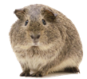
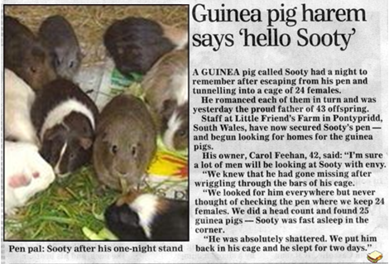
Sooty the Guinea Pig
10.2.A2 Completion and analysis of Punnett squares for dihybrid traits. AND 10.2.S1 Calculation of the predicted genotypic and phenotypic ratio of offspring of dihybrid crosses involving unlinked autosomal genes.
Key to alleles*:
C = colour c = albino
A = agouti a = black
R = round ears r = pointy ears
L = long whiskers l = short whiskers
S = soft fur s = rough fur
N = sharp nails n = smooth nails
Sooty news story from the BBC:
http://news.bbc.co.uk/2/hi/uk_news/wales/1048327.stm
* C and A genes are real. The rest are made up for this story.

Slide 27
Sooty the Guinea Pig
10.2.A2 Completion and analysis of Punnett squares for dihybrid traits. AND 10.2.S1 Calculation of the predicted genotypic and phenotypic ratio of offspring of dihybrid crosses involving unlinked autosomal genes.
Key to alleles:
S = soft fur s = rough fur
N = sharp nails n = smooth nails
Sooty has soft fur and sharp nails.
In one of his matings with a rough-furred, smooth-nailed female, the following guinea piglets are produced:
6 x rough fur, sharp nails; 3 x soft fur sharp nails.
Deduce Sooty’s genotype.
F₀
Phenotype:
Rough fur, smooth nails
Soft fur, sharp nails
Genotype:
Punnet Grid:
F₁
Phenotypes:

Slide 28
Sooty the Guinea Pig
10.2.A2 Completion and analysis of Punnett squares for dihybrid traits. AND 10.2.S1 Calculation of the predicted genotypic and phenotypic ratio of offspring of dihybrid crosses involving unlinked autosomal genes.
Key to alleles:
S = soft fur s = rough fur
N = sharp nails n = smooth nails
Sooty has soft fur and sharp nails.
In one of his matings with a rough-furred, smooth-nailed female, the following guinea piglets are produced:
6 x rough fur, sharp nails; 3 x soft fur sharp nails.
Deduce Sooty’s genotype.
F₀
Phenotype:
Rough fur, smooth nails
Soft fur, sharp nails
Genotype: ssnn
Punnet Grid:
Possible Gametes
All sn
F₁
Phenotypes:

Slide 29
Sooty the Guinea Pig
10.2.A2 Completion and analysis of Punnett squares for dihybrid traits. AND 10.2.S1 Calculation of the predicted genotypic and phenotypic ratio of offspring of dihybrid crosses involving unlinked autosomal genes.
Key to alleles:
S = soft fur s = rough fur
N = sharp nails n = smooth nails
Sooty has soft fur and sharp nails.
In one of his matings with a rough-furred, smooth-nailed female, the following guinea piglets are produced:
6 x rough fur, sharp nails; 3 x soft fur sharp nails.
Deduce Sooty’s genotype.
F₀
Phenotype:
Rough fur, smooth nails
Soft fur, sharp nails
Genotype: ssnn SSNN or SsNN or SsNn
Punnet Grid:
Possible Gametes | SN | Sn | sN | sn
All sn
F₁
Phenotypes:

Slide 30
Sooty the Guinea Pig
10.2.A2 Completion and analysis of Punnett squares for dihybrid traits. AND 10.2.S1 Calculation of the predicted genotypic and phenotypic ratio of offspring of dihybrid crosses involving unlinked autosomal genes.
Key to alleles:
S = soft fur s = rough fur
N = sharp nails n = smooth nails
Sooty has soft fur and sharp nails.
In one of his matings with a rough-furred, smooth-nailed female, the following guinea piglets are produced:
6 x rough fur, sharp nails; 3 x soft fur sharp nails.
Deduce Sooty’s genotype.
F₀
Phenotype:
Rough fur, smooth nails
Soft fur, sharp nails
Genotype: ssnn SSNN or SsNN or SsNn
Punnet Grid:
Possible Gametes | SN | Sn | sN | sn
All sn | SsNn | Ssnn | ssNn | ssnn
F₁
Soft fur
Sharp nails
Soft fur
Smooth nails
Rough fur
Sharp nails
Rough fur
Smooth nails
Phenotypes:

Slide 31
Sooty the Guinea Pig
10.2.A2 Completion and analysis of Punnett squares for dihybrid traits. AND 10.2.S1 Calculation of the predicted genotypic and phenotypic ratio of offspring of dihybrid crosses involving unlinked autosomal genes.
Key to alleles:
S = soft fur s = rough fur
N = sharp nails n = smooth nails
Sooty has soft fur and sharp nails.
In one of his matings with a rough-furred, smooth-nailed female, the following guinea piglets are produced:
6 x rough fur, sharp nails; 3 x soft fur sharp nails.
Deduce Sooty’s genotype.
F₀
Phenotype:
Rough fur, smooth nails
Soft fur, sharp nails
Genotype: ssnn SSNN or SsNN or SsNn
Punnet Grid:
Possible Gametes | SN | Sn | sN | sn
All sn | SsNn | Ssnn | ssNn | ssnn
F₁
Soft fur
Sharp nails
Soft fur
Smooth nails
Rough fur
Sharp nails
Rough fur
Smooth nails
Phenotypes:
Only these two phenotypes have been produced.
Sooty has only produced SN and sN gametes.

Slide 32
Sooty the Guinea Pig
10.2.A2 Completion and analysis of Punnett squares for dihybrid traits. AND 10.2.S1 Calculation of the predicted genotypic and phenotypic ratio of offspring of dihybrid crosses involving unlinked autosomal genes.
Key to alleles:
S = soft fur s = rough fur
N = sharp nails n = smooth nails
Sooty has soft fur and sharp nails.
In one of his matings with a rough-furred, smooth-nailed female, the following guinea piglets are produced:
6 x rough fur, sharp nails; 3 x soft fur sharp nails.
Deduce Sooty’s genotype.
F₀
Phenotype:
Rough fur, smooth nails
Soft fur, sharp nails
Genotype: ssnn SSNN or SsNN or SsNn
Punnet Grid:
Possible Gametes | SN | Sn | sN | sn
All sn | SsNn | Ssnn | ssNn | ssnn
F₁
Soft fur
Sharp nails
Soft fur
Smooth nails
Rough fur
Sharp nails
Rough fur
Smooth nails
Phenotypes:
Only these two phenotypes have been produced.
Sooty has only produced SN and sN gametes.
It is most likely that his genotype is SsNN.

Slide 33
Sooty the Guinea Pig
10.2.A2 Completion and analysis of Punnett squares for dihybrid traits. AND 10.2.S1 Calculation of the predicted genotypic and phenotypic ratio of offspring of dihybrid crosses involving unlinked autosomal genes.
Key to alleles:
R = round ears r = pointy ears
L = long whiskers l = short whiskers
Deduce Sooty’s genotype.
Offspring = five with pointy ears and long whiskers
F₀
Phenotype:
Pointy ears, short whiskers
Pointy ears, long whiskers
Genotype:
Punnet Grid:
F₁
Phenotypes:

Slide 34
Sooty the Guinea Pig
10.2.A2 Completion and analysis of Punnett squares for dihybrid traits. AND 10.2.S1 Calculation of the predicted genotypic and phenotypic ratio of offspring of dihybrid crosses involving unlinked autosomal genes.
Key to alleles:
R = round ears r = pointy ears
L = long whiskers l = short whiskers
Deduce Sooty’s genotype.
Offspring = five with pointy ears and long whiskers
F₀
Phenotype:
Pointy ears, short whiskers
Pointy ears, long whiskers
Genotype: rrll rrLL or rrLl
Punnet Grid:
Possible Gametes | rL | rl
All rl
F₁
Phenotypes:

Slide 35
Sooty the Guinea Pig
10.2.A2 Completion and analysis of Punnett squares for dihybrid traits. AND 10.2.S1 Calculation of the predicted genotypic and phenotypic ratio of offspring of dihybrid crosses involving unlinked autosomal genes.
Key to alleles:
R = round ears r = pointy ears
L = long whiskers l = short whiskers
Deduce Sooty’s genotype.
Offspring = five with pointy ears and long whiskers
F₀
Phenotype:
Pointy ears, short whiskers
Pointy ears, long whiskers
Genotype: rrll rrLL or rrLl
Punnet Grid:
Possible Gametes | rL | rl
All rl | rrLl | rrll
F₁
Pointy ears
Long whiskers
Pointy ears
Short whiskers
Phenotypes:

Slide 36
Sooty the Guinea Pig
10.2.A2 Completion and analysis of Punnett squares for dihybrid traits. AND 10.2.S1 Calculation of the predicted genotypic and phenotypic ratio of offspring of dihybrid crosses involving unlinked autosomal genes.
Key to alleles:
R = round ears r = pointy ears
L = long whiskers l = short whiskers
Deduce Sooty’s genotype.
Offspring = five with pointy ears and long whiskers
F₀
Phenotype:
Pointy ears, short whiskers
Pointy ears, long whiskers
Genotype: rrll rrLL or rrLl
Punnet Grid:
Possible Gametes | rL | rl
All rl | rrLl | rrll
F₁
Pointy ears
Long whiskers
Pointy ears
Short whiskers
Phenotypes:
Only this phenotype has been produced.
Sooty has only produced rL gametes.

Slide 37
Sooty the Guinea Pig
10.2.A2 Completion and analysis of Punnett squares for dihybrid traits. AND 10.2.S1 Calculation of the predicted genotypic and phenotypic ratio of offspring of dihybrid crosses involving unlinked autosomal genes.
Key to alleles:
R = round ears r = pointy ears
L = long whiskers l = short whiskers
Deduce Sooty’s genotype.
Offspring = five with pointy ears and long whiskers
F₀
Phenotype:
Pointy ears, short whiskers
Pointy ears, long whiskers
Genotype: rrll rrLL or rrLl
Punnet Grid:
Possible Gametes | rL | rl
All rl | rrLl | rrll
F₁
Pointy ears
Long whiskers
Pointy ears
Short whiskers
Phenotypes:
Only this phenotype has been produced.
Sooty has only produced rL gametes.
It is most likely that his genotype is rrLL.

Slide 38
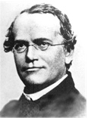
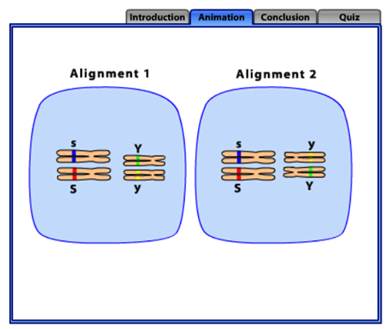
Review: 10.1.U7 Independent assortment of genes is due to the random orientation of pairs of homologous chromosomes in meiosis I.
Mendel and Meiosis
“The presence of an allele of one of the genes in a gamete has no influence over which allele of another gene is present.”
Mendel deduced that characteristics were determined by the interaction
between pairs of alleles long before the details of meiosis were known.
Where Mendel states that pairs of alleles of a gene separate independently during gamete production, we can now attribute this to random orientation of chromosomes during metaphase I.
Mendel made this deduction when working with pea plants. He investigated two separate traits (colour and shape) and performed many test crosses, recording the ratios of phenotypes produced in subsequent generations.
It was rather fortunate that these two traits happened to be on separate chromosomes (unlinked genes)! Remember back then he did not know about the contents of the nucleus. Chromosomes and DNA were yet to be discovered.
We will use his work as an example of dihybrid crosses in the next section.
Animation from Sumanas: http://www.sumanasinc.com/webcontent/animations/content/independentassortment.html

Slide 39
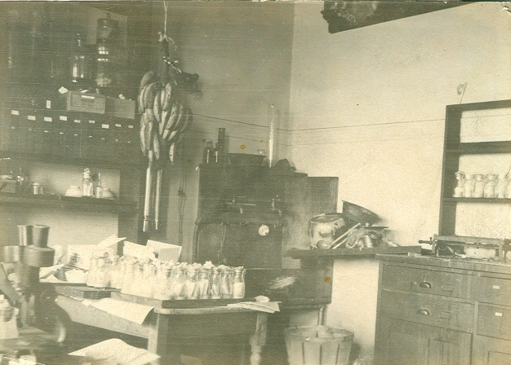
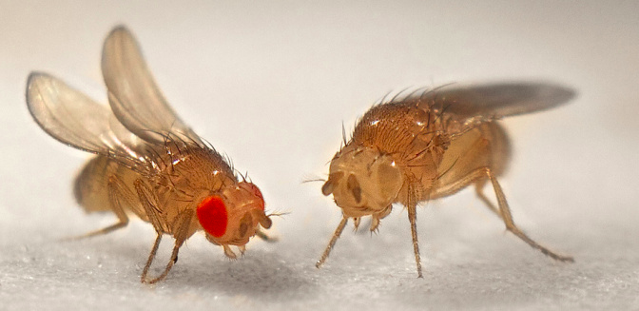
Review: Nature of Science: Making careful observations—careful observation and record keeping turned up anomalous data that Mendel’s law of independent assortment could not account for. Thomas Hunt Morgan developed the notion of linked genes to account for the anomalies. (1.8)
Morgan’s experiments (1909 - 1914) with fruit flies produced results that could not be explained by Mendel’s work on heredity as it stood.
Thomas Hunt Morgan developed the idea of sex-linked genes
The ‘anomalous’ data was repeated and found to be predictable. The experiments lead Morgan and his colleagues to revise Mendelian heredity (1915) to include certain key tenets:
Discrete pairs of factors are located on chromosomes (later to be called genes)
Certain characteristics are sex-linked
Other characteristics are also sometimes associated
https://www.dnalc.org/view/15005-Thomas-Hunt-Morgan.html
https://geneticsandevolutionch10.files.wordpress.com/2015/01/kbtnk9dz-13672096431.jpg?w=672&h=327
Columbia University Fly Room
http://www.nature.com/scitable/content/ne0000/ne0000/ne0000/ne0000/122977784/1_2.jpg

Slide 40
Nature of science: Looking for patterns, trends and discrepancies - Mendel used observations of the natural world to find and explain patterns and trends. Since then, scientists have looked for discrepancies and asked questions based on further observations to show exceptions to the rules. For example, Morgan discovered non-Mendelian ratios in his experiments with Drosophila. (3.1)
Morgan’s experiments (1909 - 1914) with fruit flies produced results that could not be explained by Mendel’s work on heredity as it stood.
Thomas Hunt Morgan developed the idea of sex-linked genes
10.2.A1 Morgan’s discovery of non-Mendelian ratios in Drosophila.
Morgan’s key insight came after breeding a white-eyed male mutant with red eyed female flies:
The 1st generation offspring all had red eyes – consistent with Mendelian theory concerning dominant and recessive traits
The 2nd generation contained a small number (roughly 25% of flies) with white eyes – again consistent with Mendalian theory
However all the white-eyed flies were male – this is inconsistent with Mendalian theory and suggested that the two traits are linked
The ‘anomalous’ data was repeated and found to be predictable. The experiments lead Morgan and his colleagues to revise Mendelian heredity (1915) to include certain key tenets:
Discrete pairs of factors are located on chromosomes (later to be called genes)
Certain characteristics are sex-linked
Other characteristics are also sometimes associated
https://www.dnalc.org/view/15005-Thomas-Hunt-Morgan.html
https://geneticsandevolutionch10.files.wordpress.com/2015/01/kbtnk9dz-13672096431.jpg?w=672&h=327
Columbia University Fly Room
http://www.nature.com/scitable/content/ne0000/ne0000/ne0000/ne0000/122977784/1_2.jpg

Slide 41
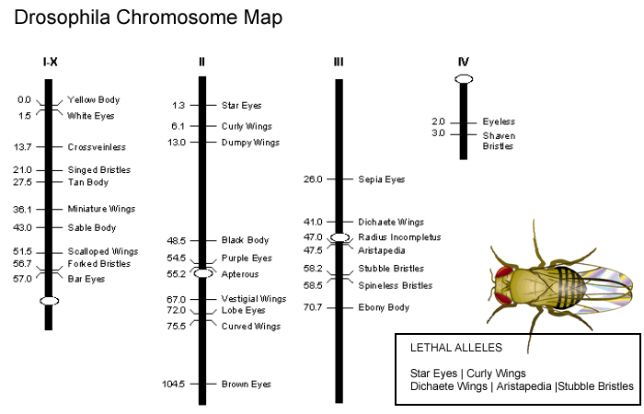
10.2.U1 Gene loci are said to be linked if on the same chromosome.
Linked genes
Dumpy wings and Shaven bristles are traits from gene loci on different chromosomes and therefore are not linked genes
Drosphila Chromosome Map
Chromosome I is the sex chromosome (here X). All traits on this chromosome are sex-linked
Curved wings and Brown eyes are traits from gene loci on the same chromosomes and therefore are linked genes
http://www.biologycorner.com/resources/dros_chrom_map.gif

Slide 42
Autosomal Gene Linkage
10.2.S2 Identification of recombinants in crosses involving two linked genes.
Linked genes are pairs or groups of genes which are inherited together, carried on the same chromosome.
Standard notation for linked genes:
A
B
“heterozygous at both loci”
SCN5A
(voltage-gated sodium channel)
a
b
Locus 1
Locus 2
The line denotes the chromosome, or the fact that the two genes are linked.
The SCN5A, PDCD10 and SOX2 genes
are all linked by being on chromosome 3.
They are a linkage group, and alleles of each will therefore be inherited together.
Independent assortment does not occur between linked genes.
PDCD10
(programmed cell death)
SOX2
(transcription factor - promoter region)
Chromosome 3 from:
http://en.wikipedia.org/wiki/Chromosome_3_%28human%29

Slide 43
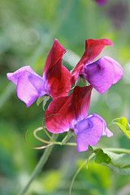
Linkage Groups
10.2.S2 Identification of recombinants in crosses involving two linked genes.
Are carried on the same chromosome and are inherited together. They do not assort independently.
In sweet peas (Lathyrus odoratus), the genes for flower colour and pollen grain shape are carried on the same chromosome.
Plants which are heterozygous at both loci are test-crossed.
What ratio of phenotypes is expected?
Key to alleles:
P = purple p = white
L = long l = short
Image: 'Sweet Pea' http://www.flickr.com/photos/69166981@N00/3600419425

Slide 44
Linkage Groups
10.2.S2 Identification of recombinants in crosses involving two linked genes.
Are carried on the same chromosome and are inherited together. They do not assort independently.
In sweet peas (Lathyrus odoratus), the genes for flower colour and pollen grain shape are carried on the same chromosome.
Plants which are heterozygous at both loci are test-crossed.
What ratio of phenotypes is expected?
Key to alleles:
P = purple p = white
L = long l = short
p
l
P
L
Genotype:
p
l
p
l
Locus 1
Locus 2
Locus 1
Locus 2
Phenotype:
White; Short
Purple; Long
Punnet Grid:
Phenotypes:
Image: 'Sweet Pea' http://www.flickr.com/photos/69166981@N00/3600419425

Slide 45
Linkage Groups
10.2.S2 Identification of recombinants in crosses involving two linked genes.
Are carried on the same chromosome and are inherited together. They do not assort independently.
In sweet peas (Lathyrus odoratus), the genes for flower colour and pollen grain shape are carried on the same chromosome.
Plants which are heterozygous at both loci are test-crossed.
What ratio of phenotypes is expected?
Key to alleles:
P = purple p = white
L = long l = short
p
l
P
L
Genotype:
p
l
p
l
Locus 1
Locus 2
Locus 1
Locus 2
Phenotype:
White; Short
Purple; Long
Punnet Grid:
Possible Gametes | PL | pl
All pl
Phenotypes:
Image: 'Sweet Pea' http://www.flickr.com/photos/69166981@N00/3600419425

Slide 46
Linkage Groups
10.2.S2 Identification of recombinants in crosses involving two linked genes.
Are carried on the same chromosome and are inherited together. They do not assort independently.
In sweet peas (Lathyrus odoratus), the genes for flower colour and pollen grain shape are carried on the same chromosome.
Plants which are heterozygous at both loci are test-crossed.
What ratio of phenotypes is expected?
Key to alleles:
P = purple p = white
L = long l = short
p
l
P
L
Genotype:
p
l
p
l
Locus 1
Locus 2
Locus 1
Locus 2
Phenotype:
White; Short
Purple; Long
Punnet Grid:
Possible Gametes | PL | pl
All pl | PpLl | ppll
Phenotypes:
Purple; Long
White; Short
Ratio: 1 : 1
Image: 'Sweet Pea' http://www.flickr.com/photos/69166981@N00/3600419425

Slide 47
Linkage Groups
10.2.S2 Identification of recombinants in crosses involving two linked genes.
Are carried on the same chromosome and are inherited together. They do not assort independently.
In sweet peas (Lathyrus odoratus), the genes for flower colour and pollen grain shape are carried on the same chromosome.
Plants which are heterozygous at both loci are test-crossed.
What ratio of phenotypes is expected?
Key to alleles:
P = purple p = white
L = long l = short
p
l
P
L
Genotype:
p
l
p
l
Locus 1
Locus 2
Locus 1
Locus 2
Phenotype:
White; Short
Purple; Long
Punnet Grid:
Possible Gametes | PL | pl
All pl | PpLl | ppll
Phenotypes:
Purple; Long
White; Short
Ratio: 1 : 1
Image: 'Sweet Pea' http://www.flickr.com/photos/69166981@N00/3600419425

Slide 48
Linkage Groups
10.2.S2 Identification of recombinants in crosses involving two linked genes.
Are carried on the same chromosome and are inherited together. They do not assort independently.
In sweet peas (Lathyrus odoratus), the genes for flower colour and pollen grain shape are carried on the same chromosome.
Plants which are heterozygous at both loci are test-crossed.
A small number of purple;short and white;long individuals have appeared in the offspring. Explain what has happened.
Key to alleles:
P = purple p = white
L = long l = short
Image: 'Sweet Pea' http://www.flickr.com/photos/69166981@N00/3600419425

Slide 49
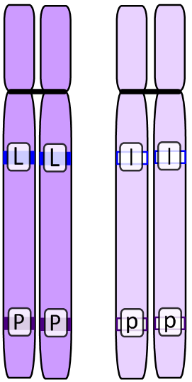
Recombination
10.2.S2 Identification of recombinants in crosses involving two linked genes.
of alleles occurs as a result of crossing-over between non-sister chromatids. Exchange of alleles gives new genotypes of gametes.
Plants which are heterozygous at both loci are test-crossed.
A small number of purple;short and white;long individuals have appeared in the offspring. Explain what has happened.
Key to alleles:
P = purple p = white
L = long l = short
The test cross individual is homozygous recessive at both loci, so only one type of gamete is produced.
Possible gametes:
Test individual:
p
l
Alleles segregate in meiosis, giving two possible gametes:
Heterozygous individual:
P
L
P
L
p
l
p
l
Diploid cell
Heterozygous at both loci
Chromosomes replicate in Synthesis phase

Slide 50
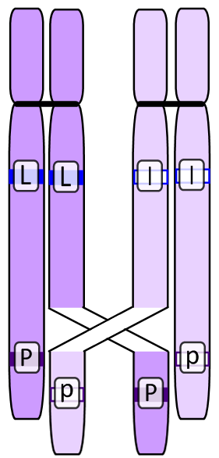
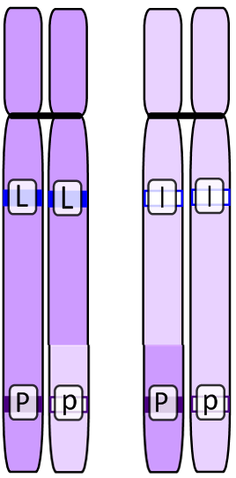
Recombination
10.2.S2 Identification of recombinants in crosses involving two linked genes.
of alleles occurs as a result of crossing-over between non-sister chromatids. Exchange of alleles gives new genotypes of gametes.
Plants which are heterozygous at both loci are test-crossed.
A small number of purple;short and white;long individuals have appeared in the offspring. Explain what has happened.
Key to alleles:
P = purple p = white
L = long l = short
Possible gametes:
Test individual:
p
l
Heterozygous individual:
P
L
p
l
Recombinants:
Diploid cell
Heterozygous at both loci
Chromosomes replicate in Synthesis phase
Crossing Over
Prophase I
Alleles are exchanged
Sister chromatids are separated in anaphase II.
Recombined gametes are produced.
P
l
p
L
Crossing-over occurs occasionally. It is more likely to happen between linked genes which are further apart.

Slide 51
Recombination
10.2.S2 Identification of recombinants in crosses involving two linked genes.
of alleles occurs as a result of crossing-over between non-sister chromatids. Exchange of alleles gives new genotypes of gametes.
Plants which are heterozygous at both loci are test-crossed.
A small number of purple;short and white;long individuals have appeared in the offspring. Explain what has happened.
Key to alleles:
P = purple p = white
L = long l = short
Normal gametes
(majority)
Possible gametes:
Test individual:
p
l
Possible Gametes | P L | p l
All p l | PpLl | ppll
Heterozygous individual:
P
L
Purple; long
White, short
p
l
Recombinants:
P
l
p
L
Crossing-over occurs occasionally. It is more likely to happen between linked genes which are further apart.

Slide 52
Recombination
10.2.S2 Identification of recombinants in crosses involving two linked genes.
of alleles occurs as a result of crossing-over between non-sister chromatids. Exchange of alleles gives new genotypes of gametes.
Plants which are heterozygous at both loci are test-crossed.
A small number of purple;short and white;long individuals have appeared in the offspring. Explain what has happened.
Key to alleles:
P = purple p = white
L = long l = short
Normal gametes
(majority)
Recombinant gametes
(small number)
Possible gametes:
Test individual:
p
l
Possible Gametes | P L | p l | P l | p L
All p l | PpLl | ppll | Ppll | ppLl
Heterozygous individual:
P
L
Purple; long
White, short
Purple; short
White, long
p
l
Recombinants:
P
l
p
L
Crossing-over occurs occasionally. It is more likely to happen between linked genes which are further apart.

Slide 53
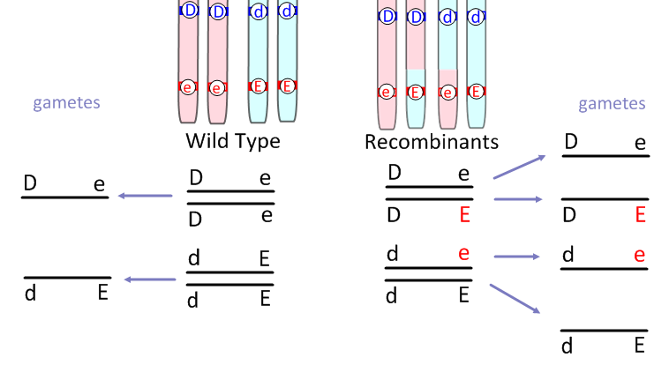
Review: 10.1.U3 Crossing over produces new combinations of alleles on the chromosomes of the haploid cells.
Crossing-Over
Increases genetic variation through recombination of linked alleles.
Crossing over leads to more variation in gametes.
This is the standard notation for writing genotypes of alleles on linked genes (more of this later when we study 10.2 Inheritance AHL)
Edited from: http://www.slideshare.net/gurustip/meiosis-ahl

Slide 54
Gene Linkage & Recombination
10.2.S2 Identification of recombinants in crosses involving two linked genes.
The further apart a pair of alleles are on a chromosome, the more likely it is that crossing over may occur between them - leading to recombination.
Knowing this, researchers can map the position of genes on a chromosome based on the frequency of recombination between gene pairs: the further apart they are, the more often they cross over.
SCN5A
(voltage-gated sodium channel)
Crossing-over is more likely to occur between SCN5A and PDCD10 than between PDCD10 and SOX2.
PDCD10
(programmed cell death)
SOX2
(transcription factor - promoter region)
Chromosome 3 from:
http://en.wikipedia.org/wiki/Chromosome_3_%28human%29
Animation and quiz from:
http://www.csuchico.edu/~jbell/Biol207/animations/recombination.html

Slide 55
Gene Linkage & Recombination
10.2.S2 Identification of recombinants in crosses involving two linked genes.
The genes for kernel colour and waxiness are linked in the corn plant (Zea mays). In a cross between a plant that is homozygous dominant at both loci with a plant that is heterozygous at both loci, identify the following genotypes as:
a: regular b:recombinants c: impossible
Key to alleles:
C = coloured c = no colour
W = waxy w = not waxy
CcWw CCWw CcWW CCWW CCww ccWW

Slide 56
Gene Linkage & Recombination
10.2.S2 Identification of recombinants in crosses involving two linked genes.
The genes for kernel colour and waxiness are linked in the corn plant (Zea mays). In a cross between a plant that is homozygous dominant at both loci with a plant that is heterozygous at both loci, identify the following genotypes as:
a: regular b:recombinants c: impossible
Key to alleles:
C = coloured c = no colour
W = waxy w = not waxy
CcWw CCWw CcWW CCWW CCww ccWW
C
W
C
W
C
w
C
W
c
w
c
W
Regular gametes
(majority)
Recombinant gametes
(small number)
Possible Gametes | C W | c w | C w | c W
All C W | CCWW | CcWw | CCWw | CcWW

Slide 57
Gene Linkage & Recombination
10.2.S2 Identification of recombinants in crosses involving two linked genes.
E
m
Two genes are linked as shown here
e
M
The genes are far apart such that crossing-over between the alleles occurs occasionally. Which statement is true of the gametes?
A. All of the gametes will be Em and eM
B. There will be equal numbers of EM, EM, eM and em
C. There will be approximately equal numbers of EM and eM gametes
D. There will be more Em gametes than em gametes

Slide 58
Gene Linkage & Recombination
10.2.S2 Identification of recombinants in crosses involving two linked genes.
E
m
Two genes are linked as shown here
e
M
The genes are far apart such that crossing-over between the alleles occurs occasionally. Which statement is true of the gametes?
A. All of the gametes will be Em and eM
B. There will be equal numbers of EM, EM, eM and em
C. There will be approximately equal numbers of EM and eM gametes
D. There will be more Em gametes than em gametes
E
m
E
M
e
M
e
m
Regular gametes
(majority)
Recombinant gametes
(small number)
E m | e M | E M | e m

Slide 59
More practise questions for inheritance – the best way to learn genetic theory is by practise.
Excellent problems and tutorials by the biology project
Sex linked inheritance problems 2: http://www.biology.arizona.edu/mendelian_genetics/problem_sets/sex_linked_inheritance_2/sex_linked_inheritance_2.html
Dihybrid inheritance problems: http://www.biology.arizona.edu/mendelian_genetics/problem_sets/dihybrid_cross/dihybrid_cross.html

Slide 60
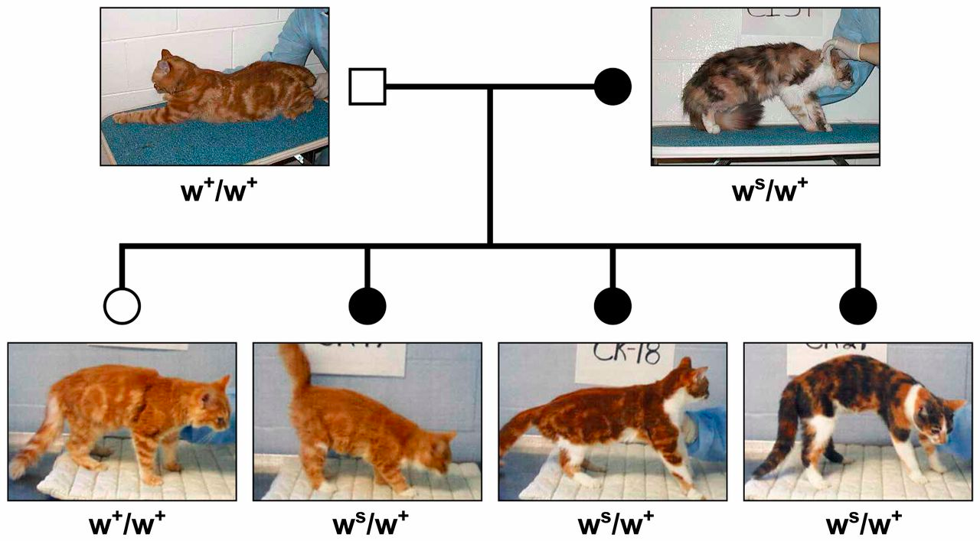
Review: 3.4.S2 Comparison of predicted and actual outcomes of genetic crosses using real data.
Cat genetics – collecting real world data
Do the inherited traits match what we know about cat genes?
http://www.g3journal.org/content/4/10/1881/F4.large.jpg

Slide 61
Review: 3.4.S2 Comparison of predicted and actual outcomes of genetic crosses using real data.
Cat genetics – collecting real world data
How well does the piebald frequency in the offspring match the predictions made from our knowledge of the genes?
F₀
Key to alleles:
W = White
w = no white
Phenotype:
Some white
No white
Genotype:
W w
w w
Punnet Grid:
gametes | w | w
W | Ww | Ww
w | ww | ww
F₁
Genotypes:
Ww
Ww
ww
ww
Phenotypes:
Some white
No white
Expected ratios
Phenotype ratio:
1 : 1

Slide 62
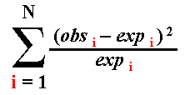
Review: 3.4.S2 Comparison of predicted and actual outcomes of genetic crosses using real data.
Cat genetics – collecting real world data
How well does the piebald frequency in the offspring match the predictions made from our knowledge of the genes?
df | critical values at 5%
1 | 3.84
2 | 5.99
3 | 7.82
4 | 9.49
5 | 11.07
genotype | observed | expected
WW (mostly white) | 0 | 0
Ww (some white) | 2 | 2
ww (no white) | 2 | 2
N = number of classes
Degrees of freedom (df) = N – 1
= 3 – 1
= 2
Chi-square value =
= (0 – 0)² + (0 – 0)² + (0 – 0)²
0 2 2
= 0
Chi-square value < critical value therefore we support the hypothesis of piebald coat colour

Slide 63
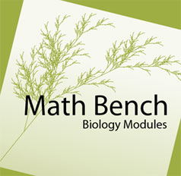
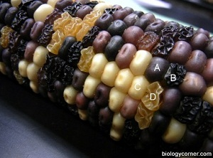
10.2.U5 Chi-squared tests are used to determine whether the difference between an observed and expected frequency distribution is statistically significant. AND 10.2.S3 Use of a chi-squared test on data from dihybrid crosses.
Testing dihybrid crosses – using the chi-squared test
Now try extending your understanding of dihybrid crosses using data. Follow the links below and complete the examples and problems:
CORN GENETICS CHI SQUARE ANALYSIS by Biology Corner
Chi-square in biology: Testing for a dihybrid ratio
http://mathbench.umd.edu/modules/statistical-tests_chisquare_intro/page15.htm
http://www.biologycorner.com/worksheets/corn_chi.html
Answer key: http://www.biologycorner.com/worksheets/corn_chi_key.html

Slide 64
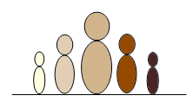
Polygenic Inheritance
10.2.U3 Variation can be discrete or continuous. AND 10.2.U4 The phenotypes of polygenic characteristics tend to show continuous variation.
A single characteristic controlled by multiple genes.
Polygenic inheritance gives rise to continuous variation in the phenotype.
Use these two examples in the exam.
Human Skin Colour
Wheat kernel colour
Other examples:
Susceptibility* to heart disease, certain types of cancer, mental illnesses.
The Autism Spectrum.
Autism is a pervasive developmental disorder that presents on a scale (known as the Childhood Autism Rating Scale). It is not as clearly polygenic as the above examples - it is suspected that gene interactions and environmental factors play a large role.
*susceptibility is not deterministic, but it is beneficial to know if you are at elevated genetic risk of these illnesses.

Slide 65
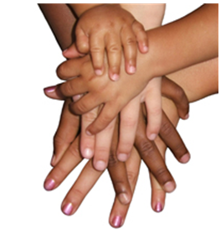
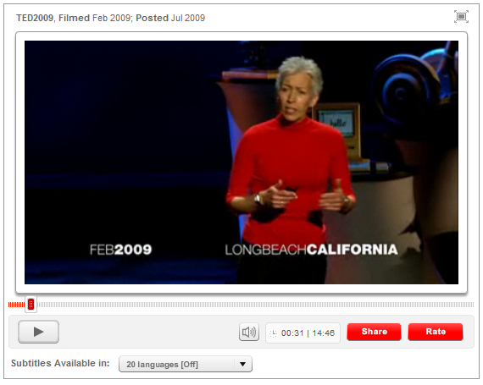
Polygenic Inheritance of Skin Colour
10.2.U3 Variation can be discrete or continuous. AND 10.2.U4 The phenotypes of polygenic characteristics tend to show continuous variation.
Polygenic inheritance gives rise to
continuous variation in the phenotype.
Globally we observe continuous variation in skin colours. Skin colour is the result of pigments, such as melanin, being produced - the darker the skin, the greater the protection against the harmful effects of the Sun.
Skin colour is thought to be controlled by up to four
separate genes, each with their own alleles. This is too large for us to deal with simply, so we'll look at two genes with two alleles each.
Image from:
http://www.danacentre.org.uk/events/2007/05/03/259
Watch this TED Talk and think about the following questions:
What is melanin and what purpose does it serve?
What skin tone were early humans most likely to have? Why does this change with latitude as humans migrated towards the poles?
What are the relative advantages and disadvantages of light and dark skin, depending on climate?
TOK: Why have people historically discriminated based on skin colour? How could the Natural Sciences educate people to think twice about their prejudices?
Nina Jablosnki breaks the illusion of skin colour, via TED.
http://www.ted.com/talks/lang/eng/nina_jablonski_breaks_the_illusion_of_skin_color.html

Slide 66
Polygenic Inheritance of Skin Colour
10.2.U3 Variation can be discrete or continuous. AND 10.2.U4 The phenotypes of polygenic characteristics tend to show continuous variation.
Example: 2 genes (A and B), 2 alleles each
Assume: genes are not linked (separate chromosomes)
In polygenics, alleles can be:
Contributing (they add to the phenotype)
Non-contributing (they do not add to the phenotype)
How many genotypes are possible?
Key to alleles:
A = add melanin
a = don’t add melanin
B = add melanin
b = don’t add melanin

Slide 67
Polygenic Inheritance of Skin Colour
10.2.U3 Variation can be discrete or continuous. AND 10.2.U4 The phenotypes of polygenic characteristics tend to show continuous variation.
Example: 2 genes (A and B), 2 alleles each
Assume: genes are not linked (separate chromosomes)
In polygenics, alleles can be:
Contributing (they add to the phenotype)
Non-contributing (they do not add to the phenotype)
How many genotypes are possible?
Key to alleles:
A = add melanin
a = don’t add melanin
B = add melanin
b = don’t add melanin
Remember that alleles segregate during meiosis.
Alleles of unlinked chromosomes orient randomly.
There is also random fertilisation of gametes.
So many combinations!
or
or
or
gametes

Slide 68
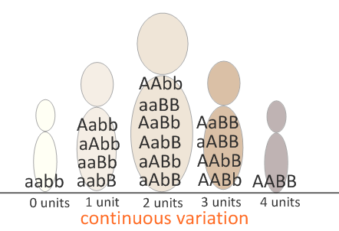
Polygenic Inheritance of Skin Colour
10.2.U3 Variation can be discrete or continuous. AND 10.2.U4 The phenotypes of polygenic characteristics tend to show continuous variation.
Example: 2 genes (A and B), 2 alleles each
Assume: genes are not linked (separate chromosomes)
In polygenics, alleles can be:
Contributing (they add to the phenotype)
Non-contributing (they do not add to the phenotype)
How many genotypes are possible?
Key to alleles:
A = add melanin
a = don’t add melanin
B = add melanin
b = don’t add melanin
Nine:
Notice that the possible combinations of genotypes gives rise to continuous variation in the phenotype.
This population follows a normal distribution.

Slide 69
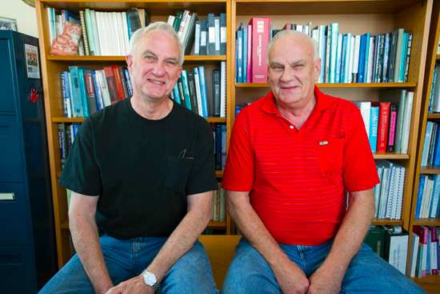
10.2.A3 Polygenic traits such as human height may also be influenced by environmental factors.
environmental factors
Most traits, including polygenetic traits such as height, maybe influenced by the environment of the organism. There are numerous ways in which this can happen.
Human Trait | Influencing Environment factors
Height | Dietary factors (e.g. protein content) Certain childhood diseases
Skin colour | Exposure to sun Burns Scaring
http://www.bu.edu/today/files/2011/11/t_11-4313-VIETNAMVET-036.jpg

Slide 70
Polygenic Inheritance of Skin Colour
Is it possible for twins to be:
Different colours?
Key to alleles:
A = add melanin
a = don’t add melanin
B = add melanin
b = don’t add melanin
Extension: the next few slides ask interesting questions, but they go beyond the syllabus. However if you can answer the questions you can be confident that you have mastered polygenetic inheritance

Slide 71
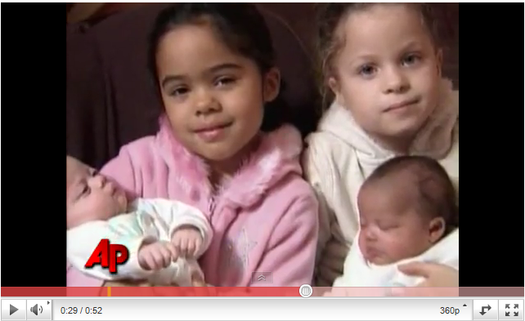
Polygenic Inheritance of Skin Colour
Is it possible for twins to be:
Different colours?
YES.
As long as they are non-identical twins. Two eggs will have been fertilised by individual sperm cells.
Key to alleles:
A = add melanin
a = don’t add melanin
B = add melanin
b = don’t add melanin
Each gamete carries a different combination of alleles, so it is possible that the twins have noticeably differently-coloured skin.
Couple has differently-coloured twins – for the second time! From Associated Press
http://www.youtube.com/watch?v=KgfObCmWJt4

Slide 72
Polygenic Inheritance of Skin Colour
Is it possible for twins to be:
b. Lighter or darker than both parents?
Key to alleles:
A = add melanin
a = don’t add melanin
B = add melanin
b = don’t add melanin
F₀
Phenotype:
AaBb
AABb
Genotype:
Punnet Grid:
gametes | AB | AB | Ab | Ab
AB
Ab
aB
ab
F₁
Genotypes:
Phenotypes:

Slide 73
Polygenic Inheritance of Skin Colour
Is it possible for twins to be:
b. Lighter or darker than both parents?
YES.
Key to alleles:
A = add melanin
a = don’t add melanin
B = add melanin
b = don’t add melanin
F₀
Phenotype:
AaBb
AABb
Genotype:
Punnet Grid:
gametes | AB | AB | Ab | Ab
AB | AABB | AABB | AABb | AABb
Ab | AABb | AABb | AAbb | AAbb
aB | AaBB | AaBB | AaBb | AaBb
ab | AaBb | AaBb | Aabb | Aabb
darker
lighter
F₁
Genotypes:
Phenotypes:

Slide 74
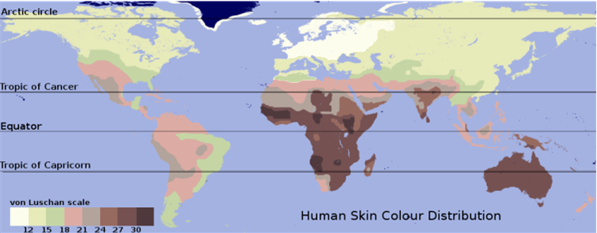
Global Evolution of Skin Colour
Map of global skin colour distribution from:
http://en.wikipedia.org/wiki/Human_skin_color
What are the advantages of:
a. Dark skin in hot climates?
b. Pale skin in cold climates?

Slide 75
Global Evolution of Skin Colour
Map of global skin colour distribution from:
http://en.wikipedia.org/wiki/Human_skin_color
What are the advantages of:
a. Dark skin in hot climates?
b. Pale skin in cold climates?
In this case, the correlation between skin colour and latitude does suggest causality.
Protection against UV and therefore skin damage and cancer.
Dark-skinned people in cold climates should use vitamin D supplements.
Increased production of vitamin D in low-sunlight conditions.
Pale-skinned people in hot climates should slip-slop-slap-seek-slide.

Slide 76
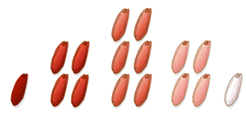
Polygenic Inheritance of Wheat Kernel Colour
Inheritance of colour of wheat kernels works in a similar way to human skin colour.
A wheat plant which is homozygous dominant for both genes is crossed with one which is heterozygous for both genes. What is the predicted ratio of phenotypes in the cross?
Key to alleles:
A = add red
a = don’t add red
B = add red
b = don’t add red
F₀
Genotype:
Punnet Grid:
gametes
F₁

Slide 77
Polygenic Inheritance of Wheat Kernel Colour
Inheritance of colour of wheat kernels works in a similar way to human skin colour.
A wheat plant which is homozygous dominant for both genes is crossed with one which is heterozygous for both genes. What is the predicted ratio of phenotypes in the cross?
Key to alleles:
A = add red
a = don’t add red
B = add red
b = don’t add red
F₀
homozygous dominant
for both genes
heterozygous for both genes
Genotype:
AABB
AaBb
Punnet Grid:
gametes | AB | Ab | aB | ab
AB | AABB | AABb | AaBB | AaBb
AB | AABB | AABb | AaBB | AaBb
AB | AABB | AABb | AaBB | AaBb
AB | AABB | AABb | AaBB | AaBb
F₁

Slide 78
Polygenic Inheritance of Wheat Kernel Colour
Inheritance of colour of wheat kernels works in a similar way to human skin colour.
A wheat plant which is homozygous dominant for both genes is crossed with one which is heterozygous for both genes. What is the predicted ratio of phenotypes in the cross?
Key to alleles:
A = add red
a = don’t add red
B = add red
b = don’t add red
F₀
homozygous dominant
for both genes
heterozygous for both genes
Genotype:
AABB
AaBb
Punnet Grid:
gametes | AB | Ab | aB | ab
AB | AABB | AABb | AaBB | AaBb
AB | AABB | AABb | AaBB | AaBb
AB | AABB | AABb | AaBB | AaBb
AB | AABB | AABb | AaBB | AaBb
“All AB”
F₁
Phenotype ratio: 1 very red : 2 Red : 1 pink

Slide 79
Mathematical Questions
A trait is controlled by two genes, each with two alleles.
How many genotypes & phenotypes are possible for this trait?

Slide 80
Mathematical Questions
Key to alleles:
A = contributing
a = non-contributing
B = contributing
b = non-contributing
A trait is controlled by two genes, each with two alleles.
How many genotypes & phenotypes are possible for this trait?
4
3
2
1
0
There are 16 combinations of parent alleles, making 9 different genotypes.
These make up 5 different phenotypes.

Slide 81
Mathematical Questions
Key to alleles:
A, B, C = contributing
a, b, c = non-contributing
A trait is controlled by three genes, each with two alleles.
How many genotypes are possible in a cross between a homozygous dominant male and a homozygous recessive female?

Slide 82
Mathematical Questions
Key to alleles:
A, B, C = contributing
a, b, c = non-contributing
A trait is controlled by three genes, each with two alleles.
How many genotypes are possible in a cross between a homozygous dominant male and a homozygous recessive female?
Phenotype:
homozygous recessive
homozygous dominant
Genotype:
aabbcc
AABBCC
Punnet Grid:
gametes | All ABC
All abc | AaBbCc
Only one possible genotype!

Slide 83
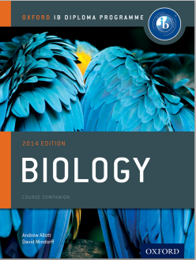
Bibliography / Acknowledgments
Bob Smullen

