Slide 1
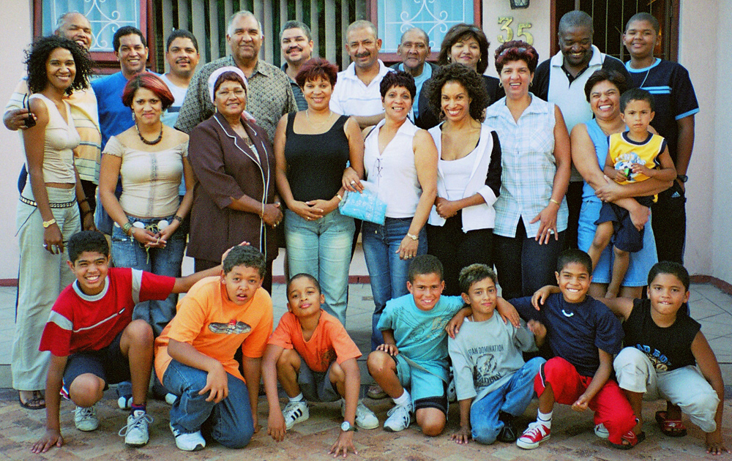
10.1 Meiosis (AHL)
Essential idea: Meiosis leads to independent assortment of chromosomes and unique composition of alleles in daughter cells.
The family portrait shows large amounts of variation within a family despite sharing a lot of genes. This shows the potential of crossing over and independent assortment to create near infinite variation in gametes and hence in offspring too.
By Chris Paine
https://bioknowledgy.weebly.com/
https://upload.wikimedia.org/wikipedia/commons/9/95/Coloured-family.jpg

Slide 2
Understandings, Applications and Skills
 | Statement | Guidance
10.1.U1 | Chromosomes replicate in interphase before meiosis.
10.1.U2 | Crossing over is the exchange of DNA material between non-sister homologous chromatids.
10.1.U3 | Crossing over produces new combinations of alleles on the chromosomes of the haploid cells.
10.1.U4 | Chiasmata formation between non-sister chromatids can result in an exchange of alleles.
10.1.U5 | Homologous chromosomes separate in meiosis I.
10.1.U6 | Sister chromatids separate in meiosis II.
10.1.U7 | Independent assortment of genes is due to the random orientation of pairs of homologous chromosomes in meiosis I.
10.1.S1 | Drawing diagrams to show chiasmata formed by crossing over. | Diagrams of chiasmata should show sister chromatids still closely aligned, except at the point where crossing over occurred and a chiasma was formed.

Slide 3
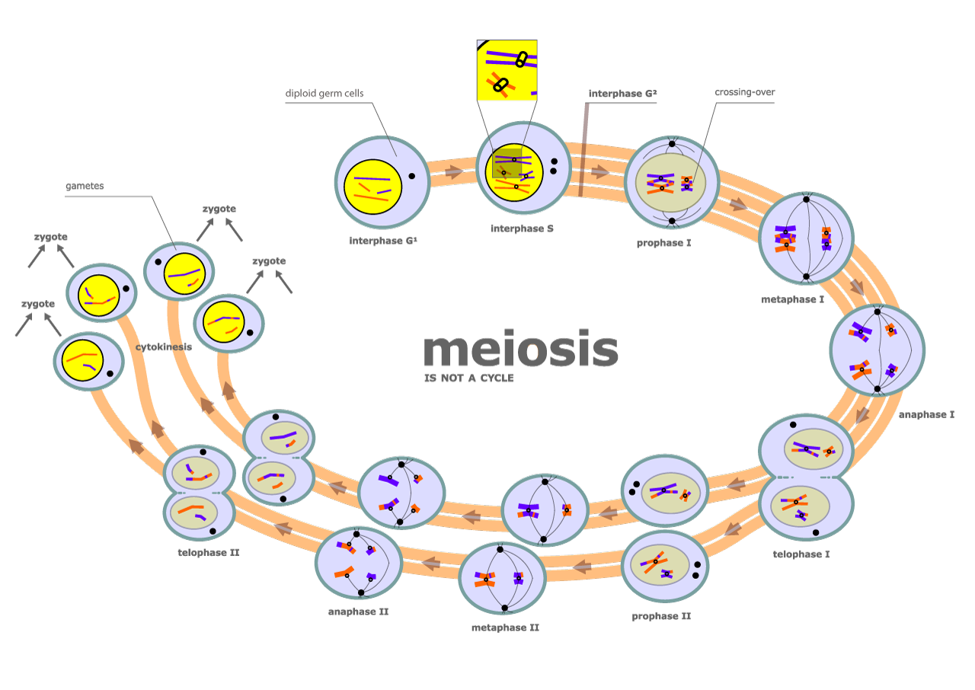
Review: 3.3.U1 One diploid nucleus divides by meiosis to produce four haploid nuclei.
Meosis is a reduction division of the nucleus to form haploid gametes
One diploid (2N) body cells contain a homologous pair of each chromosome (except for sex cells)
Chromosomes are replicated to form sister chromatids
Four haploid (N) gametes contain one of each chromosome
First division of the nucleus
Second division of the nucleus
Edited from: https://commons.wikimedia.org/wiki/File:Diagram_of_meiosis.svg

Slide 4
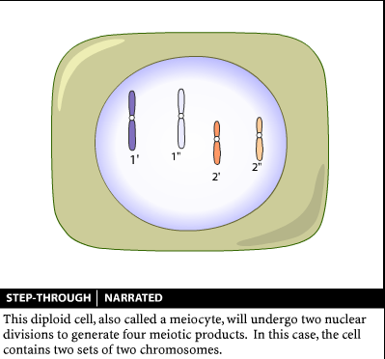
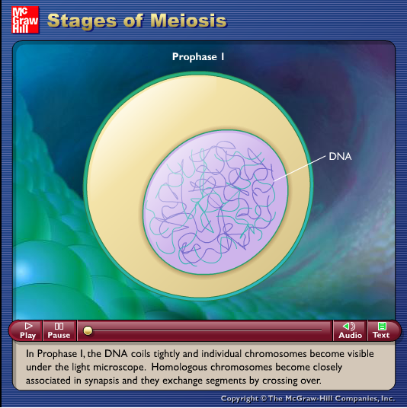
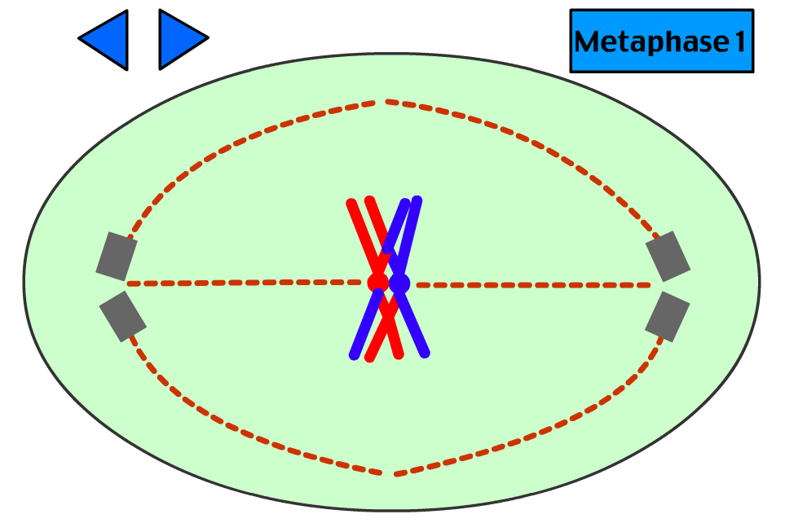
Review: 3.3.U1 One diploid nucleus divides by meiosis to produce four haploid nuclei.
Meosis is a reduction division of the nucleus to form haploid gametes
The animations are a great way to visualise the process – watch and take notes.
http://www.sumanasinc.com/webcontent/animations/content/meiosis.html
http://www.biostudio.com/d_%20Meiosis.htm
http://highered.mheducation.com/sites/dl/free/0072437316/120074/bio19.swf
http://www.stolaf.edu/people/giannini/flashanimat/celldivision/meiosis.swf

Slide 5
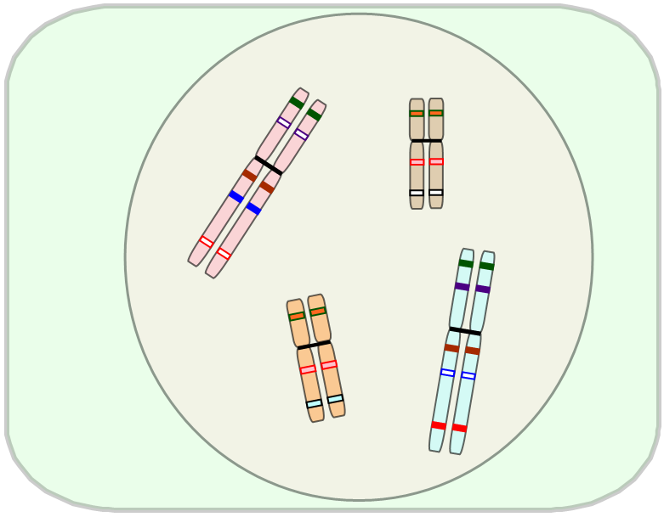
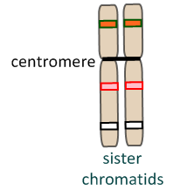
Review: 3.3.U3 DNA is replicated before meiosis so that all chromosomes consist of two sister chromatids.
Interphase
In the S-phase of the interphase before meiosis begins, DNA replication takes place.
Chromosomes are replicated and these copies are attached to each other at the centromere.
The attached chromosome and its copy are known as sister chromatids.
Following S-phase, further growth and preparation take place for meiosis.

Slide 6
10.1.U1 Chromosomes replicate in interphase before meiosis.
An homologous pair of chromosomes…

Slide 7
10.1.U1 Chromosomes replicate in interphase before meiosis.
An homologous pair of chromosomes…
…replicates during S-phase of interphase…

Slide 8
10.1.U1 Chromosomes replicate in interphase before meiosis.
An homologous pair of chromosomes…
…replicates during S-phase of interphase…
centromere
sister chromatids
…giving two pairs of sister chromatids,
each joined at the centromere.

Slide 9
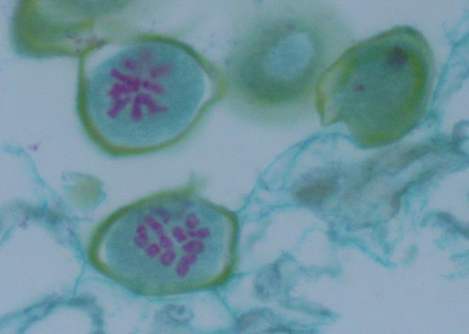
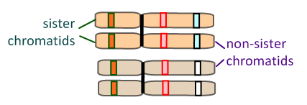
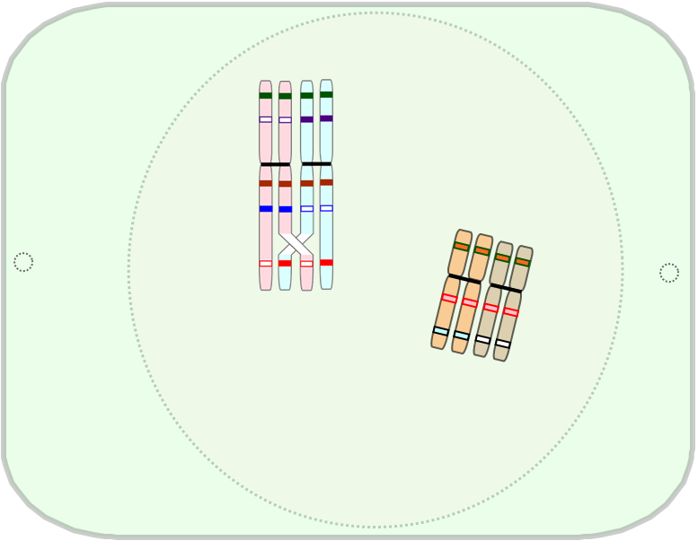
Review: 3.3.S1 Drawing diagrams to show the stages of meiosis resulting in the formation of four haploid cells. AND 3.3.U4 The early stages of meiosis involve pairing of homologous chromosomes and crossing over followed by condensation.
Prophase I
The homologous chromosomes associate with each other to form bivalents (synapsis).
DNA supercoils and chromosomes condense
nuclear membrane dissolves
centrioles migrate to the poles of the cell.
Crossing-over between non-sister chromatids can take place. This results in recombination of alleles and is a source of genetic variation in gametes.
Edited from: http://www.slideshare.net/gurustip/meiosis-ahl
http://www2.sunysuffolk.edu/gambier/micrographs/lateprophase3.htm

Slide 10
10.1.U2 Crossing over is the exchange of DNA material between non-sister homologous chromatids. AND 10.1.U4 Chiasmata formation between non-sister chromatids can result in an exchange of alleles.
The homologous pair associates during prophase I, through synapsis…
…making a bivalent.

Slide 11
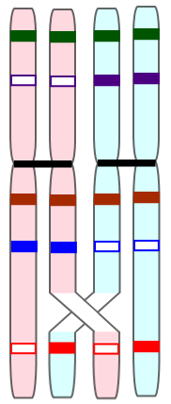
10.1.U2 Crossing over is the exchange of DNA material between non-sister homologous chromatids. AND 10.1.U4 Chiasmata formation between non-sister chromatids can result in an exchange of alleles.
Crossing-over might take place between non-sister chromatids in prophase I…
The point of crossing-over between non-sister chromatids is called the chiasma (pl. chiasmata).
…leading to recombination of alleles.

Slide 12
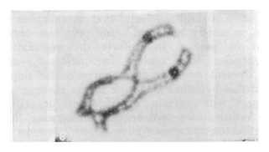
10.1.U2 Crossing over is the exchange of DNA material between non-sister homologous chromatids. AND 10.1.U4 Chiasmata formation between non-sister chromatids can result in an exchange of alleles.
The formation of chiasma is common and
is thought to be essential for meiosis
In humans the average number of chiasmata per bivalent (tetrad) is just over two.
How many chiasma can you identify in the micrographs?
a.
b.
Chiasma occur between the sister chromatids and therefore should be appear the the central space.
http://users.rcn.com/jkimball.ma.ultranet/BiologyPages/C/Chiasmata013.jpg
http://nzetc.victoria.ac.nz/etexts/Bio13Tuat01/Bio13Tuat01_063a(h280).jpg

Slide 13
10.1.U2 Crossing over is the exchange of DNA material between non-sister homologous chromatids. AND 10.1.U4 Chiasmata formation between non-sister chromatids can result in an exchange of alleles.
The formation of chiasma is common and
is thought to be essential for meiosis
In humans the average number of chiasmata per bivalent (tetrad) is just over two.
How many chiasma can you identify in the micrographs?
a.
b.
3
4
2
2
centromere
1
5
1
Chiasma occur between the sister chromatids and therefore should be appear the the central space.
http://users.rcn.com/jkimball.ma.ultranet/BiologyPages/C/Chiasmata013.jpg
http://nzetc.victoria.ac.nz/etexts/Bio13Tuat01/Bio13Tuat01_063a(h280).jpg

Slide 14
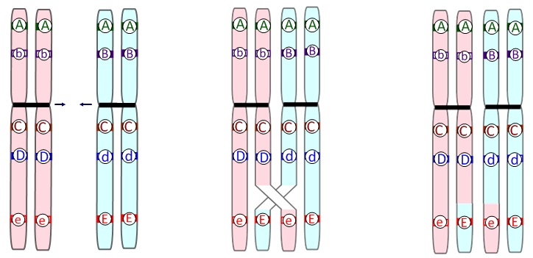
10.1.U3 Crossing over produces new combinations of alleles on the chromosomes of the haploid cells.
Crossing-over
Increases genetic variation through recombination of linked alleles.
Synapsis
Homologous chromosomes associate
Chiasma Formation
Neighbouring non-sister chromatids are cut at the same point.
A Holliday junction forms as the DNA of the cut sections attach to the open end of the opposite non-sister chromatid.
Recombination
As a result, alleles are swapped between non-sister chromatids.

Slide 15
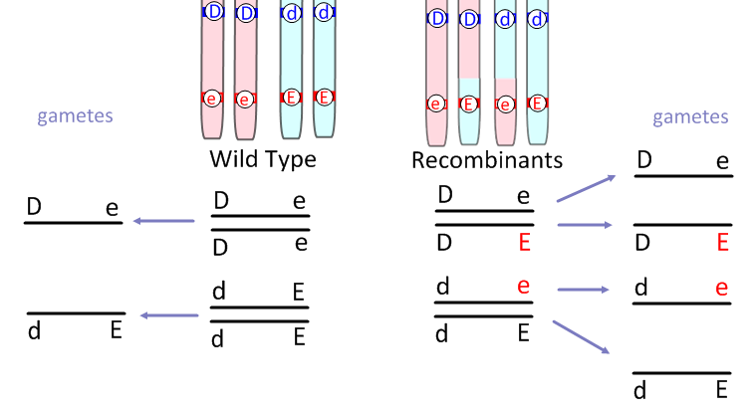
10.1.U3 Crossing over produces new combinations of alleles on the chromosomes of the haploid cells.
Crossing-Over
Increases genetic variation through recombination of linked alleles.
Crossing over leads to more variation in gametes.
This is the standard notation for writing genotypes of alleles on linked genes (more of this later when we study 10.2 Inheritance AHL)
Edited from: http://www.slideshare.net/gurustip/meiosis-ahl

Slide 16
10.1.S1 Drawing diagrams to show chiasmata formed by crossing over.
Crossing-Over
Drawing clear diagrams helps when communicating with others
Sister chromatids
centromere
Un-recombined chromatids
chiasma
Homologous pair
Recombined chromatids
Key points when drawing chiasmata:
Use colour of shading to indicate the each of the sister chromatids
Remember the homologous chromosomes are in synapsis – before and after crossing over the chromosomes should be shown close together.

Slide 17
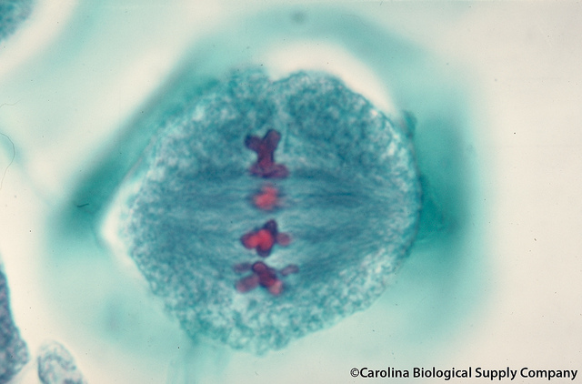
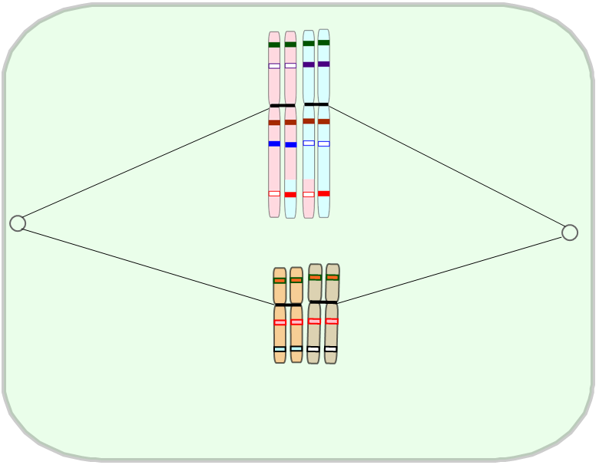
Review: 3.3.S1 Drawing diagrams to show the stages of meiosis resulting in the formation of four haploid cells. AND 3.3.U5 Orientation of pairs of homologous chromosomes prior to separation is random.
Metaphase I
The bivalents line up at the equator.
Random orientation occurs - each bivalent aligns independently and hence the daughter nuclei get a different mix of chromosomes.
This is a significant source of genetic variation: there are 2^{n} possible orientations in metaphase I and II. That is 2²³ in humans – or 8,388,068 different combinations in gametes!
Edited from: http://www.slideshare.net/gurustip/meiosis-ahl
courtesy of: http://www.flickr.com/carolinabio

Slide 18
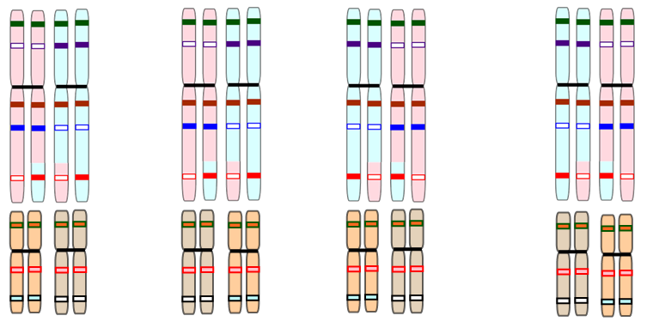
10.1.U7 Independent assortment of genes is due to the random orientation of pairs of homologous chromosomes in meiosis I.
Metaphase I
Allele have a 50 percent chance of moving to a particular pole.
The direction in which one bivalent aligns does not affect the alignment of other bivalents.
Therefore different allele combinations should always be equally possible (if the gene loci are on different chromosomes – this does not hold for linked genes)
Edited from: http://www.slideshare.net/gurustip/meiosis-ahl

Slide 19
10.1.U5 Homologous chromosomes separate in meiosis I.
In anaphase I, the homologous pair is separated but the sister chromatids remain attached.
This is the reduction division.

Slide 20
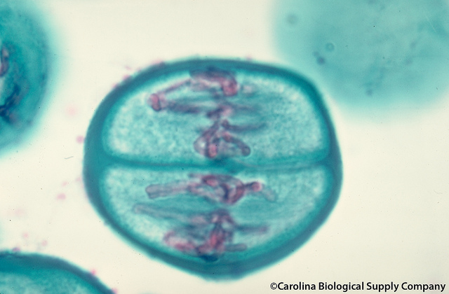
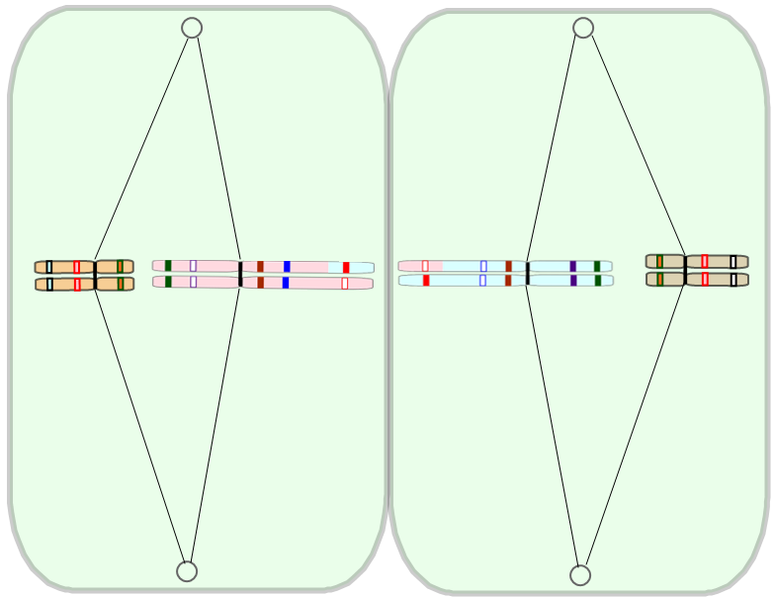
Review: 3.3.S1 Drawing diagrams to show the stages of meiosis resulting in the formation of four haploid cells.
Metaphase II
Pairs of sister chromatids align at the equator.
Spindle fibres form and attach at the centromeres.
Edited from: http://www.slideshare.net/gurustip/meiosis-ahl
courtesy of: http://www.flickr.com/carolinabio

Slide 21
10.1.U6 Sister chromatids separate in meiosis II.
Metaphase II
Pairs of sister chromatids align at the equator. Spindle fibres form and attach at the centromeres.
Random orientation again contributes to variation in the gametes, though not to such an extent as in metaphase I.
This is because there is only a difference between chromatids where crossing-over has taken place.

Slide 22
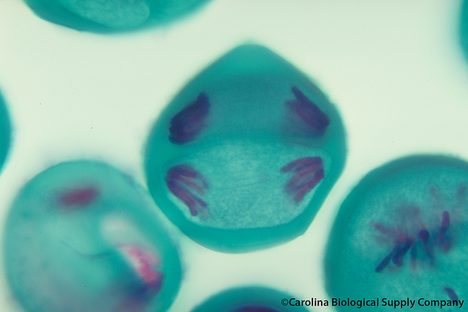
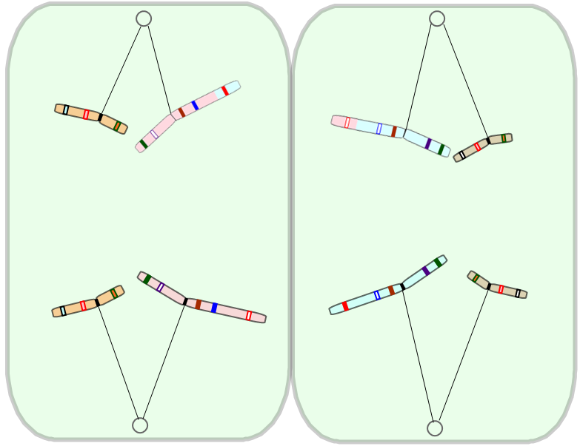
Review: 3.3.S1 Drawing diagrams to show the stages of meiosis resulting in the formation of four haploid cells.
Anaphase II
The sister chromatids are separated. The chromatids (now called chromosomes are pulled to opposing poles.
Spindle fibres contract and the centromeres are split.
Edited from: http://www.slideshare.net/gurustip/meiosis-ahl
courtesy of: http://www.flickr.com/carolinabio

Slide 23
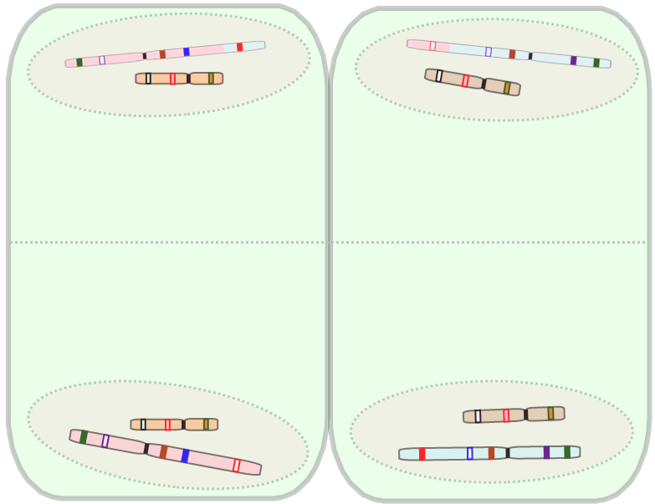
10.1.U6 Sister chromatids separate in meiosis II.
Telophase II
n.b. due to crossing over each of the four new nuclei is likely to be genetically different.
New haploid nuclei are formed.
Cytokinesis begins, splitting the cells.
The end result of meiosis is four haploid gamete cells.
Fertilisation of these haploid gametes will produce a diploid zygote.

Slide 24
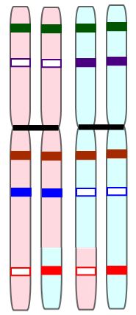
Check your language. This image shows…
Four separate chromosomes.
A bivalent.
One pair of sister chromatids.
Non-disjunction.

Slide 25
Check your language. This image shows…
Four separate chromosomes.
A bivalent.
One pair of sister chromatids.
Non-disjunction.

Slide 26
Check your language. This image shows…
Two separate chromosomes.
A bivalent.
One pair of sister chromatids.
Crossing-over.

Slide 27
Check your language. This image shows…
Two separate chromosomes.
A bivalent.
One pair of sister chromatids.
Crossing-over.

Slide 28
Check your language. This image shows…
Two separate chromosomes.
A bivalent.
One pair of sister chromatids.
Homologous chromosomes.

Slide 29
Check your language. This image shows…
Two separate chromosomes.
A bivalent.
One pair of sister chromatids.
Homologous chromosomes.

Slide 30
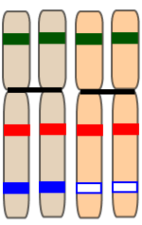
Check your language. This image shows…
8 separate chromosomes.
Two bivalents.
Two pairs of sister chromatids.
Two homologous chromosomes.

Slide 31
Check your language. This image shows…
8 separate chromosomes.
Two bivalents.
Two pairs of sister chromatids.
Two homologous chromosomes.

Slide 32
Review: 3.3.U7 Crossing over and random orientation promotes genetic variation.
Prophase I
Metaphase I
Metaphase II
Crossing-over between non-sister chromatids results in recombination of alleles
Random orientation of the homologous chromosomes means there are 2^{n} possible orientations in metaphase I and II. That is 2²³ in humans – or 8,388,068 different combinations in gametes!
Because both crossing-over and random orientation occur during meiosis the result is is effectively infinite genetic variation in the haploid gamete.
n.b. for a new organism to arise sexually meiosis occurs in both parents further increasing the genetic variation

Slide 33
Review: 3.3.U7 Crossing over and random orientation promotes genetic variation.
Prophase I
Metaphase I
Metaphase II
Which part of the process, Meiosis I or Meiosis II, produces the most genetic variation? Give evidence to support your answer.
Crossing-over between non-sister chromatids results in recombination of alleles
Random orientation of the homologous chromosomes means there are 2^{n} possible orientations in metaphase I and II. That is 2²³ in humans – or 8,388,068 different combinations in gametes!
Because both crossing-over and random orientation occur during meiosis the result is is effectively infinite genetic variation in the haploid gamete.

Slide 34
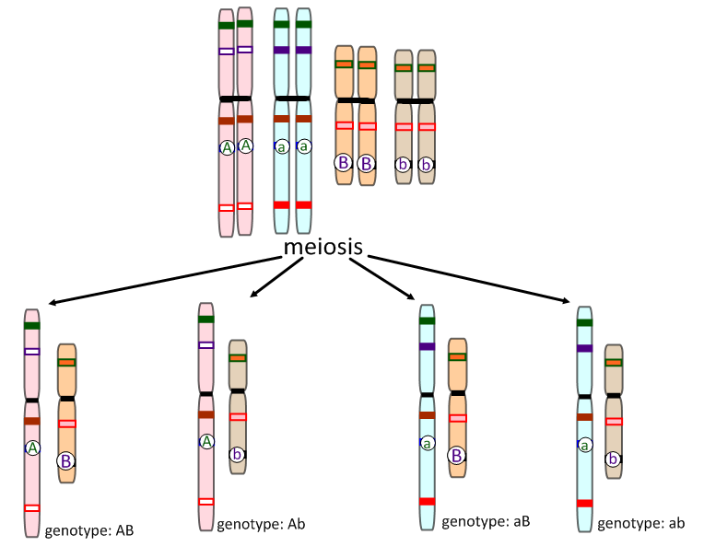
10.1.U7 Independent assortment of genes is due to the random orientation of pairs of homologous chromosomes in meiosis I.
Mendel’s Law of Independent Assortment
“The presence of an allele of one of the genes in a gamete has no influence over which allele of another gene is present.”
A and B are different genes on different chromosomes.
A is dominant over a.
B is dominant over b.
This only holds true for unlinked genes (genes on different chromosomes).

Slide 35
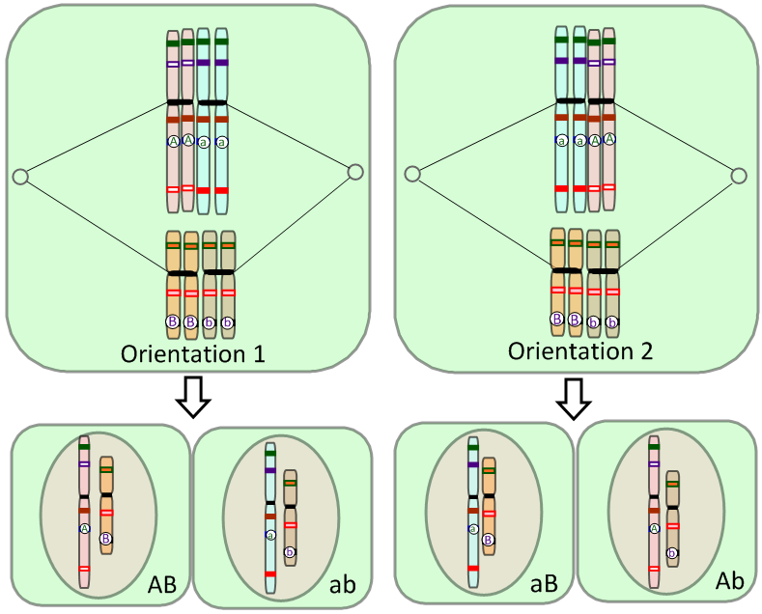
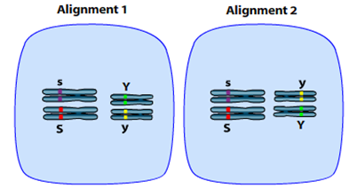
10.1.U7 Independent assortment of genes is due to the random orientation of pairs of homologous chromosomes in meiosis I.
Random Orientation vs Independent Assortment
“The presence of an allele of one of the genes in a gamete has no influence over which allele of another gene is present.”
Random Orientation refers to the behaviour of homologous pairs of chromosomes (metaphase I) or pairs of sister chromatids (metaphase II) in meiosis.
Independent assortment refers to the behaviour of alleles of unlinked genes as a result of gamete production (meiosis).
Due to random orientation of the chromosomes in metaphase I, the alleles of these unlinked genes have become independently assorted into the gametes.
Animation from Sumanas:
http://www.sumanasinc.com/webcontent/animations/content/independentassortment.html

Slide 36
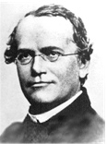
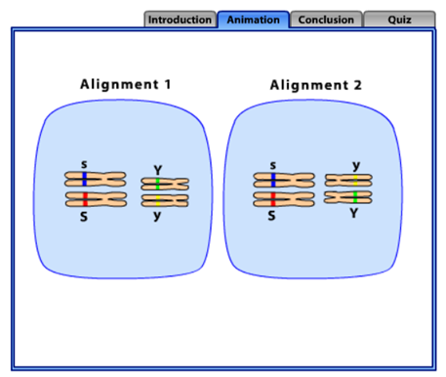
10.1.U7 Independent assortment of genes is due to the random orientation of pairs of homologous chromosomes in meiosis I.
Mendel and Meiosis
“The presence of an allele of one of the genes in a gamete has no influence over which allele of another gene is present.”
Mendel deduced that characteristics were determined by the interaction
between pairs of alleles long before the details of meiosis were known.
Where Mendel states that pairs of alleles of a gene separate independently during gamete production, we can now attribute this to random orientation of chromosomes during metaphase I.
Mendel made this deduction when working with pea plants. He investigated two separate traits (colour and shape) and performed many test crosses, recording the ratios of phenotypes produced in subsequent generations.
It was rather fortunate that these two traits happened to be on separate chromosomes (unlinked genes)! Remember back then he did not know about the contents of the nucleus. Chromosomes and DNA were yet to be discovered.
We will use his work as an example of dihybrid crosses in the next section.
Animation from Sumanas: http://www.sumanasinc.com/webcontent/animations/content/independentassortment.html

Slide 37
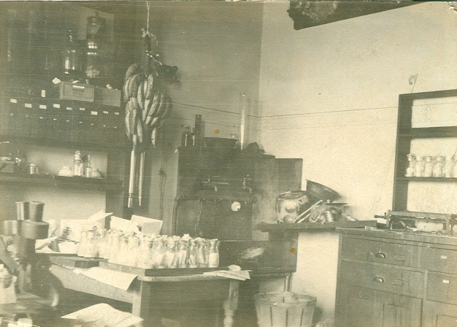
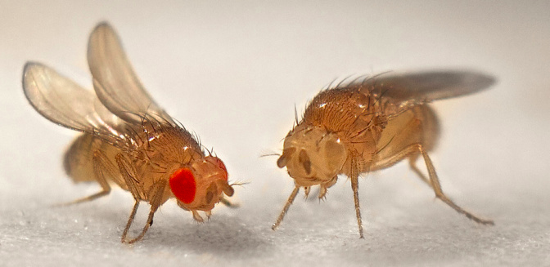
Nature of Science: Making careful observations—careful observation and record keeping turned up anomalous data that Mendel’s law of independent assortment could not account for. Thomas Hunt Morgan developed the notion of linked genes to account for the anomalies. (1.8)
Morgan’s experiments (1909 - 1914) with fruit flies produced results that could not be explained by Mendel’s work on heredity as it stood.
Thomas Hunt Morgan developed the idea of sex-linked genes
The ‘anomalous’ data was repeated and found to be predictable. The experiments lead Morgan and his colleagues to revise Mendelian heredity (1915) to include certain key tenets:
Discrete pairs of factors are located on chromosomes (later to be called genes)
Certain characteristics are sex-linked
Other characteristics are also sometimes associated
https://www.dnalc.org/view/15005-Thomas-Hunt-Morgan.html
https://geneticsandevolutionch10.files.wordpress.com/2015/01/kbtnk9dz-13672096431.jpg?w=672&h=327
Columbia University Fly Room
http://www.nature.com/scitable/content/ne0000/ne0000/ne0000/ne0000/122977784/1_2.jpg

Slide 38
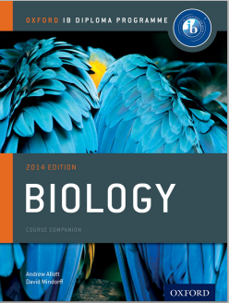
Bibliography / Acknowledgments
Bob Smullen

